Slide 1
DSM2274 – LECTURE 11
Linux & Networking - subnets

Slide 2
Subnetting
Subnetting is the strategy used to partition a single physical network into more than one smaller logical sub-networks (subnets).
An IP address includes a network segment and a host segment.
Subnets are designed by accepting bits from the IP address's host part and using these bits to assign a number of smaller sub-networks inside the original network.
Subnetting allows an organization to add sub-networks without the need to acquire a new network number via the Internet service provider (ISP).
Subnetting helps to reduce the network traffic and conceals network complexity.
Subnetting is essential when a single network number has to be allocated over numerous segments of a local area network (LAN).
Subnets were initially designed for solving the shortage of IP addresses over the Internet.

Slide 3
The Problem with IPv4 Addresses
Problem
The initial way of using IP addresses was that we were fixed with having certain parts of the address for the network and certain parts for the hosts.
Class A addresses were fixed with 8 bits for the network and 24 for the hosts.
Class B addresses were fixed with 16 bits for the network and 16 for the hosts.
Class C addresses were fixed with 24 bits for the network and 8 for the hosts.
There had to be some way for host addresses to not be wasted.
The answer came with the introduction of Subnetting.
Subnetting allowed bits that were normally used for the host part to be used for the subnet part of the address.

Slide 4
Subnet Mask
In order to let the routers or PCs know that subnetting was being used another number had to be applied.
This number is known as the subnet mask and is also a binary number.
Each bit on the subnet mask is compared with the bits on the IP address to determine:
which parts belong to the network
which belong to the host
A default subnet mask is allocated to each class of address.
If you do not want to use subnetting, simply add the subnet mask to the end of the IP address.
It is not possible to enter an IP address onto a PC or router without also entering the subnet mask.

Slide 5
Default Subnet Masks
Default subnet masks:
Class A – 255.0.0.0
or in binary: 11111111.00000000.00000000.00000000
Class B – 255.255.0.0
or in binary: 11111111.11111111.00000000.00000000
Class C – 255.255.255.0
or in binary: 11111111.11111111.11111111.00000000
A rule for subnet masks is that the 1 and 0 network and host bits must be contiguous i.e. connect without a break
You can have 11111111.11111111.0000000.000000
You cannot have 11111111.000111111.00000000.00000000

Slide 6

Subnetting Example
10001100.10110011.11110000.11001000 | 140.179.240.200 Class B
11111111.11111111.00000000.00000000 | 255.255.0.0 Subnet mask
------------------------------------------------------------
10001100.10110011.00000000.00000000 | 140.179.0.0 Network Address
Example:
The router performs something called logical ANDing

Slide 7
Cont’d…
140.179.0.0 is your network address
140.179.0.0 in binary has all of the host bits turned off:
10001100.10110011.00000000.00000000 -> Every host bit is turned off
Network. Network. Host.Host
140.179.0.1 can be used for your first host
140.179.0.2 can be used for your second host
You can keep adding hosts until both the 3rd and 4th octet are (almost) full.
140.179.0.255 is still a valid host number
140.179.1.255 is still okay
140.179.255.254 is the last host number you can use.

Slide 8
Cont’d…
140.179.255.255 in binary has all the host bits turned on:
10001100.10110011.11111111.11111111 -> Every host bit is turned on
Network. Network. Host.Host
It is not permitted to use all 0’s for the hosts since this is the network and we cannot use all 1’s because this is reserved for broadcast
for our example of 140.179.0.0 255.255.0.0 we can see we that we have the last two octets free (the 0.0) to allocate to hosts on the network
The formula is 2^n-2

Slide 9
Cont’d…
140.179.255.255 in binary has all the host bits turned on:
10001100.10110011.11111111.11111111 -> Every host bit is turned on
Network. Network. Host.Host
It is not permitted to use all 0’s for the hosts since this is the network and we cannot use all 1’s because this is reserved for broadcast
for our example of 140.179.0.0 255.255.0.0 we can see we that we have the last two octets free (the 0.0) to allocate to hosts on the network
The formula is 2^n-2
Total number of hosts would be 2^16 -(2) =65, 534

Slide 10
Cont’d…
Do you think it would be practical to have a network with over 65000 hosts on?
The solution to this is to create smaller sub-networks so that you do not end up wasting host IP addresses.
To create subnets using any IP address classes you are supposed to ‘steal’ the host bits.
Five of the host bits have been stolen to use to create the subnet
The advantage is that we have more than one subnet
There are less hosts per subnet
140.179.00000 000.00000000
[16 bits] [5 bits] [11 bits]
[network][subnet][host bits]

Slide 11
Another Subnetting Example
Calculate the number of subnets and the number of hosts per subnet.
Use the powers of two formula.
Number of subnets
2^5 = 32 subnets
Number of hosts per subnet
2^11 = 2046 hosts per subnet

Slide 12
Cont’d…
Why would you want to do this?
fewer hosts using the bandwidth on your network segment
far easier to administer smaller subnets rather than one huge network
it is desirable to limit the number of broadcasts
excessive number of hosts, will increase the number of broadcasts, this broadcast traffic will lower the overall performance of all of the networked systems
Remember: the more host bits you steal the more subnets you get but each of those subnets is capable of supporting a lesser number of hosts
Deciding how many hosts you need and how many hosts per subnet is part of the network design phase

Slide 13
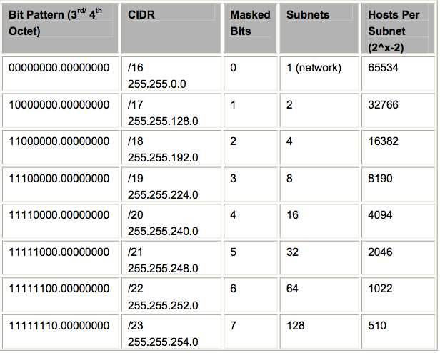
Class B Subnetting Summaries

Slide 14
How to write subnet masks?
If we steal five host bits from the third octet we have to add the binary values together
So we have 128+64+32+16+8 = 248
Since we are working with class B
We are not allowed to alter the first two octets, they are fixed
Subnet mask will be 255.255.248.0
In order for the router to know if a host is on a certain subnet it looks to the masked bits.
128 | 64 | 32 | 16 | 8 | 4 | 2 | 1
1 | 1 | 1 | 1 | 1 | 0 | 0 | 0

Slide 15
Cont’d…
Suppose we have IP address 129.10.147.1 255.255.248.0
Answer the following:
In what IP address class does it belong to?
How many bits have been borrowed for subnetting?
Represent the subnet mask in binary
Does the IP address 129.10.148.85 belong to the same subnet as 129.10.147.1?

Slide 16
Cont’d…
10000001.00001010.10010011.00010000 129.10.147.32
10000001.00001010.10010100.01010101 129.10.148.85
Subnet bits in this example above both match
For the above IP address the subnet masks do not match, this shows that they are in different subnets.
So the router or PC can see it is a different subnet.
It is not this easy for us to see it.
10000001.00001010.10011010.00000010 129.10.154.2

Slide 17
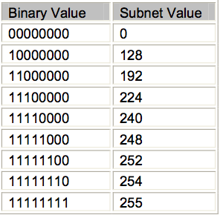
Cont’d…
Values available to use as a subnet masks:

Slide 18
Variable Length Subnet Mask (VLSM)
Although subnetting provides a useful mechanism to improve the IP addressing issue
Network admins were only able to use one subnet mask for an entire network
They could have a Class B address with a 255.255.192.0 mask but further break that subnet down into smaller units with masks such as 255.255.224.0
With VLSM subnets can be written as slash addresses
Writing out how many bits are used for subnetting.

Slide 19
Cont’d…
Examples:
255.255.0.0 can be expressed as /16 because there are 16 binary bits masked.
11111111.11111111.00000000.00000000 = 16 on or masked bits.
255.255.192.0 can be expressed as /18 because there are 18 binary bits masked.
11111111.11111111.11000000.00000000 = 18 on or masked bits.
255.255.240.0 can be expressed as /20 because there are 20 binary bits masked
11111111.11111111.11110000.00000000 = 20 on or masked bits.

Slide 20
Cont’d…
Cisco IOS 12.0 and later will recognize VLSM automatically. Prior to this you will need to use the ‘ip subnet-zero command’ if you want to use VLSM.
Represents 129.10.147.1 with the subnet mask 255.255.248.0 as a slash address.

Slide 21
Classless Inter Domain Routing (CIDR)
CIDR removed the need for classes of IP address.
Yet another solution to the problem of depletion of IP addresses
allows for something known as route aggregation
single route in a routing table can represent several network addresses saving space and routing table size
CIDR also allows for supernetting
Supernetting enables you to advertise a summary of your network addresses providing you have a contiguous block

Slide 22
Cont’d…
For example, if you owned the networks 172.16.20.0/24 up to 172.16.23.0/24
Then you could advertise a single network out to the internet of 172.16.20.0/22.
The advantage is a saving on bandwidth and greater efficiency
This is also knows as route summarization.
Route summarization only works if you work out the addresses in binary first.
11111111.11111111.11111111.00000000 = 24 bit mask
10101100.00010000.00010100.00000000 = 172.16.20.0
10101100.00010000.00010101.00000000 = 172.16.21.0
10101100.00010000.00010110.00000000 = 172.16.22.0
10101100.00010000.00010111.00000000 = 172.16.23.0

Slide 23
Cont’d…
All of the bold parts of the address are common and can be aggregated with one subnet mask to advertise them all.
There are 22 common bits so we can use the mask 255.255.252.0 or /22 to advertise the entire block of addresses.
Supernetting reduces the amount of routes advertised
CIDR allows the use of the slash system for representing subnet masks
/26 instead of 255.255.255.192

Slide 24
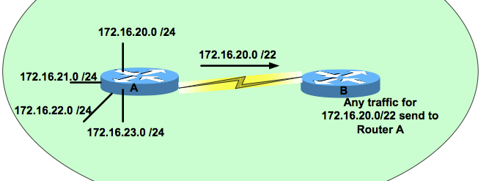
Cont’d…

Slide 25
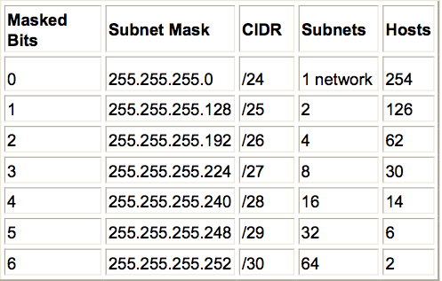
Class C Subnetting Chart

Slide 26
How many subnets and how many hosts?
When planning a network addressing scheme always ask the client what their expected growth for the next few years is and account for that. Never design a network addressing scheme for what they have now.
Given a network ID and subnet mask, how many subnets can we form and how many hosts are there per subnet?
It all boils down to the powers of two.
255.255.224.0
11111111.11111111.11100000.00000000
[16 bits ] [3 bits][13 bits]
[Network] [Subnet] [Host]

Slide 27
Cont’d…
What can we deduce from this?
This is a class B address
Three subnet bits have been borrowed
The total number of subnets is 2^3 = 8, 2 of which are not normally used
The first subnet – known as the subnet zero
The last subnet – broadcast subnet
The number of usable subnets are then 2^subnet bits (-2)
How many hosts?
13 bits left for the host addresses.
2^13-2 = 8190.
So for this subnet mask we can see we have eight subnets and each subnet has 8190 hosts available for use.

Slide 28
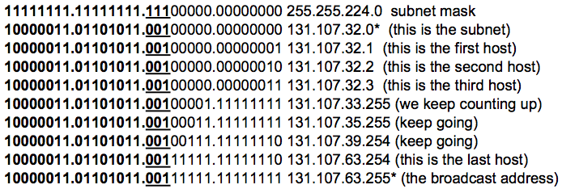
Another Example
131.107.32.0 (Network Address)
255.255.224.0 (Subnet Mask)
A class B address and are taking three bits from the host bits
three binary bits is 11100000 which is 128+64+32 or 224

Slide 29
Cont’d…
Hosts are 131.107.32.1 to 131.107.63.254 (8190 in total)
*131.107.32.0 = subnet and 131.107.63.255 = broadcast address
The IP address changed from 32.1 then 33.255 all the way up to 63.254, it is easy to look at it and mistake them for different subnets.
Using subnets means that all the hosts on the same subnet (for example the 131.107.32.0 subnet) will have to be attached to one router interface.
You cannot decide to put half of your addresses on one side of the router and half on the other

Slide 30
Cont’d…
ADVICE: If it doesn’t sink in the first or even the tenth time, just keep following the examples and re-reading.
Shortcut Method
Follow five simple steps.
Step 1. How many subnets?
2 to the power of masked bits or 2^x
Step 2. How many hosts per subnet
2 to the power of unmasked bits minus 2 (shown as -2)
Step 3. What are the valid subnets?
256 – the rightmost non-zero subnet to give us the subnet increment
Step 4. What are number of hosts per subnet?
Step 5. What is the broadcast address of the subnet?

Slide 31
3rd Subnetting Example
Which subnet is 131.107.32.1 255.255.224.0 in?
255.255.224.0 is 11111111.11111111.11100000.00000000 in binary.
slash mask of /19
1. How many subnets?
We have stolen three bits, 2^3= 8 subnets
2. How many hosts per subnet?
We have 13 bits left for hosts so:
2^13-2= 8190
3. What are the valid subnets?
Take the right most non-zero subnet (224) away from 256.
256-224= 32

Slide 32
Cont’d…
We have eight valid subnets
Each subnet will be an increment of 32
Start at 0 if subnet zero is permitted 0, 32, 64, 96, 128,160,192, 224
4. What are the valid hosts per subnet?
1st Subnet 131.107.0.0 <- This is the zero subnet
2nd Subnet 131.107.32.0* <- 131.107.32.1 is in this subnet
3rd Subnet 131.107.64.0
4th Subnet 131.107.96.0
5th Subnet 131.107.128.0
6th Subnet 131.107.160.0
7th Subnet 131.107.192.0
8th Subnet 131.107.224.0

Slide 33
Cont’d…
To get the broadcast address of each subnet, take one away from the network address of the next subnet
Subnet 131.107.64.0 (take one away to get the broadcast for the .32 subnet)
1st host 131.107.64.1
Last host 131.107.95.254
Broadcast 131.107.95.255

Slide 34
Writing out the subnets
Subnet 1: 131.107.0.1 to 131.107.31.254
Subnet 2: 131.107.32.1 to 131.107.63.254* (you can see host 32.1 is in this subnet)
Subnet 3: 131.107.64.1 to 131.107.95.254
Subnet 4: 131.107.96.1 to 131.107.127.254
Subnet 5: 131.107.128.1 to 131.107.159.254
Subnet 6: 131.107.160.1 to 131.107.191.254
Subnet 7: 131.107.192.1 to 131.107.223.254
Subnet 8: 131.107.224.1 131.107.255.254

Slide 35
Work this out
Which subnet is host 10.20.1.23 255.240.0.0 in?

Slide 36
Work this out
Which subnet is host 10.20.1.23 255.240.0.0 in?
We have taken four bits (240 in binary is 11110000 or 128+64+32+16)
This is a class A address
How many subnets?
2^4= 16
How many hosts per subnet?
We have 20 bits left for hosts so:
2^20-2= 1048574 hosts per subnet
What are the valid subnets?
256-240 = 16 (the increment). Our subnets go up in increments of 16.
0, 16, 32, 48, 64, 80, 96 ….

Slide 37
Cont’d…
What are the valid hosts per subnets?
10.0.0.0 Hosts 10.0.0.1 to 10.15.255.254
10.16.0.0 Hosts 10.16.0.1 to 10.31.255.254* <-10.20.1.23 is in this subnet
10.32.0.0 Hosts 10.32.0.1 to 10.47.255.254
10.48.0.0 Hosts 10.48.0.1 to 10.63.255.254
10.64.0.0 and so on
10.224.0.0 Hosts 10.224.0.1 to 10.239.255.254
What are the broadcast addresses?
This is the last address before each subnet.
10.15.255.254 is the last host on the first subnet
10.15.255.255 is the broadcast address

Slide 38
Questions Types
You have been given a certain network number and subnet mask and you need to determine which subnet the IP address is in.
To design a subnet mask to give a customer a certain number of hosts and a certain number of subnets.

Slide 39
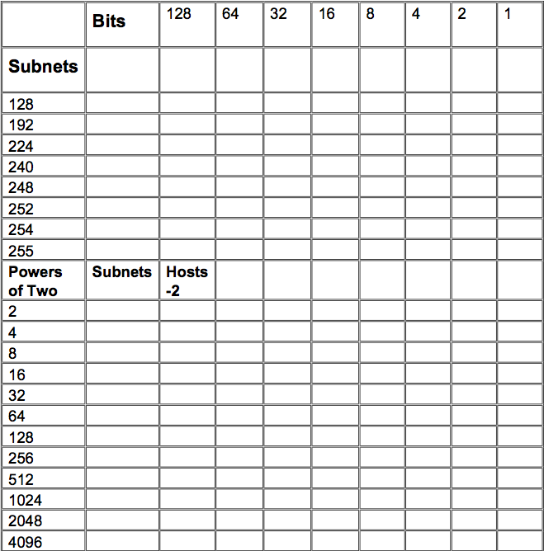
Subnetting Secrets Chart

Slide 40
Example
Which subnet is 192.168.100.203 /27 in?
Three binary octets is 24 bits and to get to 27 we need to add 3.
Tick down three numbers on the top subnetting column on the chart
This will give you the value of 224
So our subnet /27 is 255.255.255.224
Tick three across the top to get the subnet increment which is 32

Slide 41
Now finding out which subnet 203 is in
Subnet 1 192.168.100.0 hosts 1-30 (broadcast = 31)
Subnet 2 192.168.100.32 hosts 33-62 (broadcast = 63)
Subnet 3 192.168.100.64 hosts 65-94 (broadcast = 95)
Subnet 4 192.168.100.96 hosts 97-126 (broadcast = 127)
Subnet 5 192.168.100.128 hosts 129-158 (broadcast = 159)
Subnet 6 192.168.100.160 hosts 161-190 (broadcast = 191)
Subnet 7 192.168.100.192 hosts 193-222 (broadcast = 223)*
Subnet 8 192.168.100.224 hosts 225-254 (broadcast = 255)

Slide 42
More examples
You are given an IP address of 192.168.5.0 255.255.255.0. You are the network administrator and need to subnet this address to make six subnets each with at least 15 hosts per subnet.

