Slide 1
DSM2294 Lecture
OSI Network Model

Slide 2
Layers
We use the concept of layers in our daily life.
As an example, let us consider two friends who communicate through postal mail.
The process of sending a letter to a friend would be complex if there were no services available from the post office.

Slide 3
The OSI Model
Established in 1947, the International Standards Organization (ISO) is a multinational body dedicated to worldwide agreement on international standards.
An ISO standard that covers all aspects of network communications is the Open Systems Interconnection (OSI) model. It was first introduced in the late 1970s.
Note:
ISO is the organization.
OSI is the model.

Slide 4
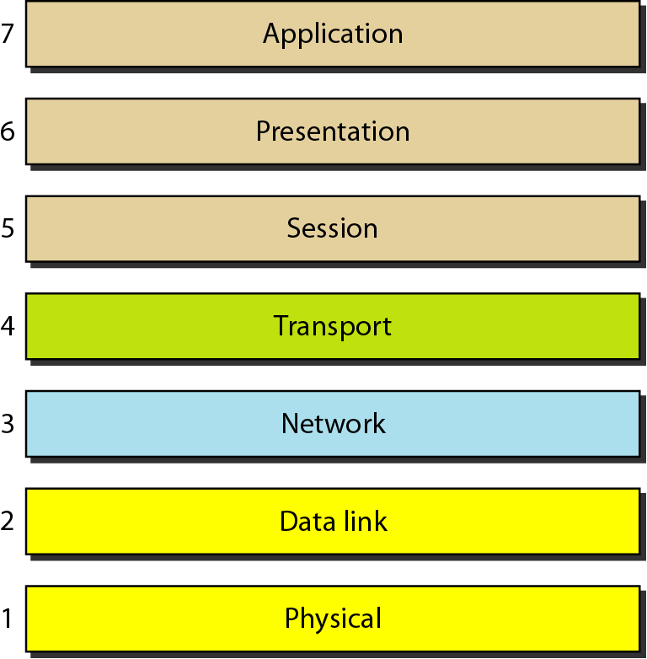
Seven layers of the OSI model

Slide 5
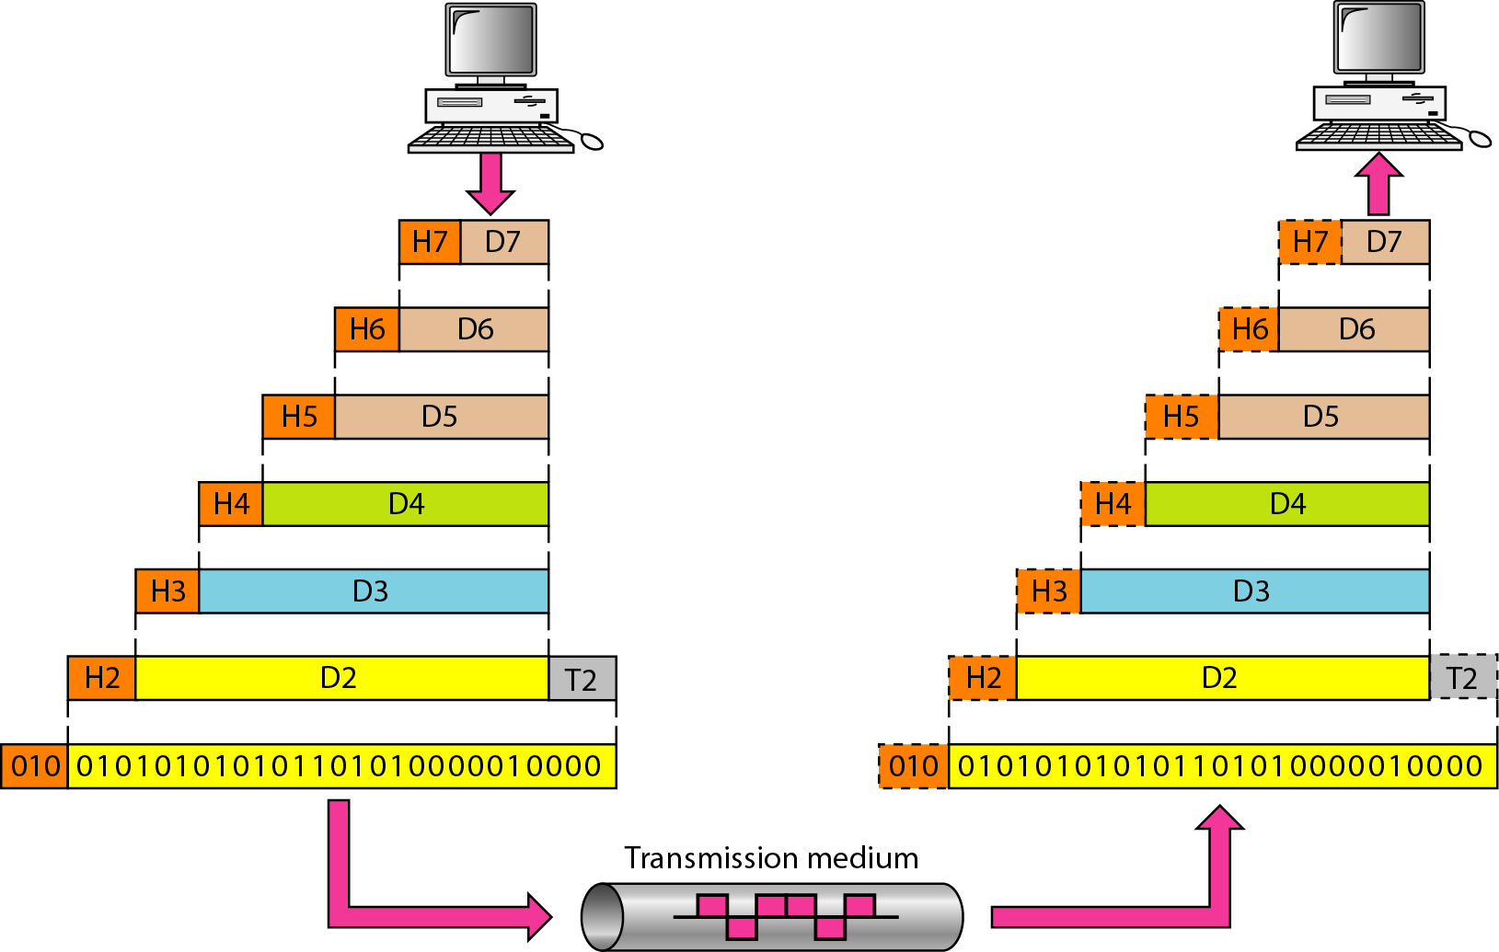
Exchange using the OSI Model

Slide 6
LAYERS IN THE OSI MODEL
Physical Layer
Data Link Layer
Network Layer
Transport Layer
Session Layer
Presentation Layer
Application Layer

Slide 7
Application Layer
Refers to application interfaces.
Example: MHS (Message handling Service) is an interface that enable a variety of email programs can be used on a intranet.
Is closest to the user
Provides network services to applications
Does not provide services to any other OSI layer
Think of browsers

Slide 8
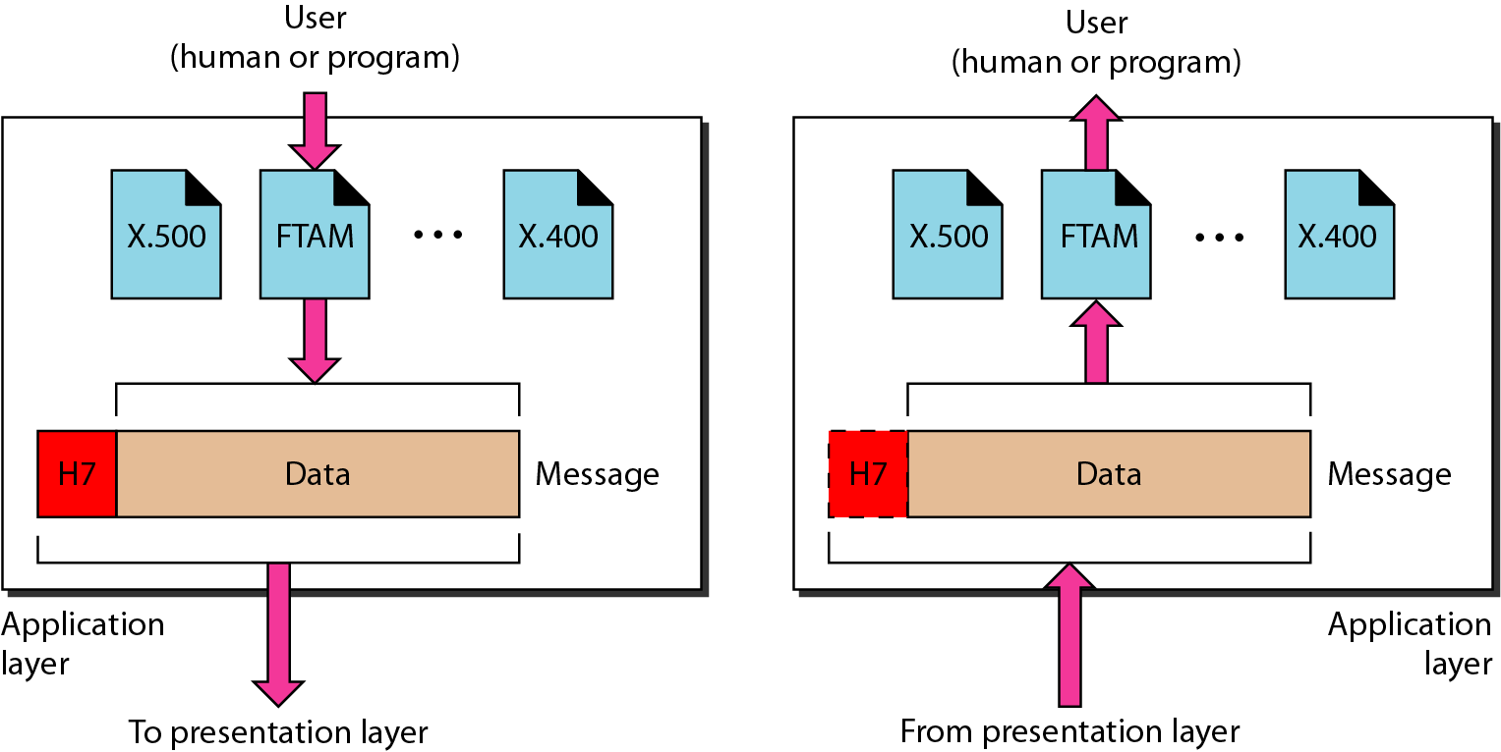
Application layer
The application layer is responsible for providing services to the user.

Slide 9
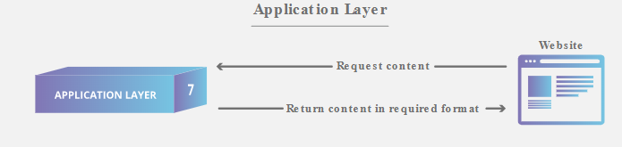
Application Layer Example - Browser

Slide 10
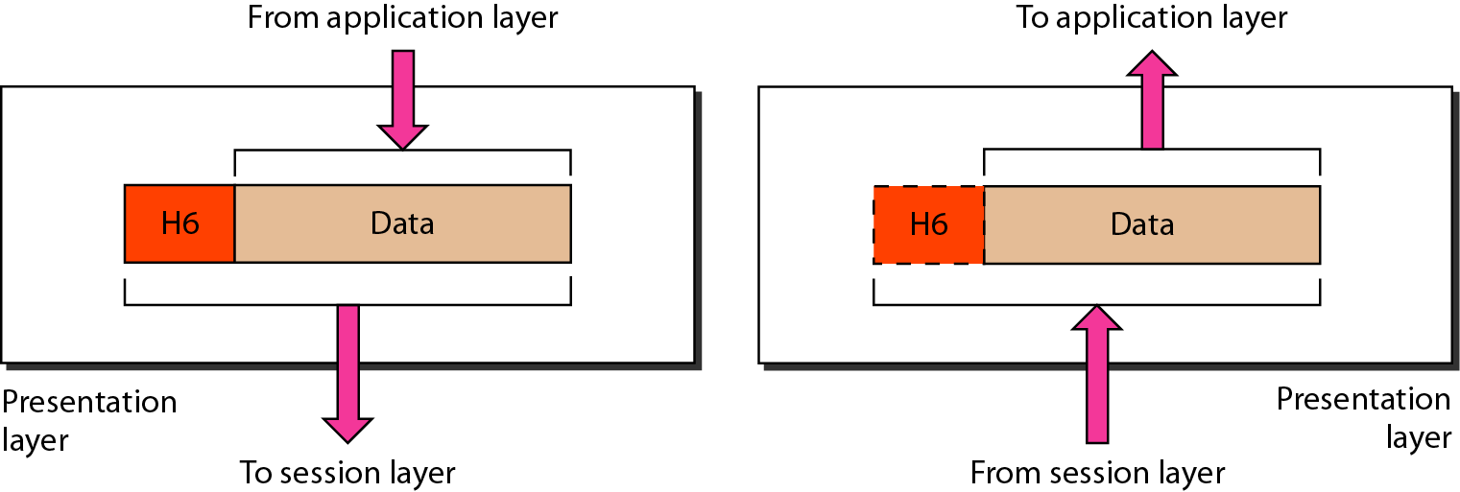
Presentation layer
The presentation layer is responsible for translation, compression, and encryption.

Slide 11
Presentation Layer
Ensures that the information that the application layer of one system sends out is readable by the application layer of another system
Think of a common data format

Slide 12
Presentation Layer
Translation: Networks can connect very different types of computers together: PCs, Macintoshes, UNIX systems, AS/400 servers and mainframes can all exist on the same network.
These systems have many distinct characteristics and represent data in different ways; they may use different character sets for example.
The presentation layer handles the job of hiding these differences between machines.

Slide 13
Presentation Layers
Compression: Compression (and decompression) may be done at the presentation layer to improve the throughput of data.

Slide 14
Presentation Layers
Encryption: Some types of encryption (and decryption) are performed at the presentation layer.
This ensures the security of the data as it travels down the protocol stack.
For example, one of the most popular encryption schemes that is usually associated with the presentation layer is the Secure Sockets Layer (SSL) protocol.

Slide 15
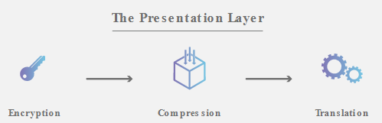
Presentation Layer

Slide 16
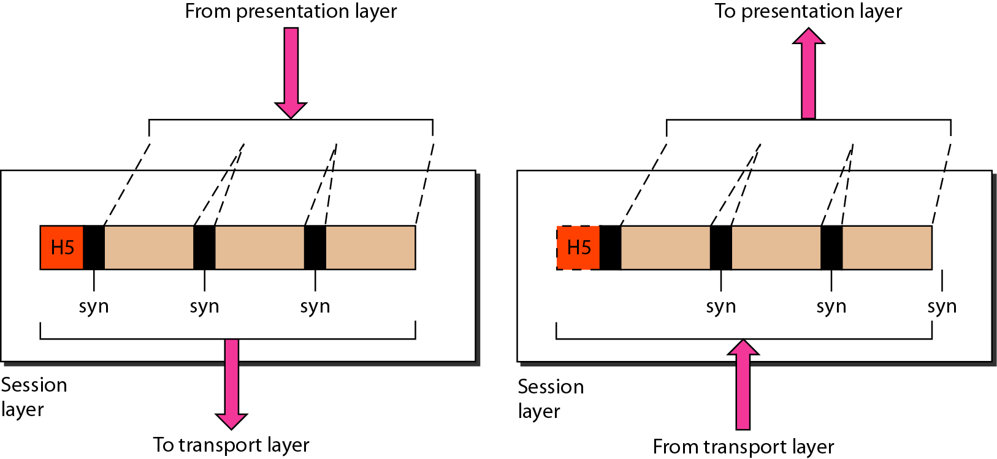
Session layer
The session layer is responsible for dialog control and synchronization.

Slide 17
Session Layer
Synchronizes dialogue between the two hosts' presentation layers and manages their data exchange
Offers provisions for efficient data transfer, class of service, and exception reporting
Think of dialogues and conversations or transaction

Slide 18
Session Layer
Dialog Control : This layer allows two systems to start communication with each other in half-duplex or full-duplex.

Slide 19
Session Layer
Synchronization : This layer allows a process to add checkpoints which are considered as synchronization points into stream of data.
Example: If a system is sending a file of 800 pages, adding checkpoints after every 50 pages is recommended.

Slide 20
Transport layer
The transport layer is responsible for the delivery of a message from one process to another.
Segmentation and reassembly
Connection control
Flow control
Error control

Slide 21
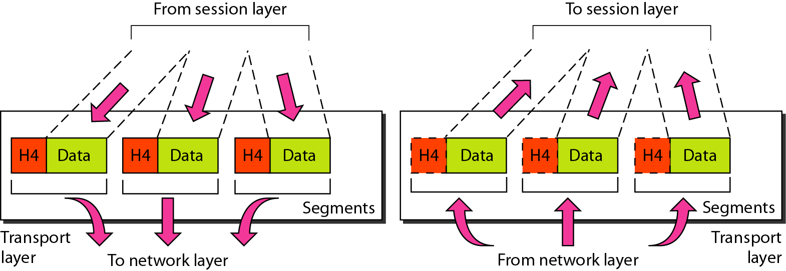
Segmentation and Reassembly

Slide 22
Transport Layer
Segments the data into acceptable packet size
Responsible for data integrity of packet segments
Provide a data transport service
Levels of service are segmenting, reassembly, error recovery, flow control
Think of quality of service, and reliability

Slide 23
Transport Layer
Support process-to-process delivery
Segmentation and reassembly: Message is divided into transmittable segments, with each contain sequence number. It will then be used to reassemble the message once arrived at the destination.

Slide 24
Transport Layer
Flow Control: coordinates the amount of data can be sent before receiving acknowledgment
Tells the sender how much data it can transmit before it must wait for an acknowledgment from the receiver

Slide 25
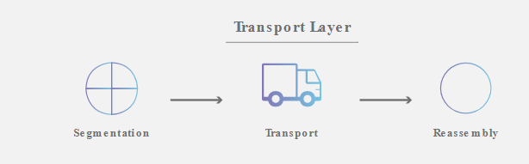
Transport Layer
Error Control: includes both error detection and error correction
It allows the receiver to inform the sender if a frame is lost or damages during transmission and resend it back
It is based on Automatic Repeat Request (ARQ)

Slide 26
Network Layer
The network layer is responsible for the delivery of individual packets from the source host to the destination host.
Think of path selection, routing, and addressing.
Sometime called Internet layer.
The header includes the source and destination addresses, the sequence order, and other data necessary for correct routing and rebuilding at the destination.

Slide 27
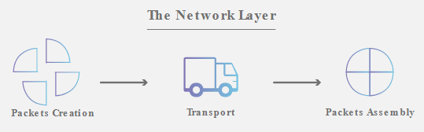
Network Layer
Responsible for source to destination delivery
Logical Addressing: Once the packet reach network layer, need additional addressing to distinguish between source and destination.
Routing:

Slide 28

Data Link Layer
The data link layer is responsible for moving frames from one hop (node) to the next.
Framing
Physical addressing
Flow control
Error control
Access control

Slide 29
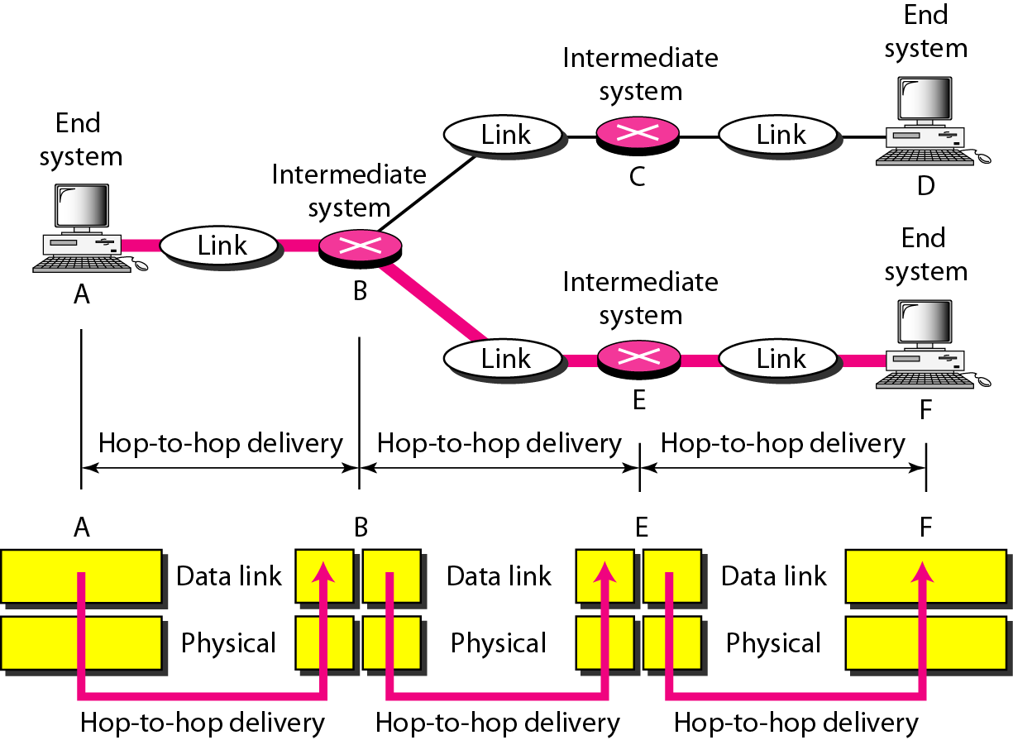
Hop-to-hop Delivery

Slide 30
Physical Layer
The physical layer is responsible for movements of individual bits from one hop (node) to the next.
Physical characteristics of interface and medium: pin assignment, connector, cables
Representation of bits: encoding
Data rate
Synchronization of bits
Line configuration: point-to-point, multipoint
Physical topology
Transmission mode: simplex, half-duplex, full-duplex

Slide 31
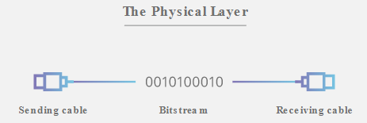
The Physical Layer

Slide 32
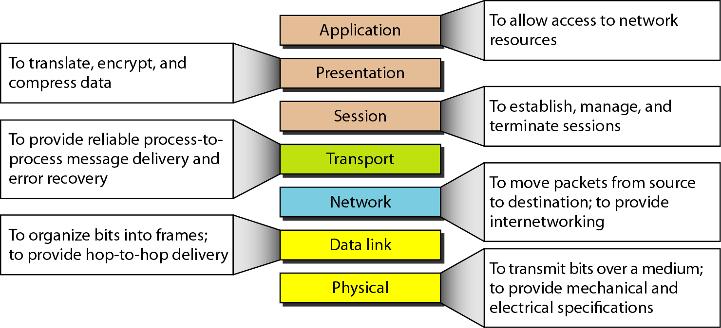
Summary of layers

