Slide 1
DSM2294 Lecture 09
FundamentalS of IP

Slide 2
IPv4 Addresses
The identifier used in the IP layer of the TCP/IP protocol suite to identify each device connected to the Internet is called the Internet address or IP address.
An IPv4 address is a 32-bit address that uniquely and universally defines the connection of a host or a router to the Internet
An IP address is the address of the interface.

Slide 3
Topics Discussed in the Section
Notation
Range of Addresses
Operations

Slide 4
IPv4
Internet Protocol
Internet Protocol Version 4 is the most popular protocol in use today, although there are some questions about its capability to serve the Internet community much longer.
IPv4 was finished in the 1970s and has started to show its age.
The main issue surrounding IPv4 is addressing—or, the lack of addressing—because many experts believe that we are nearly out of the four billion addresses available in IPv4.
Although this seems like a very large number of addresses, multiple large blocks are given to government agencies and large organizations.
IPv6 could be the solution to many problems posed by IPv4

Slide 5
IPv6
Internet Protocol
IPv6 uses 128 bit address instead of 32 bit address.
The IPv6 addresses are being distributed and are supposed to be used based on geographical location.

Slide 6
IPv4 Addresses
An IPv4 address is 32 bits long.
The IPv4 addresses are unique and universal.
The address space of IPv4 is 32 or 4,294,967,296.
Notation:

Slide 7
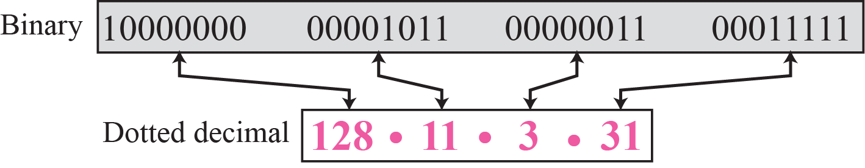
Dotted-decimal notation

Slide 8
Binary Notation to Dotted-Decimal Notation
Change the following IPv4 addresses from binary notation to dotted-decimal notation.
10000001 00001011 00001011 11101111
11000001 10000011 00011011 11111111
11100111 11011011 10001011 01101111
11111001 10011011 11111011 00001111
Solution: We replace each group of 8 bits with its equivalent decimal number and add dots for separation:
129.11.11.239
193.131.27.255
231.219.139.111
249.155.251.15

Slide 9
Dotted-Decimal Notation to Binary Notation Example
Change the following IPv4 addresses from dotted-decimal notation to binary notation.
111.56.45.78
221.34.7.82
241.8.56.12
75.45.34.78
Solution: We replace each decimal number with its binary equivalent:
01101111 00111000 00101101 01001110
11011101 00100010 00000111 01010010
11110001 00001000 00111000 00001100
01001011 00101101 00100010 01001110

Slide 10
Erroneous IPv4 addressing
Find the error, if any, in the following IPv4 addresses:
111.56.045.78
221.34.7.8.20
75.45.301.14
11100010.23.14.67
Solution
There should be no leading zeroes (045).
We may not have more than 4 bytes in an IPv4 address.
Each byte should be less than or equal to 255.
A mixture of binary notation and dotted-decimal notation.

Slide 11
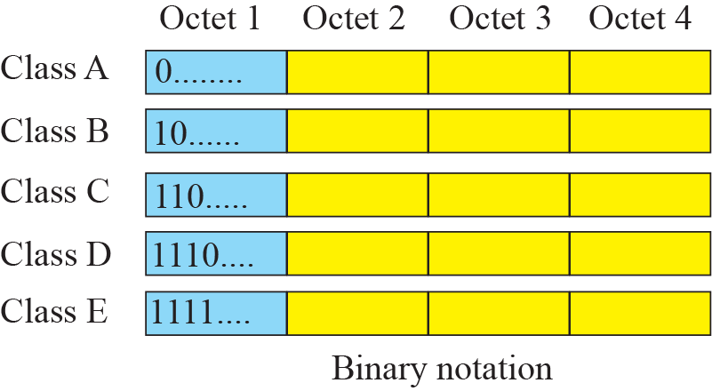
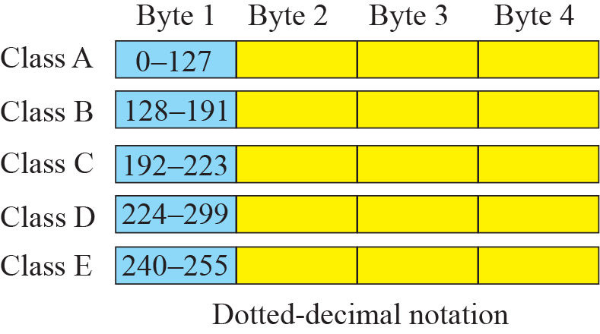
IPv4 Classes
Internet Protocol hierarchy contains several classes of IP Addresses to be used efficiently in various situations as per the requirement of hosts per network.
Broadly, the IPv4 Addressing system is divided into five classes of IP Addresses. All the five classes are identified by the first octet of IP Address.

Slide 12
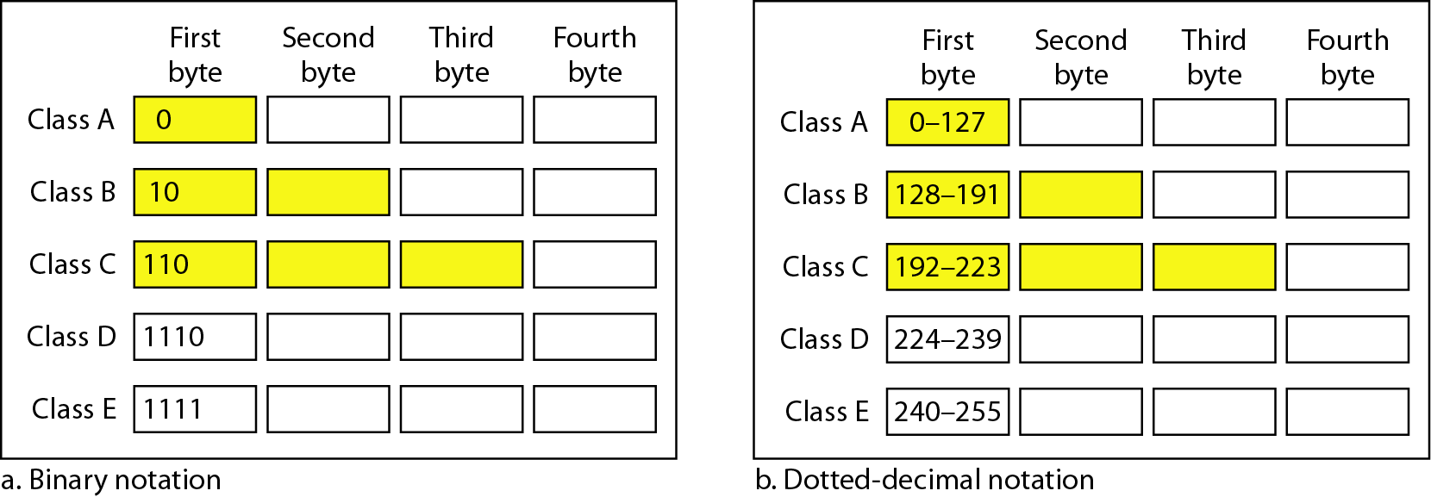
Classful Addressing
In classful addressing, the address space is divided into five classes: A, B, C, D, and E.

Slide 13
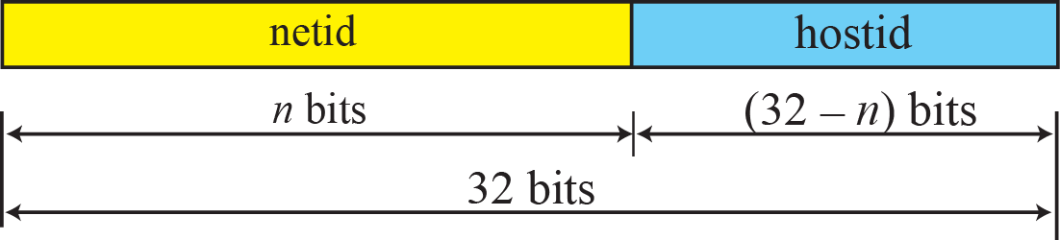
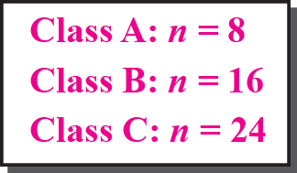
Two-level addressing in classful addressing

Slide 14
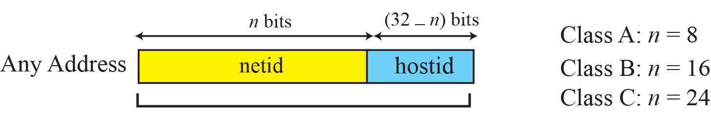
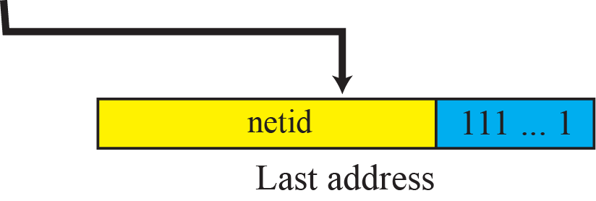
Information extraction in classful addressing

Slide 15
Classless Addressing
To overcome the depletion of address space.
Restriction
The addresses in a block must be contiguous.
The number of addresses in a block must be a power of 2.
The first address must be evenly divisible by the number of address.
Mask
Consists of n consecutive 1’s followed by zeros.
n can be any number b/w 0 and 32.
Tips:
In IPv4 addressing, a block of addresses can be defined as x.y.z.t /n, in which x.y.z.t defines one of the addresses and the /n defines the mask.
The first address in the block can be found by setting the rightmost 32 − n bits to 0s.
The last address in the block can be found by setting the rightmost 32 − n bits to 1s.
The number of addresses in the block can be found by using the formula 2^{32−n}.

Slide 16
Structure of IPv4 Address
Consists of Net ID and Host ID.
Mask
32-bit number of contiguous 1’s followed by contiguous 0’s.
To help to find the net ID and the host ID.

Slide 17
Finding the IP Address Class – Binary Notation
Find the class of each address:
00000001 00001011 00001011 11101111
11000001 10000011 00011011 11111111
10100111 11011011 10001011 01101111
11110011 10011011 11111011 00001111
Solution
The first bit is 0. This is a class A address.
The first 2 bits are 1; the third bit is 0. This is a class C address.
The first bit is 1; the second bit is 0. This is a class B address.
The first 4 bits are 1s. This is a class E address.

Slide 18
Finding the IP Address Class – Dotted Decimal Notation
Find the class of each address:
227.12.14.87
193.14.56.22
14.23.120.8
252.5.15.111
Solution
The first byte is 227 (between 224 and 239); the class is D.
The first byte is 193 (between 192 and 223); the class is C.
The first byte is 14 (between 0 and 127); the class is A.
The first byte is 252 (between 240 and 255); the class is E.

Slide 19
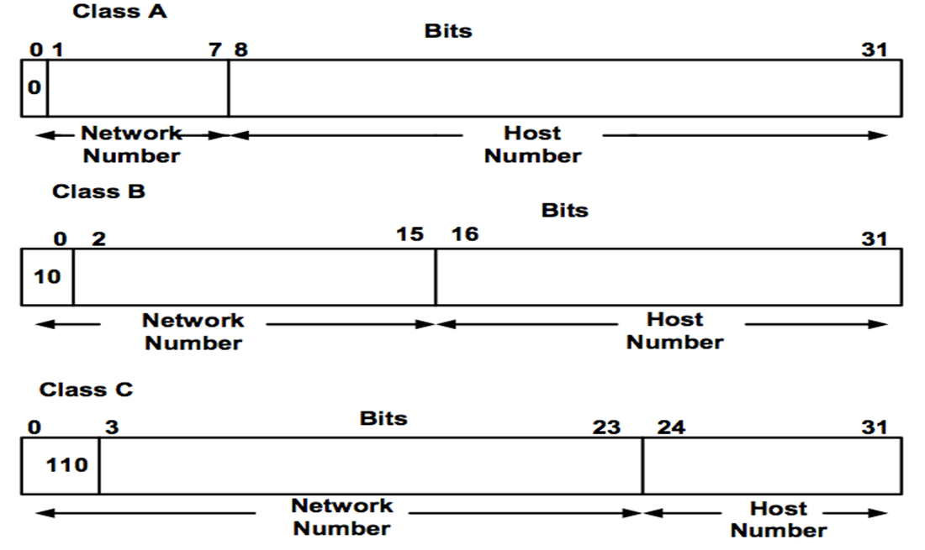
IP Address Classes

Slide 20
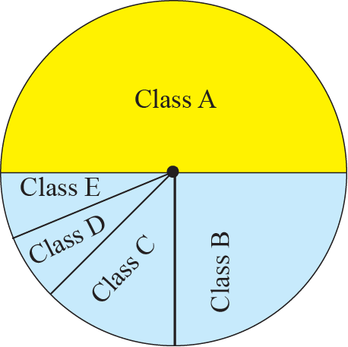
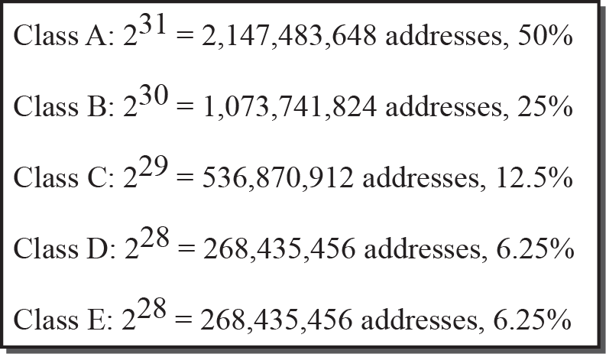
Occupation of address space

Slide 21
Netid & Hostid

Slide 22
Class A Addresses (1)
These were given to the very largest organizations
tremendous number of IP addresses since they owned more computers than everyone else.
Only use the first octet to identify the network number.
The remaining three octets are left for identifying the hosts on the network.
So the network is 10 and 2.5.4 is a host on that network.
In binary it would look like:
nnnnnnnn.hhhhhhhh.hhhhhhhh.hhhhhhhh
Network.Host.Host.Host
10.2.5.4

Slide 23
Class A Addresses (2)
You would pronounce the above IP address as ten dot two dot five dot four.
Class A addresses are numbered from 1 to 126 in the first octet.
Network equipment identifies a class A address because the very first bit on the first octet has to be a 0.
It cannot have a 1 in this bit position.
So the first network number is 1.
128 | 64 | 32 | 16 | 8 | 4 | 2 | 1
0 | 0 | 0 | 0 | 0 | 0 | 0 | 1

Slide 24
Class A Addresses (3)
128 | 64 | 32 | 16 | 8 | 4 | 2 | 1
0 | 1 | 1 | 1 | 1 | 1 | 1 | 1
The last possible network number is 127.
Use the powers of two rule:
The first octet can have a possible 256 (2^8 = 256) networks.
However, not allowed to use the first bit of the first octet, it is reserved for showing the 0 (binary) value.
So this leaves us with 7 digits. 2^7–(1)gives us 127 networks.
The full three octets to use for hosts so 8+8+8 bits gives us 2^24-(2) = 16,777,214 hosts per class A network.

Slide 25
Class A Addresses (4)
Network number 127 cannot actually be used because the value 127.0.0.1 is reserved for troubleshooting.
127.0.0.1 is known as a loopback address
You can ping the loopback address to check if TCP/IP is working on your host.
We are not permitted to use 0 as a network number or the 127 which leaves us 126 available networks for class A addresses.
For the hosts we can start at number one until every single possible value is used up.

Slide 26
Class A Addresses (5)
00001010. | 00000000. | 00000000. | 00000001
10. | 0. | 0. | 1
00001010. | 00000000. | 00000000. | 00000010
10. | 0. | 0. | 2
00001010. | 11111111. | 11111111. | 11111110
10. | 255. | 255. | 254
10.255.255.254 is the last host, or in binary:
Decimal notations are used so that it can be easy to write out the IP addresses and easy to remember.
Why can’t we have 10.255.255.255 as a host?
Because when all the binary values have a 1 on the host part of the address this tells the network that it is a broadcast packet.

Slide 27
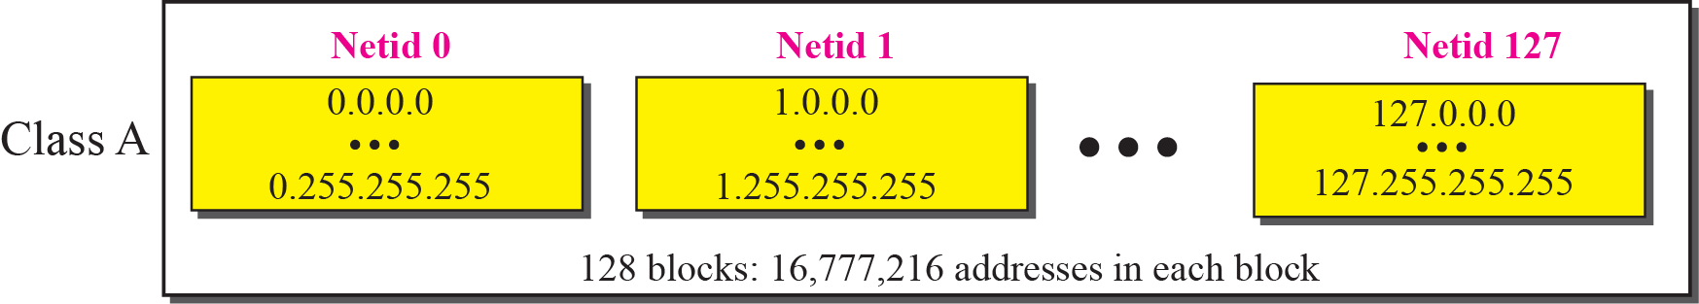
Blocks in Class A
Note: Many Class A addresses are wasted.

Slide 28
Class B Addresses (1)
They were reserved for large organizations that needed a lot of host numbers but not as many as the largest ones.
When a class B address was assigned to an organization it resulted in thousands of wasted host numbers.
They have to have the first two binary values on the first octet reserved with a 1 and a 0 next to it.
So the first network number is 128
all the available network bits on the first octet turned off.
128 | 64 | 32 | 16 | 8 | 4 | 2 | 1
1 | 0 | 0 | 0 | 0 | 0 | 0 | 0

Slide 29
Class B Addresses (2)
The last available class B network number is 191
network bits have been turned on (on the first octet).
The first two octets for the network address the other two identify the hosts on the network.
For example, the address 130.24.5.2
130.24 is the network number
5.2 is a host on that network
The range of class B IP addresses is between 128 and 191.
128 | 64 | 32 | 16 | 8 | 4 | 2 | 1
1 | 0 | 1 | 1 | 1 | 1 | 1 | 1

Slide 30
Class B Addresses (3)
Use the powers of two rule:
The first two octets can have a possible 65536 (2^16 = 65536) networks.
however, not allowed to use the first two bits of the first octet, they are reserved for showing the 10 (binary) value.
So this leaves us with 6+8 digits. 2^14 gives us 16384 networks.
The full two octets to use for hosts so 8+8 bits gives us 2^16 –(2) = 65534 hosts per class B network.

Slide 31
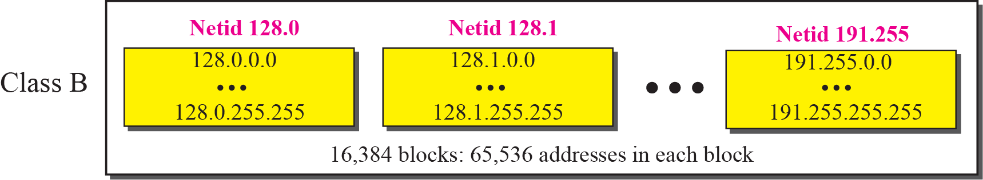
Blocks in Class B
Note: Many Class B addresses are wasted.

Slide 32
Class C Addresses (1)
Reserved for any other organization that was not large enough to warrant having a class A or B address.
It has the first three bits reserved so the network device can recognize it as such.
The first three bits must show as 110.
The first network number is 192. All the other network bits are off (0).
128 | 64 | 32 | 16 | 8 | 4 | 2 | 1
1 | 1 | 0 | 0 | 0 | 0 | 0 | 0

Slide 33
Class C Addresses (2)
And the last is 223. This time all the network bits are on (on the first octet).
An example of a class C address is 200.2.1.4
200.2.1 is the network address
.4 is a host on that network
There are lots of available network numbers to assign to companies
Limited amount of numbers free to use for the hosts on our networks.
128 | 64 | 32 | 16 | 8 | 4 | 2 | 1
1 | 1 | 0 | 1 | 1 | 1 | 1 | 1

Slide 34
Class C Addresses (3)
For networks we have to take the first three bits (011) from the first octet giving us 5+8+8= 21 (network bits).
2^21 = 2097152
For the hosts we have 2^8 giving us 256 (only 254 are usable though).

Slide 35
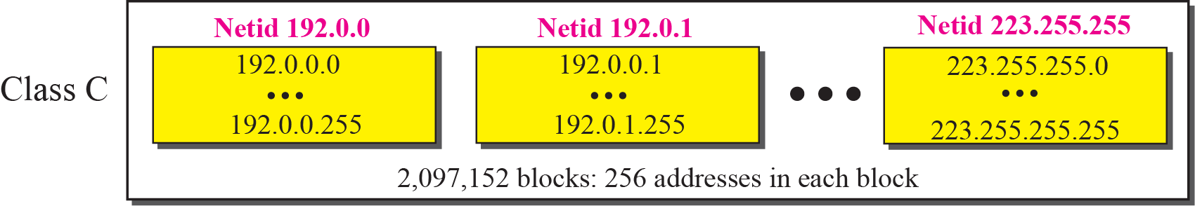
Blocks in Class C
Note: Not so many organizations are so small to have a class C block.

Slide 36
Class D and E Addresses
Class D addresses are reserved for multicast traffic and cannot be used on your network.
Multicast traffic is traffic sent to multiple hosts using one IP
A live web cast of a rock concert would be an example of multicasting.
Class E addresses are reserved for experimental use only.
Addresses Reserved for Private Use
InterNIC has set aside certain addresses and have been reserved for private use only.
For example, 127.0.0.0 is reserved for testing purposes only
Other include a list of addresses that are used only on private networks, not the Internet

Slide 37
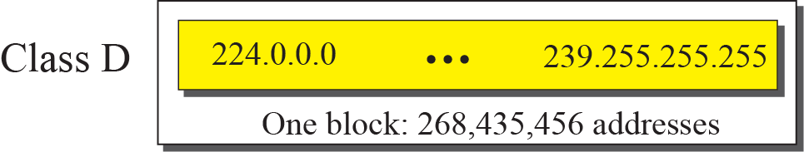
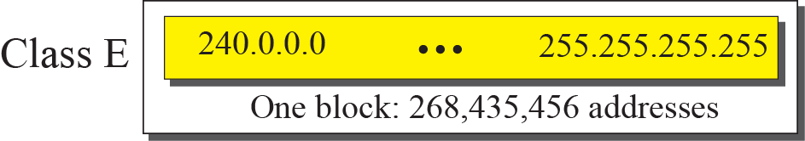
Blocks in Classes D and E
Note: Class D addresses are made of one block, used for multicasting.
Note: The only block of class E addresses was reserved for future purposes.

Slide 38
IP Addresses for Intranet
If you would like to use TCP/IP on your internal network (intranet) and not use the Internet, the following addresses are suggested:
Class A 10.0.0.0 through 10.255.255.255
Class B 172.16.0.0 through 172.31.255.255
Class C 192.168.0.0 through 192.168.255.255
Routers on the Internet will not route data from or to these addresses; they are for internal, private use only.
To use these addresses on an intranet and have access to the Internet, you must use a proxy server or Network Address Translation (NAT).

