Slide 1
System Administration
Introduction

Slide 2
Topics
What is System Administration?
What do system admins do?
Principles and First Steps
Organizations and Certifications
Maturity and Complexity
Ethics

Slide 3
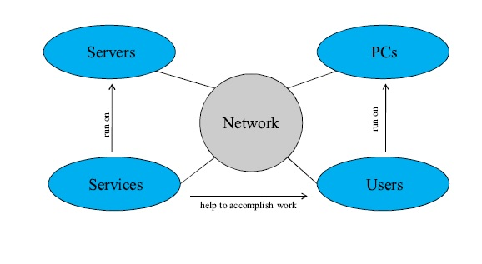
What is a System?
System: An organized collection of computers interacting with a group of users.

Slide 4
System State
System Policy: specifications of a system’s configuration and its acceptable usage.
System State S(t): the current configuration (files, kernel, memory or CPU usage) of a system.
Ideal State S*(t): States of the system that match the system policy. Over time, the system state shifts away from ideal state.
System Administration: Modifying the system to bring it closer to an ideal state S*(t).

Slide 5
What do sys-admins do?
Small organizations: the system administrator (sys-admin) can be entire IT staff
Phone Support
Order and install software and hardware
Fix everything that breaks from phones to servers
Develop software
Large organizations: sys-admin is one of many IT staff
Specialist instead of “jack of all trades”
Database admin, Network admin, Fileserver admin, Help desk worker, Programmers, Logistics

Slide 6
Common Activities
Manage users
Manage hardware
Perform backups.
Install new software systems.
Troubleshooting.
System monitoring.
Auditing security.
Help users.
Communicate.

Slide 7
DESCRIPTION OF ACTIVITIES User Management
Creating user accounts
Consistency requires automation
Startup (dot) files
Namespace Management
Usernames and UIDs
Multiple namespaces or SSI?
Removing user accounts
Consistency require automation
Many accounts across different systems

Slide 8
Hardware Management
Adding and removing hardware
Configuration, cabling, etc.
Purchase
Evaluate and purchase servers + other hardware
Capacity Planning
How many servers? How much bandwidth, storage?
Data Center Management
Power, racks, environment (cooling, fire alarm)
Virtualization
When can virtual servers be used vs. physical?
Notes:
1. How to put out fire from server room: Inert gas (Chemical substance that don’t react with other chemical substance)
Carbon dioxide
Argonite
Inergen
Nitrogen

Slide 9
Backups
Backup Strategy and policies
Scheduling: When and how often?
Capacity Planning
Location: on site vs offsite
Monitoring backups
Checking logs
Verifying media
Performing restores when requested.

Slide 10
Software Installation
Automated consistent OS installs
Desktop vs Server OS image needs.
Installation of Software
Purchase , find, or build custom software.
Managing software installations
Distributing software to multiple hosts.
Managing multiple version of software package.
Patching and updating software.

Slide 11
Troubleshooting
Problem Identification
By user notification
By log files or monitoring programs
Tracking and Visibility
Ensures users know you’re working on problem
Provide an ETA if possible.
Finding the root cause of problems
Provide temporary solution if necessary
Solve the root problem to permanently eliminate

Slide 12
System Monitoring
Automatically monitor system for
Problems (disk full, error logs, security)
Performance (CPU, mem, disk, network)
Provides data for capacity planning
Determine need for resources
Establish case to bring to management

Slide 13
Helping Users
Request tracking system
Ensures that you don’t forget problems.
Ensures users know you’re working on their problem; reduce interruptions, status queries.
Lets management know what you’ve done.
User documentation and training
Policies and procedures
Schedule and communicate downtimes

Slide 14
Communicate
Customer
Keep customer appraised of process.
When you’ve started working on a request with ETA.
When you make progress, need feedback.
When you’re finished.
Communicate system status
Uptime, scheduled downtimes, failures.
Meet regularly with customer managers
Managers
Meet regularly with your manager.
Write weekly status reports

Slide 15
Specialized SA skills
Heterogeneous Environments
Integrating multiple-OSes, hardware types, or network protocols, distributed sites.
Database
SQL RDMS
Networking
Complex routing, manage high speed networks and VOIP.
Security
Firewalls, authentication, NIDS, cryptography
Storage
NAS, SANS, cloud storage
Virtualization and cloud computing
VMware, cloud architectures.

Slide 16
Qualities of a successful Sys-admin
Customer oriented
Ability to deal with interrupts, time pressure
Communication skills
Service provider, not system police
Technical Knowledge
Hardware, network, and software knowledge
Debugging and troubleshooting skills
Time Management
Automate everything possible
Ability to prioritize task: urgency and importance.

Slide 17
1st Step to Better Sys-Admin
Use request system
Customer know what you’re doing.
You know what you’re doing.
Manage priorities
Handle emergencies quickly (priorities)
Use request system to avoid interruptions.
Establish policies
How do people get help?
What is the scope of responsibility for SA teams?
What is our definition of emergency?
Start every host in a known state.

Slide 18
Principles of Sys-Admin
Simplicity
Choose the simplest solution that solves the entire problem.
Work towards a predictable system.
Clarity
Choose a straightforward solution that’s easy to change , maintain, debug, and explain to other SAs.
Generality
Choose reusable solutions that scale up; use open protocols.
Automation
Use software to replace human effort.
Communication
Be sure that you’re solving the right problems and that people know what you’re doing.
Basic First
Solve basic infrastructure problems before advanced ones.

Slide 19
Organizations
USENIX: Advance Computing Association
LISA: Large Installation System Administration
SAGE: System Administration Guild
LOPSA: League of Professional System Administrator.

Slide 20
Types of Sites
Small
2-10 computers, 1 OS, 2-20 users.
Small staff size requires outsourcing to obtain most specialized skills.
Mid-sized
11-100 computers, 1-3 OSes, 21-100 users
Large
100+ computers, multiple OSes, 100+ users
Outsources to reduce cost, some specializations.

Slide 21
Certifications
CCNA, CCNP, CCIE (Cisco)
cSAGE(SAGE)
MCSA (Mircosoft)
RHCE (Red hat)
SCSA (Sun)
VCP (VMware)

Slide 22
Job Description EXAMPLE - SAGE
Novice : OS familiarity, help desk skills
Junior: Can use system administration tools (370)
Intermediate: Understanding of distributed computing, common servers, automate small tasks, independent action
Senior: Understanding of scaling issues, including capacity planning, solve problems by addressing the root cause, higher level programming abilities, write proposals for purchasing, data center planning, etc.

Slide 23
Sys-Admin Maturity Model (SAMM)
Ad Hoc
Ad-Hoc non-repeatable solutions, firefighting.
Repeatable
Some repeatable process
Defined
Documented standard process
Managed
Process effectiveness measured, adapted.
Optimized

Slide 24
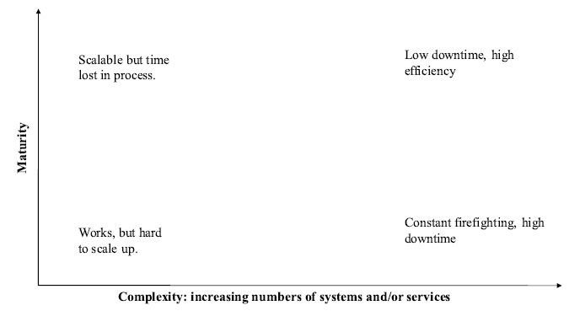
Maturity and Complexity

Slide 25
Tool Maturity Levels
Ad-Hoc : OS GUI, CLI, or web administration interfaces
Repeatable : Version Control (RCS, SVN, GIT), request tracker.
Defined : automatic monitoring (Nagios, Monit, god)
Managed : Configuration management (AutomateIT, cfengine)
Optimized

Slide 26
SAGE Code of Ethics (SA CODE OF ETHICS)
Professionalism
Personal Integrity
Privacy
Laws and Policies
Communication
System Integrity
Education
Social Responsibility

Slide 27
SYS-ADMIN Case STUDY: Terry Child
Network Administrator for SAN Fransisco CCIE
who built city’s FiberWAN network.
Terry was only person with router passwords
IT department acknowledges knowing that
He was on-call 24x7x365 to resolve issues
Terry refused to give password to boss
Cited fears that they would be misused by management, outside contractors.
What was the right thing for Terry to do?

Slide 28
Other operational issues
An employee is working from home and has trouble joining a video call. How would you help them?
Some employees are complaining about their Internet speed. What steps would you take to identify the problem?
We would like to create simple manuals to help employees to use our equipment properly. What instructions would you give to help your colleagues use a printer?
How would you deal with a virus?

Slide 29
Key Points
Definitions
System, system state, ideal state, administration
Principles of System Administration
Simplicity
Clarity
Generality
Automation
Communication
Basic First
System Administration Maturity Model
Maturity and Complexity, tools

Slide 30
