Slide 1
DSM2294 – Lecture 6b
Linux – Intro to shell scripting

Slide 2
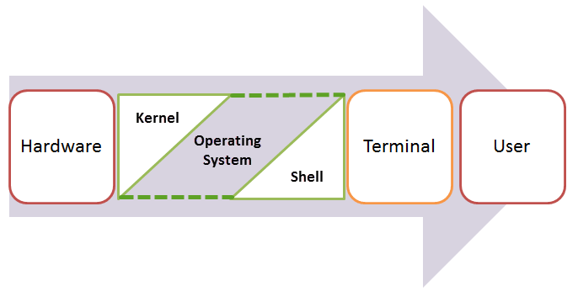
Kernel & Shell
An Operating System is made of many components, but its two prime components are:
Kernel
Shell

Slide 3
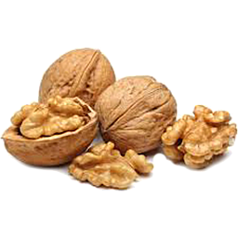
What is a Shell?
A Kernel is at the nucleus of a computer.
It makes the communication between the hardware and software possible.
While the Kernel is the innermost part of an operating system, a Shell is the outermost one.
A Shell in a Linux operating system takes input from you in the form of commands, processes it, and then gives an output.
It is the interface through which a user works on the programs, commands, and scripts.
A Shell is accessed by a Terminal which runs it.
When you run the Terminal, the Shell issues a command prompt (usually $), where you can type your input, which is then executed when you hit the Enter key.
The output or the result is thereafter displayed on the Terminal.
The Shell wraps around the delicate interior of an Operating System protecting it from accidental damage.
Hence the name Shell.

Slide 4
Types of Shell
There are two main shells in Linux:
1. The Bourne Shell: The prompt for this shell is $ and its derivatives are listed below:
POSIX shell also is known as sh
Korn Shell also knew as sh
Bourne Again SHell also knew as bash (most popular)
2. The C shell: The prompt for this shell is %, and its subcategories are:
C shell also is known as csh
Tops C shell also is known as tcsh
We will discuss bash shell based shell scripting in this lecture.

Slide 5
What is Shell Scripting?
Shell scripting is writing a series of command for the shell to execute.
It can combine lengthy and repetitive sequences of commands into a single and simple script, which can be stored and executed anytime.
This reduces the effort required by the end user.
Let us understand the steps in creating a Shell Script
Create a file using a vi editor(or any other editor). Name script file with extension .sh
Start the script with #! /bin/bash
Write some code.
Save the script file as filename.sh
For executing the script type bash filename.sh
"#!" is an operator called shebang which directs the script to the interpreter location.
So if we use"#! /bin/bash" the script gets directed to the bourne-shell.

Slide 6

Creating a small shell script
Let’s create a small script:
Create a new script file called scriptsample.sh: vi scriptsample.sh
Add the command ls’ after #!/bin/bash
#!/bin/bash
ls
Execute the script file: bash scriptsample.sh
Command 'ls' is executed when we execute the scriptsample.sh file.
Note: remember to set the execute permission for your script.

Slide 7
Another script example
Lets create a another shell script which says "Hello World“
Create a file (first.sh) as follows:
#!/bin/bash
# This is a comment!
echo Hello World # This is a comment, too!
#!/bin/bash
The first line tells Unix that the file is to be executed by /bin/bash. This is the standard location of the Bash shell on just about every Unix system.
# This is a comment!
The second line begins with a special symbol: #. This marks the line as a comment, and it is ignored completely by the shell.
The only exception is when the very first line of the file starts with #! - as ours does.
This is a special directive which Unix treats specially. It means that even if you are using csh, ksh, or anything else as your interactive shell, that what follows should be interpreted by the Bash shell.
#echo Hello World # This is a comment, too!
The third line runs a command: echo, with two parameters, or arguments - the first is "Hello"; the second is "World". The # symbol still marks a comment; the # and anything following it is ignored by the shell.

Slide 8
Add executing permissions to your script
now run chmod 755 (or chmod +x) first.sh to make the text file executable, and run ./first.sh.
Your screen should then look like this:
$ chmod 755 first.sh (or chmod +x first.sh or./first.sh)
$ ./first.sh (or sh first.sh or bash first.sh)
Hello World
$

Slide 9
Adding shell comments
Commenting is important in any form of programming.
In Shell programming, the syntax to add a comment is: #comment
Example:
Add a comment: # sample scripting
Shell executes only the command but it ignores the comment

Slide 10
What are Shell Variables?
Variables store data in the form of characters and numbers.
Similarly, Shell variables are used to store information and they can by the shell only.
For example, the following creates a shell variable and then prints it:
variable ="Hello"
echo $variable
Below is a small script which will use a variable:
#!/bin/bash
echo "what is your name?"
read name
echo "How do you do, $name?"
read remark
echo "I am $remark too!"

Slide 11
Steps to create and execute a script
These are the steps to create and execute a script:
Create a script (use the sample script in the previous slide)
Run the script file
Enter the input
Enter the remark
As you see, the program picked the value of the variable 'name' as Joy and 'remark' as excellent.
This is a simple script. You can develop advanced scripts which contain conditional statements, loops, and functions.

Slide 12
Summary:
Kernel is the nucleus of the operating systems, and it communicates between hardware and software
Shell is a program which interprets user commands through CLI like Terminal
The Bourne shell and the C shell are the most used shells in Linux
Shell scripting is writing a series of command for the shell to execute
Shell variables store the value of a string or a number for the shell to read
Shell scripting can help you create complex programs containing conditional statements, loops, and functions

