Slide 1
DSM2294 – Lecture 08
Linux – printer setup

Slide 2
Objectives
Set up, manage, and print to printers on a Linux system
Understand the purpose of log files and how they are administered

Slide 3
Printer Administration: The Common UNIX Printing System (1)
Common Unix Printing System (CUPS): most common printing system used on Linux
Print job: set of information sent to a printer at the same time
Can consist of a file, a set of files, or the output of a command
lp command: sends a print job to a printer

Slide 4
Printer Administration: The Common UNIX Printing System (2)
cups daemon (cupsd): backend process responsible for printing in CUPS printing system
Print job ID: print job’s unique identifier
Assigned by cupsd
Print queue: directory holding print jobs waiting to be printed
Typically /var/spool/cups

Slide 5
Printer Administration: The Common UNIX Printing System (3)
Printer can accept or reject request to print
If rejected, CUPS gives an error message
Spooling or queuing: accepting print jobs into a print queue
Printing: sending print jobs from print queue to a printer
Occurs if the printer is enabled, cupsd removes copy of print job from the print queue.

Slide 6
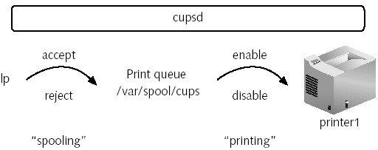
Printer Administration: The Common UNIX Printing System (4)
Figure 10-1: The print process

Slide 7
Printer Administration: The Common UNIX Printing System (5)
lpstat command: with –t (total) option, lists all printers and their status
cupsaccept, cupsreject, cupsenable, and cupsdisable commands: manipulate status of a printer
-r option: used to specify reason for cupsdisable and cupsreject commands

Slide 8
Managing Print Jobs (1)
lp –d command: print to a specified printer
If –d option omitted, prints to default printer
lpoptions –d command: set default printer
Each user can set his own default printer
Add name of the default printer to .lpoptions file in home directory
Use PRINTER or LPDEST variable

Slide 9
Managing Print Jobs (2)
lp command accepts information from stdin
lpstat command can list print jobs in queue for a printer
cancel command: remove print jobs from print queue
Receives print job IDs as arguments
-u option: remove all the jobs sent by specified user
lpadmin command: perform printer administration
e.g., restrict specific user access to specific printers

Slide 10
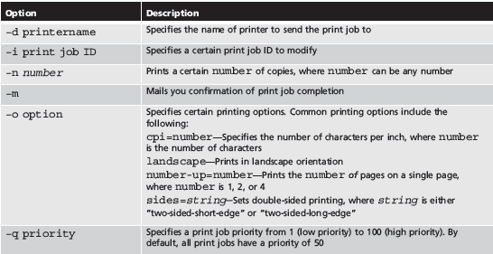
Managing Print Jobs (3)
Table 10-1: Common options to the lp command

Slide 11
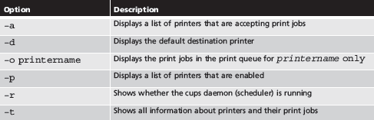
Managing Print Jobs (continued)
Table 10-2: Common options to the lpstat command

Slide 12
The LPD Printing System
Line Printer Daemon (LPD): printing system used on older Linux systems
lpr command: send documents to a print queue
lpc command: view status of printers
lpq command: view print jobs in print queue
lprm command: remove print jobs
CUPS contains versions of the lpr, lpc, lpq, and lprm commands

Slide 13
Configuring Printers (1)
/etc/cups/cupsd.conf: contains cupsd settings
/etc/cups/printers.conf: contains each printer’s configuration information
Printer Configuration tool: used to edit printer and cupsd setting files and thus configure printers
Activated using the system-config-printer command in a desktop environment
e.g., add new printers

Slide 14
Configuring Printers (2)
For local printers that do not support PnP, must specify the Uniform Resource Identifier (URI) for the device
Within Printer Configuration tool you can:
Give a printer a name to identify it within programs and commands
Specify printer location and description
Modify printer properties
Manage the status of the printer, share it using IPP, choose an error action, and configure banner pages

Slide 15
Configuring Printers (3)
To apply standard printer properties to several printers on a system, create printer class
Apply the properties to the printer class
Printer Configuration tool allows configuration of the properties of CUPS daemon
Add shared network printers
Share printers on the system
Remotely create and manage printers

Slide 16
Log File Administration (1)
Log file: file containing system information
Typically recorded during daemon activity
Information includes error messages
/var/log: contains most log files
Many programs store log files in subdirectories

Slide 17
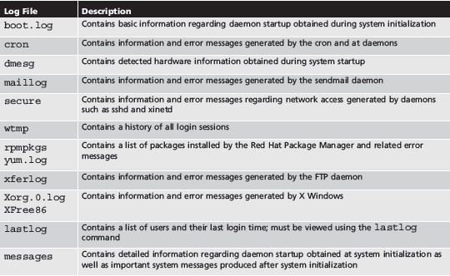
Log File Administration (2)
Table 10-3: Common Linux log files found in /var/log

Slide 18
The System Log Daemon
System log daemon (syslogd): central handling of logging system events
Creates /dev/log socket for system processes to write to
Writes to appropriate log file using /etc/rsyslog.conf file
Entries indicate facility and priority
Facility: area of system that information is gathered from
Priority: importance of system information

Slide 19
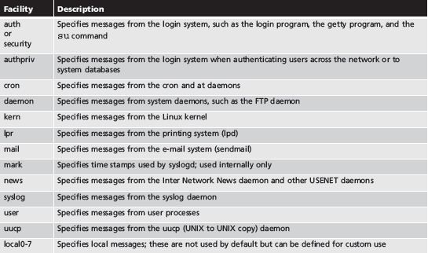
The System Log Daemon (continued)
Table 10-4: Facilities used by the System Log Daemon

Slide 20
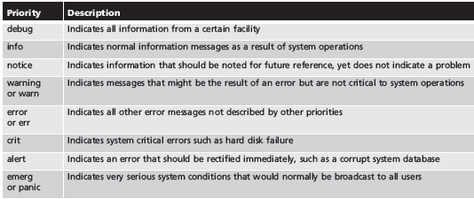
The System Log Daemon (continued)
Table 10-5: Priorities used by the log daemon

Slide 21
Managing Log Files (1)
Log files can take up unnecessary space
Clear contents occasionally
Print copy for records
Use > redirection symbol to clear log file
Use cron daemon for repetitive clearing
Do not remove log files
Permissions and ownership will be removed

Slide 22
Managing Log Files (2)
logrotate command: back up and clear log files
Compress old log files and save under new name
/etc/logrotate.conf: used by logrotate utility
Specifies rotation parameters for log files

