Slide 1
DSM2294 Lecture 09
Linux & Networking – lan technologies

Slide 2
LAN Technology Options
Ethernet (up to 10 Mbps)
Fast Ethernet (up to 100 Mbps)
Gigabit Ethernet (up to 1 Gbps)
10 Gig Ethernet (up to 10 Gbps)
WLAN – similar to Ethernet but uses radio waves instead of cables

Slide 3
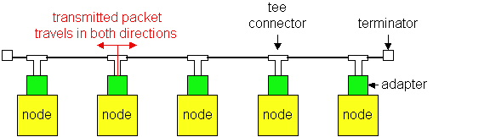
Media Access
Ethernet and Wi-Fi are both “multi-access” technologies
Broadcast medium, shared by many hosts
Simultaneous transmissions will result in collisions
Media Access Control (MAC) protocol required
Rules on how to share medium
The Data Link Layer is divided into two Part MAC Media Access Control) Sublayer and LLC (Logic Link Control) Sublayer

Slide 4
802.3 Ethernet
Carrier-sense multiple access with collision detection (CSMA/CD).
CS = carrier sense
MA = multiple access
CD = collision detection
Base Ethernet standard is 10 Mbps.
100Mbps, 1Gbps, 10Gbps standards came later

Slide 5
Ethernet CSMA/CD
CSMA/CD (carrier sense multiple access with collision detection) media access protocol is used.
Data is transmitted in the form of packets.
Sense channel prior to actual packet transmission.
Transmit packet only if channel is sensed idle; else, defer the transmission until channel becomes idle.
After packet transmission is started, the node monitors its own transmission to see if the packet has experienced a collision.
If the packet is observed to be undergoing a collision, the transmission is aborted and the packet is retransmitted after a random interval of time using Binary Exponential Backoff algorithm.

Slide 6
Ethernet Address
End nodes are identified by their Ethernet Addresses (MAC Address or Hardware Address) which is a unique 6 Byte address.
MAC Address is represented in Hexa Decimal format
e.g 00:05:5D:FE:10:0A
The first 3 bytes identify a vendor (also called prefix) and the last 3 bytes are unique for every host or device

Slide 7

Ethernet Frame Structure
Preamble:
7 bytes with pattern 10101010 followed by one byte with pattern 10101011
Used to synchronize receiver, sender clock rates
Addresses: 6 bytes, frame is received by all adapters on a LAN and dropped if address does not match
Length: 2 bytes, length of Data field
CRC: 4 bytes generated using CR-32, checked at receiver, if error is detected, the frame is simply dropped
Data Payload: Maximum 1500 bytes, minimum 46 bytes
If data is less than 46 bytes, pad with zeros to 46 bytes

Slide 8
Ethernet Wiring Standards
Physical Media:
10 Base 5 (Thicknet) – Thick Co-axial Cable with Bus Topology
10 Base 2 (Thinnet) – Thin Co-axial Cable with Bus Topology
10 Base T (UTP) – UTP Cat 3/5 with Tree Topology
10 Base FL (Fiber) – Multimode/Singlemode Fiber with Tree Topology
Maximum Segment Length
10 Base 5 – 500 m with at most 4 repeaters (Use Bridge to extend the network)
10 Base 2 – 185 m with at most 4 repeaters (Use Bridge to extend the network)
10 Base T – 100 m with at most 4 hubs (Use Switch to extend the network)

Slide 9
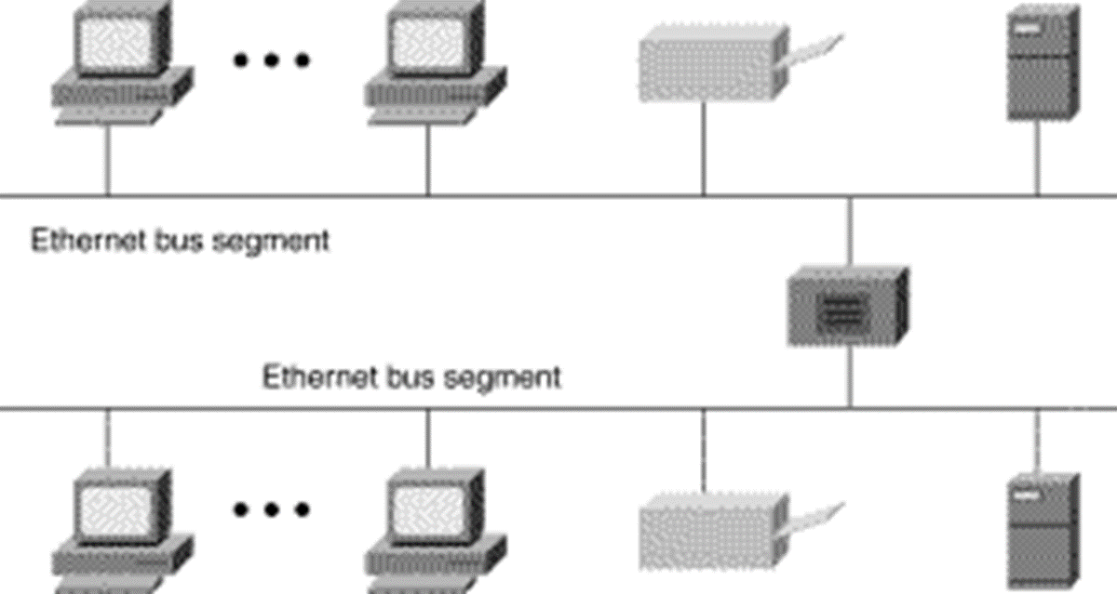
Ethernet BUS Topology

Slide 10
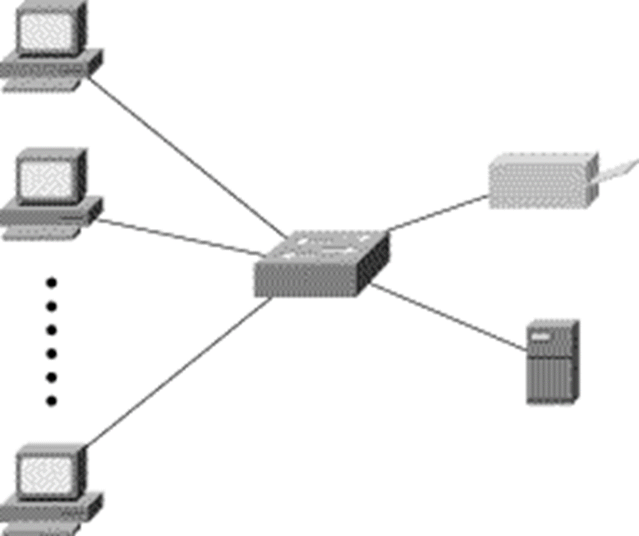
Ethernet STAR Topology

Slide 11
Fast Ethernet
100 Mbps bandwidth
Uses same CSMA/CD media access protocol and packet format as in Ethernet.
100BaseTX (UTP) and 100BaseFX (Fiber) standards
Physical media :-
100 BaseTX - UTP Cat 5e
100 BaseFX - Multimode / Singlemode Fiber
Full Duplex/Half Duplex operations.

Slide 12
Fast Ethernet
Provision for Auto-Negotiation of media speed: 10 Mbps or 100Mbps (popularly available for copper media only).
Maximum Segment Length
100 Base TX - 100 m
100 Base FX - 2 Km (Multimode Fiber)
100 Base FX - 20 km (Singlemode Fiber)

Slide 13
Gigabit Ethernet
1 Gbps bandwidth.
Uses same CSMA/CD media access protocol as in Ethernet and is backward compatible (10/100/1000 modules are available).
1000BaseT (UTP), 1000BaseSX (Multimode Fiber) and 1000BaseLX (Multimode/Singlemode Fiber) standards.
Maximum Segment Length
1000 Base T - 100m (Cat 5e/6)
1000 Base SX - 275 m (Multimode Fiber)
1000 Base LX - 512 m (Multimode Fiber)
1000 Base LX - 20 Km (Singlemode Fiber)
1000 Base LH - 80 Km (Singlemode Fiber)

