Slide 1
DTP3033n Technopreneurship
Topic 2: Raising Capital

Slide 2
Learning outcome
Identify the types of funds.
Create required cash flow.
Identify the documents for requesting the financial aid.

Slide 3
Types of Fund- Recap
GOVERNMENT FUNDING SCHEMES
STARTUP INCUBATORS

Slide 4
Raising Capital
Investor gives funds to assist with starting, growing, and managing day-to-day operations.
Forms of financial sources are represented by:
Bank loan
Crowdfunding
people pool their money together, in order to invest in and support efforts initiated by other people or organizations.
Venture capital -
type of financing that investors provide to startup companies/small businesses that are believed to have long-term growth potential.
well-off investors, investment banks, and any other financial institutions.
Business Angels
individual who provides capital for a business start-up
Friends and Family
Self-funding

Slide 5
Government Grants For SME Malaysia
Soft Loan Schemes for Services Sector
start-up enterprises and service sectors who want to enhance their services to higher value.
4% per annum for SMEs and not exceeding RM5 million.
Soft Loan for SMEs
start-up enterprises and existing companies
financial minimum amount is RM 50,000, but the interest rate is 4% per annum yearly.
Project: RM5 millions (maximum)
Tabung Usahawan Siswazah (TUS)
funding for start-up is usually between RM 20,000 to RM 250, 000. Interest rate of the borrowers’ repayment is 4% within ten years given.
Young Entrepreneur Fund
to help the young entrepreneurs to start their new business and fulfil the needs for their existing enterprises.
financials are limited to the range of RM20, 000 to RM100, 000, but gain the net profit rate around 5% per annum.

Slide 6
Government Grants For SME Malaysia
Tabung Pembangunan Pengangkutan Awam (TPPA)
provide a fund loan for the public transportation business including the commercial bus and taxi operators in Malaysia.
varies from RM30, 000 to RM 10 millions.
Business Start-up Fund (BSF)
to help fund new start-up technology-based companies, following to match their main objectives.
fund raising to these companies with the amount up to RM5 million or 90% of total cost of project.
TEKUN Financing
to provide a loan fund or programme to aid youths who get involved in Farming and Agro-based Industries.
Small Loan Scheme (SPK) – RM10, 000 until RM 50, 000.
Medium Loan Scheme (SPS) – RM50, 000 until RM 100, 000.

Slide 7
Cash Flow
Cash flows originate from operating, investing, and financing activities.
Cash flow is the money that is moving (flowing) in and out of your business in a month.
Received
customers or clients who are buying your products or services.
Spending
in the form of payments for expenses, like rent or a mortgage, in monthly loan payments, and in payments for taxes and etc

Slide 8
Cash Flow
Developed to focus on inflows and outflows on a cash basis.
Cash inflows are
Revenues,
Gains,
Investment by Owners,
Increases in Operating Liabilities (money a business owes to a person or an entity for an expense necessary for it run effectively. This may include employee salaries, unpaid supplies, and other accounts payable)
Increases in Financing Liabilities. (debt payable and interest payable)
cash outflows are
Expenses,
Losses,
Distributions to Owners,
Increases in Operating Assets,
Increases in Investing Assets

Slide 9
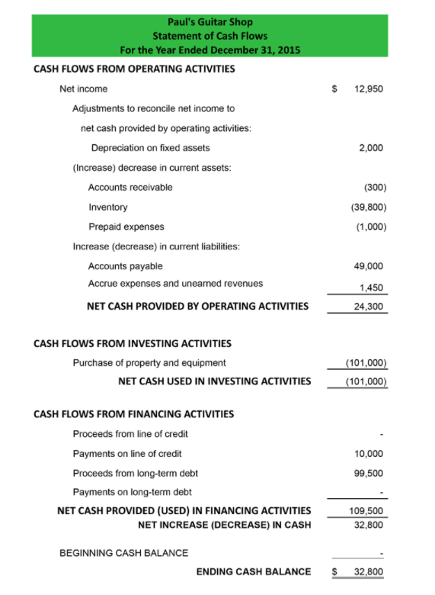
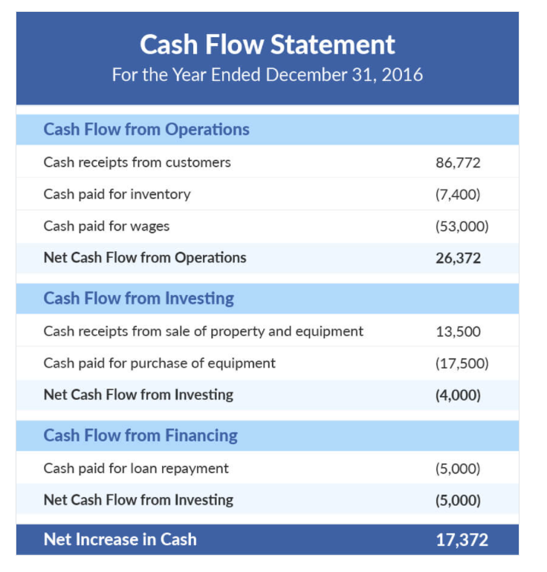
Examples

Slide 10
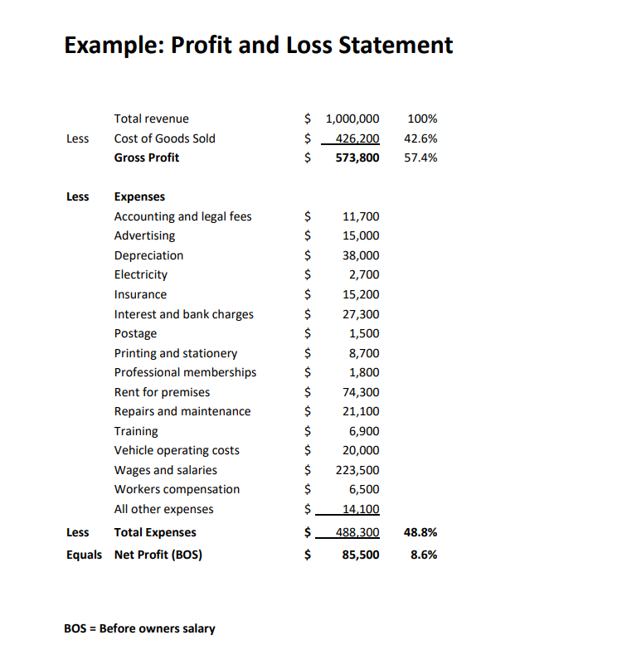
Examples

Slide 11
Related documents for the financial aid
Depends:
SSM registration form
6 months' company bank statements
Income tax documents for borrowers
Borrower's IC copy
Pictures of office or business operations

Slide 12
CONCLUSION / SUMMARY

