Slide 1
DTP3033N Technopreneurship
Topic 5: Financial

Slide 2
Learning outcome
Define financial management.
Examine financial planning.
Describe usefulness on the financial statement.
Create a balance sheet.

Slide 3
Financial Management

Slide 4

Good financial management will enable you to:
Monitor the operational health of your company
Plan for growth or shortfalls

Slide 5
Financial Management
Means
planning,
organizing,
directing and
controlling the financial activities such as procurement and utilization of funds of the enterprise.

Slide 6
Conti…
Is the use of tools to reflect the financial health of a business
Enables you to plan the future financial performance for capital, assets, and personnel requirements.
To ensure regular and adequate supply of funds to the concern.

Slide 7
Examine Financial Management

Slide 8
Components of working capital
Item | Description
1. Cash | Usually marketable securities or short-term certificate of deposit.
2. Accounts Receivable | Monies owed by clients.
3. Inventories | Stock at hand often makes up about 50% or more of a firm's current assets.
4. Accounts Payable and Trade Notes Payable | Trade credit is often a major source of financing for the firm. The amount of money owed to suppliers should be reasonable in relation to purchases.
5. Notes Payable | Notes payable to banks or other lenders are a second major source of financing for the business. Keep a check on the amount of bank borrowing employed and make sure that the debt amount is reasonable in relation to the equity financing of the firm.
6. Accrued (increase) Expenses and Taxes Payable | These are obligations of the firm as of the date of balance sheet preparation. Accrued expenses are items such as salaries, interest payments on bank notes, insurance premiums and similar items.

Slide 9
usefulness of Financial Management

Slide 10
The Importance of A Financial Plan
To determine the amount money to be invested-the project cost
To identify and propose the relevant sources of fund.
To ensure that the initial capital is sufficient.
To appraise the viability before actual investment is committed.
As a guideline for implementation.

Slide 11
What are the Tools of Financial Planning?
Basic Financial Statements:
Balance Sheet
Income Statement
Ratio Analysis
Individual business performance is compared to similar businesses in the same category
The Pro Forma Statement of Income
To forecast future profitability
Break-Even Analysis
To calculate at which point your product stops costing you money and starts to generate profit
The Cash Flow Statement
Shows the flow of cash in and out of the business
Pricing formulas and policies
To calculate profitable selling prices for products and services
Short- and long-term planning

Slide 12
Sources of Financial Information
Financial information is gathered through budgets.
Operational budget
Administrative budget
Marketing budget
Production budget

Slide 13
Sources of Financial Information
Financial budget
Project implementation cost
Sources of fund
Projected cash flow statements
Projected profit & loss statements
Projected balance sheet statements

Slide 14
Steps in Financial Management

Slide 15
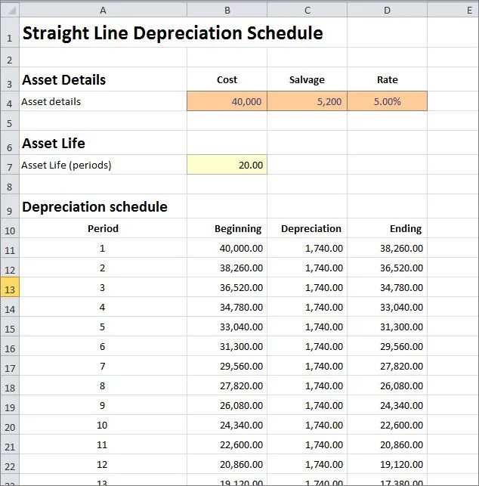
Steps in Preparing a Financial Plan
Step 1:
Prepare the project implementation cost schedule
Prepare table of depreciation for each fixed asset owned or purchased by the company
A depreciation schedule is a table that shows you how much each of your assets will be depreciated over the years.

Slide 16
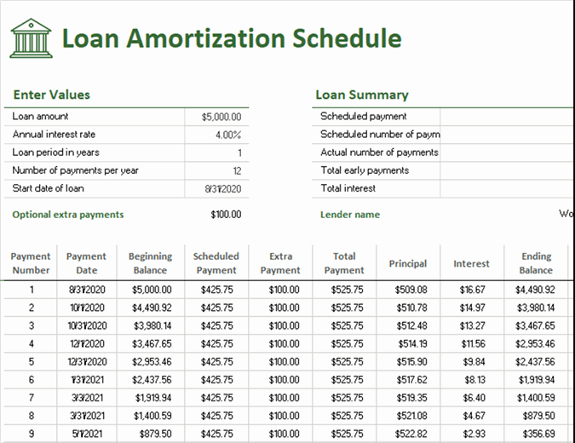
Steps in Preparing a Financial Plan
Step 2:
Prepare the sources of fund to finance the project cost.
Prepare a loan amortization schedule for term loan
Prepare a hire-purchase repayment schedule if hire-purchase financing is used.

Slide 17
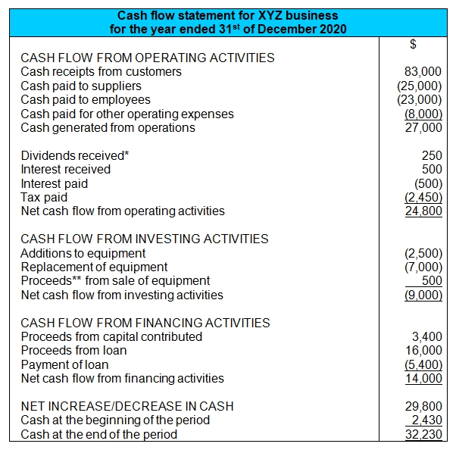
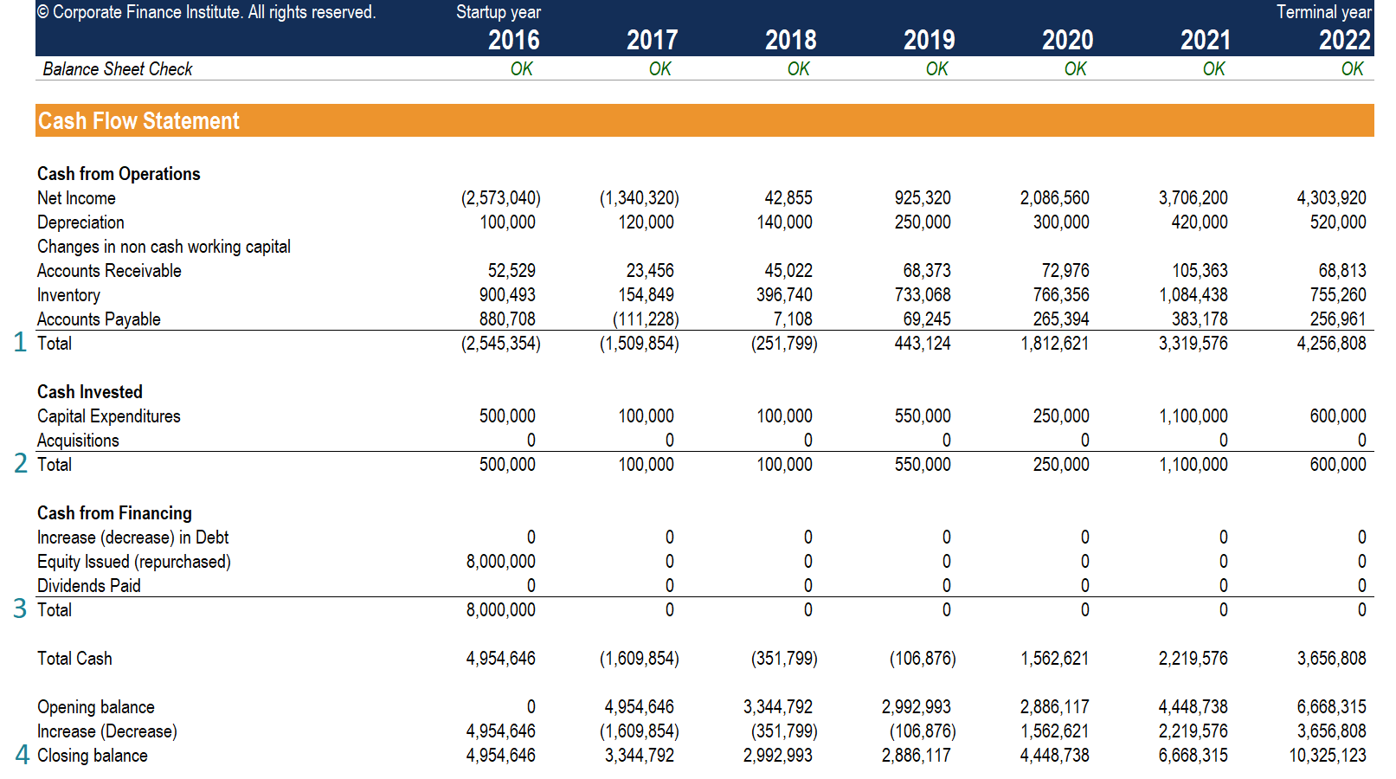
Steps in Preparing a Financial Plan
Step 3:
Prepare the projected cash-flow statements (for 3 years)
For year 1 –monthly
For year 2 and 3 – annually

Slide 18
Steps in Preparing a Financial Plan
Step 4:
Prepare projected trading, profit & loss statements (for 3 years)
For manufacturing companies, include manufacturing accounts.

Slide 19
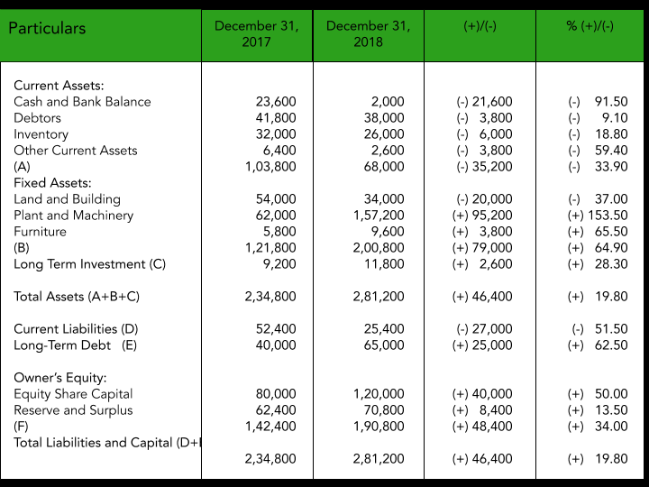
Steps in Preparing a Financial Plan
Step 5:
Prepare projected balance sheet statements (for 3 years)
Step 6:
Perform relevant financial analysis based on the projected financial statements.

Slide 20
Project Implementation Cost
Project implementation cost refers to the total costs (short & long term costs) needed to implement the proposed business/project.
Long-term costs refer to capital expenditure required to buy fixed assets (ex: land, building, machinery, equipment, furniture and vehicle)
Short-term costs refer to expenditure to finance day-to-day operation of the business (ex: raw materials/inventory, wages & salaries utilities and other overheads.

Slide 21
Elements in Project Cost Schedule
Capital Expenditure
Land
Building
Renovation
Machinery & Equipment
Furniture & Fixtures
Vehicle
Working Capital (xx month)
Administrative
Marketing
Operation

Slide 22
Elements in Project Cost Schedule
Pre-operational costs
Business registration & licenses
Legal fees
Road tax & insurance
Stamp duties etc.
Deposits
Rental
Utilities
Provision for contingencies
2-5 percent

Slide 23
Examples

Slide 24
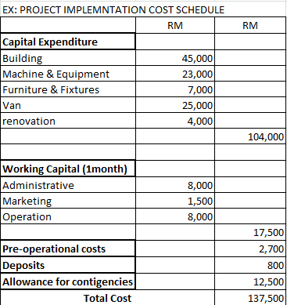
Example: Project Implementation Cost Schedule

Slide 25
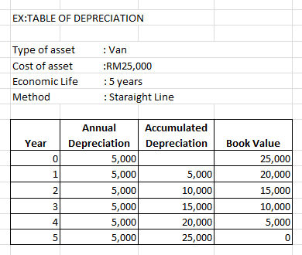
Example: Table of Depreciation

Slide 26
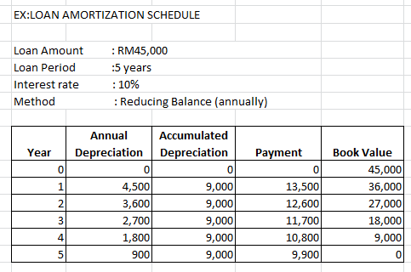
Example: Loan Amortization Schedule

Slide 27
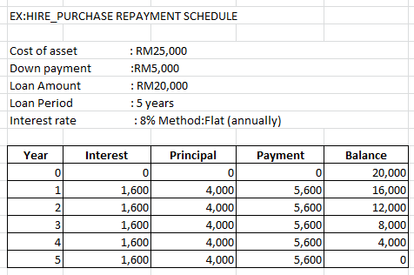
Example: Hire-purchase Repayment Schedule

Slide 28
Balance Sheet-in Detail
Describes a company’s financial position (types and amounts of assets, liabilities and equity) at a point in time.

Slide 29
Balance Sheet Pro-forma Statements
It is projected statement which shows the financial position of the company at a specific point in time in terms of assets owned and how those assets are financed.
Projected statements are presented for the period of 3 years.

Slide 30
Elements in A Balance Sheet
Fixed Assets
List all fixed assets at its book value (Cost-Accumulated depreciation)
Current Assets
List all current assets (e.g.cash, stocks, account receivables, deposits etc.)
Equity
Equity contribution (cash+assets) plus net profit (accumulated)
Long-term Liabilities
Term-loan (year end balance)
Hire-purchase (year end balance)

Slide 31
Elements in Cash Flow Statement
Cash Inflows
Equity –cash only
Term loan
Cash sales
Collection of receivables
Sales of asset

Slide 32
Elements in Cash Flow Statement
Cash Outflows
Operational expenditure
Marketing expenditure
Administrative expenditure
Loan repayment
Hire-purchase repayment
Purchase of fixed assets
Pre-operational expenses
Miscellaneous expenses

Slide 33
Elements in Cash Flow Statement
Cash Surplus or Deficit
Inflows > Outflows = Surplus (+)
Inflows < Outflows = Deficit (-)
Cash Position
Beginning cash + Surplus / (- Deficit) =Ending cash
(Note: The ending cash balance for a particular month becomes the beginning balance for the next consecutive month)

Slide 34
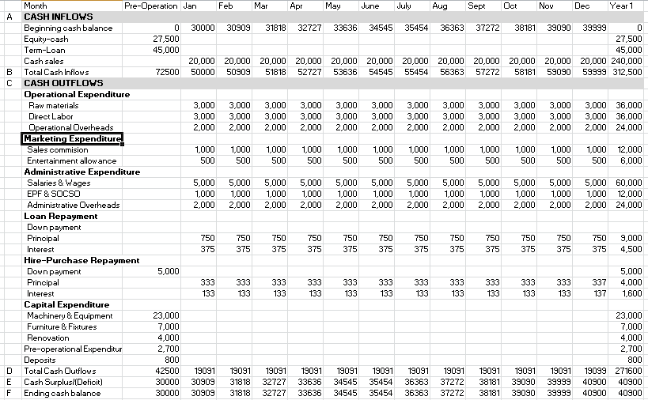
Example of Cash Flow
Prepare for 3 years in another table

Slide 35
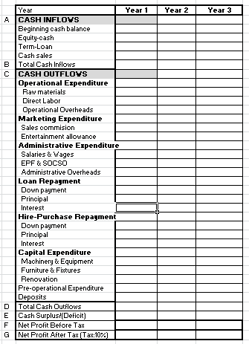
Example: Cash Flow for 3 years

Slide 36
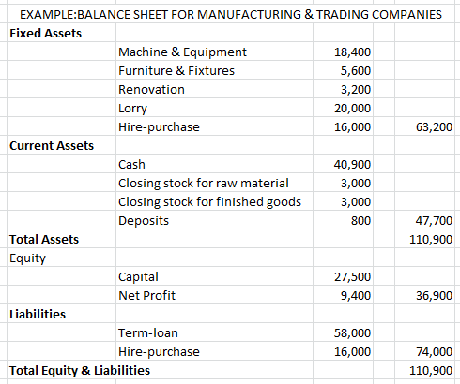
Example: Balance Sheet for Manufacturing & Trading

Slide 37
Sample of Balance Sheet
Assets | RM
Current Assets Cash On Hand Cash at Bank Accounts Receivable Merchandise Inventory Prepaid Expenses Rent Total Current Assets | 300 2,200 1,600 5,500 1,200 10,800
Fixed Assets Equipment and Fixtures (less Depreciation) Total Assets | 1,200 12,000
Liabilities Current Liabilities Accounts Payable Notes Payable, Bank Accrued Payroll Expenses Total Current Liabilities | 1,100 2,200 500 3,800
Long-Term Liabilities Notes Payable Total Liabilities Net Worth* Total Liabilities and Net Worth | 5,500 9,300 2,700 12,000
*Net Worth = Total Assets – Total Liabilities

Slide 38
Profit & Loss Statement
Net Sales - Cost of Goods Sold e.g. 12,000 – 7,000 | = Gross Margin = 5,000
Gross Margin - Selling and Administrative Expense e.g. 5,000 – 2,000 | = Net Operating Profit = 3,000
Net Operating Profit + Other Income - Other Expense e.g. 3,000 + 1,000 – 500 | = Net Profit before Taxes = 3,500
Net Profit before Taxes - Income Taxes e.g. 3,500 – 350 | = Net Profit (or Net Loss) = 3,150

Slide 39
Task

Slide 40
Relate to Your Company
List items for your cash flow statement.

Slide 41
Task 2

Slide 42
Question
Create estimated budget to purchase necessities such as equipment, software, utilities and etc.
- Create in Excel or .doc and share file

Slide 43
CONCLUSION / SUMMARY

