Slide 1

INTRODUCTION TO ARTIFICIAL INTELLIGENCE
1

Slide 2
LEARNING OBJECTIVES
AT THE END OF THE COURSE, STUDENTS WILL BE ABLE TO:
CO1: DEMONSTRATE FUNDAMENTAL UNDERSTANDING OF THE
HISTORY OF (AI) AND ITS FOUNDATIONS
CO2: APPLY BASIC PRINCIPLES OF AI IN SOLUTIONS THAT REQUIRE PROBLEM SOLVING, INFERENCE, PERCEPTION, KNOWLEDGE REPRESENTATION AND LEARNING.
CO3: DEMONSTRATE PROFICIENCY DEVELOPING APPLICATIONS IN AN AI LANGUAGE, EXPERT SYSTEM SHELL OR DATA MINING TOOL
CO4: EXPLAIN PROFICIENCY IN APPLY SCIENTIFIC METHOD TO
MODELS OF MACHINE LEARNING.
2

Slide 3
UNCERTAINTY
LET ACTION A_{T} = LEAVE FOR AIRPORT T MINUTES BEFORE FLIGHT. WILL A_{T} GET ME THERE ON TIME?
PROBLEMS:
PARTIAL OBSERVABILITY (ROAD STATE, OTHER DRIVERS' PLANS, ETC.)
NOISY SENSORS (TRAFFIC REPORTS)
UNCERTAINTY IN ACTION OUTCOMES (FLAT TIRE, ETC.)
IMMENSE COMPLEXITY OF MODELING AND PREDICTING TRAFFIC
HENCE A PURELY LOGICAL APPROACH EITHER
RISKS FALSEHOOD: “A₂₅ WILL GET ME THERE ON TIME”, OR
LEADS TO CONCLUSIONS THAT ARE TOO WEAK FOR DECISION MAKING:
“A₂₅ WILL GET ME THERE ON TIME IF THERE'S NO ACCIDENT ON THE
BRIDGE AND IT DOESN'T RAIN AND MY TIRES REMAIN INTACT ETC ETC.”
(A₁₄₄₀ MIGHT REASONABLY BE SAID TO GET ME THERE ON TIME BUT I'D HAVE TO STAY OVERNIGHT IN THE AIRPORT …)

Slide 4
METHODS FOR HANDLING UNCERTAINTY
DEFAULT OR NONMONOTONIC LOGIC:
ASSUME MY CAR DOES NOT HAVE A FLAT TIRE
ASSUME A₂₅ WORKS UNLESS CONTRADICTED BY EVIDENCE
ISSUES: WHAT ASSUMPTIONS ARE REASONABLE? HOW TO HANDLE CONTRADICTION?
RULES WITH FUDGE FACTORS (CONSTANT):
A₂₅ |→_{0.3} GET THERE ON TIME
SPRINKLER |→ _{0.99} WETGRASS
WETGRASS |→ _{0.7} RAIN
ISSUES: PROBLEMS WITH COMBINATION, E.G., SPRINKLER CAUSES RAIN??
PROBABILITY
MODEL AGENT'S DEGREE OF BELIEF
GIVEN THE AVAILABLE EVIDENCE,
A₂₅ WILL GET ME THERE ON TIME WITH PROBABILITY 0.04

Slide 5
OUR STATUS
WE’RE DONE WITH:
SECTION 1: THEORY, SEARCH AND PLANNING!
SECTION 2: MACHINE LEARNING
SECTION 3: PROBABILISTIC REASONING
DIAGNOSIS
SPEECH RECOGNITION
TRACKING OBJECTS
ROBOT MAPPING
GENETICS
ERROR CORRECTING CODES
… LOTS MORE!

Slide 6

PROBABILITY

Slide 7
TODAY
PROBABILITY
RANDOM VARIABLES
JOINT AND MARGINAL DISTRIBUTIONS
CONDITIONAL DISTRIBUTION
PRODUCT RULE, CHAIN RULE, BAYES’ RULE
INFERENCE
INDEPENDENCE
YOU’LL NEED ALL THIS STUFF A LOT FOR THE NEXT FEW LESSONS, SO MAKE SURE YOU GO OVER IT NOW!

Slide 8
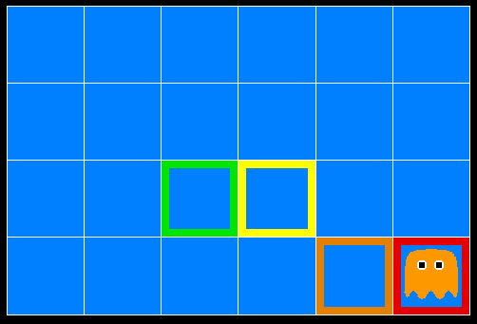
INFERENCE IN GHOSTBUSTERS
A GHOST IS IN THE GRID SOMEWHERE
SENSOR READINGS TELL HOW CLOSE A SQUARE IS TO THE GHOST
ON THE GHOST: RED
1 OR 2 AWAY: ORANGE
3 OR 4 AWAY: YELLOW
5+ AWAY: GREEN
Sensors are noisy, but we know P(Color | Distance)
P(red | 3) | P(orange | 3) | P(yellow | 3) | P(green | 3)
0.05 | 0.15 | 0.5 | 0.3

Slide 9
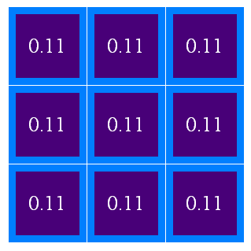
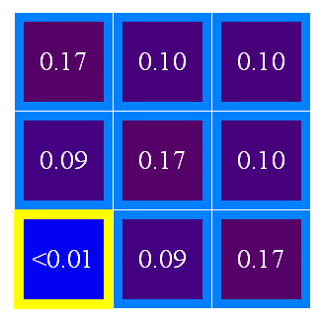
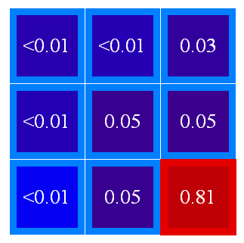
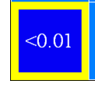
UNCERTAINTY
GENERAL SITUATION:
OBSERVED VARIABLES (EVIDENCE): AGENT KNOWS CERTAIN THINGS ABOUT THE STATE OF THE WORLD (E.G., SENSOR READINGS OR SYMPTOMS)
UNOBSERVED VARIABLES: AGENT NEEDS TO REASON ABOUT OTHER ASPECTS (E.G. WHERE AN OBJECT IS OR WHAT DISEASE IS PRESENT)
MODEL: AGENT KNOWS SOMETHING ABOUT HOW THE KNOWN VARIABLES RELATE TO THE UNKNOWN VARIABLES
PROBABILISTIC REASONING GIVES US A FRAMEWORK FOR MANAGING OUR BELIEFS AND KNOWLEDGE

Slide 10
RANDOM VARIABLES
A RANDOM VARIABLE IS SOME ASPECT OF THE WORLD ABOUT
WHICH WE (MAY) HAVE UNCERTAINTY
R = IS IT RAINING?
T = IS IT HOT OR COLD?
D = HOW LONG WILL IT TAKE TO DRIVE TO WORK?
L = WHERE IS THE LOCATION (GHOST)?
WE DENOTE RANDOM VARIABLES WITH CAPITAL LETTERS
LIKE VARIABLES IN A CSP, RANDOM VARIABLES HAVE DOMAINS
R IN {TRUE, FALSE}
T IN {HOT, COLD}
D IN [0, ∞)
(OFTEN WRITE AS {+R, -R})
L IN POSSIBLE LOCATIONS, MAYBE {(0,0), (0,1), …}

Slide 11
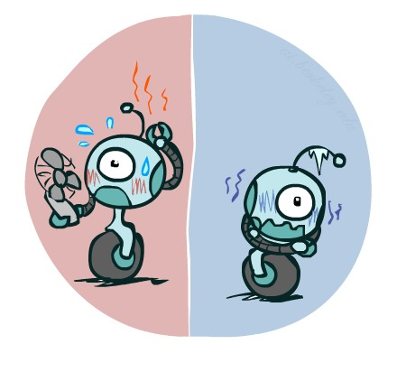

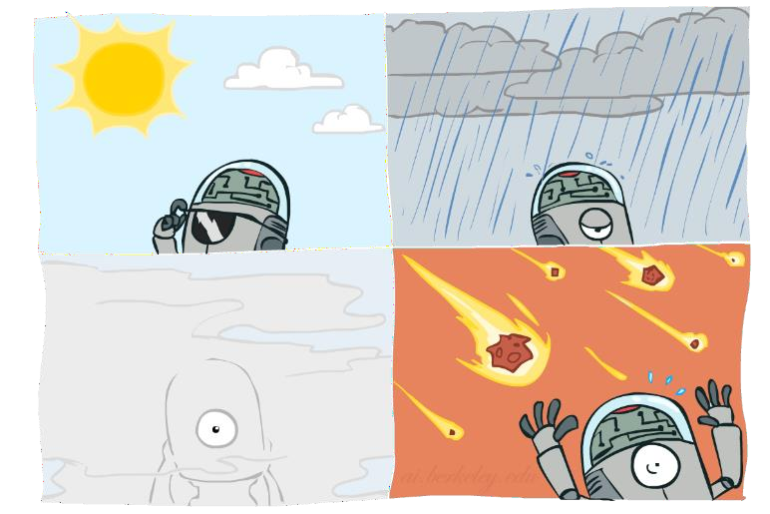

PROBABILITY DISTRIBUTIONS
ASSOCIATE A PROBABILITY WITH EACH VALUE
TEMPERATURE:
Weather:
W | P
sun | 0.6
rain | 0.1
fog | 0.3
meteor | 0.0
T | P
hot | 0.5
cold | 0.5

Slide 12

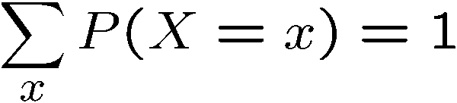

PROBABILITY DISTRIBUTIONS
UNOBSERVED RANDOM VARIABLES HAVE DISTRIBUTIONS
Shorthand notation:
OK if all domain entries are unique
T | P
hot | 0.5
cold | 0.5
W | P
sun | 0.6
rain | 0.1
fog | 0.3
meteor | 0.0
A DISTRIBUTION IS A TABLE OF PROBABILITIES OF VALUES
A PROBABILITY (LOWER CASE VALUE) IS A SINGLE NUMBER
MUST HAVE:
AND

Slide 13




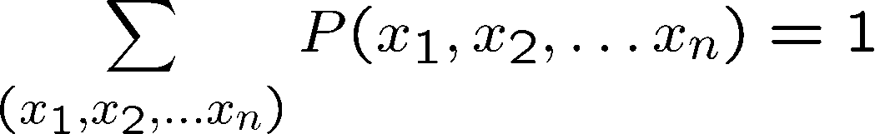
JOINT DISTRIBUTIONS
A JOINT DISTRIBUTION OVER A SET OF RANDOM VARIABLES: SPECIFIES A REAL NUMBER FOR EACH ASSIGNMENT (OR OUTCOME):
T | W | P
hot | sun | 0.4
hot | rain | 0.1
cold | sun | 0.2
cold | rain | 0.3
MUST OBEY:
SIZE OF DISTRIBUTION IF N VARIABLES WITH DOMAIN SIZES D?
FOR ALL BUT THE SMALLEST DISTRIBUTIONS, IMPRACTICAL TO WRITE OUT!

Slide 14
PROBABILISTIC MODELS
Distribution over T,W
A PROBABILISTIC MODEL IS A JOINT DISTRIBUTION OVER A SET OF RANDOM VARIABLES
T | W | P
hot | sun | 0.4
hot | rain | 0.1
cold | sun | 0.2
cold | rain | 0.3
PROBABILISTIC MODELS:
(RANDOM) VARIABLES WITH DOMAINS
ASSIGNMENTS ARE CALLED OUTCOMES
JOINT DISTRIBUTIONS: SAY WHETHER
ASSIGNMENTS (OUTCOMES) ARE LIKELY
NORMALIZED: SUM TO 1.0
IDEALLY: ONLY CERTAIN VARIABLES DIRECTLY INTERACT
Constraint over T,W
T | W | P
hot | sun | T
hot | rain | F
cold | sun | F
cold | rain | T
CONSTRAINT SATISFACTION PROBLEMS:
VARIABLES WITH DOMAINS
CONSTRAINTS: STATE WHETHER ASSIGNMENTS ARE POSSIBLE
IDEALLY: ONLY CERTAIN VARIABLES DIRECTLY INTERACT

Slide 15
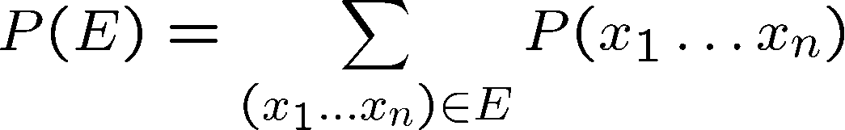
EVENTS
AN EVENT IS A SET E OF OUTCOMES
FROM A JOINT DISTRIBUTION, WE CAN CALCULATE THE PROBABILITY OF ANY EVENT
PROBABILITY THAT IT’S HOT AND SUNNY?
PROBABILITY THAT IT’S HOT?
PROBABILITY THAT IT’S HOT OR SUNNY?
T | W | P
hot | sun | 0.4
hot | rain | 0.1
cold | sun | 0.2
cold | rain | 0.3
TYPICALLY, THE EVENTS WE CARE ABOUT ARE PARTIAL ASSIGNMENTS, LIKE
P(T=HOT)

Slide 16

QUIZ: EVENTS
P(+x, +y) ?
X | Y | P
+x | +y | 0.2
+x | -y | 0.3
-x | +y | 0.4
-x | -y | 0.1
P(+x) ?
P(-y OR +x) ?

Slide 17
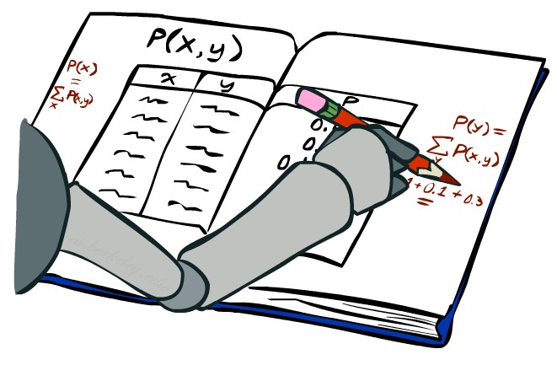
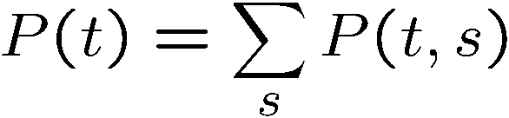
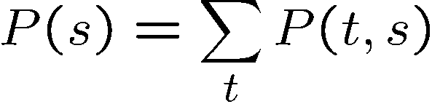
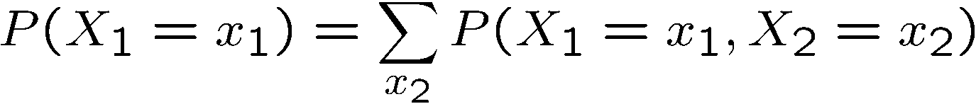
MARGINAL DISTRIBUTIONS
MARGINAL DISTRIBUTIONS ARE SUB-TABLES WHICH ELIMINATE VARIABLES
MARGINALIZATION (SUMMING OUT): COMBINE COLLAPSED ROWS BY ADDING
T | W | P
hot | sun | 0.4
hot | rain | 0.1
cold | sun | 0.2
cold | rain | 0.3
T | P
hot | 0.5
cold | 0.5
W | P
sun | 0.6
rain | 0.4

Slide 18


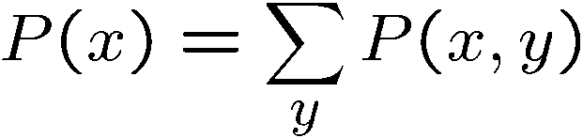

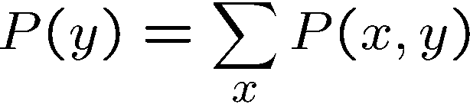
QUIZ: MARGINAL DISTRIBUTIONS
X | P
+x
-x
X | Y | P
+x | +y | 0.2
+x | -y | 0.3
-x | +y | 0.4
-x | -y | 0.1
Y | P
+y
-y

Slide 19
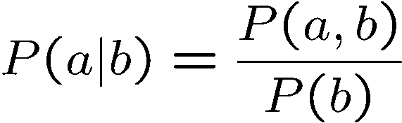
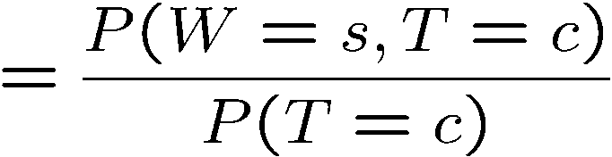
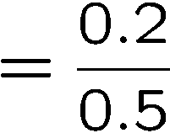



CONDITIONAL PROBABILITIES
A SIMPLE RELATION BETWEEN JOINT AND CONDITIONAL PROBABILITIES
IN FACT, THIS IS TAKEN AS THE DEFINITION OF A CONDITIONAL
P(a,b)
PROBABILITY
P(a)
P(b)
T | W | P
hot | sun | 0.4
hot | rain | 0.1
cold | sun | 0.2
cold | rain | 0.3

Slide 20
QUIZ: CONDITIONAL PROBABILITIES
P(+x | +y) ?
1/3
X | Y | P
+x | +y | 0.2
+x | -y | 0.3
-x | +y | 0.4
-x | -y | 0.1
P(-x | +y) ?
2/3
P(-y | +x) ?
3/5

Slide 21



CONDITIONAL DISTRIBUTIONS
CONDITIONAL DISTRIBUTIONS ARE PROBABILITY DISTRIBUTIONS OVER SOME VARIABLES GIVEN FIXED VALUES OF OTHERS
Conditional Distributions
Joint Distribution
W | P
sun | 0.8
rain | 0.2
T | W | P
hot | sun | 0.4
hot | rain | 0.1
cold | sun | 0.2
cold | rain | 0.3
W | P
sun | 0.4
rain | 0.6

Slide 22
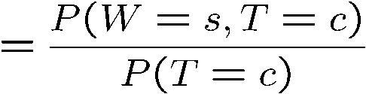

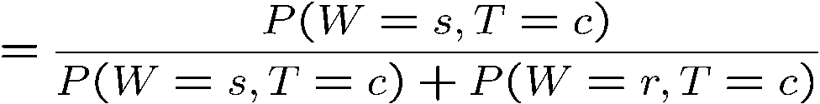
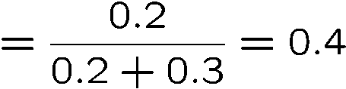

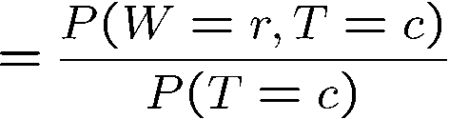

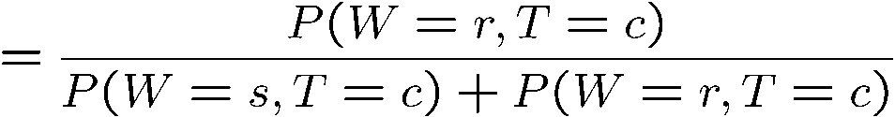
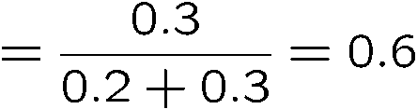
NORMALIZATION TRICK
T | W | P
hot | sun | 0.4
hot | rain | 0.1
cold | sun | 0.2
cold | rain | 0.3
W | P
sun | 0.4
rain | 0.6

Slide 23








NORMALIZATION TRICK
SELECT the joint probabilities matching the evidence
NORMALIZE the
selection
(make it sum to one)
T | W | P
hot | sun | 0.4
hot | rain | 0.1
cold | sun | 0.2
cold | rain | 0.3
T | W | P
cold | sun | 0.2
cold | rain | 0.3
W | P
Sun | 0.4
Rain | 0.6
Divide by
The sum of all probabilities of the sub distribution following the fact

Slide 24
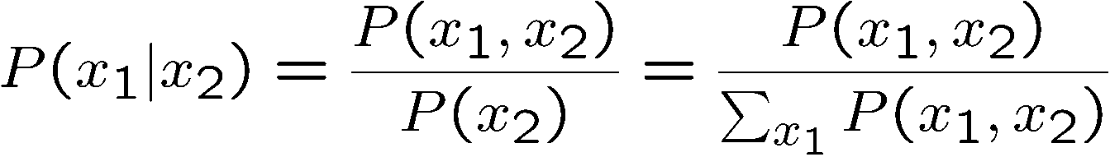
NORMALIZATION TRICK
SELECT the joint probabilities matching the evidence
NORMALIZE the
selection (make it sum to one)
T | W | P
hot | sun | 0.4
hot | rain | 0.1
cold | sun | 0.2
cold | rain | 0.3
T | W | P
cold | sun | 0.2
cold | rain | 0.3
W | P
sun | 0.4
rain | 0.6
WHY DOES THIS WORK? SUM OF SELECTION IS P(EVIDENCE)! (P(T=C), HERE)

Slide 25

QUIZ: NORMALIZATION TRICK
P(X | Y= -y) ?
SELECT the joint probabilities matching the evidence
NORMALIZE the
selection
(make it sum to one)
X | Y | P
+x | +y | 0.2
+x | -y | 0.3
-x | +y | 0.4
-x | -y | 0.1

Slide 26
TO NORMALIZE
(DICTIONARY) TO BRING OR RESTORE TO A NORMAL CONDITION
PROCEDURE:
STEP 1: COMPUTE Z = SUM OVER ALL ENTRIES
STEP 2: DIVIDE EVERY ENTRY BY Z
All entries sum to ONE
T | W | P
hot | sun | 20
hot | rain | 5
cold | sun | 10
cold | rain | 15
T | W | P
hot | sun | 0.4
hot | rain | 0.1
cold | sun | 0.2
cold | rain | 0.3
W | P
sun | 0.2
rain | 0.3
Normalize
W | P
sun | 0.4
rain | 0.6
Normalize
Z = 0.5
Z = 50

Slide 27
PROBABILISTIC INFERENCE
PROBABILISTIC INFERENCE: COMPUTE A DESIRED PROBABILITY FROM OTHER KNOWN PROBABILITIES (E.G. CONDITIONAL FROM JOINT)
WE GENERALLY COMPUTE CONDITIONAL PROBABILITIES
P(ON TIME | NO REPORTED ACCIDENTS) = 0.90
THESE REPRESENT THE AGENT’S BELIEFS GIVEN THE EVIDENCE
PROBABILITIES CHANGE WITH NEW EVIDENCE:
P(ON TIME | NO ACCIDENTS, 5 A.M.) = 0.95
P(ON TIME | NO ACCIDENTS, 5 A.M., RAINING) = 0.80
OBSERVING NEW EVIDENCE CAUSES BELIEFS TO BE UPDATED

Slide 28





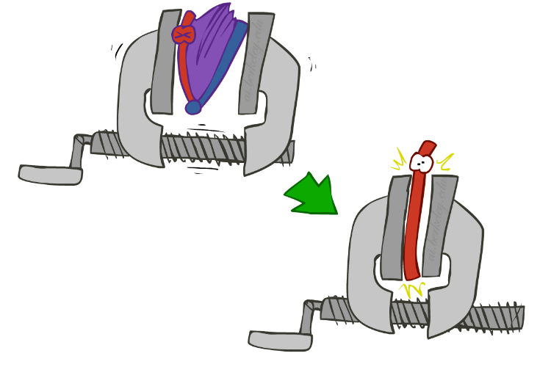
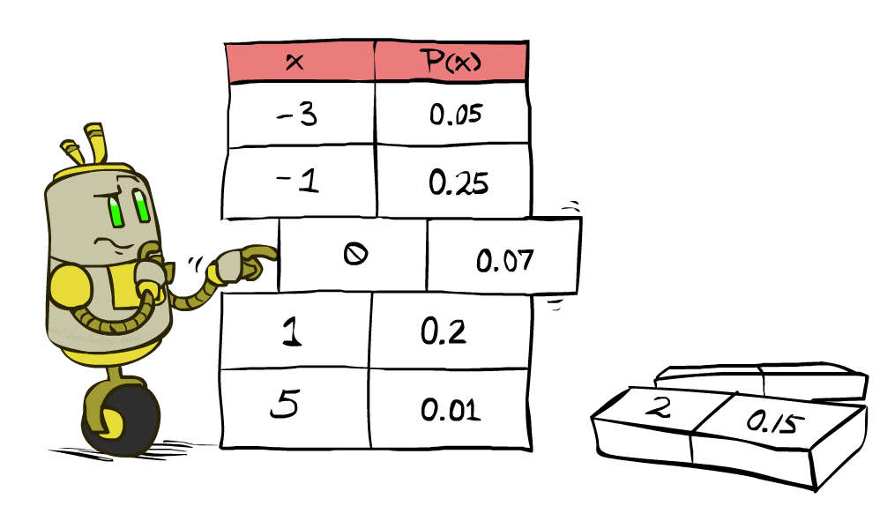

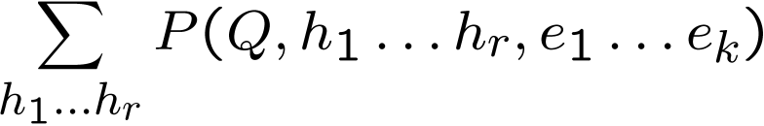
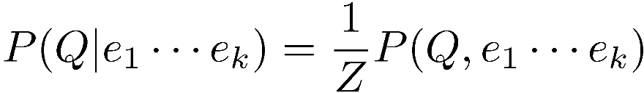

Inference by Enumeration
* Works fine with multiple query variables, too
General case:
Evidence variables:
Query* variable:
Hidden variables:
We want:
All variables
Step 1: Select the entries consistent with the evidence
Step 2: Sum out H to get joint of Query and evidence
Step 3: Normalize

Slide 29
INFERENCE BY ENUMERATION
W | P(W)
sun | 0.65
rain | 0.35
S | T | W | P
summer | hot | sun | 0.30
summer | hot | rain | 0.05
summer | cold | sun | 0.10
summer | cold | rain | 0.05
winter | hot | sun | 0.10
winter | hot | rain | 0.05
winter | cold | sun | 0.15
winter | cold | rain | 0.20
P(W)?
W | P (W, winter) | P (W|winter)
sun | 0.25 | 0.5
rain | 0.25 | 0.5
P(W | WINTER)?
W | P (W, winter, hot) | P (W|winter, hot)
sun | 0.1 | 0.67
rain | 0.05 | 0.33
P(W | WINTER, HOT)?

Slide 30
INFERENCE BY ENUMERATION
Obvious problems:
Worst-case time complexity O(d^{n})
Space complexity O(d^{n}) to store the joint distribution

Slide 31


THANK YOU

