Slide 1
BACHELOR OF COMPUTER SCIENCE
(HONS)

Slide 2
CAI3014-Introduction to Artificial Intelligence
21/09/2020
2
INTRODUCTION TO ARTIFICIAL INTELLIGENCE
CAI3014

Slide 3
LEARNING OBJECTIVES
CAI3014-Introduction to Artificial Intelligence
21/09/2020
3
At the end of the course, students will be able to:
CO1: Demonstrate fundamental understanding of the history of (AI) and its foundations
CO2: Apply basic principles of AI in solutions that require problem solving, inference, perception, knowledge representation and learning.
CO3: Demonstrate proficiency developing applications in an AI language, expert system shell or data mining tool
CO4: Explain proficiency in apply scientific method to models of machine learning.

Slide 4
INTELLIGENT AGENTS

Slide 5
REMINDER
21/09/2020
5
Assignment #1 :
Moderation and draft stage:
Release : Week-3

Slide 6
OUTLINE
21/09/2020
6
Agents and environments
Rationality
PEAS (Performance measure, Environment, Actuators, Sensors)
Environment types
Agent types

Slide 7
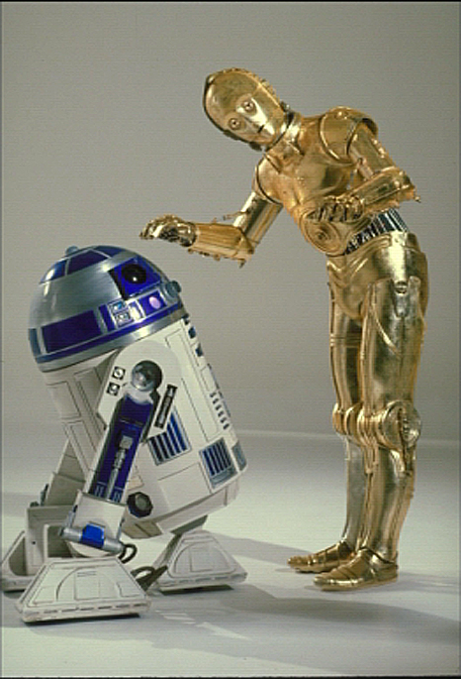
AGENTS
21/09/2020
7
An agent is anything that can perceive its environment through sensors and acting upon that environment through actuators
Human agent: eyes, ears, and other organs for sensors; hands, legs, mouth, and other body parts for actuators
Robotic agent: cameras and infrared range finders for sensors; various motors for actuators

Slide 8
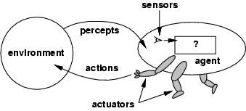
AGENTS AND ENVIRONMENTS
21/09/2020
8
The agent function maps from percept histories to actions:
[ f: P* → A]
The agent program runs on the physical architecture to produce f
agent = architecture +program

Slide 9
DEGREES OF INTELLIGENCE
21/09/2020
9
Focusing on rational agents (agents that try to do the best thing under the circumstances), one tends to measure the intelligence of the agent according to:
the ability to perceive and understand a variety of circumstances
the ability to adopt complex goals and manage them to arrive at an optimal objective
the ability to learn effectively
the ability to adapt to new circumstances

Slide 10
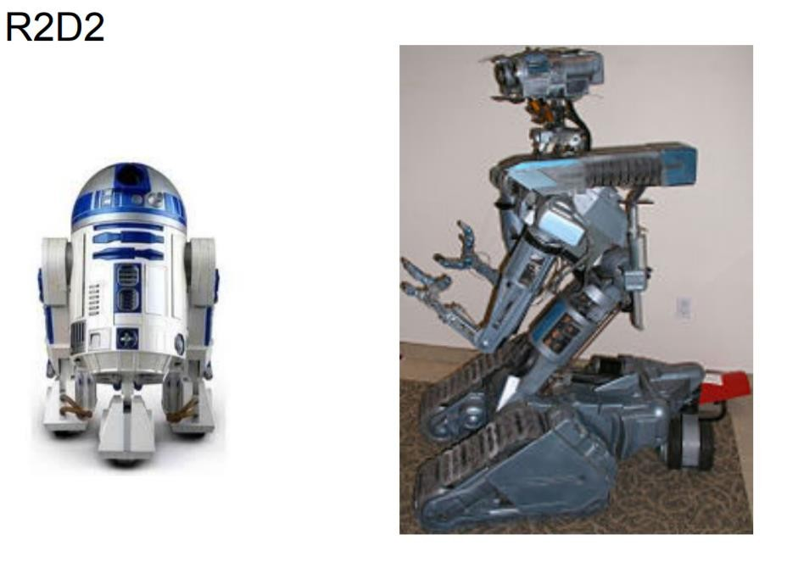
INTELLIGENT AGENTS
21/09/2020
10

Slide 11
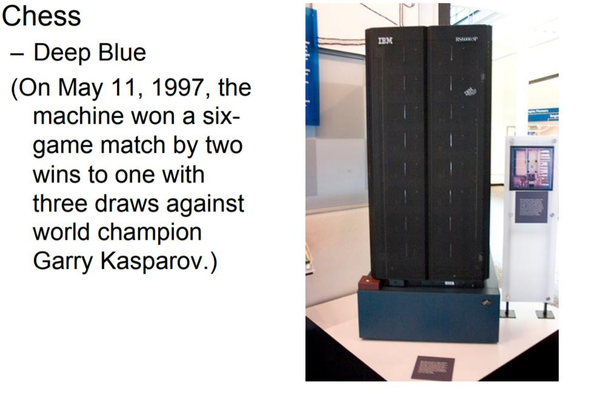
INTELLIGENT AGENTS
21/09/2020
11

Slide 12

INTELLIGENT AGENTS
21/09/2020
11
Chat-bot

Slide 13
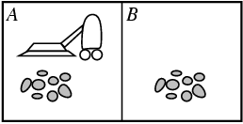
VACUUM-CLEANER WORLD
21/09/2020
12
Percepts: location and contents, e.g., [A,Dirty]
Actions: Left, Right, Suck, NoOp

Slide 14
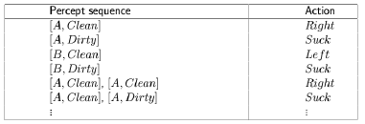
A VACUUM-CLEANER AGENT (FINITE STATE MACHINE)
13
\input{tables/vacuum-agent-function-table}

Slide 15
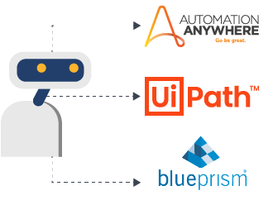

Robotic Process Automation (RPA)
https://www.uipath.com/resources/automation-demo/create-servicenow-ticket-demo?

Slide 16
RATIONAL AGENTS (MAIN FOCUS)
14
An agent should strive to "do the right thing", based on what it can perceive and the actions it can perform. The right action is the one that will cause the agent to be most successful.
Performance measure: An objective criterion for success of an agent's behavior
E.g., performance measure of a vacuum-cleaner agent could be:
amount of dirt cleaned up,
amount of time taken,
amount of electricity consumed, etc.

Slide 17
RATIONAL AGENTS
15
Rational Agent: For each possible percept sequence, a rational agent should select an action that is expected to maximize its performance measure, given the evidence provided by the percept sequence and whatever built-in knowledge the agent has.

Slide 18
RATIONAL AGENTS
21/09/2020
16
Rationality is distinct from omniscience (all-knowing with infinite knowledge).
Agents can perform actions in order to modify future percepts so as to obtain useful information (information gathering, exploration).
An agent is autonomous if its behavior is determined by its own experience (with ability to learn and adapt).

Slide 19
21/09/2020
PEAS
SPECIFYING THE ENVIRONMENT
17
Performance measure, Environment, Actuators, Sensors.

Slide 20


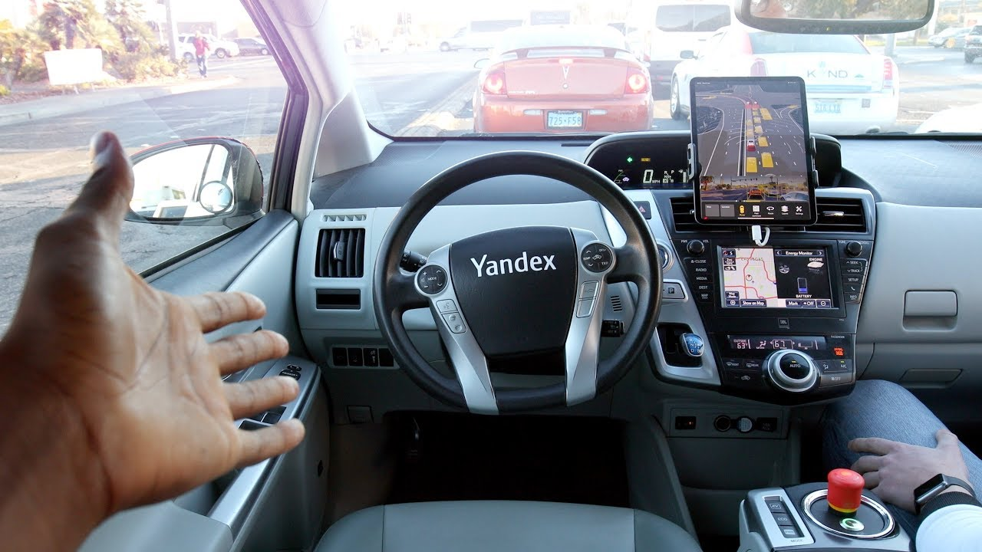
PEAS
21/09/2020
18
To design a rational agent, we must specify the task environment.
Consider, e.g., the task of designing an automated taxi:
Performance measure? :
Safe, fast, legal, comfortable trip, maximize profits
Environment?:
Roads, other traffic, pedestrians, customers
Actuators?:
Steering wheel, accelerator, brake, signal, horn
Sensors?:
Cameras, sonar, speedometer, GPS, odometer, engine sensors, keyboard

Slide 21
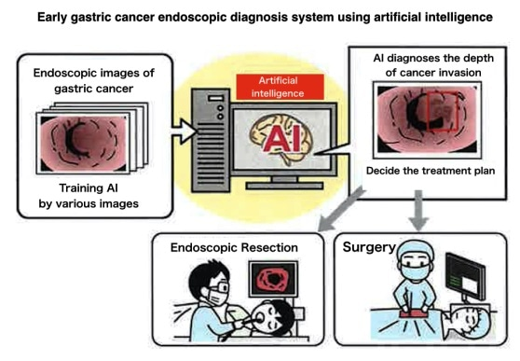
PEAS EXERCISE-1
21/09/2020
19
Agent: Medical diagnosis system
Performance measure:
Health of patient, minimize costs, lawsuits
Environment: Patient, hospital, staff
Actuators:
Screen display (questions, tests, diagnoses, treatments, referrals)
Sensors:
Keyboard (entry of symptoms, findings, patient's answers)

Slide 22
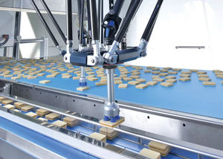
PEAS EXERCISE-2
21/09/2020
20
Agent: P art-picking robot
Performance measure:
Percentage of parts in correct bins
Environment:
Conveyor belt with parts, bins
Actuators:
Jointed arm and hand
Sensors:
Camera, joint angle sensors

Slide 23
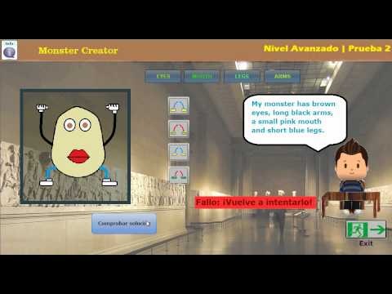
PEAS
21/09/2020
21
Agent: Interactive English tutor
Performance measure:
Maximize student's score on test
Environment:
Set of students
Actuators:
Screen display (exercises, suggestions, corrections)
Sensors:
Keyboard

Slide 24
ENVIRONMENT TYPES
21/09/2020
22
Fully observable (vs. partially observable): An agent's sensors give it access to the complete state of the environment at each point in time.
Deterministic (vs. stochastic):The next state of the environment is completely determined by the current state and the action executed by the agent. (If the environment is deterministic except for the actions of other agents, then the environment is strategic)
Episodic (vs. sequential): In an episodic environment, each agent’s performance is the result of a series of independent tasks performed.The agent decides which action is best to take, it will only consider the task at hand and doesn’t have to consider the effect it may have on future tasks.
Notes:
Stochastic environment is an environment where future environment states is not in the agent’s control

Slide 25
23 ENVIRONMENT TYPES
21/09/2020
Static (vs. dynamic):The environment is unchanged while an agent is deliberating. (The environment is semidynamic if the environment itself does not change with the passage of time but the agent's performance score does)
Discrete (vs. continuous): A limited number of distinct, clearly defined percepts and actions.
Single agent (vs. multiagent): An agent operating by itself in an environment.

Slide 26
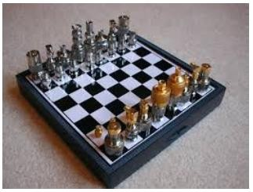
TASK ENVIRONMENT – EXAMPLES.
21/09/2020
24

Slide 27
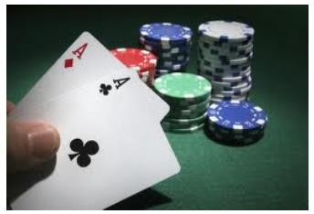

TASK ENVIRONMENT – EXAMPLES.
21/09/2020
25

Slide 28
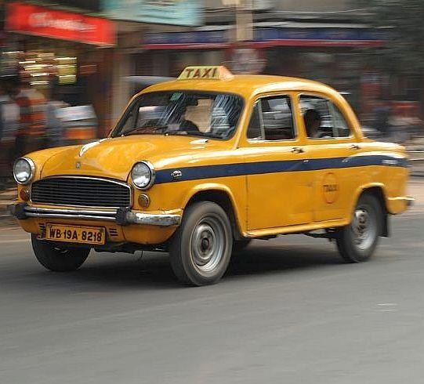
TASK ENVIRONMENT – EXAMPLES.
21/09/2020
26

Slide 29

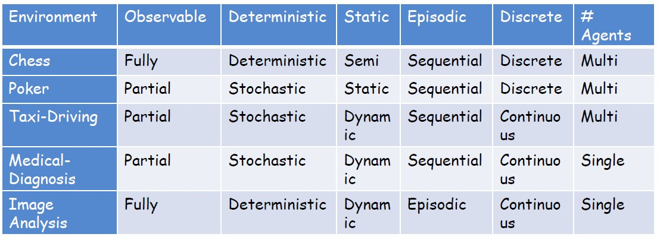
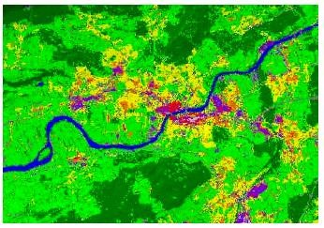
21/09/2020
27
The real world is partially observable, stochastic, dynamic and continuous How do we handle it then?

Slide 30
AGENT TYPES
21/09/2020
28
Five basic types in order of increasing generality:
Open loop agents
Simple reflex agents
Model-based reflex agents
Goal-based agents
Utility-based agents

Slide 31
AGENT FUNCTIONS AND PROGRAMS
21/09/2020
29
An agent is completely specified by the agent function mapping percept sequences to actions.
Programmed to to implement the rational agent function concisely

Slide 32
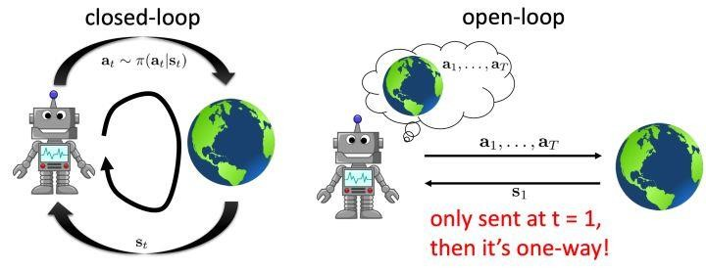
OPEN LOOP AGENT
21/09/2020
30
Notes:
Closed loop agents are agents that determine the following actions by considering environment changes
Open loop agents are agents that follow a predetermined set of actions to produce results without considering environment changes

Slide 33
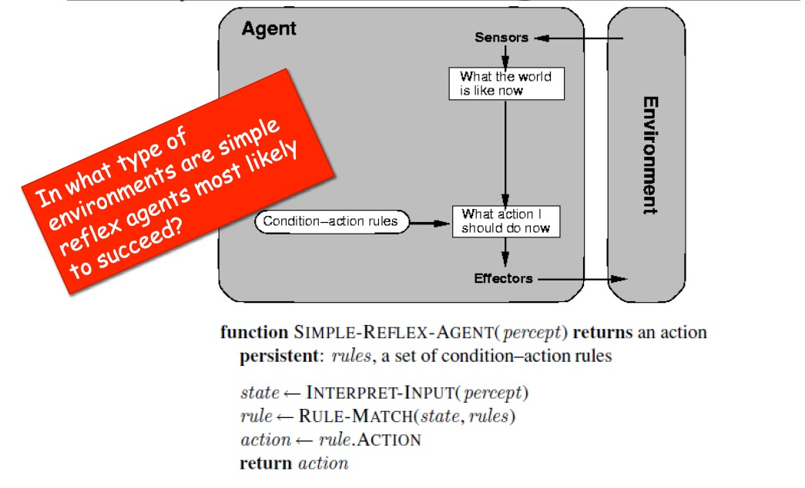
SIMPLE REFLEX AGENT (SIMPLEST CLOSE LOOP AG²¹E^{/09/}N²⁰²⁰ T)
31
Notes:
Simple reflex agents takes pre-determined actions based on only the current environment.
They do not study the pattern of outcomes

Slide 34
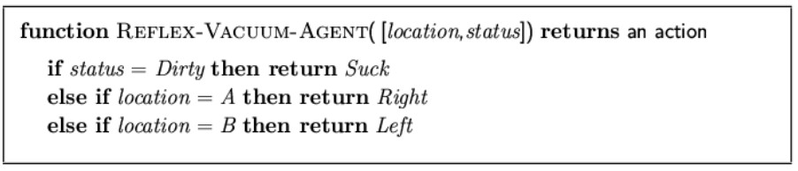
32 AGENT PROGRAM FOR A VACUUM-CLEANER AGENT
21/09/2020

Slide 35
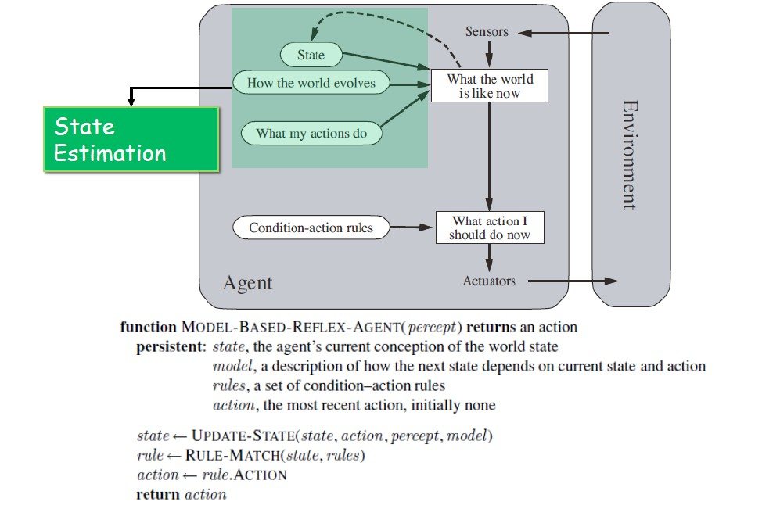
MODEL BASED REFLEX AGENTS
21/09/2020
33
Notes:
Model-based reflex agents stores a percept history of the environment and take actions based on an internal behavioral model built from the percept history.
it uses the percept history to help reveal the current unobservable aspects of the environment.
Model:
1) Something that describes the supposed system behavior based on current states
2) Something that describes expected outcome based on current states

Slide 36
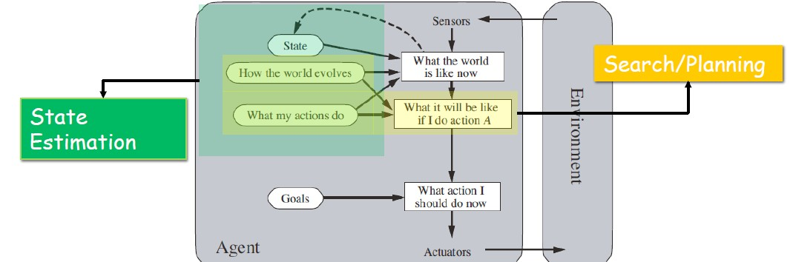
GOAL BASED AGENTS
21/09/2020
34
Search: process of looking for a sequence of actions that reaches the
goal state
Planning: can be viewed as search in a structured environment.
Notes:
Goal-based reflex agents respond to current conditions by searching for the best action to take to reach the intended goal
A goal-based reflex agent has a goal and has a strategy to reach that goal. All actions are taken to reach this goal. More precisely, from a set of possible actions, it selects the one that improves the progress towards the goal (not necessarily the best one)

Slide 37
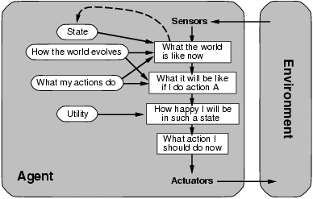
35 UTILITY-BASED AGENTS
21/09/2020
Notes:
Utility-based reflex agents respond to current conditions by searching for the most rational action to take to achieve goals and fulfillment.

Slide 38
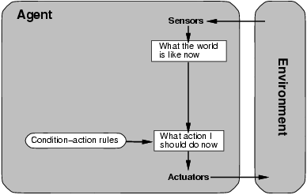
36 SIMPLE REFLEX AGENTS
21/09/2020

Slide 39
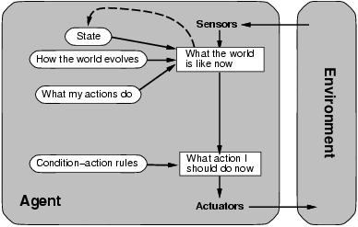
37 MODEL-BASED REFLEX AGENTS
21/09/2020

Slide 40
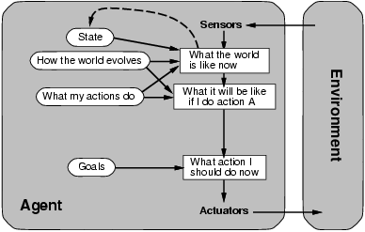
38 GOAL-BASED AGENTS
21/09/2020

Slide 41
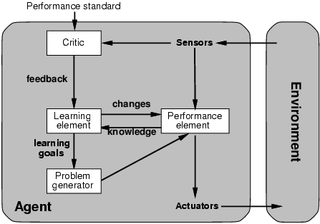
39 LEARNING AGENTS
21/09/2020
Notes:
A learning agent is an agent capable of learning from experience. It has the capability of automatic information acquisition and integration into the system.
https://ai.stackexchange.com/questions/3243/what-are-some-examples-of-intelligent-agents-for-each-intelligent-agent-class
Simple reflex agents
Model-based reflex agents
Goal-based agents
Utility-based agents
Learning agents

Slide 42
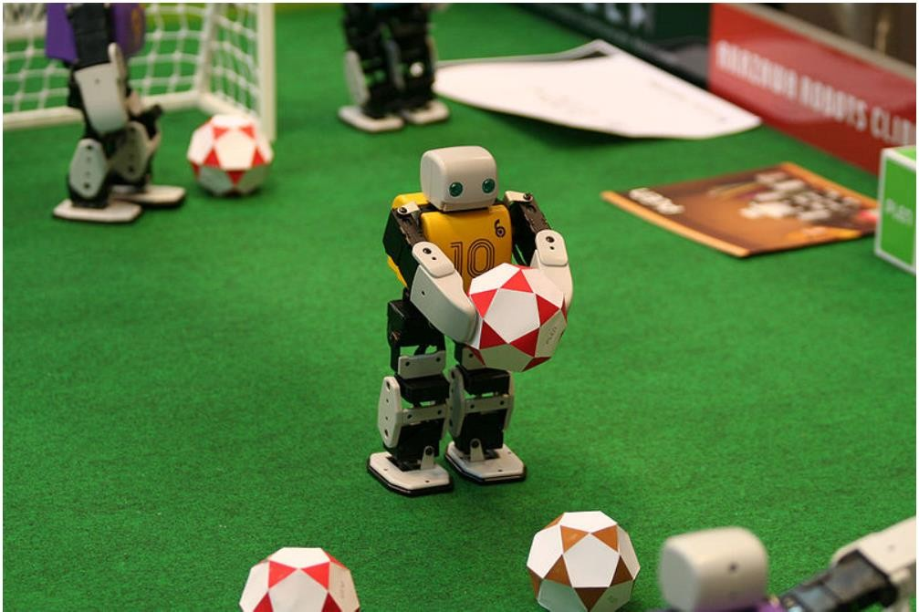
40 MULTIPLE AGENTS - ROBOCUP
21/09/2020

Slide 43
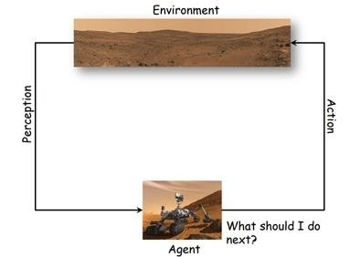
INTELLIGENT AGENTS USE IN BIG TASK (MARS ROVER)
21/09/2020
41

Slide 44
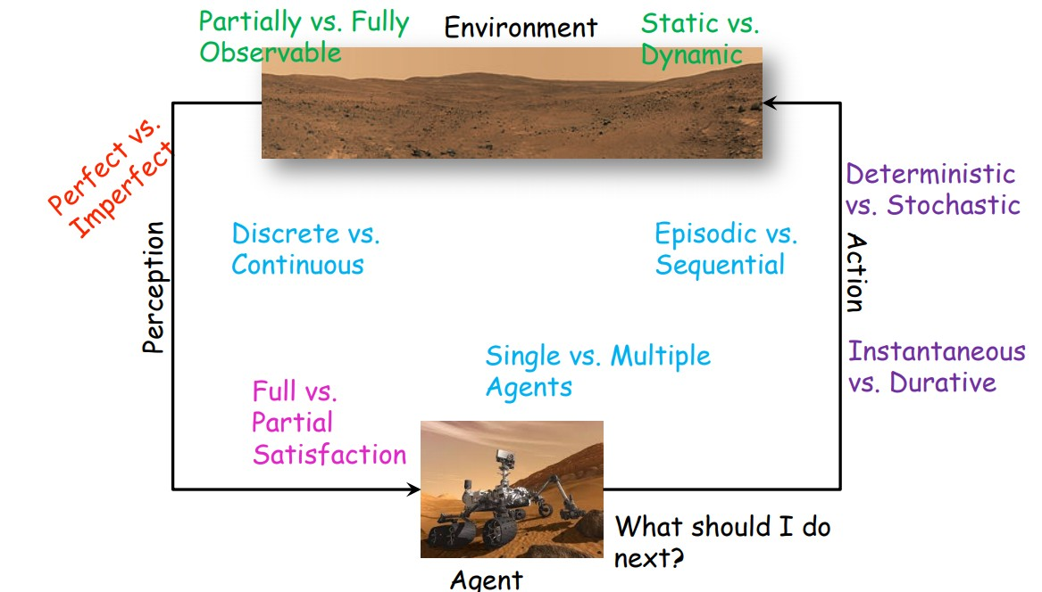
MARS-ROVER TASK ENVIRONMENT
21/09/2020
42

Slide 45

BUILDING MARS -ROVER
21/09/2020
43

Slide 46
44 FINITE STATE MACHINE
21/09/2020

Slide 47
₄₅ FINITE STATE MACHINE
State Diagrams
21/09/2020
A state diagram describes the behaviour of a system, some part of a system, or an individual object.
At any given point in time, the system or object is in a certain state.
So it can respond in a specific way to an event.
Some events will cause the system to change state.
In the new state, the system will behave in a different way to events.
A state diagram is a directed graph whose nodes are
states and arcs are transitions between states.
Notes:
Finite state machines is a computational model applicable for environments that are static, deterministic and fully observable

Slide 48
FINITE STATE MACHINE
States
21/09/2020
46
At any given point in time, the system is in one state.
A state is represented by a rounded rectangle
containing the name of the state.
Special states:
A black circle represents the start state
A circle with a ring around it represents an end state
A transition is a change of state in response to an event.
The label on each transition is the event that triggers it.
The system remains in a state until an event occurs that causes it to change state.

Slide 49
FINITE STATE MACHINE
21/09/2020
47
State diagrams and transitions
GreenLightNoTrigger
vehicleWaitingToTurn
GreenLight
GreenLightChangeTriggered
after(25s since exit from
state RedLight)
after(25s)
YellowLight
after(30s)
YellowLight
after(30s)
after(5s)
after(5s)
RedLight
RedLight

Slide 50
FINITE STATE MACHINE
21/09/2020
⁴⁸ Activities in state diagrams
An activity is an event that occurs in a particular state.
It takes a period of time.
The system may transition out of the state when the activity completes.
Another outgoing transition may interrupt the activity before it completes.
E.g.,
press button
ProposeSelection
MusicPlaying
do:
play chosen
selection

Slide 51
FINITE STATE MACHINE
⁴⁹ Actions in state diagrams
21/09/2020
An action takes place instantaneously - either during a transition, on entry to a state, or on exit from a state.
An action should consume no noticeable amount of time
Closed Opening
Enter /
stop motor
pressButton
Enter /
start motor forward
closingCompleted
openingCompleted
pressButton
Closing
pressButton
Open
Enter /
start motor backward
Enter /
stop motor

Slide 52
FINITE STATE MACHINE
21/09/2020
50
tic-tac-toe game
XWin
XTurn
Tie
OWin
OTurn

Slide 53
51 FINITE STATE MACHINE (EG: TIC-TAC-TOE GAME)
21/09/2020
9 States
S0 S1 S2
? Transitions
3 state values (X, O, E)
S3 S4 S5
S6 S7 s8
Winning mode | S0 | S1 | S2 | Transitio n | Next state
 | X | X | E | S2 = X | XXX
 | X | E | X | S1 = X | XXX
 | E | X | X | S0 = X | XXX

Slide 54
FINITE STATE MACHINE
21/09/2020
52
If(S0==X && S1==X && S2==E){ S2 = X; } //Rule 1
else if(S0==X && S1==E && S2==X){ S1 = X; } //Rule 2 else if(S0==E && S1==X && S2==X){ S0 = X; } //Rule 3 The above is only 1 way of winning.
However, there are 8 ways of winnings.
Therefore, we have to code 8 × 3 rules = 24 rules to provide full coverage for the winning mode in Tic-tac-toe game.
Block mode = 24 rules
Multistrike = 72 rules
Thus, a total of 120 rules is required to provide full coverage of the tic-tac-toe.

Slide 55

Thank you

