Slide 1
BACHELOR OF COMPUTER SCIENCE (HONS)

Slide 2
INTRODUCTION TO ARTIFICIAL INTELLIGENCE
CAI3014
22/09/2020

Slide 3
LEARNING OBJECTIVES
AT THE END OF THE COURSE, STUDENTS WILL BE ABLE TO:
CO1: DEMONSTRATE FUNDAMENTAL UNDERSTANDING OF THE HISTORY OF (AI) AND ITS FOUNDATIONS
CO2: APPLY BASIC PRINCIPLES OF AI IN SOLUTIONS THAT REQUIRE PROBLEM SOLVING, INFERENCE, PERCEPTION, KNOWLEDGE REPRESENTATION AND LEARNING.
CO3: DEMONSTRATE PROFICIENCY DEVELOPING APPLICATIONS IN AN AI LANGUAGE, EXPERT SYSTEM SHELL OR DATA MINING TOOL
CO4: EXPLAIN PROFICIENCY IN APPLY SCIENTIFIC METHOD TO
MODELS OF MACHINE LEARNING.
22/09/2020

Slide 4
KNOWLEDGE REPRESENTATION AND REASONING

Slide 5
OUTLINE
Examples of Knowledge-based systems
Capturing expert Knowledge (Knowledge representation)
Reasoning Strategies
Rule Chaining
Production Rules
Rule Ordering
Representation of Rule Base
Combining Rules
9.
Rule Ordering
22/09/2020
5

Slide 6
EXAMPLES of KB systems
VARIOUS EXPERT SYSTEMS
MYCIN (1970S, STANFORD UNIVERSITY) XCON (1978, CARNEGIE MELLON UNIVERSITY)
PERHAPS MOST FAMOUS KNOWLEDGE BASE: CYC (1980S, DOUGLAS LENAT, CYCORP, AUSTIN, TEXAS)
ONTOLOGIES
SNOMED CT HTTP://SNOMED.DATALINE.CO.UK/
GENE ONTOLOGY HTTP://WWW.GENEONTOLOGY.ORG/
NHS CHOICES SYMPTOM-CHECKER
WATSON IBM
22/09/2020
6

Slide 7
MYCIN
1970s, Stanford University (Edward Shortliffe, Pat Buchanan)
Production rule system (we will see them later in the course)
Purpose: automatic diagnosis of bacterial infections
Lots of interviews with experts on infectious diseases, translated into rules (knowledge acquisition is a non-trivial process;
approximately 500 rules
G53KRR
22/09/2020
7

Slide 8
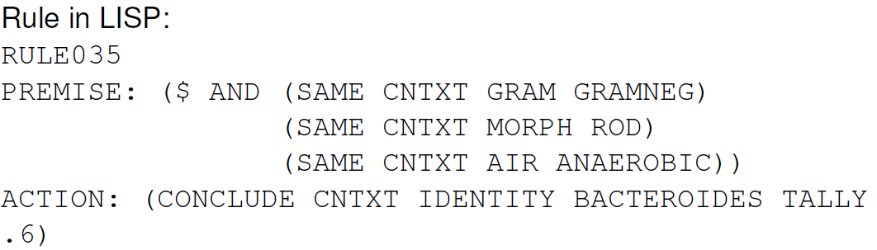
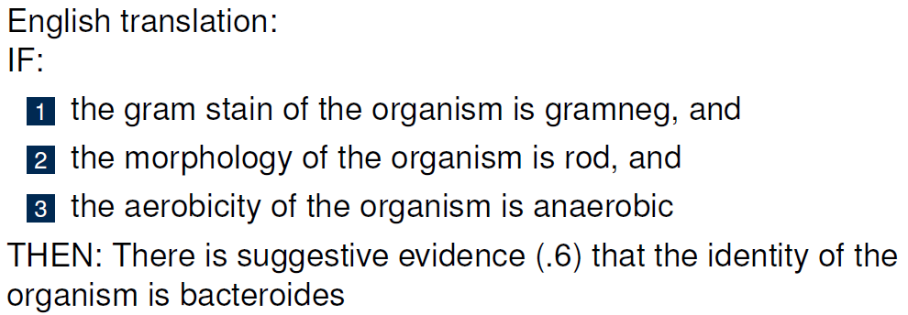
EXAMPLE MYCIN RULE
CAI3014-Introduction to Artificial Intelligence- Dr. JJT
22/09/2020
8

Slide 9
MORE ABOUT MYCIN
some facts and some conclusions of the rules (as above) are not absolutely certain
MYCIN uses numerical certainty factors; range between -1 and 1
(reasonably involved) rules for combining certainty factors of premises, with the number in the rule (as 0.6 above) into a certainty factor for the conclusions
later it turned out that MYCIN’s recommendations would have been the same if it used only 4 values for certainty factors
MYCIN was never used in practice (ethical and legal is22/s09u/20e20s) 9

Slide 10
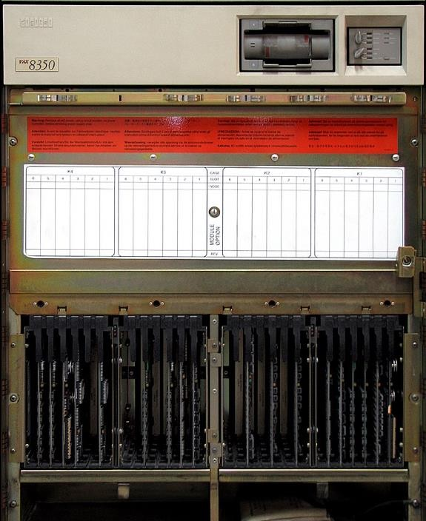
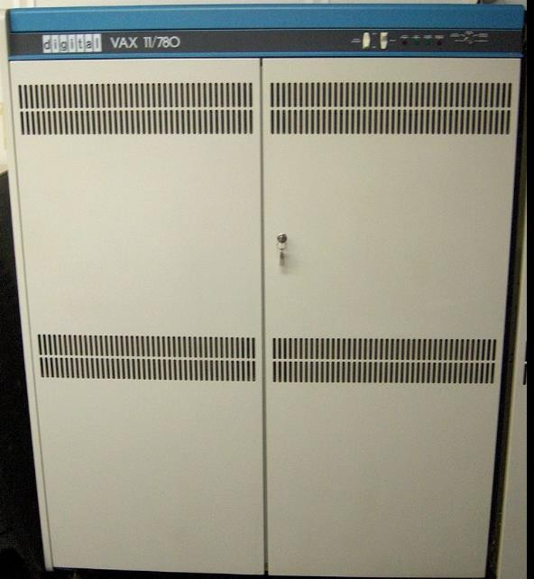
XCON
John McDermott, CMU, 1978
eXpert CONfigurer - system for configuring VAX computers
production rule system, written using OPS5 (language for production systems, implemented in LISP)
10,000 rules
used commercially by Sales person To get correct matching of peripherals
22/09/2020
10

Slide 11
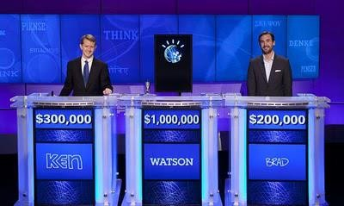
IBM WATSON A KNOWLEDGE-BASED SYSTEM
CAI3014-Introduction to Artificial Intelligence- Dr. JJT
22/09/2020
11

Slide 12
IBM- WATSON
developed at IBM by a team led by David Ferrucci
question answering system (originally developed to play Jeopardy [game show])
has access to terabytes of data (all Wikipedia pages, other encyclopedias)
mostly uses statistical correlation methods in plain English text to find answers to questions such as, which city has airports named after a WWII hero and a WWII battle
assuming (not true really) this is all that Watson does – is it a knowledge based system?
22/09/2020
12

Slide 13
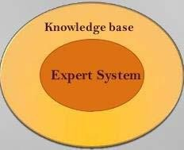
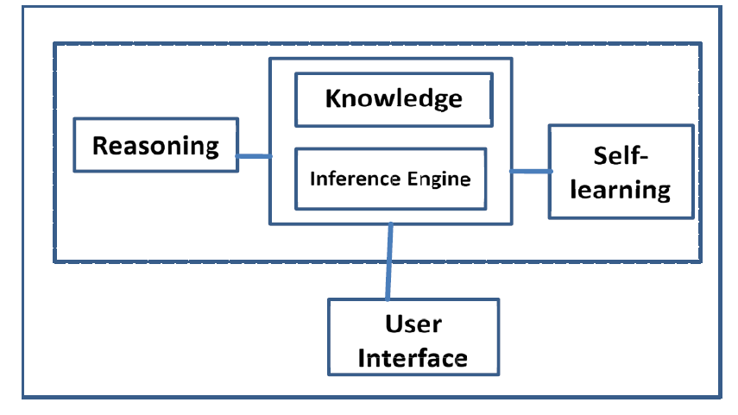
KNOWLEDGEBASE SYSTEM
A knowledgebase system is a program that uses AI to solve problems within a specialized domain that ordinarily requires human expertise.
Typical tasks of expert systems include classification, diagnosis, monitoring, design, scheduling and planning for specialized tasks.
Knowledgebase is a more general than expert system
Structure of a Knowledgebase System

Slide 14
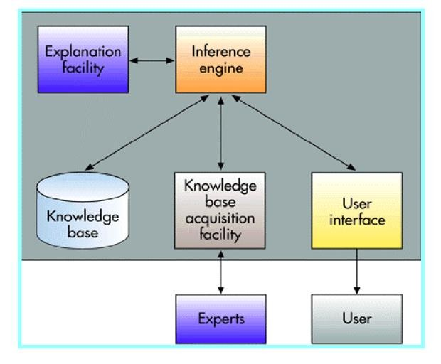
EXPERT SYSTEMS
Expert Systems
Can explain their reasoning or
Car Loan application for an amount of RM100,000 to RM200,000
If there are no previous credits problems, and
If month net income is greater than 4x monthly loan payment, and
If down payment is 15% of total value of property, and
If net income of borrower is > RM
50,000 and
If employment is > 3 years at same company
Then accept the applications , Else check other credit rules.
suggested decisions.
Can display intelligent
behaviour.
Can draw conclusions from complex relationships.
Can provide portable
knowledge
Components of Expert Systems

Slide 15
Expert systems aim to capture expert knowledge in specific domain in form that non-expert can use:
CAPTURING EXPERT KNOWLEDGE
What knowledge do we need?
How do we capture it?
How do we represent it?
How do we make use of it?
22/09/2020
15

Slide 16
BASIC FEATURES OF AN EXPERT SYSTEM
ESSENTIAL
A knowledge base to store expertise
An inference engine to exploit this expertise
A temporary store of situational information
A user interface, providing I/O and explanation facilities
DESIRABLE
Some means of handling uncertainty
6. A means of updating the knowledge base
16

Slide 17
PROPERTIES OF EXPERT SYSTEMS
Representational Accuracy: It should represent all kinds of required knowledge.
Inferential Adequacy: It should be able to manipulate the representational structures to produce new knowledge corresponding to the existing structure.
Inferential Efficiency: The ability to direct the inferential knowledge
mechanism into the most productive directions by storing appropriate guides.
Acquisitional efficiency: The ability to acquire new knowledge easily using automatic methods

Slide 18
KNOWLEDGE REPRESENTATION
Why is knowledge representation important?
Humans and machines communicate via symbols, which represent knowledge imperfectly
Each representation emphasizes some aspects of problem and ignores others
Representation predetermines possible reasoning
What types of knowledge are relevant?
facts ("data")
logical inferences
rules and procedures
– hypotheses and theories
22/09/2020
18

Slide 19
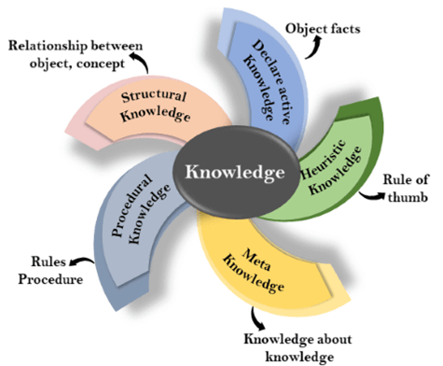
KNOWLEDGE REPRESENTATION
TYPES OF KNOWLEDGE
KR TECHNIQUES
1
Logical Representation
2
Semantic Networks
3
Production Rules
4
Frames Representation

Slide 20
LOGICAL APPROACH
Formal Logic is the primary vehicle for representing & reasoning about knowledge.
Formal logic is – Precise and Definite – Declarative
Logic consists of two parts, a language and a method of reasoning.
Language has syntax and semantics
Logical systems with different syntax and semantics
Propositional logic
First order predicate logic
Temporal logic
Modal
Higher order logic
Non-monotonic

Slide 21
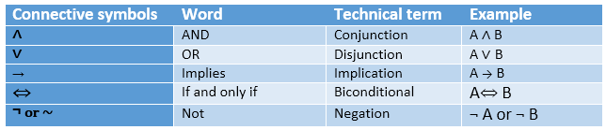
PROPOSITIONAL LOGIC
In propositional logic (PL), a user defines a set of propositional symbols, like P and Q. User define the semantics of each of these symbols.
For example, P means "It is hot“, Q means "It is humid“, R means "It is raining“
Examples of propositional logic sentences:
(P ^ Q) -> R (here meaning "If it is hot and humid, then it is raining")
Q -> P (here meaning "If it is humid, then it is hot")
Q (here meaning "It is humid”).
Compound propositions are formed from atomic
propositions using the logical connectives such as, and, not,
or, if.. then , if and only if, etc.
Compound proposition is defined by values of elementary propositions and the meaning of connectives.
Examples:
An atomic proposition is sentence that is true or false.
A proposition formula which is always true is called tautology, and it is also called a valid sentence.
A proposition formula which is always false is called Contradiction.
Statements which are questions, commands, or opinions are not propositions such as "Where is Rohini", "How are you", "What is your name", are not propositions.
Rama became ill and he went to the doctor.
The difference of 20 and 5 is 15 and not 25.

Slide 22
FIRST ORDER LOGIC
Consider the following sentence, which we cannot represent using PL logic: "Some humans are intelligent", or "Sachin likes cricket.“
FOL is sufficiently expressive to represent the natural language statements in a concise way.
First-order logic is also known as Predicate logic or First-order predicate logic. First-order logic is a powerful language that develops information about the objects in a more easy way and can also express the relationship between those objects.
First-order logic (like natural language) does not only assume that the world contains facts like propositional logic but also assumes the following things in the world:
Objects: A, B, people, numbers, colors, wars, theories, squares, pits, wumpus, ......
Relations: It can be unary relation such as: red, round, is adjacent, or n-any relation such as: the sister of, brother of, has color, comes between
Function: Father of, best friend, third inning of, end of, ......
As a natural language, first-order logic also has two main parts: Syntax and Semantics
Example(s):
Ravi and Ajay are brothers: => Brothers(Ravi, Ajay). Chinky is a cat: => cat (Chinky).
∀x man(x) → drink (x, coffee).
It will be read as: There are all x where x is a man who drink coffee.
∃x: boys(x) 𝖠 intelligent(x)
It will be read as: There are some x where x is a boy who is intelligent.

Slide 23
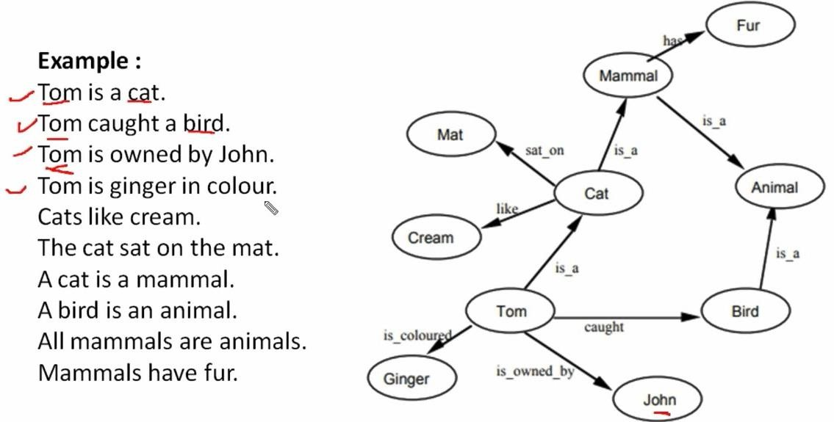
STRUCTURED : SEMANTIC NETWORKS
Represent knowledge as a structured hierarchy, allowing properties of whole classes to be inherited by members, e.g.
22/09/2020
23

Slide 24
PRODUCTION RULES
Represent knowledge as a set of IF... THEN... clauses, allowing inferences to be drawn to solve problems, e.g.
IF claimant is currently in employment AND has made no claim in last 4 weeks THEN claimant is eligible for Loan
IF claimant is eligible for Loan
AND earns less than $98.30 per week
THEN flat-rate benefit is payable
IF claimant is self-employed
THEN claimant is not eligible for Loan
22/09/2020
24

Slide 25
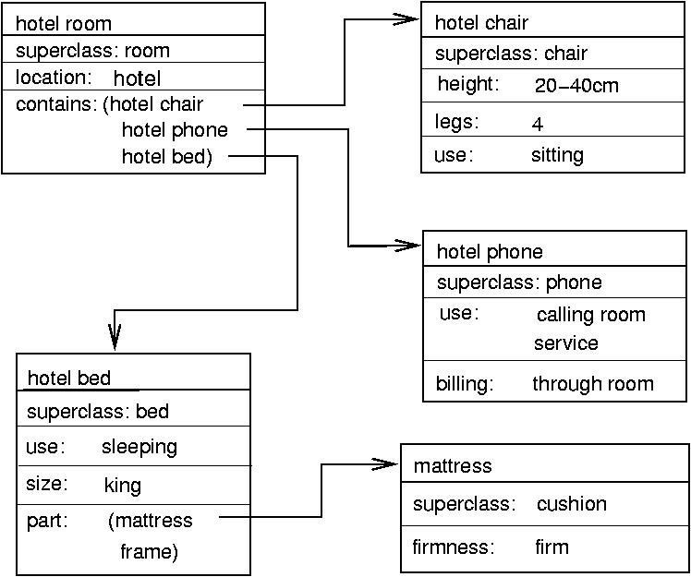
FRAME REPRESENTATION
A frame is a record like structure which consists of a collection of attributes and its values to describe an entity in the world.
Frames are the AI data structure which divides knowledge into substructures by representing stereotypes situations. It consists of a collection of slots and slot values. These slots may be of any type and sizes. Slots have names and values which are called facets.
Facets: The various aspects of a slot is known as Facets. Facets are features of frames which enable us to put constraints on the frames. Example: IF-NEEDED facts are called when data of any particular slot is needed.
Frames system consist of a collection of frames which are connected.
In the frame, knowledge about an object or event can be stored together in the knowledge base.
The frame is used in various applications including Natural
language processing and machine visions.

Slide 26
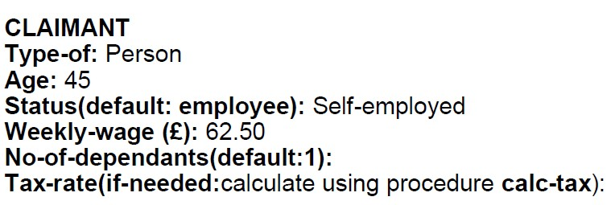
FRAMES
Structured data objects with a number of slots, each of which can take a range of values, whether assigned, default or calculated by if-needed procedures
22/09/2020

Slide 27
EXERCISE 1
Devise a simple production rule used car advice system, based on the following set of rules:
A second hand car is a good buy if it costs £1500 or less, has sound bodywork, has covered less than 40000 miles and has no more than 2 previous owners.
A car has sound bodywork if there is no visible rust, the paintwork is unblemished and there is no trace of filler.
A car has travelled less than 40000 miles if the speedometer reading is less than 40000 and there is no evidence of wear on the driver's seat.
22/09/2020

Slide 28
Answer for previous, Overall purpose of system:
– Is the used car a good buy ?
IF costs <= £1500,
AND has sound bodywork,
IF no visible rust
AND paintwork is unblemished
AND no trace of filler
AND covered less than 40000 miles,
AND has no more than 2 previous owners,
OR no wear on driver's seat
THEN is a good buy
22/09/2020

Slide 29
REASONING STRATEGIES
Several possible reasoning strategies available to both machines and humans, including:
Deductive reasoning (logical inference)
Inductive reasoning
Abductive reasoning
Reasoning by analogy
22/09/2020

Slide 30
DEDUCTIVE REASONING (LOGICAL INFERENCE)
Basic principle that of modus ponens -
given a fact P
and a rule P => Q
the fact Q logically follows,
e.g.
Fact: Smith has a tattoo of a fish with pink scales on his arm
Rule: IF a person has a tattoo of a fish with pink scales THEN that person must have been to China
New fact: Smith has been to China
Main reasoning technique in rule-based systems
22/09/2020

Slide 31
INDUCTIVE REASONING (GENERALISING)
Basic principle is generalization from examples, e.g. if:
an IBM PC has the <ESC> key at the top left-hand corner of the keyboard
an Elonex PC has the <ESC> key at the top left-hand corner of the keyboard
a Dell PC has the <ESC> key at the top left-hand corner of the keyboard
inductive reasoning tells us that:
– all PCs have the <ESC> key at the top left-hand corner of the keyboard
22/09/2020

Slide 32
ABDUCTIVE REASONING
The reverse of deductive reasoning (Logical Inference), i.e: given the observed fact Q
and the inference rule P => Q
it is possible that P may be true – though we can’t be sure!
e.g.
Fact: We can't get anything to print out over the network.
Rule: IF the print queue is stalled THEN no jobs will be printed
Conclusion: Our problem may be a stalled printer queue.
NB - if we know that Q is false, we can prove that P is false too (modus tollens),
e.g. if job prints normally, print queue can't be stalled.
Useful in suggesting possible hypotheses to investigate.
22/09/2020
32

Slide 33
REASONING BY ANALOGY
Basic principle is that two similar objects may behave in similar fashion,
e.g:
Experience tells us that old Epson dot-matrix printers often suffer from jammed pins inside their print heads.
We have a faulty OEM dot-matrix printer with a print head the same size and shape as a once common Epson model.
Hence we conclude:
The first fault to investigate is a jammed pin inside the print head.
Mainly used by case-based systems. May be used with frames, but of little use in rule-based systems.
22/09/2020
33

Slide 34
RULE CHAINING
Logical connection between output from invocation of one rule and input to next.
Can operate in two directions:
Forward chaining (data driven) - proceed from given data to conclusions
Backward chaining (goal driven) - attempt to prove hypothesis, requesting data as required
Backward chaining used for most operational expert systems
22/09/2020
34
Notes:
Useful link:
https://www.section.io/engineering-education/forward-and-backward-chaining-in-ai/

Slide 35
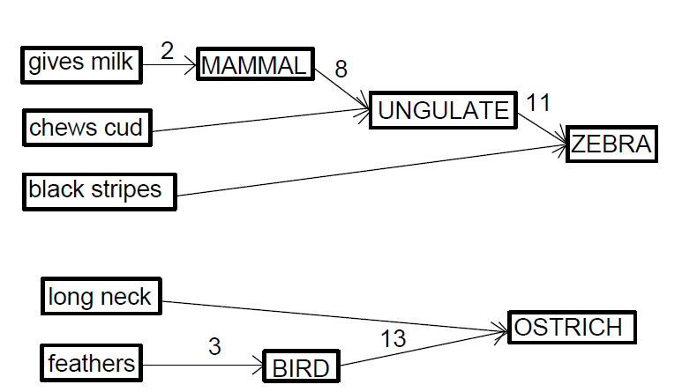
FORWARD CHAINING
Proceeds FROM start data TO conclusions., e.g.
22/09/2020

Slide 36
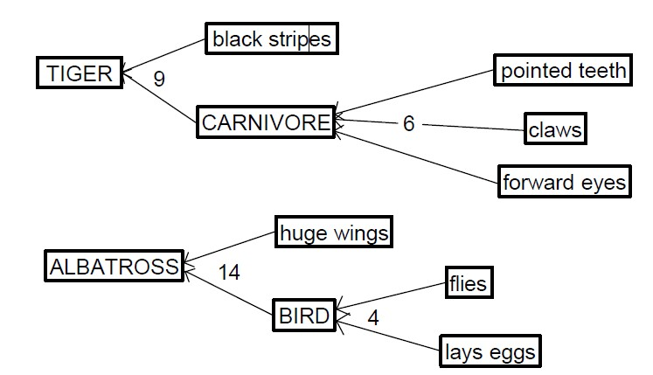
BACKWARD CHAINING
Proceeds FROM starting hypothesis TO data which will support or refute it, e.g.
22/09/2020

Slide 37
EXERCISE
Illustrate Forward chaining and, Backward chaining of buying a mobile phone
22/09/2020

Slide 38
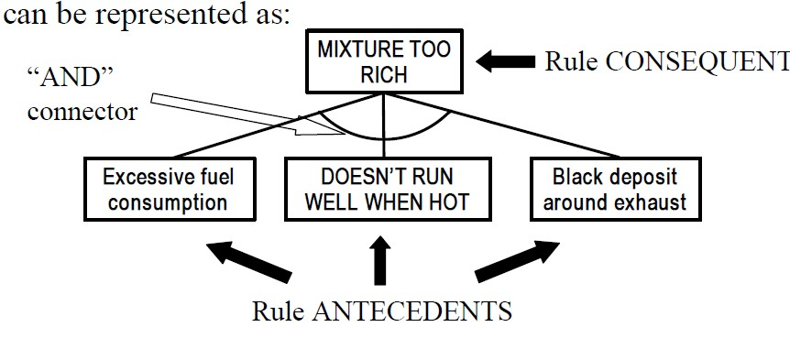
REPRESENTING A RULE BASE -1
Most straightforward way is to represent rules in form of goal trees,
e.g. the statement:
“The fuel/air mixture in a car engine is too rich if fuel consumption is excessive, the car doesn’t run well when hot, and there is a black deposit around the exhaust”
22/09/2020

Slide 39
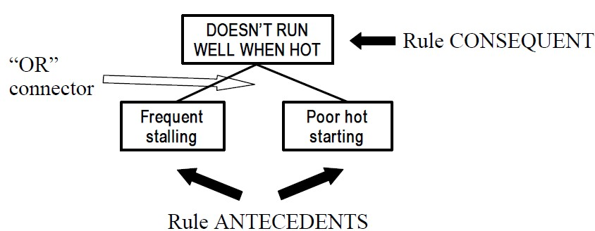
REPRESENTING A RULE BASE -2
Similarly, the statement :
“Symptoms of a car not running well when hot might be frequent stalling or poor starting when hot”
can be represented as:
22/09/2020

Slide 40
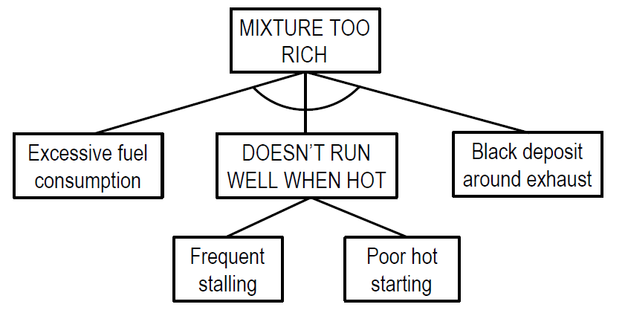
COMBINING RULES
Rules whose goals form antecedents for other rules can then be combined into a multi-level goal tree, e.g:
22/09/2020

Slide 41
PRODUCTION RULES: A MORE DETAILED LOOK
Rules consist of antecedent (conditions) and consequent (actions) parts.
Both halves of a rule involve variables which may be single- or multi- valued.
Variables are initially undefined, and acquire values as inference proceeds.
Forward chaining is triggered by volunteering values of starting variables in rule antecedents.
Backward chaining is triggered by seeking a value for a goal variable in a
rule consequent.
22/09/2020

Slide 42
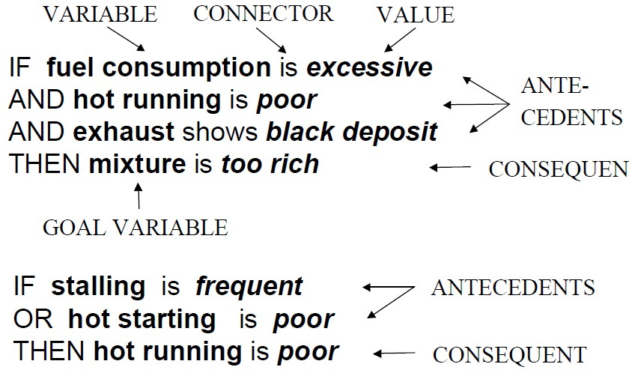
EXAMPLES OF BACKWARD CHAINING (IS)
22/09/2020

Slide 43
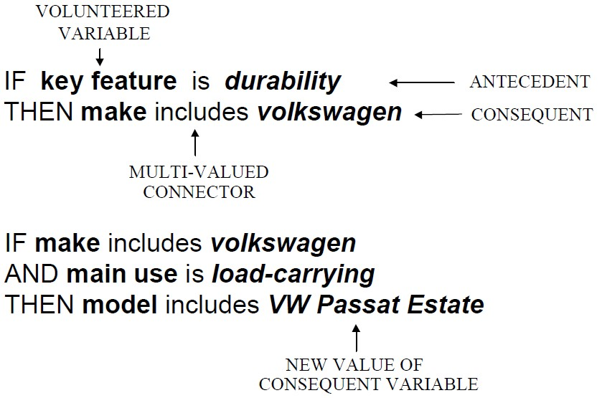
EXAMPLES OF FORWARD CHAINING (INCLUDES)
22/09/2020

Slide 44
RULE ORDERING
Standard order of rule firing:
apply first matching rule in sequence
activate clauses in order specified in rule
Can over-ride using meta-rules, specifying order in which goals are tested or questions asked, e.g:
IF choice includes bmw
THEN ask performance rating
IF influenza is eliminated
THEN seek mumps
22/09/2020

Slide 45
DESIGNING A RULE BASE FOR A SIMPLIFIED EXPERT SYSTEMS APPLICATION
Consider the following scenario -
“Three factors all need to be favourable before a heat pump can be considered suitable. Firstly, the condenser temperature must not be too
high, to avoid any risk of the heat transfer fluid exploding. 120°C is a safe maximum temperature. Secondly, the difference in temperature between the condenser and evaporator must be within the right limits. If it is too high, the process will not run efficiently. If it is negative (i.e. the evaporator is warmer than the condenser) then the process will not work at all. A temperature difference between 0 and 60° is normally recommended. Finally, there must be no significant adverse factors - a
very dusty or very corrosive atmosphere normally rules out the use of a heat pump”.
22/09/2020 45

Slide 46
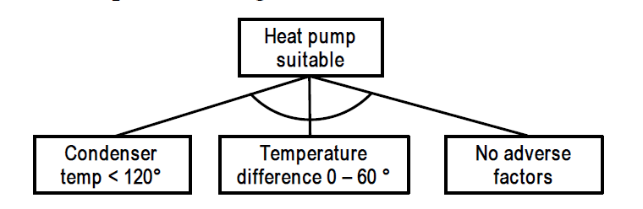
GOAL TREE DESIGN-1
Overall purpose of system:
Is a heat pump suitable?
Antecedents to main goal:
Condenser temperature < 120°C
Temperature difference 0 - 60°C
No adverse factors
Hence top-level design could be:
22/09/2020

Slide 47
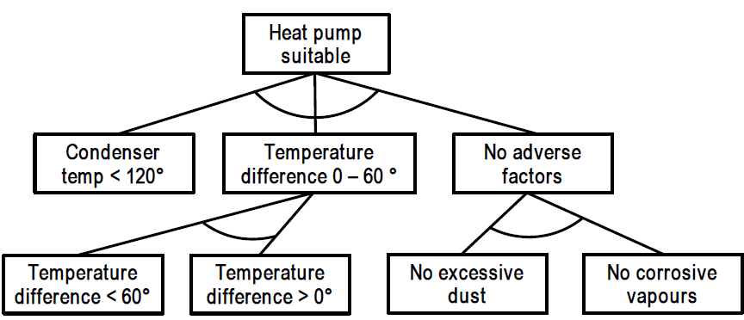
GOAL TREE DESIGN-2
Subsidiary goals no adverse factors and temperature difference 0-60° can also be broken down further.
Hence second-level design could be:
22/09/2020
Notes:
“No adverse factors” no AND connector because it is OR rule

Slide 48
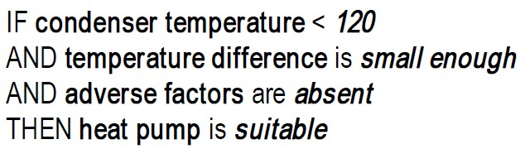
GENERATING RULES FROM GOAL TREE -1
Rule consequent (goal) forms THEN clause
Rule antecedents form IF (plus AND or OR) clauses
Rules must all follow VARIABLE CONNECTOR –VALUE syntax So top level rule might be:
22/09/2020

Slide 49
GENERATING RULES FROM GOAL TREE -2
and lower level rules might be:
IF (condenser temp – evaporator temp) < 60 AND (condenser temp – evaporator temp) > 0 THEN temperature difference is small enough
IF dust level is not excessive
AND corrosive vapours are not present THEN adverse factors are absent
22/09/2020

Slide 50
EXERCISE
Design a simple advice system (goal tree and production rules) able to advise a parent whether they are entitled to claim child benefit, using the following (simplified) rules:
Child benefit may be claimed for each dependent child, provided certain age, residence and employment qualifications are met, and provided no-one else is already claiming benefit for that child. A child counts as "dependent" if living with, or receiving regular maintenance payments from, the parent. The child has to be under 16, or under 19 and in full-time education.
Both parent and child must have been resident in the Malaysia for at least 6 of the last 12 months.
The child must not be working, even on a PTPTN scheme.
22/09/2020

Slide 51
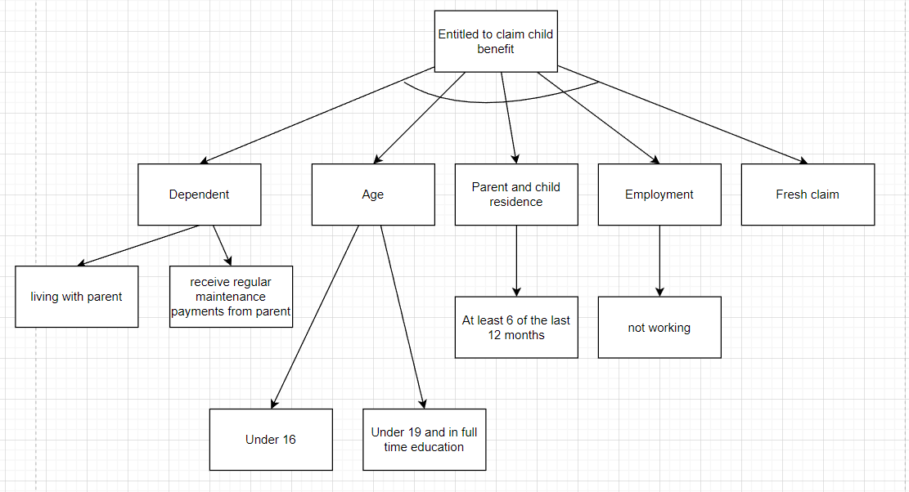

Slide 52


THANK YOU

