Slide 1
INTRODUCTION TO
ARTIFICIAL INTELLIGENCE
CAI3014
21/09/2020

Slide 2
Logic programming for AI
Prolog

Slide 3
Learning Objectives
At the end of the course, students will be able to:
CO1: Demonstrate fundamental understanding of the history of (AI) and its foundations
CO2: Apply basic principles of AI in solutions that require problem solving, inference, perception, knowledge representation and learning.
CO3: Demonstrate proficiency developing applications in an AI language, expert system shell or data mining tool
CO4: Explain proficiency in apply scientific method to models of machine learning.

Slide 4
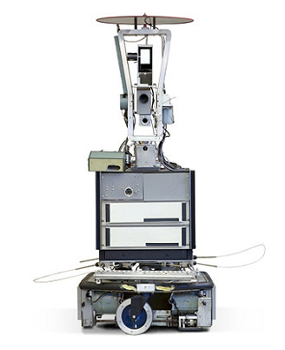
Introduction: Classical AI
Symbolic AI represents a classical method of AI programming.
Developed based on logic.
Symbolic AI had one of its biggest successes with shakey the robot, by stanford research institute in 1972.
It could reason resided within hard-coded and human-designed rules that provided the knowledge-base from which the robot would base its actions.
The project was the originator of the A* search algorithm, as well as the Stanford Research Institute Problem Solver (or strips) automated planner.

Slide 5
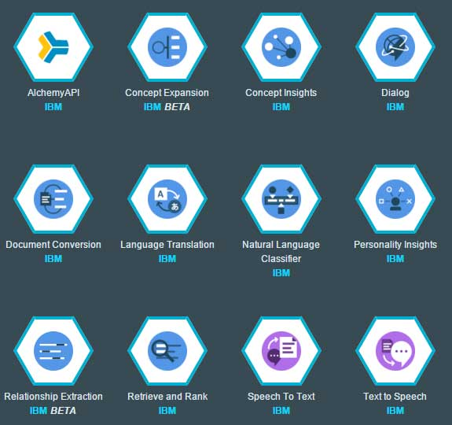

Introduction: Classical AI
One of the longest running implementations of classical AI is the CYC database project.
The cyc project could even be thought of as the predecessor to IBM Watson, which itself, includes a massive knowledge-base of domain-specific rules, facts, and conclusions.
IBM Watson, at its core, is a natural language processing tool. It uses a variety of machine learning techniques to analyze text, process data, and generate insights from large amounts of unstructured data.
We will investigate two of the basic reasoning methods behind those projects: - propositional logic and first-order logic.

Slide 6
Propositional Logic
Symbolic artificial intelligence uses human-readable logical representations of knowledge (such as production rules) in order to provide intelligent decisions (output).
What about machine learning?
Rules for logical-based AI can be provided in the form of propositional logic as follows:
Production rules:
Today is hazy
Today is gloomy
If Today is hazy, then Today is gloomy
Propositional Logic:
P: Today is hazy
G: Today is gloomy
P => G

Slide 7
Propositional Logic
Propositional Logic:
P: Today is hazy
G: Today is gloomy
P => G
We can prove propositional statements with truth tables, providing for a precise logical conclusion for arguments programmed into a symbolic AI system.
We will refer to the teaching materials for more on propositional logic.
P | G | P => G
F | F | T
F | T | T
T | F | F
T | T | T

Slide 8
Upgrading to First Order Logic
Propositional logic:
P: today is hazy
G: today is gloomy
P => g
We can improve the readability of the propositional logic by using first order logic:
Weather(hazy).
Weather(gloomy).
Weather(hazy):-weather(gloomy).
Weather(gloomy).
Query: weather(which).
Let’s put it into prolog!

Slide 9
Prolog-programming

Slide 10
Outline
Facts, rules, questions
Operators
Variables, constants
Interpreter environment

Slide 11
Facts
Facts can be as simple as:
‘It is raining today’.
Or
jill.
Useful facts usually contain predicates:
boy(jack).
girl(jill).
friends(jack, jill).
go(jack, jill, ‘up the hill’).
give(jack, jill, crown).

Slide 12
Order
Order is generally speaking arbitrary, but once you decide on the order, you should be consistent. For example:
eating(joshua, burger).
intuitively means that “joshua is eating a burger”.
We could have chosen to put the object of eating (i.e. food) first:
eating(burger, joshua).
which we can interpret as “A burger is being eaten by joshua”. The order is arbitrary in that sense.

Slide 13
Order
However,
eating(joshua, burger).
by no means implies that
eating(burger, joshua).
for clearly
eating(joshua, burger).
eating(burger, joshua).
mean different things.
Rule of thumb is to use ‘intuitive’ order, sticking to the English language when possible.

Slide 14
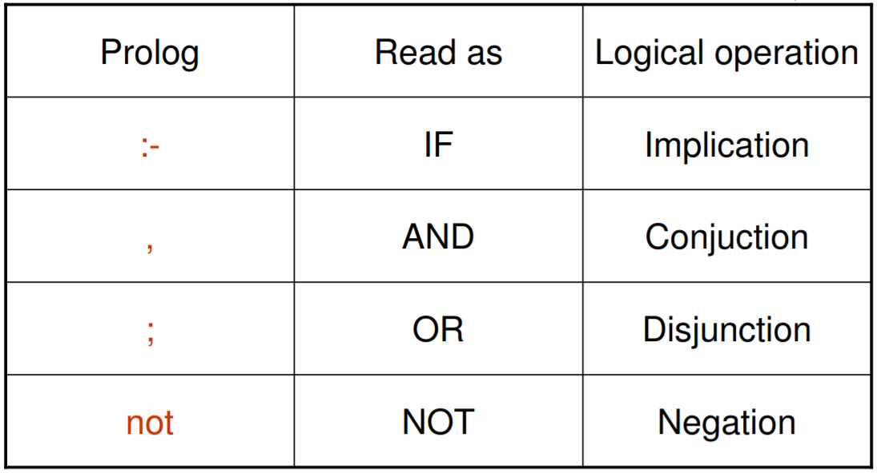
Logical operators
Prolog stands for ‘Programming in Logic’

Slide 15
Rules
Rules are used to express dependency between a fact and another fact:
child(X, Y) :- parent(Y, X).
odd(X) :- not even(X).
or a group of facts:
son(X, Y) :- parent(Y, X) , male(X).
child(X, Y) :- son(X, Y) ; daughter(X, Y).
Remember that Prolog stands for ‘Programming in Logic’

Slide 16
Questions / Queries
A question starts with the “?-” symbol (and ends with a “.”). For example:
?- eating(joshua, burger).
yes
?- eating(joshua, X).
X = burger
Facts, rules and questions are commonly referred to as clauses.

Slide 17
Variables
Remember the X of the previous slide? X is a variable.
Variables start with an upper case letter.
Another example of using variables:
?- eating(X, Y).
X = joshua
Y= burger

Slide 18
Anonymous Variables
If we need to use a variable because the rule requires it, but that variable will never be subsequently used, we can resort to using the anonymous variable, denoted by an underscore, “_”.
For example:
?- eating(joshua, _).
yes

Slide 19
Constants
In Prolog, Constants are either
Numbers
Words starting with a lower case letter
Enclosed in single quotes
So, joshua and burger and jack and jill and ‘it is rainning today’ were constants.

Slide 20
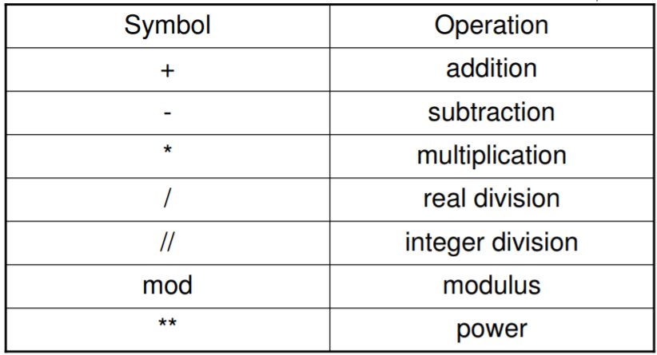
Arithmetic operators

Slide 21
Arithmetic operators
For example, in questions:
?- X is 3*4.
X = 12
Or in rules:
plus(X, Y, Z) :- Z is X + Y.

Slide 22
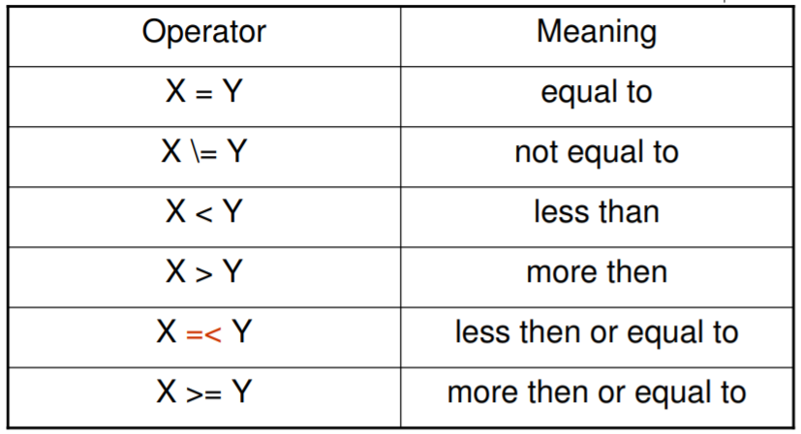
Relational operators

Slide 23
Relational operators
For example, in questions:
?- age(X, Y), Y < 30.
Or in rules:
minimum(M, N, M) :- M =< N.
minimum(M, N, N) :- N =< M.

Slide 24
Interpreter environment
?- help(what). Give help on predicate what. Actually, help has more options. Try ?- help(help). to see them all.
?- apropos(what). Display predicates, functions and sections that have `what'(or`What', etc.) in their summary description.
?- halt. Terminates the interpreter.
?- consult(file). Load a program from a local file.
?- [filename]. Synonymous with consult.

Slide 25
Interpreter environment
?- listing(what). Lists all lines that start with the predicate what.
?- listing. List all lines of the loaded program.
; If there is more than one answer to a question, Prolog will pause after the first one. Typing “;” and hitting enter will lead Prolog to look for the following answers. Just hitting enter will make Prolog stop looking for answers.

Slide 26

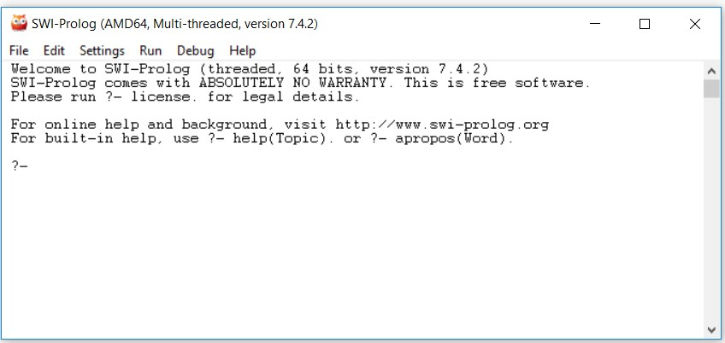
COMPILE AND RUN
21/09/2020

Slide 27

HTTPS://SWISH.SWI-PROLOG.ORG/

Slide 28
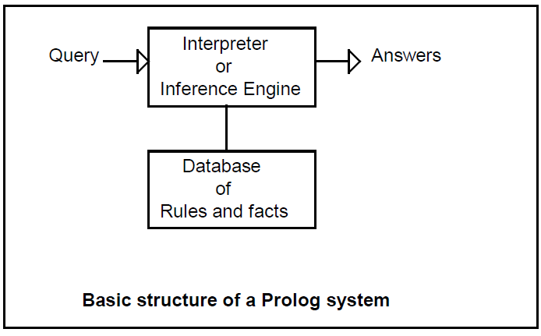
PROLOG ENGINE
21/09/2020

Slide 29
FACT EXAMPLES
John is thin
The cat is brown
suzan likes jack thin(john).
brown(cat).
likes(suzan, jack).
21/09/2020

Slide 30
RULES - EXAMPLES
likes(ryan, jacky). likes(jacky, ryan). likes(dan, josh).
// All are friends. If you want to know who is dating who!!!
dating(X,Y):-
likes(X,Y),
likes(Y,X).
21/09/2020

Slide 31


THANK YOU

