Slide 1
Introduction to Python

Slide 2
Why python?
The need for python can be distributed under various aspects as discussed below:
FOR DEVELOPERS
Intuitive Syntax
Free and Open
Sourced
Community Support
Strong Guidelines
Strong Standards
APPLICATIONS
Data Science
Data Engineering
Web Development
Big Data Analytics
Web Testing
Artificial Intelligence
Smart Device
Programming
GENERAL CHARACTERISTICS
High Level language
Readable
General Purpose
Widely Used
JOB ROLES
Research Analyst
Data Analyst
Data Scientist
Web Developers
FEATURES OF PYTHON
Does not need compilers to run python codes
Its an interpreter
Executes line by line
Writing application, testing, deployment is faster
Easy to integrate different modules
Debugging is easier
Rich data types, object-oriented
Notes:
Python is a high-level programming language.
It is Easy to read and has intuitive syntax.
It is also a general purpose programming language which is Free and open-source.
It has Good community support, Strong guidelines and standards.
It is Widely used across industries and has De facto standard for building data science applications.

Slide 3
Advantages of python
Listed below are few advantages of python
Easy and
Simple syntax
Anyone can easily
learn and adopt
Is it Object Oriented ?
YES
Includes Nested and
Heterogeneous
structure
Simple to construct
programs and use
Supports multiple formats
of files
Flat files, pdf, excel
xml, JSON, Images
Automatic integration
Capability ( With C, C++,
Fortran etc.)
Ease of integration helps
in taking advantages of other
Languages and integrate with
Existing applications
built in other
languages
Can be integrated with
all standard database
and big data tools
Ease of integration helps
to talk to wide variety of
data sources
Seamless integration of
Visualization and
Simulations (Execution)
Quickly and easily
visualize
your computation results
Is python used only for
Data Science and
analytic applications ?
NO, Many more
applications
Notes:
Given its easy and simple syntax, anyone can start programming in python right from day one.
It is an interpreted language.
Object-oriented programming is also possible.
Nested, heterogeneous data structures are simple to construct and use.
Supports many sources of data like flat files, excel, PDFs, images, etc.
Ability to connect to all standard databases and big data tools.
Another factor is the tight integration of simulation and visualization.
One can quickly and easily visualize what they have computed.
Not just for data analysis, Python can also be used for testing, web applications, text mining, DevOps, etc.
Integration of Python with C, C++, Fortran and Java is (almost) automatic.

Slide 4
Applications of python
Python is largely used in a variety of applications scenarios as categorized below:
Data Science
Machine Learning
Web Scraping
Exploratory Data
Analysis
Deep Learning
Artificial Intelligence
Unstructured Data
Analysis
General
Scientific Analysis
Testing Applications
Web Development
Django
Tornado
Flask
Notes:
Here are a few examples of what Python will let you do:
You can use Python to create web applications on many levels of complexity.
There are many excellent Python web frameworks including, Pyramid, Django and Flask, to name a few.
Python is the leading language of choice for many data scientists.
Python has grown in popularity, within this field, due to its excellent libraries including; NumPy and Pandas and its superb libraries for data visualization like Matplotlib and Seaborn.
There are many wonderful libraries implementing machine learning algorithms such as Scikit-Learn, NLTK and TensorFlow.
You can create video games using module Pygame.
You use Python to write the logic of the game.
PyGame applications can run on Android devices.
You can use Python for scraping data, can write scripts to automate repetitive stuff and is also great for validating ideas or products for established companies and start-ups alike.

Slide 5
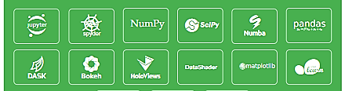
Anaconda Distribution package
WHY?
Package:
Free, open-source, easy-to-install package manager, environment manager and Python distribution with a collection of 1,000+ open source packages with free community support.
Platform-agnostic:
Use on Windows, macOS or Linux.
The package includes:
Jupyter Notebook – Popular IDE for development using python
Popular libraries like NumPy, Pandas, SciPy
We will be using Jupyter Notebook IDE which is part of anaconda distribution package on our platform to do application development using python
We will also be using popular packages like pandas, NumPy and SciPy from this distributable in later courses
Download and Install Instructions
Step 1: Download Anaconda Distribution package.
Step 2: Install Python 3.6 (Anaconda Distribution package).
Notes:
We will be using Anaconda Distribution to install Python 3.6 .
Download & Install Python 3.6 version (64-Bit) from www.anaconda.com/download .
It comes with Jupyter Notebook IDE , which CAN BE used for executing and saving python commands as notebooks.

Slide 6
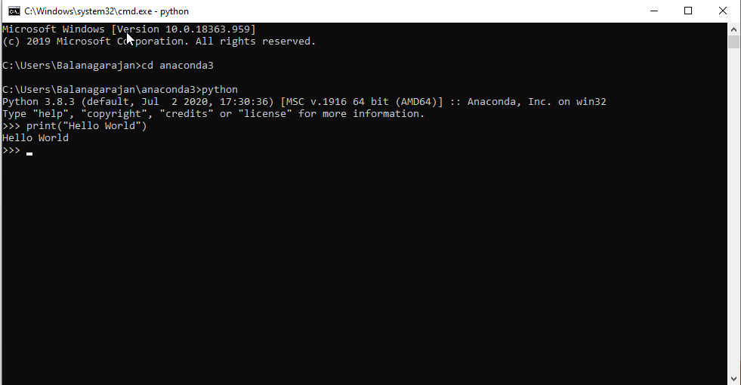
Installation verification
On Windows Environment
Open command Prompt
Set path to anaconda
Type “python” on command prompt to verify if python is accessible
Notes:
After installation of anaconda to check if python is properly installed along with the distributable,
run “python” in command prompt or in shell prompt depending upon the Operating System where it is installed.
Make sure that you are in to python environment before running the command else set the environment variable to anaconda’s bin directory.

Slide 7
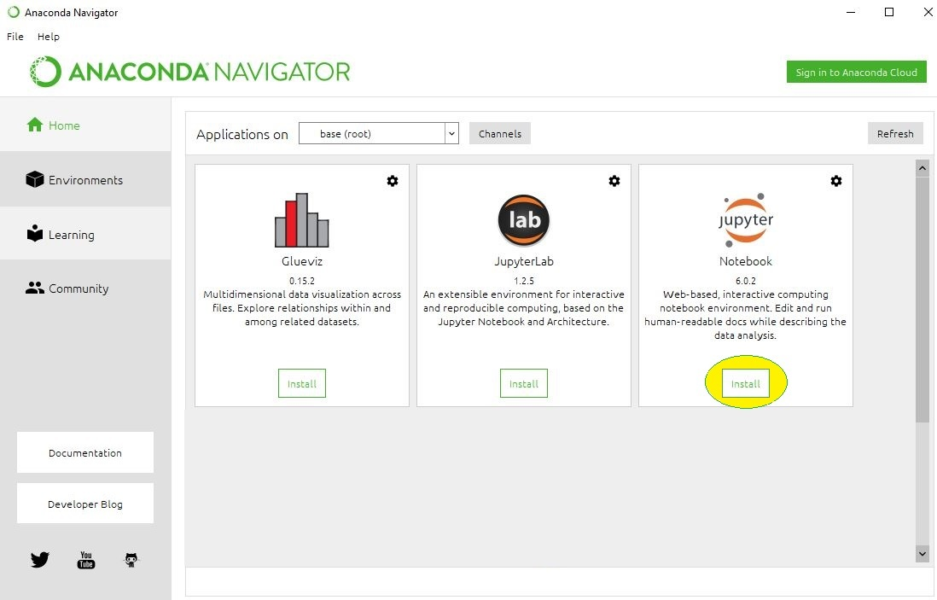
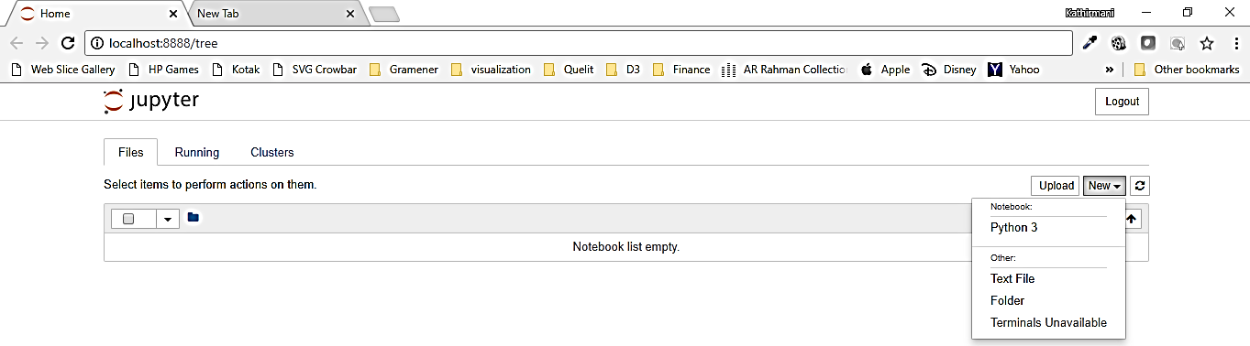
Starting Jupyter Notebook
http://localhost:8888/tree
Click on New -> Python3
Notes:
Any python commands can be executed inside python environment via command line itself.
Though we will be using Jupyter notebook, the command mode is handy to quickly check syntax or to get help.
Start the jupyter server by typing jupyter notebook on command prompt.
Once the server is started, open a browser to access jupyter notebook by typing the URL http://localhost:8888 .
Please note, local host is the same machine where your jupyter server is running .
If the server is installed in some other machine, make sure to replace localhost with the appropriate server name, or the IP address of the machine where the server is running.
Jupyter notebook will start in port 8888.

Slide 8
Variable Declaration
Variable declaration is as easy as you can imagine in python
Create variable easily by directly assigning values to it
age=25
Python destroys unused variable storages automatically
You can add variables during runtime
Need not explicitly declare the variable
age=25
Here the variable age is not explicitly defined of its type
Automatically recognizes type based on data assigned to variable
age=25 → Default type is int
Sum =100.75 → Default type is float
Name=‘JOHN’ → Default type is string
Notes:
Variables play a major role in any programming language.
It is used to store values temporarily or permanently in RAM, or in hard disk depending upon the usage.
A variable can store any type of value.
For example, we can store numbers or strings or a group of these as well.
In python, it is easy to create a variable by directly assigning values to it.
Unlike many other languages, it is not required to declare the variable type before assigning a value to it.
Python will automatically recognize and assign the type of variable based on assigned value.
Whole numbers will be considered as integers.
Decimal numbers will be considered as Float.
We can very easily create strings by wrapping the text within single quotes or double quote.
Unlike SQL, we need not declare the variable size or length before creating it.
Python will dynamically allocate memory.
One can just create variables when needed.
Once used, Python will destroy them automatically from memory.
By default, python stores all the variables in RAM.
One can also create dynamic variables at run time.
Thus, it is much more dynamic than many other languages.

Slide 9
Data Types
Data types in python can be grouped as follows:
BOOLEAN
True / False
NUMBERS
Integer, Float
STRINGS
Sequence of Unicode characters
BYTES AND BYTEARRAY
immutable and mutable sequence
If (age > = 18)
eligible _to _vote = True
else
eligible_to_vote=False
Age=35
TotalPrice=100.78
Complex_value=2+3j
Message=“Welcome to python”
Message=‘Welcome’
X=b”Welcome” → byte object
x = bytearray(b"Python Bytes") → byte array
LISTS
Ordered sequence of values
TUPLES
Ordered immutable sequence of values
SETS
Unordered collection of values
DICTIONARIES
Unordered collection of Key-Value pairs
Week={‘Mon’, ‘Tue’, ‘Wed’}
Value={‘key’:1, ‘value’: apple}
Value=[1, 2.2, ”python”]
Value=[2, “Tuple”, “95”]
Notes:
Standard default data types which are commonly used in Python are as follows.
Numeric, which can be either integer or float.
Boolean, which takes the values True or False.
Strings, which takes bunch of characters together.
List, which stores collection of heterogenous elements together.
Tuples, which is similar to list, except for the fact that they are immutable.
Dictionary, which takes values along with a key for each value and stores them with no specific order.
They are also called as key-value pairs.
Dates, using which we can extract additional information, like year, month, weekday etc.
None is a special type which is used when we do not want to store or return any value.
These data types are part of default python.
There are few other data types which are module specific.
For example, we will learn about data types called series and data frames which are not native python data types, but part of a data processing library called Pandas.
Likewise, the Numpy library comes with many other data types like n-dimensional array. Going forward, we will learn more of these data types, in detail.

Slide 10
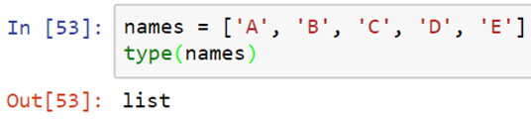
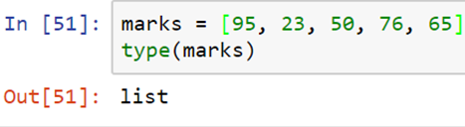
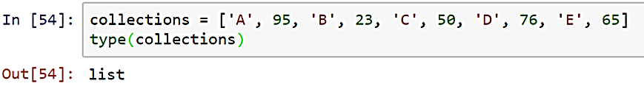
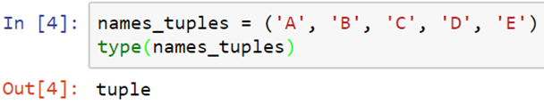
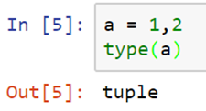

LIST
A data structure that contains group of elements.
Elements can be of type numbers, strings, Boolean or even mix of these.
Lists, tuples & dictionary
Let us understand the concept of LISTS, TUPLES & DICTIONARY
LIST
TUPLE
Similar to list, but tuples are immutable (the elements cannot be modified).
The syntax uses parenthesis instead of square brackets
Tuples can also be created without parenthesis.
useful when returning multiple results in a function.
TUPLE
DICTIONARY
An associative array (also known as hashes).
A value in the dictionary has a name (or Key).
Each element in a dictionary contains a key and value
The key & value can be of any type. It could be a string, number, Boolean
Elements in a dictionary are not ordered.
DICTIONARY
Notes:
Lets learn about another important data type in python called as Lists.
List or array is a data structure that contains group of elements.
Elements can be of type numbers, strings, Booleans or even mix of these.
For example, here marks is a list which contains bunch of numbers.
To create a list we have to pass the elements within square brackets.
The elements should be separated by commas.
We can also group bunch of strings like this.
If all the elements in a list is of same type, for example integers, floats, or strings we can say that the list contains homogenous data.
If we have mix of elements with different types, for example, in this collections list, we have strings and numbers together.
This is also a valid python list and contains heterogenous data.
Lists are very powerful and widely used across data analysis.
There is lot of useful operations we can do with a list.
We will learn them in detail in upcoming sections.
Tuples is an another data types in python which is also used to store group of elements.
Tuples are similar to list, just that tuples are immutable.
That is, once the tuple is created the elements cannot be modified.
While creating a tuple, we will be using parenthesis instead of square brackets as shown in this example.
But the parenthesis are optional.
But it is advisable to use parenthesis to explicitly indicate that it is a tuple.
When functions return more than one element, it will be returned as tuple.
Another widely used data type in python is dictionary.
Dictionary is an associate array, also known as hashes in some other languages.
It is very close to a list.
But have both advantages and disadvantages when compared to list.
Each element in a dictionary has a value and a name to that value.
The name to the value is also called as KEY.
Thus each element in a dictionary will always have a key and value.
Both these can be of any type, that is, a key could be a string or a number or Boolean.
Dictionaries are useful for mappings and configurations.
In a list, we access the elements using their position, whereas in a dictionary we can access using its key.
There is no other direct way to access a value without using its key.
Only disadvantage and the very important concept to keep in mind is that, elements in a dictionary are not ordered.
Since there is no concept of position, we cannot access elements using its position.
If we try to loop in to the elements, the order in which they appear is not the same order in which they are created.

Slide 11
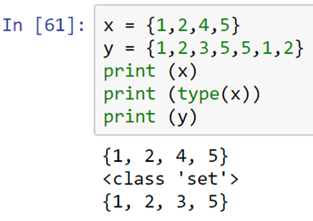

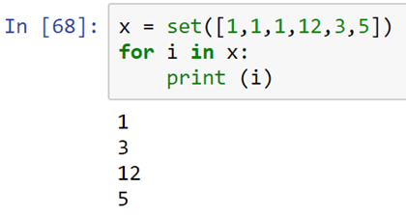
set
A set is an unordered collection of items.
Every element is unique (no duplicates) and it is immutable (which cannot be changed).
However, the set itself is mutable. We can add or remove items from it.
One can use for loop to access the individual elements, but the order will not be maintained.
A set is an unordered collection of items.
Every element is unique (no duplicates) and it is immutable (which cannot be changed).
However, the set itself is mutable. We can add or remove items from it.
Even if the values that are passed for set function contain
duplicates, the method will remove them and will store only unique values
!
Notes:
A set is a unordered collections of items.
Every element is unique in the set and the elements are immutable, that is - it cannot be changed once created.
However the set itself is mutable.
We can add or remove items from it.
To create a set, we have to pass collection of elements within flower braces.
The elements should be comma separated.
Lets take an example, in the first line we are creating a set called x, with values 1,2,4,5.
The set does not contain any duplicates while getting created.
Lets create another set which has duplicates on creation.
For example, here the values like 5, 1, 2 are duplicated.
But when we print the values in y, we see only the unique elements in the collections.
Even though the values that are passed for set function contains duplicates, the method will remove them and will store only unique values.
Set function is used very often to remove duplicates from list.
In this example, we are passing a list to the set function.
The output is a set with only the unique elements in the list.
Since sets are unordered, the elements cannot be accessed using its position - that is its index.
Python will throw error if we index a set.
Instead, one can use a for loop to access the individual elements, but the order will not be maintained.
For example in this list, the value 3 appears after 12 while creating the set.
But while looping through each element and printing the same, we can see that the value 3 appears before 12.
This is a simple for loop which is used to access one element at a time.
We will learn more about for loop in upcoming sections.

Slide 12
HANDS-ON PRACTICE
File: Programming basic

Slide 13
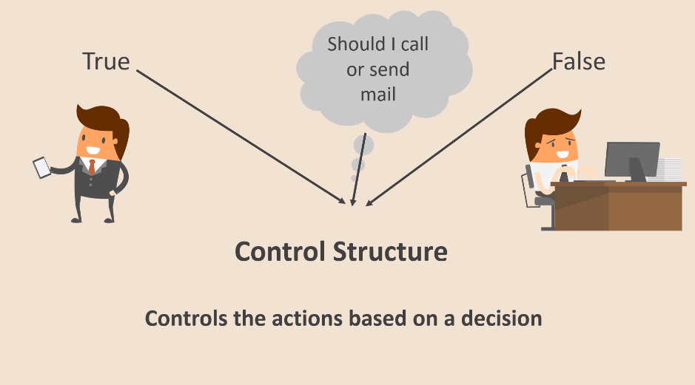
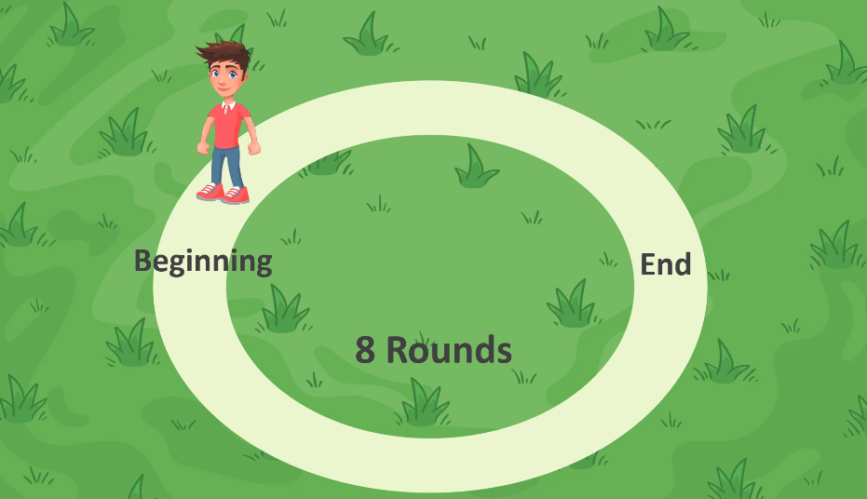

CONTROl STRUCTURES
CONDITIONAL STATEMENTS AND LOOPS

Slide 14
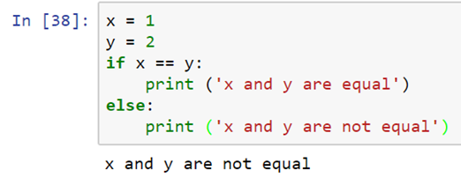
Conditional Statements
Let us understand the decision making and branching statements in detail
It is used to test any assumptions or to compare values
It must be indented properly
Nested conditional statements are also possible
Simple conditional statement can have just the if part alone
True Flow
False Flow
Condition ?
Validation
True Block
False Block
Next Statements
Notes:
Conditional statements are another building blocks of any programming language. They are used to test any assumption or compare values to decide upon what action to be taken. Like loops conditional statements uses indentation to identify where is starts and ends. The syntax is pretty simple. We have to use the if keyword along with the logical comparison that we wanted to use. After the logical comparison, we can use colon to start the indentation from the next line. Whatever code placed inside this block will be executed only if the logical comparison returns True. Else the execution will be switched to the code inside the else block as shown here. In this example, x is not equal to one. Hence the print statement inside the else block will be executed. Simple conditional statement can have just the if part alone, if we do not wish to do anything if the logical comparison fails. Nested conditional statements are also possible.

Slide 15
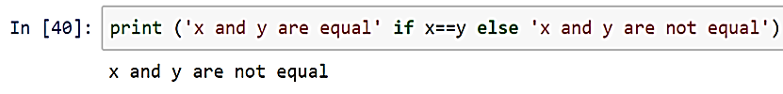
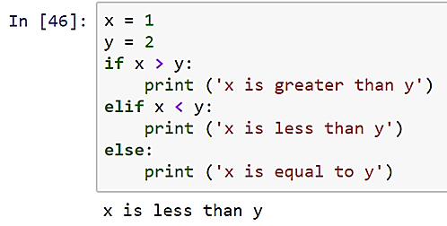
Single line & elif in conditional statements
Let us understand single line and elif usage in conditional statements
Example – Single Line statements
Example - ELIF
Notes:
At times single line conditional statements comes handy as shown here. In this type of syntax, the first part will be statements which should be executed when the condition passes. Followed by this we will have the if keyword along with the logical comparison. Finally we can have the else keyword along with the statement which will be executed when the condition fails
El if statements can be used if we want to test more than one condition. In this example we have three print statements. The first print statement will get executed when x is greater than y. The second print statement, which is part of el if block, will get executed if x is less than y. If both conditions fail, which means than x is equal to y, the last print statement will be executed. Note than one can have more than one el if block in a single conditional statement

Slide 16
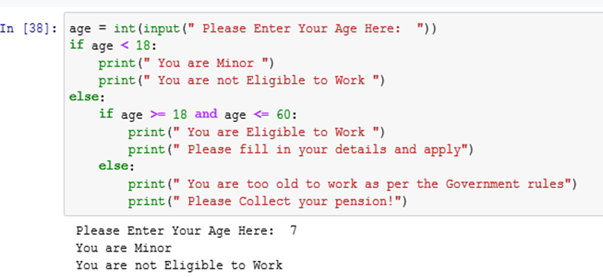
Nested conditional statements
Let us understand the usage of nested conditional statements
Nest conditional statements to any depth
It is not mandatory that every if in nesting must have an else coupled with it
Notes:
You can nest the conditional statements to any depth.
And it is not mandatory that every if in the nesting must have an else coupled with it.
Here’s an example that depicts the usage of nested conditional statements very clearly.

Slide 17
And / or operator in conditional statements
Let us understand the usage of AND / OR operator in conditional statements
Condition 1
Condition 2
Statement executes only if condition 1 and condition 2 is TRUE
Condition 1
Condition 2
Statement executes if either one condition TRUE
Notes:
There will be situations in which we want to have more than one logical comparison at a time.
For example, if we want to do something only if both the values of x and y are greater than 5, we can use AND operator.
Logical AND or OR are possible inside the conditional statements.
Usage of them is intuitive and easy to understand.
Enclose the individual conditions by parenthesis and separate them using either AND operator or OR operator depending upon the logic to be implemented.
In this example, the logical comparison inside the if block checks if the value of both x and y are greater than 5.
Whereas the el if block compares whether any one of the values in x or y is greater than 5.
If both these logical comparisons fail, the execution will be moved to the else block.
Since the value of x and y is greater than 5 in our case, the print statement inside the if block gets executed.

Slide 18
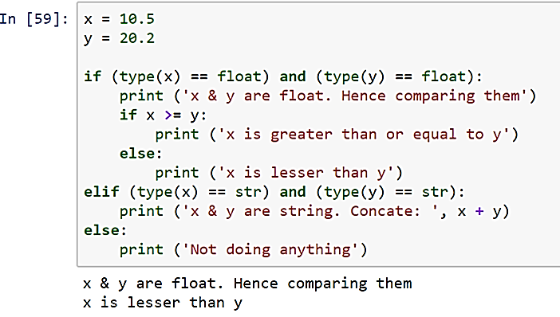
Sample – conditional statements
Let us understand the decision making and branching statements using an example
Problem Statement :
Check if two variables are of type float or str
If they are floats, check with is higher, else they are string; concatenate two strings
Validation
Illustrates usage of …
If statement
ELIF
AND Operator
OR Operator
NESTED Conditional Statements
Notes:
Here’s a simple example pertaining to branching statement. The code here, checks if 2 variables are of type float or string.
If they are both floats, check which is one is higher and if they are both strings, then concatenate two strings.
If one of them is a string and other a float, then the else block gets executed.

Slide 19
HANDS-ON PRACTICE
My electricity bills for the last three months have been 23, 32 and 64. What is the average monthly electricity bill over the three month period? Write an expression to calculate the mean, and use print() to view the result.
Perform the following some calculations for a tiler. Two parts of a floor need tiling. One part is 9 tiles wide by 7 tiles long, the other is 5 tiles wide by 7 tiles long. Tiles come in packages of 6. a) How many tiles are needed? b) You buy 17 packages of tiles containing 6 tiles each. How many tiles will be left over?
File: Practice 1

Slide 20
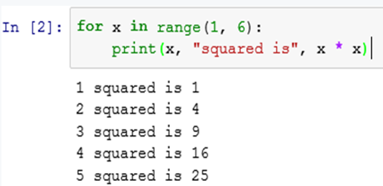
For loop
Let us understand the usage of FOR LOOP in detail
Indent the statements to be repeated with 4 white spaces.
variableName gives a name to each value, so you can refer to it in the statements.
groupOfValues can be a range of integers, specified with the range function.
Syntax :
for variableName in groupOfValues: statements
For conditional statement ?
FALSE
TRUE
VariableName
groupOfValues
Execution Statements
Within FOR BLOCK
NEXT ITERATION
Execution Statements
Out of FOR BLOCK
Notes:
Whenever we need to executed a set of statements repeatedly for a period of time, we need to use for loop.
This loop will help us to iterate though each value specified in the group of values and each time it fetches a value, the statements given within the for loop will get executed. In the given example, the for loop fetches each value specified within the range, 1 to 6 and its squared value gets printed.

Slide 21
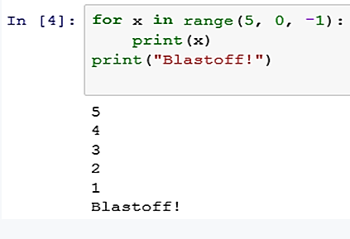
Range in loops
Let us learn about the concept of ranges in loops
Range Syntax 1:
range(start, stop)
the integers between start (inclusive) and stop (exclusive)
Range Syntax 2:
range(start, stop, step)
the integers between start (inclusive) and stop (exclusive) by step
Start
Stop
Step
Notes:
We can specify the group of values of a for loop using a range function. This function takes two or tree parameters.
If we specify 2 parameters, the first integer will be the starting value and second integer will be the stop value.
If we specify 3 parameters, the first integer will be the starting value, second integer will be the second values and third integer will be step value.

Slide 22
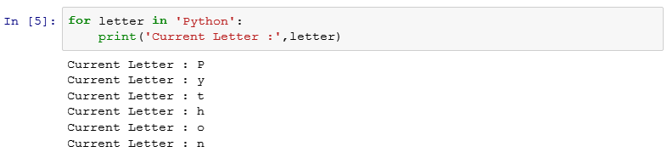
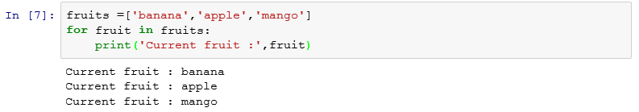
More examples
Let us understand the concepts of FOR using examples
Notes:
Here you can see certain examples for using for loop.
In the first example; from a string named “Python” , for loop fetches each character separately and displays it.
In the second example; a list called ‘fruits’ contain a list of fruit names. Then using a for loop, you can access each value in the list and display it.

Slide 23
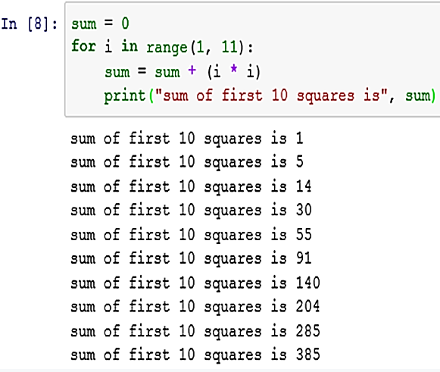
cumulative loops
Let us understand the concept of cumulative loops
Initialize variable for
Usage in loop
Some loops incrementally compute a value that is initialized outside the loop.
This is called a cumulative sum
For conditional statement ?
FALSE
TRUE
Execution Statements
Within FOR BLOCK
NEXT ITERATION
Execution Statements
Out of FOR BLOCK
Notes:
A cumulative sum is summation of a sequence of numbers which is updated each time a new number is added to the sequence.
The given example depicts a program to calculate the cumulative sum of the squares of first 10 numbers.

Slide 24
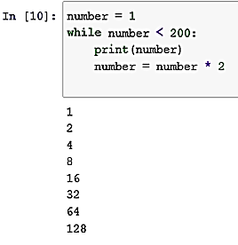
while loop
Let us understand WHILE Statements in detail
Initialize variable for
Usage in loop
Syntax :
while condition:
statements
Executes a group of statements as long as a condition is True.
This is good for indefinite loops (repeat an unknown number of times.
WHILE conditional statement ?
FALSE
TRUE
Execution Statements
Within WHILE BLOCK
NEXT ITERATION
Execution Statements
Out of WHILE BLOCK
Notes:
While loop is another type of looping statement. Whenever we need to execute a group of statements unknown number of
Times , we can use this statement. As long as the condition is true, while loop executes the given statements.
In the given example as long as the variable ‘number’ is less than 200, the given statements will get executed.

Slide 25
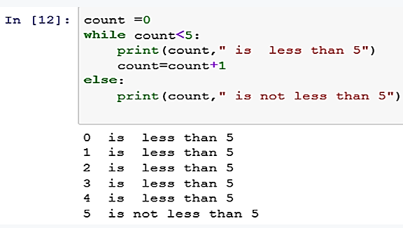
Else statement in loops
Let us understand the usage of else in loops
Initialize variable for
Usage in loop
Python supports an else statement associated with a loop statement.
If the else statement is used with a for loop, the else statement is executed when the loop has exhausted iterating the list.
If the else statement is used with a while loop, the else statement is executed when the condition becomes false.
WHILE conditional statement ?
FALSE
TRUE
Execution Statements
Within WHILE BLOCK
NEXT ITERATION
ELSE block of while loop
Execution Statements
Out of WHILE BLOCK
Notes:
Along with the loop statements, Python also allow as to give ‘else’ statement. The statement that is given in the ‘else’ part in the while loop will get executed, when the condition becomes false and in the case of for loop, the ‘else’ part is executed when the loop has finished iterating the list of values.

Slide 26
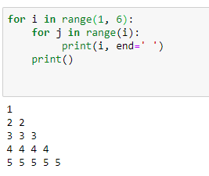
Nested loops
Let us understand the usage of nested loops
A nested loop is a loop that occurs within another loop
Example:
Program to print the number pattern
Syntax:
for [first iterating variable] in [outer loop]: # Outer loop
[do something]
for [second iterating variable] in [nested loop]: # Nested loop
[do something]
Notes:
Loops can be nested in Python. A nested loop is a loop that occurs within another loop.
Observe the syntax for a nested loop.
The program first encounters the outer loop, executing its first iteration. This first iteration triggers the inner, nested loop, which then runs to completion. Then the program returns to the top of the outer loop, completing the second iteration and again triggering the inner loop. Again, the inner loop runs to completion, and the program returns to the top of the outer loop until the sequence is completed, or, a control statement disrupts the process.
Observe the sample program for printing a number pattern. Here we have used two loops. The outer loop will iterate for 1 to 5 times and for each of these Iterations another loop will run ‘i’ items and it will print the value of i.

Slide 27
Nested loops
Let us understand the usage of nested loops
Nested loops can be:
For loop:
For Loop:
While loop:
While loop:
For loop:
While loop:
While loop:
For loop:
Notes:
Loops can be in different ways:
For loop within a for loop.
While loop within a while loop.
While loop within a for loop.
For loop within a while loop.

Slide 28
Control statements in loops
Let us understand the usage of control statements in loops
Loop control statements change execution from its normal sequence
break
Terminates the loop statement and transfers execution to the statement immediately after the loop.
continue
Causes the loop to skip the remainder of its body and immediately retest its condition prior to next iteration.
pass
The pass statement in Python is used when a statement is required syntactically but you do not want any command or code to execute
Notes:
Some times we need to change the execution of statements from the normal sequence. Python provides some statements for this and they are known as loop control statements. They are break, continue and pass.
The statement ‘break’ helps us to terminate the loop during iteration and to execute the statements immediately after the loop.
The ‘Continue’ statement helps us to skip the remaining statements after this and to continue with the next iteration.
The ‘pass’ statement is required when you syntactically need a statement but you don’t need to execute it.

Slide 29
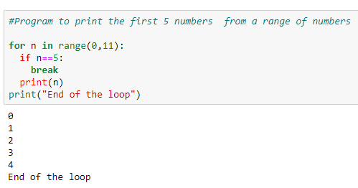
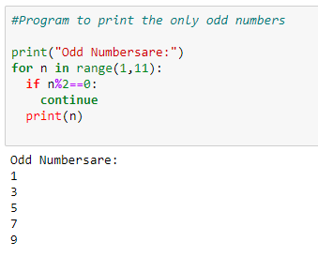
Break and continue
Let us understand the usage of BREAK and CONTINUE
Using ‘break’
Using ‘continue’
Notes:
Observe the sample programs given for the control statements: break and continue.
In the first example we are displaying the first 5 numbers from a range of values. In the ‘for’ loop the range is starting from 0 to 11-1 and fetching each Element into the variable ‘n’. If the fetched values is not 5, then the program will print that value. Whenever ‘n’ s value become 5, it breaks the ‘for’ loop and execute the next statement after the loop. Remember, a break always exits from the inner loop if there are nested loops.
In the next example, we are trying to print the odd numbers from a range of values. Using ‘for’ loop , it fetch each number from the loops and if the number is divisible by 2, then assume that the number is an even number and continue the next iteration without printing that number.

Slide 30
pass
Let us understand the usage of PASS
Pass
This is a null statement.
Generally used as a placeholder.
Nothing happens when it is executed.
It is used when a statement is required syntactically but you do not want any command or code to execute.
When to use:
If we have a loop or a function that is not implemented yet, but we want to implement it in the future.
They cannot have an empty body because interpreter would complain. So, we use the pass statement to construct a body that does nothing. (Stubs for example).
Syntax of pass:
for val in sequence:
pass
Notes:
Python considers ‘pass’ is a null statement. It is just a placeholder for a command or code to be executed. Assume, we need to use a loop or function which we want to implement in future. If we keep the function or loop with an empty body , the interpreter will complain. To avoid this, we must use ‘pass’ statement to construct a body that does nothing. Observe the example.

Slide 31
HANDS-ON PRACTICE
File: Loops Example

Slide 32
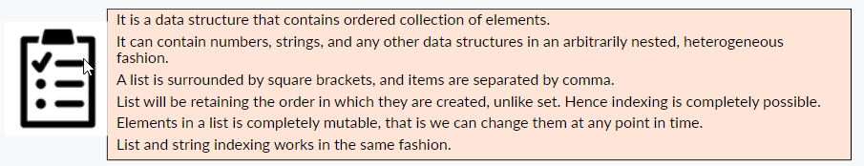
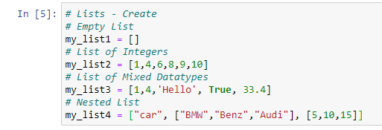
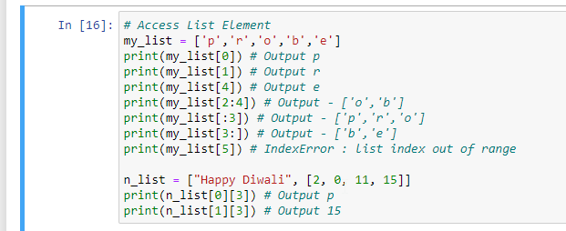
LISTs

Slide 33
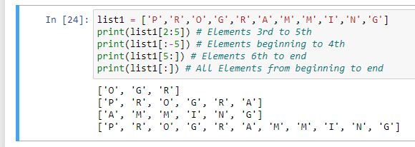
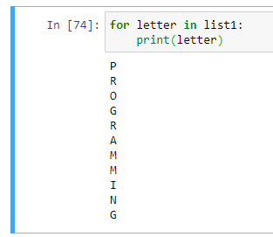
LIST - ACCESSING ELEMENTS using POSITION and FOR LOOP
Understand List Index
P | R | O | G | R | A | M | M | I | N | G
0 | 1 | 2 | 3 | 4 | 5 | 6 | 7 | 8 | 9 | 10
-11 | -10 | -9 | -8 | -7 | -6 | -5 | -4 | -3 | -2 | -1
Positive
Index
Negative
Index
POSITION
FOR LOOP

Slide 34
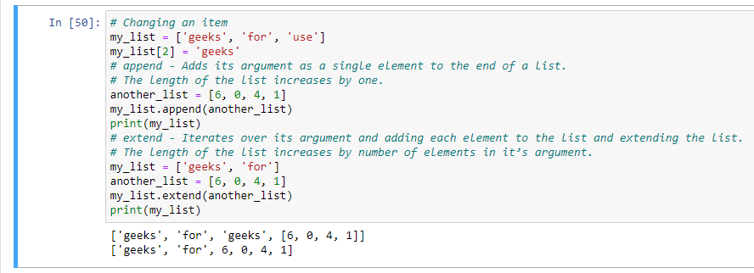
LISTS - CHANGING AND ADDING ITEMS
append() - Adds its argument as a single element to the end of a list. The length of the list increases by one.
extend() - Iterates over its argument and adding each element to the list and extending the list. The length of the list increases by number of elements in it’s argument.

Slide 35
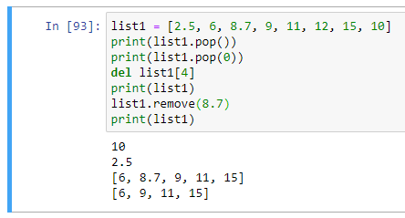
LISTS – DELETING ITEMS
pop() - index is not a necessary parameter, if not mentioned takes the last index
del() - Element to be deleted is mentioned using list name and index.
remove() - Element to be deleted is mentioned using list name and element.

Slide 36
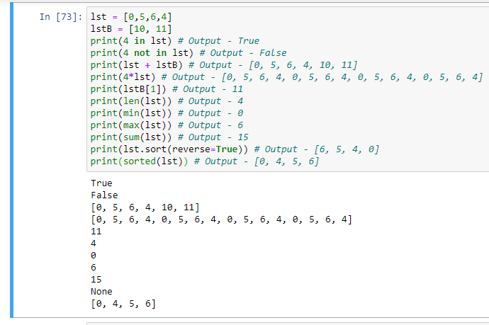
TRY THESE - LIST OPERATORS & FUNCTIONS
Practice
Usage | Explanation
x in lst | x is an item of lst
x not in lst | x is not an item of lst
lst + lstB | Concatenation of lst and lstB
lst*n, n*lst | Concatenation of n copies of lst
lst[i] | Item at index i of lst
len(lst) | Number of items in lst
min(lst) | Minimum item in lst
max(lst) | Maximum item in lst
sum(lst) | Sum of items in lst
lst.sort(reverse=True) | Sorts the items in descending order
sorted(lst) | sorts the items in ascending order

Slide 37
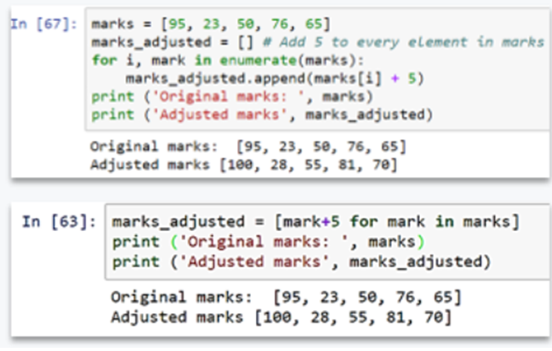
LIST COMPREHENSION
Let us understand List Comprehension
Python supports a compact way to manipulate item by item in a list using list comprehensions.
They may contain any number of nested lists, combined with conditional expressions if desired.
Scenario:
Add 5 marks to existing set of marks
Solution:
Create an empty list
Use FOR LOOP to access each mark in the marks list
Add 5 to it and finally append the mark one by one to the new list
Instead of using for loop separately, we can use the for loop inside the new list itself.

Slide 38
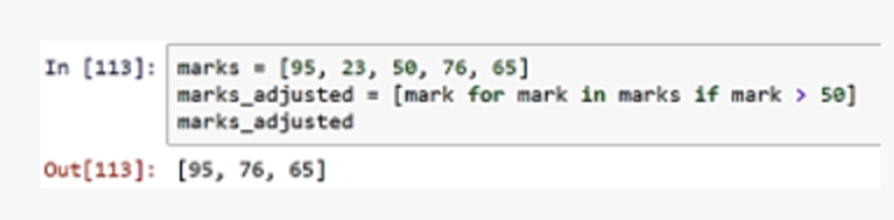
LIST COMPREHENSION
Scenario:
Extract marks which are greater than 50
Solution:
Use FOR LOOP and if condition in a single list using list comprehension. This avoids multiple lines of code.

Slide 39
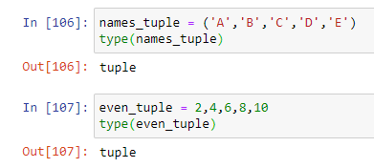

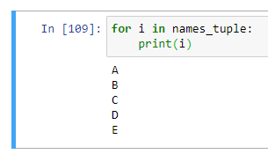
TUPLES
Let us understand TUPLES
Tuples is data structure that contains group of elements
Tuples are similar to list, just that tuples are immutable i.e. the elements cannot be changed
The syntax uses parenthesis instead of square brackets
Tuples can also be created without parenthesis
Tuples are very useful when returning multiple results in a function
In tuples elements cannot be appended or edited, unlike list
CREATING TUPLE
ACCESSING TUPLE USING POSITION
ACCESSING TUPLE USING FOR LOOP

Slide 40
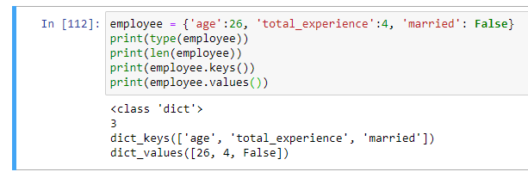
DICTIONARY
Key – Value Pairs
An associative array
A Value in the dictionary has a name (for Key)
Each element in a dictionary contains a key and value.
Elements in a dictionary are not ordered
The values can be of any type. It could be a string, number, Boolean
Dictionaries are useful for mappings and configurations.
CREATING DICTIONARY

Slide 41


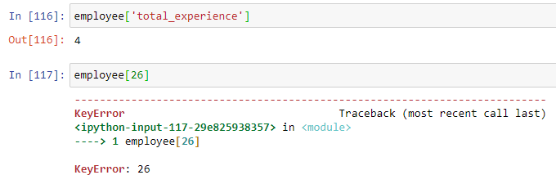
We can access a value using corresponding key
We cannot access a key using its value

Slide 42
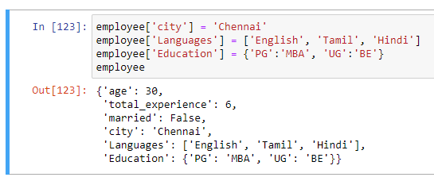
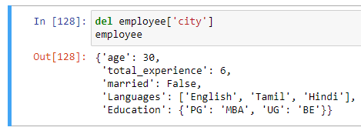
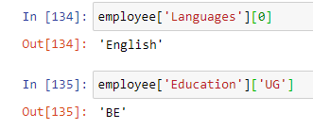


DICTIONARY - Adding NEW ELEMENTS
Add – Syntax: Variable_name[<new_key_name>] = <new_value>
Delete – Syntax: del Variable_name[<key_name>] or Variable_name.pop(<key_name>, None)
ADDING NEW ELEMENTS
DELETE USING DEL
ACCESSING ELEMENTS
CHECK EXISTENCE OF A KEY
DELETE USING POP

Slide 43
LIST VS TUPLE VS SET VS DICTIONARY
Summary
Data Structure | Ordered | Mutable | Constructor | Example
List | Yes | Yes | [ ] or list() | [5.7, 4, 'yes', 5.7]
Tuple | Yes | No | ( ) or tuple() | (5.7, 4, 'yes', 5.7)
Set | No | Yes | {}* or set() | {5.7, 4, 'yes'}
Dictionary | No | No** | { } or dict() | {'Jun': 75, 'Jul': 89}
*You can use curly braces to define a set like this: {1, 2, 3}. However, if you leave the curly braces empty like this: {} Python will instead create an empty dictionary. So to create an empty set, use set(). ** A dictionary itself is mutable, but each of its individual keys must be immutable.

Slide 44
HANDS-ON PRACTICE
File: Data_Structure

Slide 45
Functions
At the core of any programming language is the notion of functions
Functions allow code to be encapsulated in to individual units, which can be re-used rather than being duplicated all over the place
When we define a function, we specify the name and the sequence of statements
Functions:
Later we can call the function by name how many every times we want
Named sequence of statements that perform a computation
Functions generally takes arguments and returns a result
There could be more than one arguments and more than one value to return
The arguments and results could be of any type like number, string, Boolean, list, dictionary etc.
Notes:
Functions allow code to be encapsulated in to individual units, which can be re-used.
In the context of programming, a function is a named sequence of statements that perform a computation.
When we define a function, we specify the name and the sequence of statements.
Later, we can call the function by name, how many ever times we want, whenever we want.
Function generally takes arguments and returns a result.
This is not mandatory, though.
There could be sometimes, more than one argument and more than one value to return.
These arguments and results could be of any datatype.

Slide 46
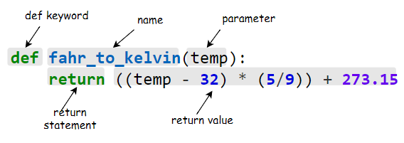
function definition
def: Keyword to define a function
01
02
name: Name by which the function will be called
parameter: input(s) to the function
03
04
return: Keyword used to pass variables back
return value: Variable(s) returned back accessing all the keys and values
05
Notes:
Lets understand the syntax of a function.
We have to define the function using def keyword.
After the def keyword, we can provide the name of our function by which it will be called.
As discussed, function often takes one or more than one parameter as its input.
The name for these parameters should be declared within parenthesis, here.
The value to these parameters will be passed by the calling function.
After executing all the statements inside the function, the interpreter can return any value back from where it is called.
Return keyword is used to pass such variables back.
If no return statement is provided, by default a function returns None.

Slide 47
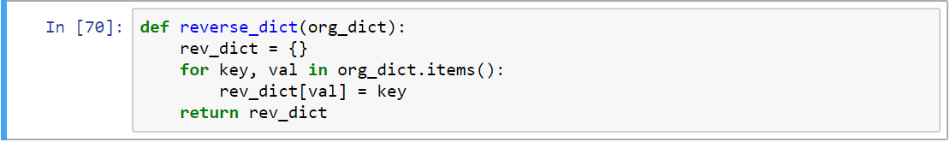
DEFINING OF FUNCTION
In the following example, we are defining a function called “reverse_dict” to reverse a dictionary
The function takes one argument which should be of type dictionary. If any other data type is passed, the function will throw error, because we are using dictionary specific methods like .items()
FEATURES:
Inside the function we are creating a empty dictionary and looping in to each element in the dictionary that is passed to the function
Inside the for loop, we are adding new element to the new dictionary which is created inside the function
While adding element, the key becomes the value and value becomes the key
We are returning the new dictionary as output from the function
Notes:
In the following example, we are defining a function called reverse_dict. This function takes one argument which should be of type dictionary and returns the reverse of that dictionary. That is keys of the input dictionary should be converted to values, and value of the original dictionary should be converted to keys of the new dictionary. If we pass variable with any other data type, the function might throw error in between, because we are using dictionary specific methods like .items() in the calculation. Inside the function we are creating a dictionary to which we will be pushing elements one by one. Once the empty dictionary is created, we are looping through each element in the dictionary using items method

Slide 48
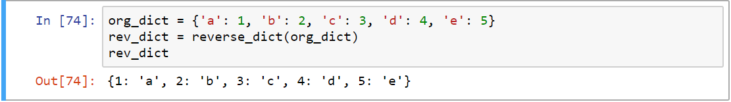
CALLING FUNCTION
The function will not get executed unless we call it explicitly
The output of the function is saved in the variable rev_dict
In the following snippet, we have created a dictionary called org_dict.
The function cannot be called without passing one parameter. We cannot pass more than one parameter as well
We can pass this dictionary while calling the function which we just created reverse_dict()
Notes:
The function will not get executed unless we call it explicitly.
Observe the code snippet where we have created a dictionary called org_dict.
We can pass this dictionary while calling the function which we just created reverse_dict()
The output of the function is saved in the variable rev_dict
It is a must to pass one parameter to the function.

Slide 49
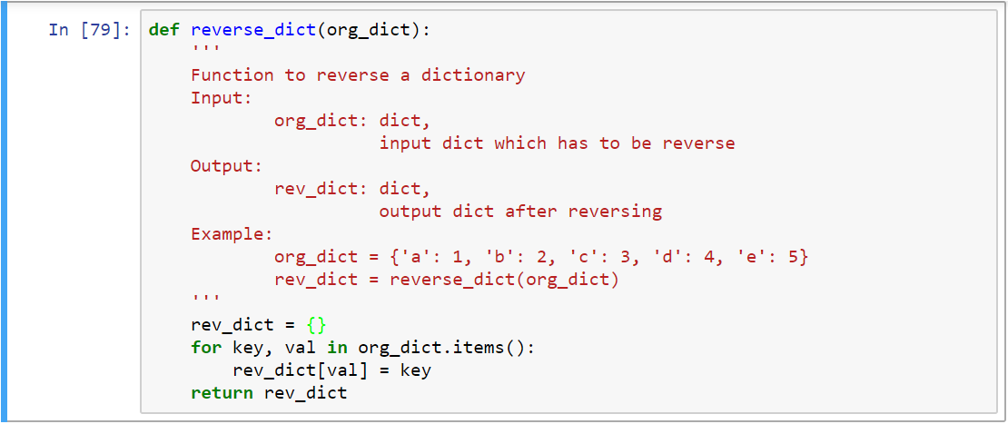
DOC STRINGS
Doc strings are enclosed with triple quotes
Python doc strings are used to document functions
Doc stings should follow immediately after defining function
Notes:
Python doc strings are used to document functions .
Doc stings should follow immediately after defining function header.

Slide 50
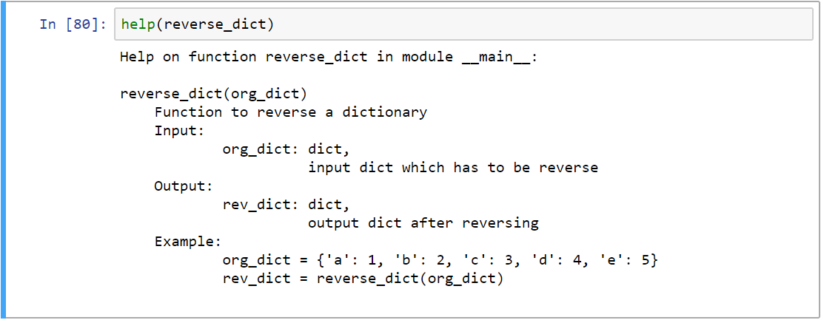
DOC STRINGS
We can use help function to understand the documentation of any function .It is advisable to provide documentation to any function that we create
Notes:
We can use help function to understand the documentation of any function
It is advisable to provide documentation to any function that we create, so that it is obvious for others as well in terms of what operations it will do

Slide 51

Example: read_csv
01
A function can take many input parameters and most of it can be optional
02
Following function is such an example, which is used to read a csv file using pandas library
03
The function takes only one mandatory parameter, which is file path or buffer
The other bunch of parameters are optional. Most of functions from packages will be similar, because they try to address many requirements using a single function
04
Notes:
A function can take many input parameters.
There can be optional parameters too.
Observe the example given, read_csv method of pandas library can be used to read csvees.
The function takes only one mandatory parameter, which is filepath_or_buffer.
The other bunch of parameters are optional.

Slide 52
SCOPE OF VARIABLES
Not all variables are accessible from all parts of our program, and not all variables exist for the same amount of time
Two types of variables namely local vs. global variables
.
Local variables are specific to set of statements. For example any variable inside the function is a local variable. The variable cannot be accessed outside the function
Where a variable is accessible and how long it exists depend on how it is defined
The part of a program where a variable is accessible its scope and the duration for which the variable exists its lifetime
Global variable can be accessed across functions
Notes:
Not all variables are accessible from all parts of our program.
The part of a program where a variable is accessible is its scope .
And the duration for which the variable exists is its lifetime.
Two types of variables are namely local and global variables.
Local variables are those variables whose scope is only inside that function, in which it is defined.
The variable cannot be accessed outside the function.
Global variable can be accessed across functions.

Slide 53

example
In the following example we have created a function to square the value
1
The calculated value is stored in the variable called x_squared, and the value is returned at the end of the function
The variable x_squared is local to the function. i.e. it is available only inside that function. If tried accessing outside the function, python will throw NameError, as shown below
2
3
The lifetime of the variable x_squared is killed the moment the function gets executed
Notes:
Here is a function to square the value.
The function takes x as the input argumen.t
The squared value is stored in the variable called x_squared, and the value is returned at the end of the function.
The variable x_squared is local to the function. Trying to access it outside the function will throw NameError.
The variable x_squared is killed the moment the function finishes its execution.

Slide 54

GLOBAL VARIABLES
In the following example we have created a variable x before & outside the function.
It will be considered as global variable within the file. Any statements after the first line, will have access to the variable x
Though we have not assigned the variable x inside the function, the scope of the variable is available for calculations within the function to square the same and return the squared value.
This function doesn’t take any argument, but returns a value
Notes:
In the example given, we have created a variable x before & outside the function.
Now, this is a global variable. Any statement after the first line, will have access to the variable x.
Though we have not assigned the variable x inside the function, this variable is available for the calculation.
The function returns the squared value. See, the function doesn’t take any argument, but returns a value.

Slide 55

GLOBAL & LOCAL VARIABLE
The following example can be used to get a clear picture of global vs. local variables
We have defined the variable x in two places. One value outside the function (global variable) has value 3 and the one which is defined inside the function (local variable) with a value 5
While calculating the square inside the function, the value of x will be 5 and so it returns 25
.
But while printing x again outside the function, the value will be 3 only. Because the value of 5 is local to the function, outside the function the value will be 3 only
Notes:
See this example, we have defined the variable x in two places.
One, outside the function (x is given the value 3) and another inside the function (x is given the value 5).
On calculating the square inside the function, 5 gets squared and 25 is returned.
On printing x again outside the function, the value 3 gets printed.
Because the value 5 for x is local to the function, while the value 3 is global.

Slide 56


Lambda functions
Single line functions are called as lambda functions
Lambda functions at times can be anonymous i.e. without a name
Followed by the keyword lambda, is a list of arguments, separated by commas
The entire body of the function is just a single expression used to return a value. Hence an explicit return keyword is not required
Notes:
Single line functions are called as lambda functions
Lambda functions at times can be anonymous i.e. without a function name
You must specify the lambda function using the keyword lambda, followed by the list of arguments that the function has to deal with, separated by commas.
The entire body of the function is just a single expression and this returns a value by default. Hence an explicit return keyword is not required.

Slide 57
HANDS-ON PRACTICE
File: Function and Lambda

Slide 58

MAP & filter
Map applies a function to all the items in an input list. It takes two arguments.
First the function which needs to be applies to each element in the list, second the list itself.
Filter is another useful method to filter only those values which matches the condition inside the filter.
For example the below code, only those values which are less than 3 will be returned.
Notes:
Map applies a function to all the items in an input list. It takes two arguments.
First the function which needs to be applied to each element in the list, second the list itself.
Filter is another useful method to filter only those values which matches the condition inside the filter.

Slide 59


Sample Program
Problem: Compare two list
Solution:
Notes:
Observe the exercise that tells you how to compare 2 lists

Slide 60
Python modules & packages
A module is a file containing Python definitions (i.e. functions) and statements
The file name is the module name. The file will be saved with extension “.py”
Packages are a way of structuring one or more modules together
Python Package Index is a repository of software for the Python
There are currently 118274 packages in this repository
To use a package from this index run:
"pip install <package_name>“ from command prompt
numpy : Used for array manipulations
os: Provides useful operating system dependent functionality
pandas: Used for data analysis and transformations
matplotlib: Used for plotting and visualization
Notes:
A module, is a file containing functions and statements.
The file name is the module name.
The file will be saved with extension, dot p y.
Packages are a way of structuring one or more modules together.
There are many in-built modules or packages in python.
For example,
Nampay , is Used for array manipulations.
OS, Provides useful operating system dependent functionalities.
Pandas, is Used for data analysis and transformations.
Matplotlib, is Used for plotting and visualization of analysed data.
Python Package Index is a repository of software for the Python.
There are currently 1 lakh 18 thousand 274 packages in this repository.
To use a package from this index, run "pip install space package name" from the command prompt.

Slide 61

Importing modules
Modules or packages can be imported in our program using “import” keyword, followed by the module’s name
Use help functions to know the description and available routines (or functions) within the imported module
Notes:
“import” keyword followed by the module’s name can be use to import modules or packages, in our program. Help functions can be used to know the description and the available routines (or functions) within the imported modules.

Slide 62


Using module’s routines
Use dot operator to call a routine within a module
For example use “os.getcwd()”, to know the current working directory
Change working directory
Get all files under the current working directory
Notes:
Use dot operator to call a routine within a module.
“o s dot get c w d” tells you the current working directory.
“o s dot c h d i r” changes the current working directory.
“o s dot list d i r” gets you all the files under the current working directory.

Slide 63


Different ways in importing modules
Note that we can call those functions directly without using the module name and dot operator.
One can also import all the functions and use them directly using “*” operator while importing
By default, all the routines will be available when we import a module.
We can also import only those routines which we will be using.
For example in the below snippet we are importing only three functions/routines from o’os’ module.
Note: Importing all the definitions using * operator is not recommended
Notes:
All the functions from a module can be imported at once using “*” operator.
It is also possible to import only those routines which we will be using.
In the second snippet , we are importing only the three functions or routines that we require from os module.
It is also possible to import all the functions directly without using the module name and dot operator.

Slide 64

Creating custom modules
Very often we will be creating custom functions and variables based on our requirements to use them any point in time
01
It is easy to store them as modules by saving them inside a file .The file should have extension .py
Definitions from the modules are easy to import, just like how we import inbuilt modules
02
There are few restriction while naming the file. Like we cannot have spaces, hyphens, underscore with in the file name
03
04
For example the definitions shown in the right side are stored in a file with name utils.py
Notes:
It is possible to create custom functions and variables based on our requirements, to use them any point of time.
It is easy to store them as modules, by saving them inside a file with dot py extension.
Do not include spaces, hyphens, underscores while naming the file.
Definitions from such modules are easy to import, just like we import inbuilt modules

Slide 65


Custom modules
The function square_number() under utils module can be called as shown. We have to use dot operator to separate the module and function
All the definitions inside the module can be viewed by typing the module name, following by dot operator and then by pressing tab key
Notes:
Custom modules can be imported just like normal modules.
All the definitions inside the module can be viewed by typing the module name following by dot operator and then by pressing tab key.

Slide 66
Calling module definitions
Just like function, the variables used inside the module can be used while importing the module. These variables are called as attributes
Just like any other standard module, our custom module can also be imported.
Notes:
We have to use dot operator to separate the module and function in the module.
Not just functions, even the variables inside the module can be used on importing the module.
These variables are called as attributes.

Slide 67
Creating Packages
Packages are nothing but collection of one or more modules in a single folder
test.ipynb
custom/
__init__.py
utils.py
utils2.py
Instead of import every module individually, we can import a package and access all the modules and its definitions
While placing modules (i.e. python files with extension .py) inside a folder, additionally we need to create a empty file with a name “__init__.py”. Note that it is double underscore before and after ‘init’ key word
Only then the modules will be importable inside another python file or code
Assume we want to import the ‘utils’ module from ‘test.ipynb’ notebook
We can create a folder called custom , which will also be the package name
The package folder should have ‘__init__.py’ and ‘utils.py ‘as shown here.
Notes:
Packages are collection of one or more modules in a single folder.
Instead of importing every module individually, we can import a package and access all the modules and the definitions inside modules.
While placing modules (python files with extention dot p y) inside a folder, we need to create a empty file with a name “_ _init_ _ dot p y”.
Note that it is double underscore before and after init key word.
Only then the modules will get imported inside another python file or code.

Slide 68


Import modules from packages
As per python is concerned, the type of the package will be module only. Package is just a convenient name used by everyone to differentiate between module and a folder with collection of modules.
Instead of directly importing the module, we have to use it along with the package name separated by dot operator.
In the following example, we are importing ‘utils’ module from custom package.
After importing, we can start using the definitions easily
Notes:
We can import a module within the package, only on specifying the package name.
In the example, we are importing the utils module from custom package.
After importing, we can start using the definitions normally.
In python, the type of the package is module.
Package is just a convenient name used by everyone to differentiate between module and a folder with collection of modules.

Slide 69
HANDS-ON PRACTICE
File: Series and DataFrame

Slide 70
REGULAR EXPRESSIONS
Let us understand Regular Expressions
A regular expression describes one or more strings to match when you search a body of text
The expressions serves as character pattern to compare with the text being searched
Regular Expressions are used to find certain patterns in the strings.
Used for data manipulation, text mining, using raw data to search for patterns.
Applied in Machine Learning, Data Processing, NLP
Regular expressions (called REs, or regexes, or regex patterns) are essentially a tiny, highly specialized programming language embedded inside Python and made available through the re module.

Slide 71
RE Module
Let us understand use of regular expressions
Using this little language, you specify the rules for the set of possible strings that you want to match;
This set might contain English sentences, or e-mail addresses, or TeX commands, or anything you like.
You can then ask questions such as “Does this string match the pattern?”, or “Is there a match for the pattern anywhere in this string?”.
You can also use REs to modify a string or to split it apart in various ways.
The re module offers a set of functions that allows us to search a string for a match:
Function | Description
findall() | Returns a list containing all matches
search() | Returns a Match object if there is a match anywhere in the string
split() | Returns a list where the string has been split at each match
sub() | Replaces one or many matches with a string

Slide 72
Metacharacters – RE
Metacharacters are characters with a special meaning:
Character | Description | Example
[] | A set of characters | "[a-m]"
\ | Signals a special sequence (can also be used to escape special characters) | "\d"
. | Any character (except newline character) | "he..o"
^ | Starts with | "^hello"
$ | Ends with | "world$"
* | Zero or more occurrences | "aix*"
+ | One or more occurrences | "aix+"
{} | Exactly the specified number of occurrences | "al{2}"
| | Either or | "falls|stays"
() | Capture and group

Slide 73
Special Sequences
A special sequence is a \ followed by one of the characters in the list below, and has a special meaning:
Character | Description | Example
\A | Returns a match if the specified characters are at the beginning of the string | "\AThe"
\b | Returns a match where the specified characters are at the beginning or at the end of a word (the "r" in the beginning is making sure that the string is being treated as a "raw string") | r"\bain" r"ain\b"
\B | Returns a match where the specified characters are present, but NOT at the beginning (or at the end) of a word (the "r" in the beginning is making sure that the string is being treated as a "raw string") | r"\Bain" r"ain\B"
\d | Returns a match where the string contains digits (numbers from 0-9) | "\d"
\D | Returns a match where the string DOES NOT contain digits | "\D"
\s | Returns a match where the string contains a white space character | "\s"
\S | Returns a match where the string DOES NOT contain a white space character | "\S"
\w | Returns a match where the string contains any word characters (characters from a to Z, digits from 0-9, and the underscore _ character) | "\w"
\W | Returns a match where the string DOES NOT contain any word characters | "\W"
\Z | Returns a match if the specified characters are at the end of the string | "Spain\Z"

Slide 74




RE FUNCTIONS - EXAMPLES
FINDING MATCH
SPLIT TEXT
FIND - SPECIAL PATTERN
REPLACE PATTERN WITH TEXT

Slide 75

ERRORS
Errors are common in any programming language. No code is error free
We can have few or many of the following types of errors

Slide 76

EXCEPTION HANDLING
01 Errors can be handled using "try" and "except" statements.
02 Any errors inside "try" block, can be handled carefully if we can upfront guess the type of error.
03 We can specify the type of error to handle in "except" statement.
04 Inside "except" block, we can provide necessary steps to be taken in case of error.
In the given example, we are passing the value error and continuing the for loop.
one can also break the for loop inside the except block, if necessary.

Slide 77


EXCEPTION HANDLING
EXAMPLE

Slide 78

RAISE EXCEPTION

