Slide 1
Supervised and Unsupervised ML Algorithms - Implementation
Exploratory Data Analysis

Slide 2
INTRODUCTION
Exploratory data analysis (EDA) is an approach to analyzing data sets to summarize their main characteristics, often with visual methods. Whether a statistical model is used or not, primarily EDA is for seeing what data can reveal beyond the formal modeling or hypothesis testing task.
Purpose
Data discovery
Tell stories
Data mining
Detect outliers/patterns
Understand relationships between metrics
Understand data quality/sanity
Notes:
Exploratory data analysis is one of the first courses that one should take while starting their journey on data science after learning the programming language.
In statistics, exploratory data analysis is an approach to analyzing data sets to summarize their main characteristics, often with visual methods.
Whether a statistical model is used or not, primarily EDA is for seeing what the data can tell us beyond the formal modeling or hypothesis testing task.
EDA can be performed for many purposes.
We can use it for data discovery using which we can understand the characteristics of our data.
Using this, we can tell interesting stories, identify outlers, anomalies and patterns in data.
We can also understand the relationships between different columns in a dataset.
We can understand the quality of the data too.

Slide 3
Types of data
DATA
S
U
STRUCTURED DATA
UNSTRUCTURED DATA
Finance data
Transactional data
Sensor data (IoT)
Web log data
Click stream data
Customer master data
Emails
Multimedia
Forms
Transcripts
Web chats, blogs, web pages
Date
Notes:
As discussed earlier, there are many types of data that exist.
One of the main classifications of these data is whether they are structured or unstructured.
Structured data are those which are in the form of tables - that reside in data bases, flat files, excel sheets etc.
Typical examples are financial data, transactional data in super markets, Sensor data from IoT devices, web log data, click stream data and customer master data
On the other hand unstructured data are quite complex in nature which are mostly not in the form of rows and columns and cannot be directly used for analysis.
Data like email content, multimedia messages like audios, videos. Transcripts, web chats, blogs, web pages etc are typical examples of unstructured data.

Slide 4
Types of data analysis
D
D
P
P
descriptive
predictive
prescriptive
Discover patterns
“What happened?”
Trending Analysis, Correlations, crosstabs, outliers, distribution etc.
Forecast future
“What could happen?”
Regression, clustering, time series forecasting etc.
Suggest actions
“What should be done?”
Recommendation systems, artificial intelligence etc.
Notes:
Broadly there are three types of data analysis namely descriptive, predictive and prescriptive.
Assume a HR wants to use data science to reduce the attrition in the company. i.e. reduce the number of employees who leave the organization.
Different stages exist to perform data analysis to solve this problem
One we have understood the characteristics of our data using descriptive analysis, we will be in a better edge to start predicting the future values using the past data.
Predictive analytics is mainly used to forecast what could happen in future.
Techniques like regression analysis, clustering analysis, classification analysis, time series forecasting are typically used in predictive analytics.
In our HR problem statement, we can predict how many employees will be leaving the organization by next month, possibly.
Descriptive analysis is one of the first analysis we will be doing before we start predicting something using our data.
Descriptive analysis helps us to discover patterns and they try to answer the question -“What happened in the past”
Techniques like trending analysis, correlation analysis, distribution analysis are the ones which are typically used under descriptive analysis.
In the HR example, we will understand the characteristics of employees who leave the organization and try to understand if it has any correlation with processes like percentage of hikes, culture, years of experience under current manager etc.
The HR business problem does not get solved just by predicting how many employees will be leaving the organization. Ideally one should suggest actions to prevent loss to the company because of attrition.
Prescriptive analysis goes one step further and suggests us on what should be done.
Techniques like recommendation systems, artificial intelligence etc are widely used for this purpose.
In our HR business problem statement, may be the algorithm will suggest us that we give some additional benefits or switch teams of certain employees who are likely to leave the organization.

Slide 5
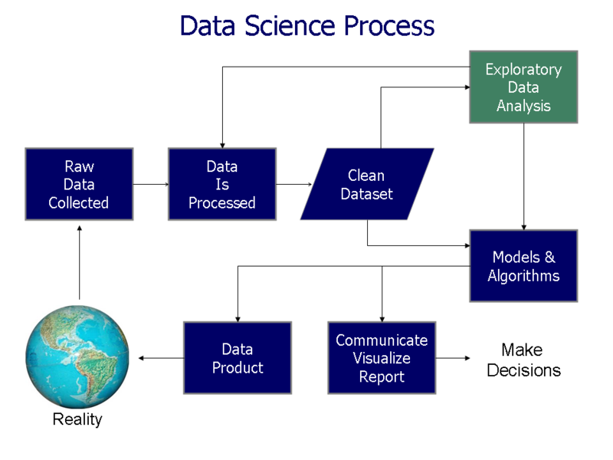
Data science PROCESS
Notes:
Data science is a cyclic process.
Everything starts with the raw data which is collected real time.
These data should be processed so that they are in the right format to get loaded in statistical or BI tools.
At times we need to clean the data sets.
After which either we can directly start applying predictive modelling algorithms if we have complete understanding about our data.
This is not easy for most of the people.
Hence it is mandatory to do Exploratory data analysis before we apply predictive modelling. Once we create algorithms we can communicate to stake holders or end customers in the form of visualization reports or we can come up with a real time data science product.
This product can be made live and we can again start colleting data from the customers, product etc.
Which is again fed in to the process to further understand the customer behavior.
Hence data science is a cyclic process and every step in this is equally important.

Slide 6
STEPS IN EDA
Classify variables in data
Derive metrics
Outlier treatment
Data cleansing
Univariate Analysis
Bivariate Analysis
Multivariate Analysis
Hypothesis Testing
Visualize and report insights
Notes:
Let us understand different steps that exist while performing exploratory data analysis.
And this is not the only way to do EDA.
This is one of the processes which is widely used in industry
First step is to classify the different variables i.e different columns in our data.
For example we need identify how many quantitative columns and how many qualitative columns are there in our data.
Once we have classified our columns, we can create many new metrics i.e new columns using the existing columns.
For example we can create a age column using date of birth column.
We can extract latitude and longitudes from geographical columns.
Deriving metrics is one of the crucial steps in EDA.
Usually the raw data might will not reveal all the important patterns.
We can extract hidden insights by creating new variables.
We are not inventing anything new but we are making the hidden data easily available for the algorithms.
Just like how we mine the gold from its raw structure.
And that is why many call this process as data mining.
Because this unturns the hidden insights
After deriving new metrics we can see if there is any outliers in our data.
If so either we can treat them by removing or altering the values or just by reporting them.
It is not adviceable to remove outliers just like that.
We need to carefully process them using various data cleaning techniques.
Once we are ready with clean data, we can start doing analysis like univariate analysis in which we take one column at a time and understand its characteristics.
For example we can identify the distribution of customer age from age column.
We can extent the analysis by including more columns at a time and thereby performing bivariate and multi variate analysis.
Before presenting our results, we can perform hypothesis testing to statistically validate our interpretations and finally we can visualize the results using charts or dashboards.
While visualizing, we will get new questions or patterns from data.
We have to again start the process from the beginning.
Hence EDA is also a cyclic process.
And thats how we will torture our data to confess

Slide 7
Classification of variable types
Data
Qualitative (Dimension/ categorical)
Quantitative (Metrics)
Location
Text
Dates
Continuous
Discrete
VARIABLE TYPES
EXAMPLE: CRICKET DATA
Groups
Country
Metrics
Runs
Dates
Country
Location
Versus
Match Date
Player
Ground
Score Rate
Match Date
Versus
Ground
Notes:
One of the widely used classifications is to divide the columns either as qualitative or quantitative columns.
Qualitative columns are those columns which are non numeric.
Typically categorical or dimensions.
Columns like Country name, product name, department, etc are typical examples of qualitative columns.
Values in these types of columns will mostly get repeated.
On the other hand quantitative columns are the numerical columns in our data.
They can also be called as metrics.
In a data set few important columns can be called as KPI stands for Key point indicators.
KPIs are the ones which are highly important.
Most of the analysis should be done using those columns.
Columns like revenue, profit, runs, marks. TRP rating, volumes etc are typical examples of quantitative columns or KPI metrics
Though this classification is crucial for any analysis, this one type of classification alone is not enough for exploratory data analysis. We need to further classify our columns like we have identified earlier - like if there are any dates columns, text columns, location columns i.e geographical columns in our data
Inclusion or exclusion of analysis are mainly driven by these additional columns.
For example we can do trending analysis if we have date columns.
On the other hand we cannot do any geographical analysis if we do not have any location columns.

Slide 8
DATA PREPROCESSING
Imputing missing values
Treating outliers
encoding
Split data & test data
Fill missing values using various techniques like Mean/Median/Mode imputation, prediction using KNN etc.
Identify outliers using exploratory data analysis (boxplot, histogram, scatter plots, bar charts)
Replace outliers with missing values
Impute missing values.
In Python, all input features should be of type numerical
Other types of features should be converted to numerical features.
Build models using training data
Evaluate models using test data.
Notes:
One of the important stages before getting in algorithms is to have a proper data for modeling. There are different types of data preprocessing that we generally do.
Among them the first one is imputing missing values. That is filling missing values using various techniques like Mean or Median or Mode imputation, prediction using KNN, etc.
Second data processing is treating outliers. We need to identify outliers using exploratory data analysis (boxplot, histogram, scatter plots, bar charts). Once identified, we can Replace outliers with missing values and impute them using missing value treatment.
In Python, all input features should be of type numerical. Other types of features should be converted to numerical features. This process of converting non-numerical columns to numerical columns is called encoding. There are various types of encoding available.
Finally we need to Split data in training and test data. We will Build models using training data and evaluate them using test data.
In this section, we will understand each one of these data processing in detail.

Slide 9
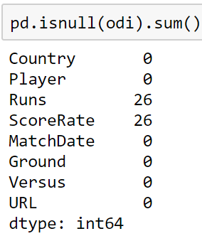
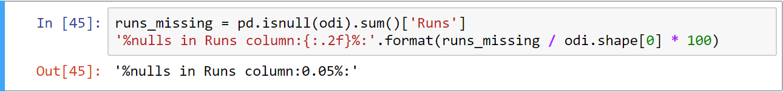
Identify missing data
Using pd.isnull() method, we can identify the total number of null values in each column in a data frame. For example, in the odi data set, there are 26 rows with null values in Runs & ScoreRate columns
One can further compute the percentage of missing values in a specific column by taking the ratio of null values against the total number of rows in that column. As shown below, only 0.05% of values are missing in the Runs column.
Notes:
One of the most important issues to look for is - if there are missing values in the data.
This can be achieved by using the function pd.isnull().
It can take up a data frame and for each column in it, the function will check for the presence of missing values.
For those rows, in which we have missing values, the function will return True.
If not, False.
If we apply sum operation on the result, it will count the True values from each column.
This is nothing but the total number of missing values in each column.
For example, for the odi data set, there are 26 rows in all, with null values in Runs & ScoreRate columns.
One can further compute the percentage of missing values in a specific column by taking the ratio of null values against total number of rows in that column.
In the given example, we take the total number of missing values in the runs column and we store the same in a variable called runs_missing.
This value is divided by the total number of rows and its result could be obtained from odi.shape[0].
We can see that only 0.05% values are missing in the runs columns.

Slide 10
Handling missing values
Many algorithms will not perform well, if the data contain missing values. There are many ways in which we can handle missing values. Few are listed below:
1
Drop rows
4
Segmented mean / mode
Drop those rows which have missing values
Instead of taking mean/mode based on the entire column, one can perform a group wise imputation. For example, in the case of cricket data, missing values can be imputed after grouping the data by Player. This might be a better approximation.
Impute mean
2
Impute a constant value instead of a null value. Most frequently used method is to fill the missing values with the column mean. At times, median is also used if the data has outliers because mean is very sensitive to outliers, where as median isn’t
Prediction based imputing
5
KNN: Nearest neighbour imputations SoftImpute: Iterative soft thresholding of SVD decompositions.
MICE: Multiple imputation by chained equations
3
Impute mode
If it is a categorical column that has missing values, instead of mean, one can use mode. Mode is the most frequently appearing category
Notes:
Many algorithms will not perform well, if the data contain missing values
There are many ways in which we can handle missing values
Few are listed below
Drop rows
Drop those rows which have missing values
Impute mean
Impute a constant value instead of a null value. Most frequently used method is to fill the missing values with the column mean. At times, median is also used if the data has outliers because mean is very sensitive to outliers, where as median isn’t
Impute mode
If it is a categorical column that has missing values, instead of mean, one can use mode. Mode is the most frequently appearing category
Segmented mean / mode
Instead of taking mean/mode based on the entire column, one can perform a group wise imputation. For example, in the case of cricket data, missing values can be imputed after grouping the data by Player.This might be a better approximation.
Prediction based imputing
KNN: Nearest neighbor imputations
SoftImpute: Iterative soft thresholding of SVD decompositions
MICE: Multiple imputation by chained equations

Slide 11
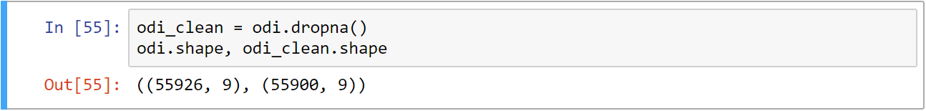
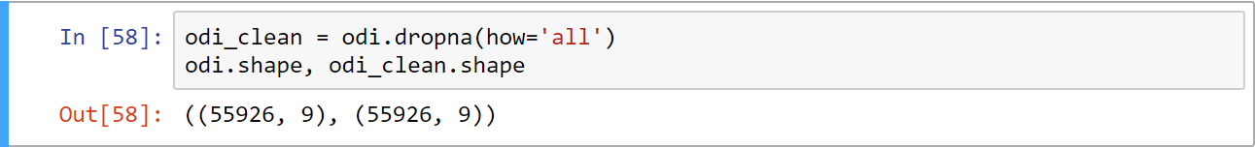
dropping rows
Multiple ways of dropping rows exists.
In the given code snippets, it drops all the rows which has missing values even if there is only one missing value in a row, the entire row will get dropped
Use the parameter “how” - to drop only those rows in which all the values are missing. A row will not
get dropped if there’s at least one value present in it
Notes:
Let us now understand how to drop those rows with missing values.
Multiple ways to drop exists.
In the given example, we are dropping all the rows with missing values using the function - dropna().
Even if there is only one missing value in a row, the entire row gets dropped.
From our result, we can see that - totally 26 rows are dropped on applying dropna function.
We can use the parameter “how” - to drop only those rows in which all the values are missing.
I mean, a row will not get dropped if there’s at least one value present in it.
In the given example, since the columns other than Runs and Score rate has values in them, not even a single row gets dropped.

Slide 12
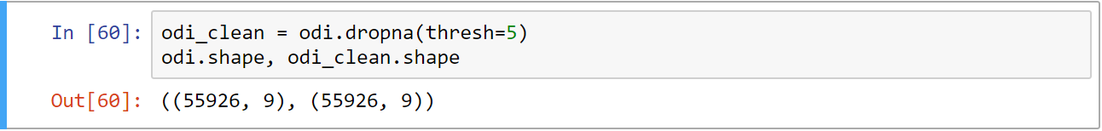
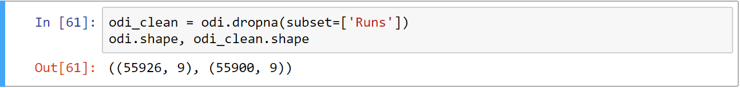
dropping rows
Instead of using “how” parameter, use “thresh” parameter to keep only those rows which has at least certain number of non-null values.
In the given example, since the ‘thresh’ parameter set as 5 (thresh=5), those rows which have at least 5 non-null values will be retained. Others will be ignored. But in the odi data, all rows have at least five non null values
The ‘subset’’ parameter is to specify the columns to be considered while dropping rows.
The given sample code depict how to drop those rows in which ‘Runs’ column is empty. The other columns might or might not have missing values but consider only on Runs columns
Notes:
Instead of using the “how” parameter, we can also use “thresh” to keep only those rows with atleast certain number of non-null values.
In the given example, since we are passing thresh as 5, those rows with at least 5 non-null values will be retained.
And others will be ignored.
But in the odi data, all rows do have at least five non null values.
We can also specify columns to be considered while dropping rows.
In the given example, we are dropping only those rows in which Runs column is empty.
The other columns might or might not have missing values, in this case.
But we are concentrating only on Runs columns.
And hence 26 rows are dropped.

Slide 13
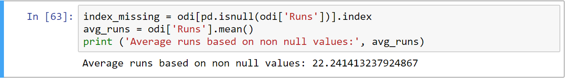
imputing
Instead of dropping the column value, impute some number in the place of missing values
As mentioned earlier, one of the common practices is to impute the missing values with the average of non-null values
In the following code, firstly, it identifies those rows in which have missing Runs then it calculates the
average of non-null values in the Runs column using .mean().
Note: mean() function will ignore the missing values while computing the average
Notes:
Instead of dropping rows, which will reduce the number of observations we have, we can impute - that is : fill some number in the place of the missing value.
As mentioned earlier, one of the common practices is to impute the missing values with the average of the non-null values
In the given code, firstly, we are identifying those rows in which we have missing Runs
Next, we are calculating the average of non-null values in the Runs column using .mean().
Please, note that the mean function will ignore the missing values while computing the average

Slide 14
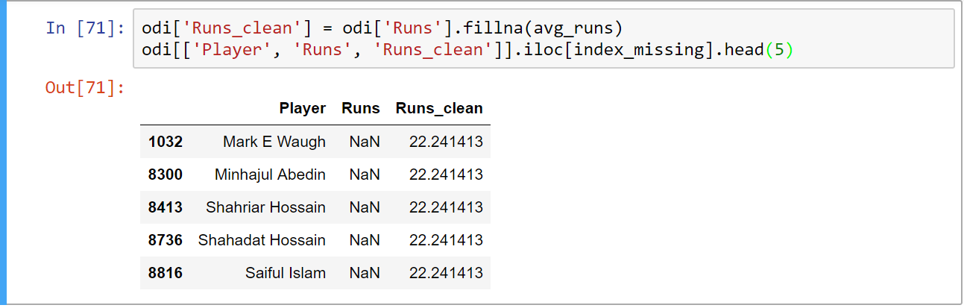
imputing
Use .fillna() method to fill a constant value in those places where it has missing values
In given sample code, the Runs values after imputation, is saved in a new column called ‘Runs_clean’.
Use .iloc method to specifically filter those indexes where we had missing values in the Runs column
In the output, it shows the missing values are imputed with the average value, which is approximately 22.24
Irrespective who the player is, it imputes the missing values with the same value.
Notes:
Instead of manually identifying those rows which has missing values, we can use .fillna() method to automatically fill a constant value in those places where there are missing values.
The Runs values after imputation, is saved in a new column called ‘Runs_clean’.
We can use .iloc method to specifically filter for those indexes where we had missing values in the Runs column.
From the output we can observe that the missing values are imputed with the average value, which is approximately 22.24.
We can see that irrespective of who the player is, we are imputing the missing values with the same value.
However, this is logically not correct.

Slide 15
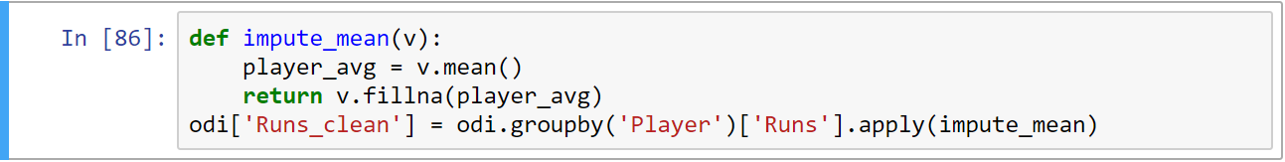
Impute group wise
Instead of filling missing values using a single constant value, do missing value treatment by each player
Group data based on each player and then identify the average of runs specific to each player
In the following code, after grouping by Player column based on their ‘runs’ and passing each group’s runs
individually - to the impute_mean() function.
impute_mean() function will take up only one player’s runs at a time and calculate the average run for that payer.
While returning runs values, it imputes the missing values with the average run scored by that specific player,
considering his other matches.
Notes:
Instead of filling missing values using a single constant value, we can do missing value treatment by each player too.
We can group data by each player and then identify the average of runs specific to each player.
In the given example, after grouping by Player, we are considering the Runs column in the grouped object and are passing each group’s runs (in other words - each player’s runs) individually - to the impute_mean function.
Impute_mean() function will take up only one player’s runs at a time.
We can calculate the average run for that player inside this function.
While returning runs values, we can impute the missing values with the average run scored by that specific player, considering his other matches.

Slide 16
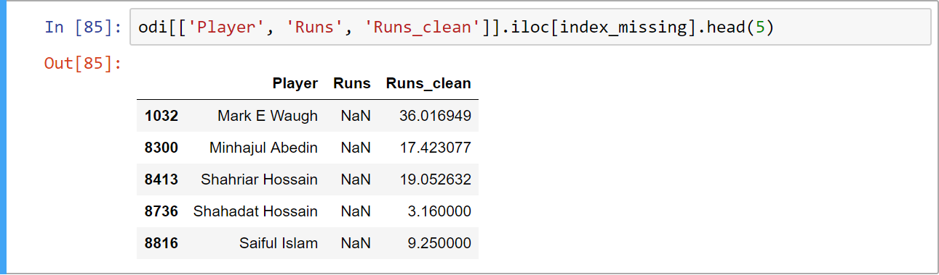
Impute group wise
In the given output, each player’s missing runs are imputed with different values, based on their averages in other matches
For example, a missing record from ‘Mark E Waugh’ is 36.01, whereas for Shahadat Hossain , it is just 3.16. This makes sense, because Shahadat Hossain is a bowler, where as Mark E Waugh is a batsman
A batsman will ideally have more average run than a bowler
Hence it is better to group the values using other columns, meaningfully and then impute the missing values - group-wise
Notes:
From the result, we can observe that each player’s missing runs is imputed with different values, based on their averages in other matches
For example, a missing record from Mark E Waugh is 36.01, whereas for Shahadat Hossain, it is just 3.16
This makes sense, because Shahadat Hossain is a bowler, where as Mark E Waugh is a batsman
A batsman will ideally have more average run than a bowler
Hence it is better to group the values using other columns, meaningfully and then impute the missing values - group-wise.

Slide 17
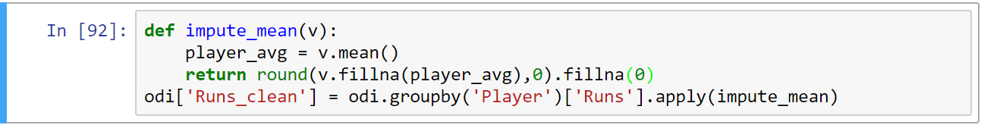
Impute group wise
In the earlier exercise, the missing values are in decimals for Runs columns (in cricket, 36.01 runs ) which is not a proper value.
To round the values before filling - as shown below and for few players whose values are missing.
In such case, use the fillna() method to fill the missing values with either 0 or with the overall average values (which is approximately 22).
Missing value treatment is very subjective to every data and its domain. The same process can be
universally applied to any data set.
One has to carefully understand the domain and also should pay attention to the results after imputing.
Notes:
One has to be very careful while filling the missing values.
In the earlier exercise, we had seen that the missing values are in decimals for Runs columns.
In cricket, 36.01 runs is not a proper value.
Ideally, we have to round the values before filling - as shown in the slide.
And for few players whose values are missing, we might not have their other matches records - if they have not played one before.
In such cases, we can call the fillna() method to fill the missing values with either 0 or with the overall average values (which is approximately 22)

Slide 18
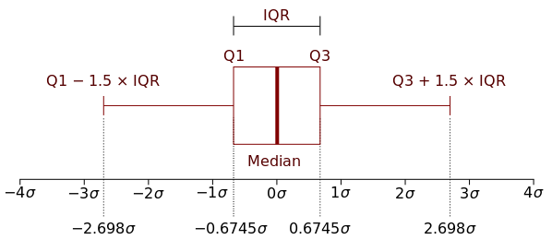
detecting outliers
Boxplot can be used to detect outliers as well
Any observation whose value is below Q1 – 1.5 x IQR can be considered as an outlier
Likewise, any observation whose value is above Q3 + 1.5 x IQR can also be considered an outlier though this is the standard formula to calculate the presence of outliers, variance of this is also used across packages.
Summarizes the distribution of quantitative values
using the five point summary.
Boxplot represents the IQR (Q3 – Q1) using box
Median (Q2) is represented using a thick line
within the box
Minimum & maximum values are represented using
lines or whiskers. For this reason, box plot is also called as box and whisker plot
Few packages also report outliers using dots above and below, upper & lower whiskers respectively
Notes:
So far we were trying to understand how to manage the missing values in the data.
Another important data cleaning that we have to do is - detecting outliers.
As discussed earlier, Boxplot can be used to detect outliers.
If you remember, we can identify outliers using inter quartile range.
Any observation whose value is below Q1 – 1.5 x IQR can be considered as an outlier.
Likewise, any observation whose value is above Q3 + 1.5 x IQR can also be considered an outlier.
Though, this is the standard formula to calculate the presence of outliers, there are also other types of outliers detection.

Slide 19
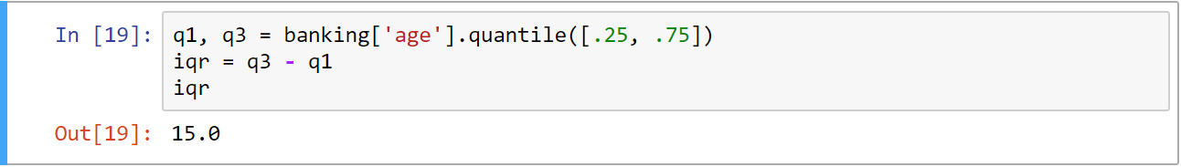
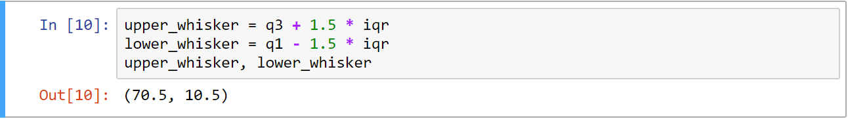
Percentage of outliers
Calculate IQR by subtracting third quartile from first quartile
Calculate the upper whisker and the lower whisker value using the below mentioned formula:
Notes:
Let us see how we can identify the outliers in the age column of the banking data set.
Firstly, calculate IQR by subtracting the third quartile from the first quartile.
In our data, IQR for age column is 15.
Calculate the upper whisker and the lower whisker value using the formula mentioned in the slide.

Slide 20
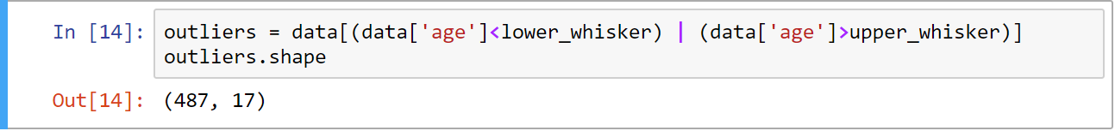
Percentage of outliers
Filter those rows which are below the lower whisker and also for those rows which are above the upper whisker values. Totally 487 values in age column should be treated as outliers as per the formula
Compute percentage of outliers by dividing number of outlier values with the total number of
values present. For the age column, we have totally 1.1% of outliers
One can choose to impute null for those values which are identified as outliers and perform missing
value treatment for these null values.
Notes:
Filter those rows which are below the lower whisker and those rows which are above the upper whisker values.
We can see that - totally 487 values in the age column should be treated as outliers as per the formula.
Compute the percentage of outliers by dividing the number of outlier values with the total number of values present.
For the age column, we have 1.1% of outliers, in total.
Note that - one can choose to impute null for those values which are identified as outliers and perform missing value treatment for these null values.

Slide 21
Input feature types
Real life data will have the following types of input features
In Python, we will be using a library called scikit-learn for machine learning
Numerical features. Example: Salary, Sales, Age etc.
scikit-learn, can take only numerical columns as input. We cannot pass categorical, dates or text features
Categorical features:
Example: Department, Product type, Qualification etc.
There are different ways of converting categorical columns to numerical columns:
Label Encoding
One Hot Encoding
Text features: Reviews, product description etc.
For dates and text columns, we need to derive new columns to utilize them in model building
Date features: Transaction date, Date of birth etc.
Example: From a date column, we can extract, day of the month, month, year etc.
Notes:
Real life data has the following types of input features:
Numerical features. Example: Salary, Sales, Age etc.
Categorical features: Example: Department, Product type, Qualification, etc.
Text features: Reviews, product description etc.
Date features: Transaction date, Date of birth etc.
In Python, we will be using a library called Scikit Learn for machine learning.
Scikit learn, can take only numerical columns as input. We cannot pass categorical, dates or text features.
There are different ways of converting categorical columns to numerical columns: Label Encoding and One Hot Encoding.
For dates and text columns, we need to derive new columns to utilize them in model building.
For Example: From a date column, we can extract, the day of the month, month, year, etc.

Slide 22
Label encoding
Label encoding
Assign integer values to each unique category
Example: Each department is assigned a unique number without any specific order
Label encoding is generally avoided. If we change the numbers assigned to each departments, results might change for many algorithms which are index based
Department
Sales Executive
Human Resources
Research Scientist
Manager
Department Head
Department
1
2
3
4
5
Original column
Label encoded column
Notes:
First let us understand about label encoding. In this type of encoding, assume we have a categorical column like a department as shown in this table. We have various categories like sales executive, human resources etc.. For each unique category we will assign an integer like: 1, 2, 3 in no specific order.
Here is the preview of the same department column after label encoding.
Label encoding is generally avoided. If we change the numbers assigned to each department, results might change for many algorithms which are distance based.

Slide 23
One hot encoding
For each unique category, create a new column. In each new column assign the value 1 if the row belongs to that category. Else assign 0. This process is also called as creation of Dummy Variables
Sales Executive | Human Resources | Research Scientist | Manager | Department Head
1 | 0 | 0 | 0 | 0
0 | 1 | 0 | 0 | 0
0 | 0 | 1 | 0 | 0
0 | 0 | 0 | 1 | 0
0 | 0 | 0 | 0 | 1
Department
Sales Executive
Human Resources
Research Scientist
Manager
Department Head
01
Even if we change the order of the departments, still the final output from the algorithms will not change
Drawback: If we have too many categories in a column, we need to group less frequently appearing categories in OTHERS category
02
Notes:
Instead of label encoding, very often one hot encoding is used.
For each unique category, create a new column. In each new column assign the value 1 if the row belongs to that category. Else assign 0. This process is also called as creation of Dummy Variables
For example, here we have five unique department. Hence five new columns will be created. One for each department.
In the first row, we have sales. Hence for the sales column in the right hand side table, we will fill it with 1. For other columns in row one, we will fill zero. Like wise for other categories, the respective columns will be filled with 1 or 0.
Advantage of one hot encoding is Even if we change the order of the departments, still the final output from the algorithms will not change.
But the Drawback is: If we have too many categories in a column, we need to group less frequently appearing categories in OTHERS category.

Slide 24
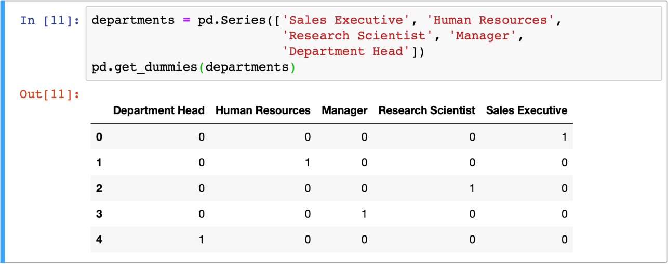
One hot encoding in python
Use both pandas and scikit-learn to create one hot encoded columns.
For this, pass a single or multiple categorical columns to pd.get_dummies() function
Notes:
We can use both Pandas and Scikit Learn to create one hot encoded columns.
In pandas, we can pass a single or multiple categorical columns to pd.get_dummies() function.

Slide 25
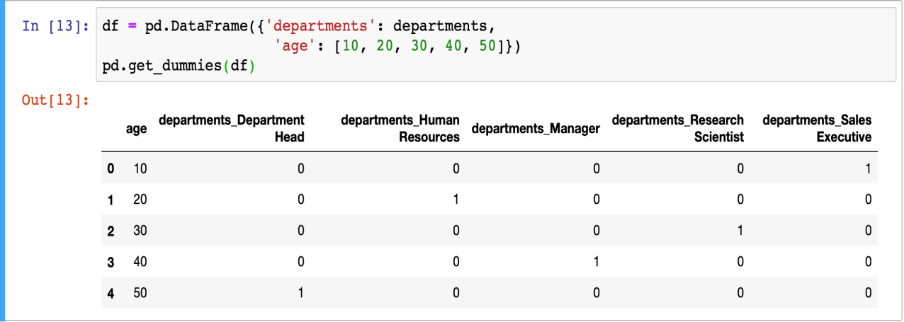
One hot encoding in python
Numerical columns will not be converted to dummy variables in pd.get_dummies() function
During model building, ignoring the target column, we can pass all the columns to this function
Notes:
Numerical columns will not be converted to dummy variables in pd.get_dummies() function.
During model building, ignoring the target column, we can pass all the columns to this function.

Slide 26
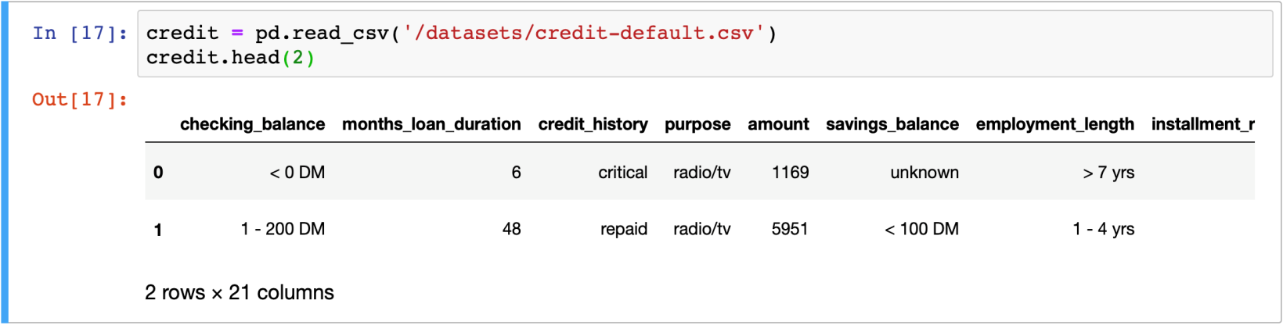
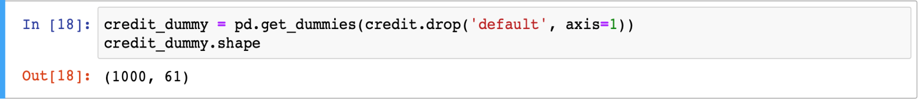
One hot encoding in python
Lets create dummy variables for all categorical columns in a data except for the target variable.
This is a credit default dataset, in which we would like to predict if a customer will default credit card payment.
We have totally 21 columns. In which ”default” column is a target column to which we should not be using dummy variables
After conversion we have totally 61 columns. Numerical columns will not converted. Only categorical columns will be encoded using one hot encoding
Notes:
Lets create dummy variables for all categorical columns in the data except for the target variable
This is a credit default dataset, in which we would like to predict if a customer will default credit card payment
We have totally 21 columns. In which ”default” column is a target column to which we should not use dummy variables
After conversion we have totally 61 columns. Numerical columns will not be converted. Only categorical columns will be encoded using one hot encoding.

Slide 27
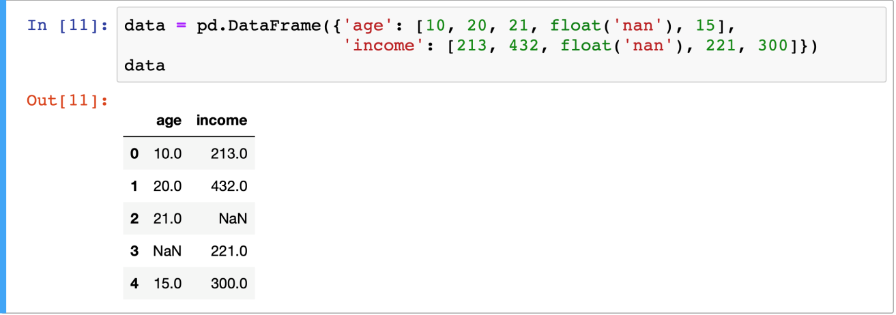
Imputing missing values
Techniques to impute missing values
Impute mean or median for numerical columns, mode for categorical columns
Use predictive techniques like KNN or regression to predict new values for missing rows
Scikit SimpleImputer is used to fill missing values using respective column mean
Example: In the following sample dataframe, two columns, namely Age and Income have missing values
Notes:
There are multiple ways to handle missing values. Few techniques which are commonly used are:
Impute mean or median for numerical columns, mode for categorical columns
Use predictive techniques like KNN or regression to predict new values for missing rows
Scikit SimpleImputer is used to fill missing values using respective column mean.
Example: In the following sample dataframe, two columns, namely Age and Income have missing values.

Slide 28
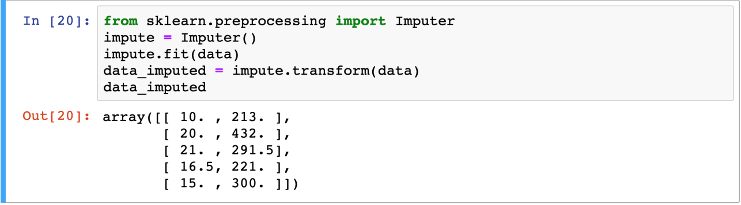
Missing value imputer
Impute values using the respective column means
Example: impute any missing value in age column with the value 16.5 (average age)
Imputer Method
Declare the Imputer() class
Use .fit() to pass the data with missing values. It will calculate column wise mean
Use .transform() to pass the data again to fill the missing values using mean values which were calculated during fit. If required, we can convert the results back to pandas data frame
Notes:
scikit-learn has a powerful function called as Imputer.
It will Impute values using the respective column means
Example: impute any missing value in the age column with the value 16.5 (average age)
let us understand Imputer Method
First Declare the Imputer() class
Use .fit() to pass the data with missing values. It will calculate column-wise mean
Use .transform() to pass the data again to fill the missing values using mean values which were calculated during fit. If required, we can convert the results back to pandas data frame

Slide 29
Train vs. test data
We need to split the available data in training data and test data
Build one or multiple models using training data
Evaluate the performance of the model(s) using test data
All machine learning models should be tested with a new data to understand the performance of the model
Also to compare performance of multiple models to choose the best model
TRAIN vs.
TEST DATA
Generally we split the data into 70% for training and 30% for testing
At times, people also go for 80%-20% split, if they have very small data
In many real time examples, we will not be given multiple data sets to test our model
Using the available data set, we need to train our model and also test our model
Notes:
All machine learning models should be tested with a new data to understand the performance of the model
Also to compare performance of multiple models to choose the best model
In many real time examples, we will not be given multiple data sets to test our model
Using the available data set, we need to train our model and also test our model
We need to split the available data in training data and test data
Build one or multiple models using training data
Evaluate the performance of the model(s) using test data
Generally we split the data into 70% for training and 30% for testing
At times, people also go for 80%-20% split, if they have very small data

Slide 30
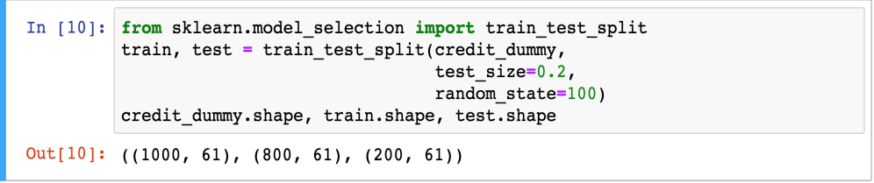
Split data using scikit
Use train_test_split() function to divide any data frame into two sets
Randomly, rows are sampled from the actual data to create training and testing data
test_size represents the size of the test data. In the following example, 20% is for test and remaining 80% will be used for training the model
Out of 1000 rows, 800 rows are randomly selected for
training and 200 rows are selected for testing.
No. of columns will remain the same
random_state: is set to any integer to regenerate the same split when we run this function multiple times. Since rows are randomly selected, every time different rows will be selected between training and testing. If random_state is fixed, we get the same set of training and testing data every time
Notes:
To divide any dataframe into two sets - train data and test data; we can use the ‘train_test_split()’ method in the scikit learn.
Rows are randomly sampled from the actual data to create training and testing data.
The parameter ‘test_size’ represents the size of the test data. In the given example, 20% is for test and remaining 80% will be used for training the model.
The parameter ‘random_state: is set to any integer to regenerate the same split when we run this function multiple times. Since rows are randomly selected, every time different rows will be selected between training and testing. If random_state is fixed, we get the same set of training and testing data every time.
Out of 1000 rows, 800 rows are randomly selected for training and 200 rows are selected for testing. No. of columns will remain the same.

Slide 31
HANDS-ON PRACTICE
Lets Try Python programming on:
Series and DataFrame
EDA OdiBatting

Slide 32

WEB SCRAPING
Web Scraping is a technique to fetch data and information from websites. Everything you see on a webpage can be scraped.
Can be done in most programming languages, we’ll use Python later.
https://www.uipath.com/

Slide 33
NEED OF WEB SCRAPING
But I Can Just Copy/Paste the Data… why border?
What about a thousand webpages or even more?
When no API is provided or there is only limited number of requests.
Online tools with less customizations.
Learn something new and be your own boss!

Slide 34
Where to Use?
Web Crawlers
E-Commerce price comparer.
Preparing dataset for your ML model.
Scraping Social Media Profiles.
Weather Data.
To your imagination!

Slide 35
SOP & tools
Send Request and Load the webpage. (Requests, urllib, httplib)
Parse the content for desired data. (Beautiful Soup, re, Scrapy)
Store the data in the format you need.

Slide 36
Ethical WEB SCRAPING
Don’t crawl at disruptive rate.
Read T&C of use.
Data is valuable use it wisely.

Slide 37
LET’S try in python
WebScrapAastock.ipynb MetWeather.ipynb

