Slide 1

CSE3033N Software Engineering Topic: The Golden Rules of UI Design

Slide 2
Topic Learning Objectives
By the end of the lecture, you should be able to understand:
3 areas of golden rules:
Place the user in control
Reduce the user’s memory load
Make the interface consistent

Slide 3
Goal of User Interface Design
To make the user's interaction as simple and efficient as possible, in terms of accomplishing user goals.
A user interface is like a joke.
If you have to explain it, it’s not that good.

Slide 4
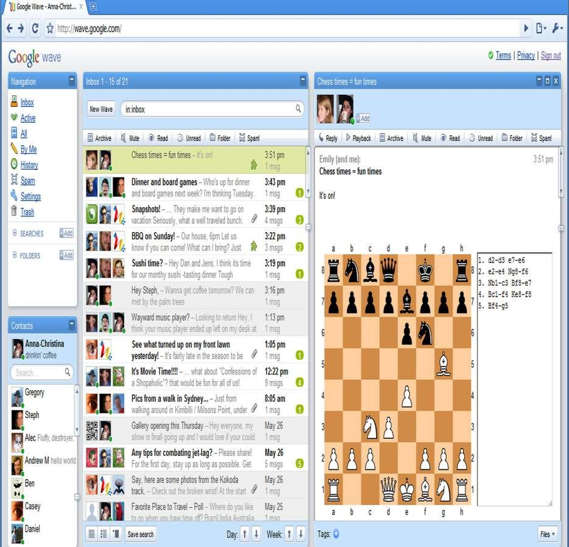
Example of Failure Bad UI Design – Google Wave
https://techcrunch.com/2009/05/28/google-wave-drips-with-ambition-can-it-fulfill-googles-grand-web-vision/
https://en.wikipedia.org/wiki/Google_Wave
2009 - 2012

Slide 5

What Should We do to Make a Good UI?
We should follow the Three Golden Rules coined by Mr. Theo Mandel, Ph.D.
The basis for a set of UI design principles that guide this important aspect of software design.

Slide 6










The Golden Rules
▧ Place the user in control
▧ Reduce the user’s memory load
▧ Make the interface consistent

Slide 7



1. Place the User in Control
"What I really would like,” said the user solemnly, “is a system that reads my mind. It knows what I want to do before I need to do it and makes it very easy for me to get it done. That’s all, just that.”
During a requirements-gathering session, a key user was asked about the attributes of the window-oriented graphical interface.

Slide 8
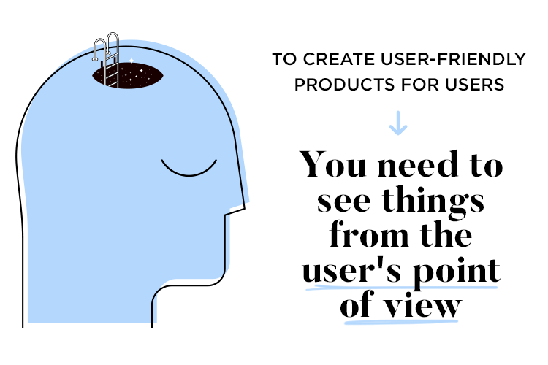
1. Place the User in Control
Users want to control the computer but does not want to be controlled by the computer.
So, user interface constraints specified by the designer must simplify the mode of user's interaction with the computer. User interface must not frustrate the user.

Slide 9
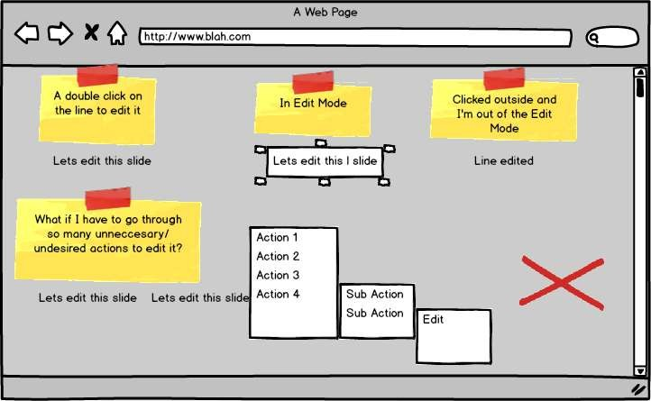
1. Place the User in Control
Method 1:
Define interaction modes in a way that does not force a user into unnecessary or undesired actions.
The user should always be able to enter and exit the mode with little or no effort.

Slide 10


The user should always be able to enter and exit the mode
with little or no effort.

Slide 11
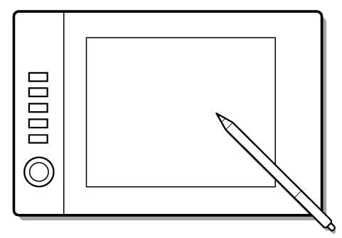


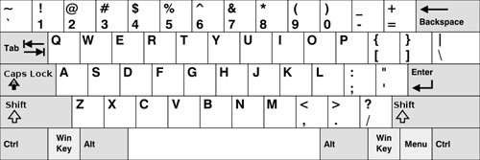

Different users have different interaction preferences, choices should be provided.
1. Place the User in Control
Method 2: Provide for flexible interaction
Drawing complex shapes via keyboard commands frustrates users but doing the same via mouse is simple.

Slide 12
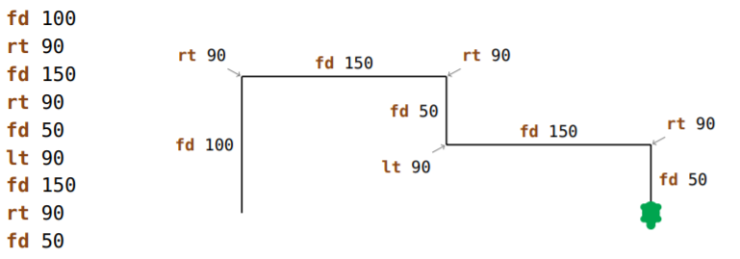
Logo Programming – draw with coding

Slide 13
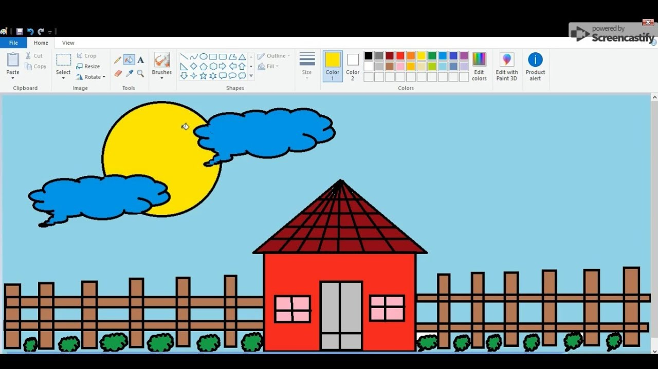

Easy Drawing with Paint and Photoshop Sketch

Slide 14
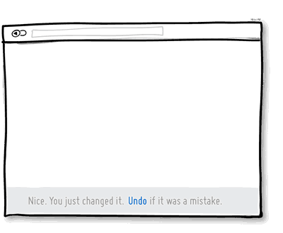
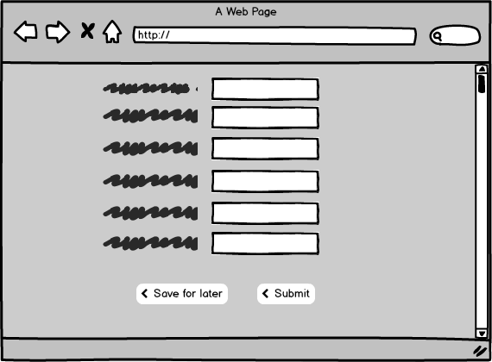
1. Place the User in Control
Method 3: Allow user interaction to be interruptible and undoable.
User should be able to interrupt even when in a sequence of actions but without losing any progress. Also, any user action must be undoable.

Slide 15
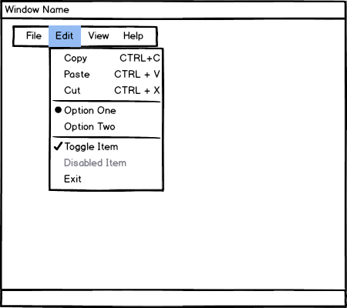
1. Place the User in Control
Method 4:
Streamline interaction as skill levels advance and allow the interaction to be customized.
Users may be normal people or computer experts.
Users of different skill levels should be able to interact with a program at different levels.

Slide 16
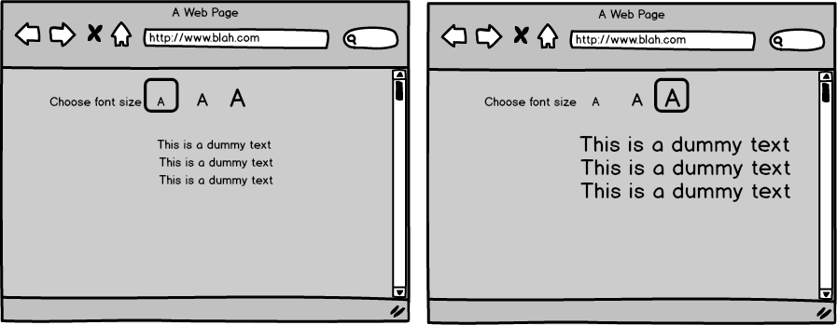

1. Place the User in Control
Method 4:
Streamline interaction as skill levels advance and allow the interaction to be customized.
Users may be normal people or computer experts. Users of different skill levels should be able to interact with a program at different levels.

Slide 17
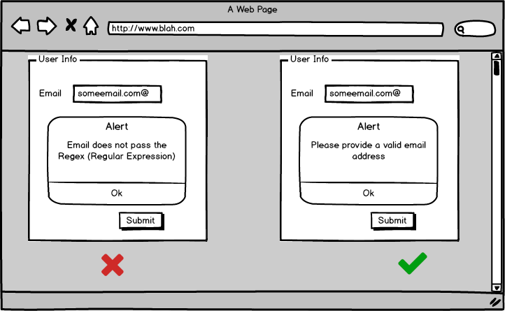
1. Place the User in Control
Method 5: Hide technical internals from the casual user.
The user should not be aware of the operating system, file management functions, or other arcane computing technology.

Slide 18
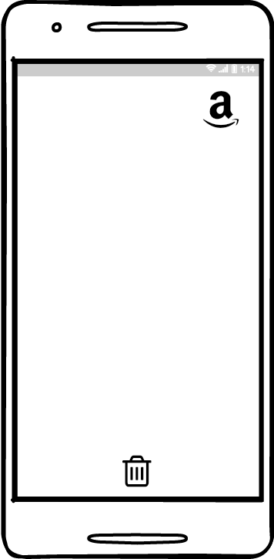
1. Place the User in Control
Method 6: Design for direct interaction with objects that appear on the screen.
The user feels a sense of control when able to manipulate the objects that are necessary to perform a task in a manner similar to what would occur if the object were a physical thing

Slide 19
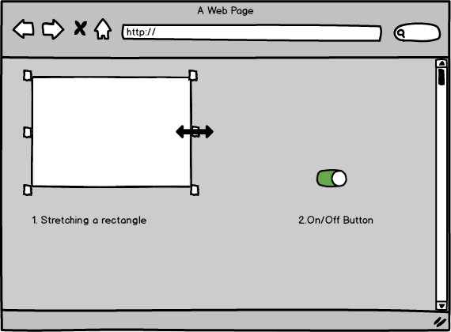

1. Place the User in Control
Method 6: Design for direct interaction with objects that appear on the screen.
The user feels a sense of control when able to manipulate the objects that are necessary to perform a task in a manner similar to what would occur if the object were a physical thing.

Slide 20
2.Reduce the User’s Memory Load
A software must not force a user to memorize anything.
On the other hand, it should provide recall feature to provide data when it is needed by storing it in its memory.

Slide 21
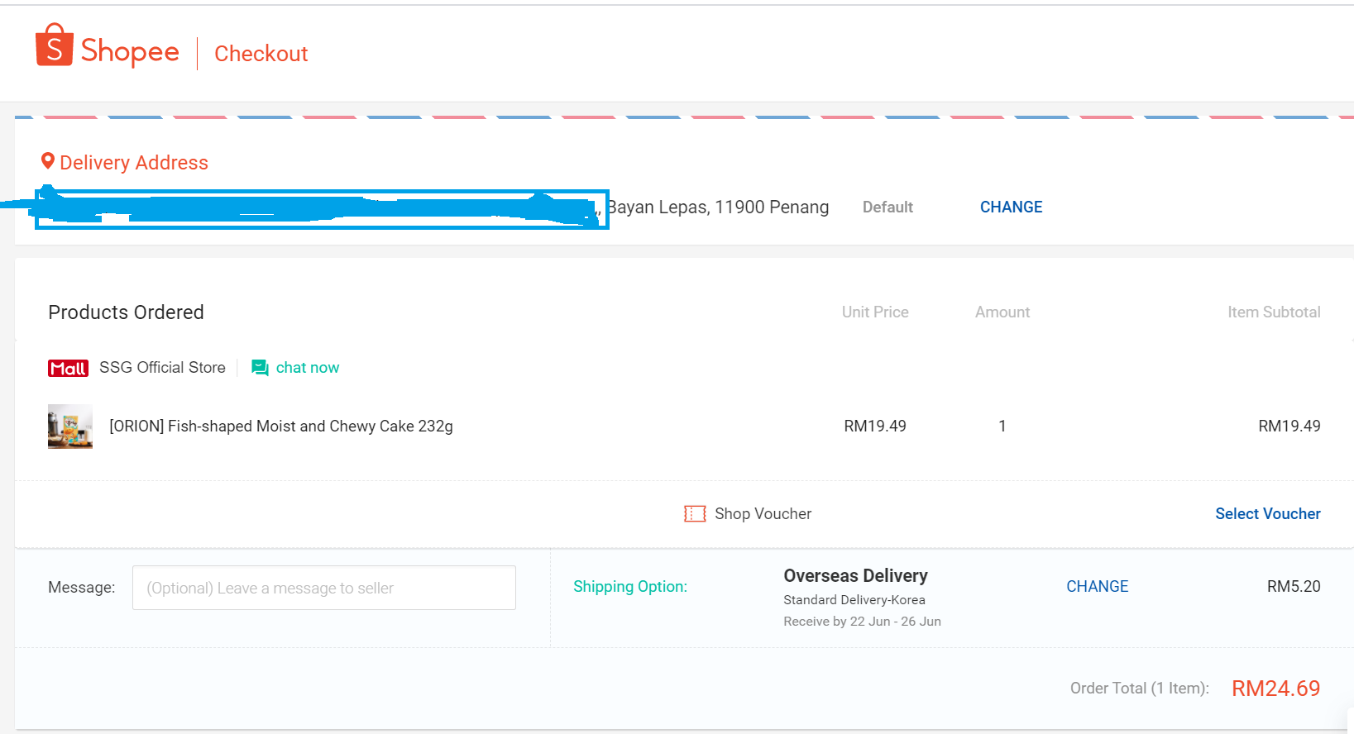
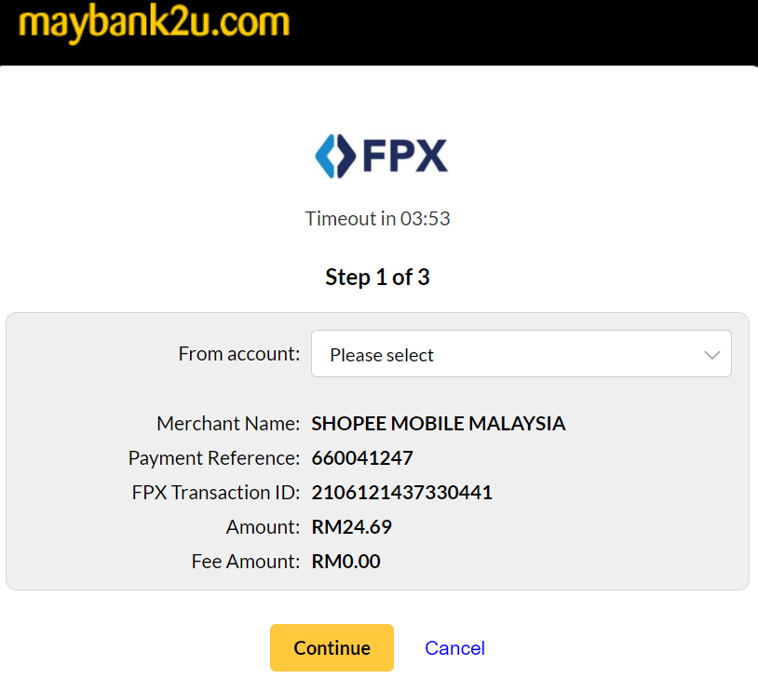
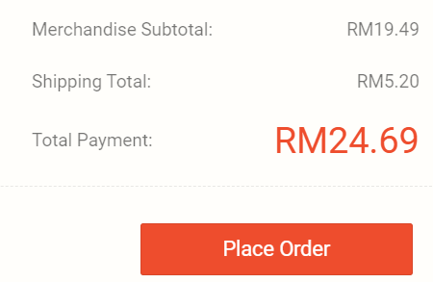
2.Reduce the User’s Memory Load
Method 1: Reduce demand on short-term memory.

Slide 22
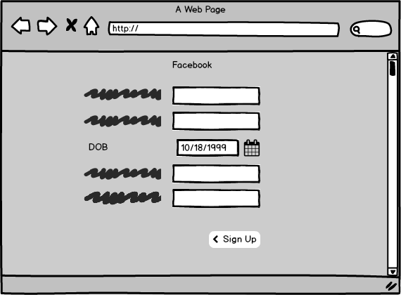
2.Reduce the User’s Memory Load
Method 2: Establish meaningful defaults.
The default values of such properties must be meaningful
i.e. generally used.
The user must be able to change the properties if he/she wants to.
Also, user must be able to reset the properties to their default values.

Slide 23
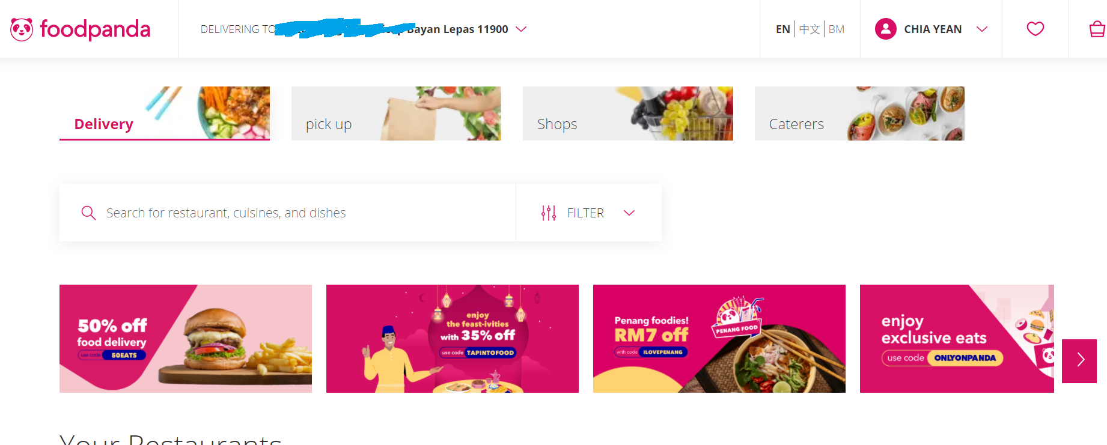
2.Reduce the User’s Memory Load
Default address based on GPS
Or Google location, user can give
alternative address too
Method 2: Establish meaningful defaults.

Slide 24
2.Reduce the User’s Memory Load
Method 3: Define shortcuts that are intuitive.
The shortcuts must be designed such that they are easy to remember i.e. Ctrl + C to copy is easy to remember as C is for Copy etc.

Slide 25



Photos
Add User
Cloud
Battery
Let’s match the column.

Slide 26
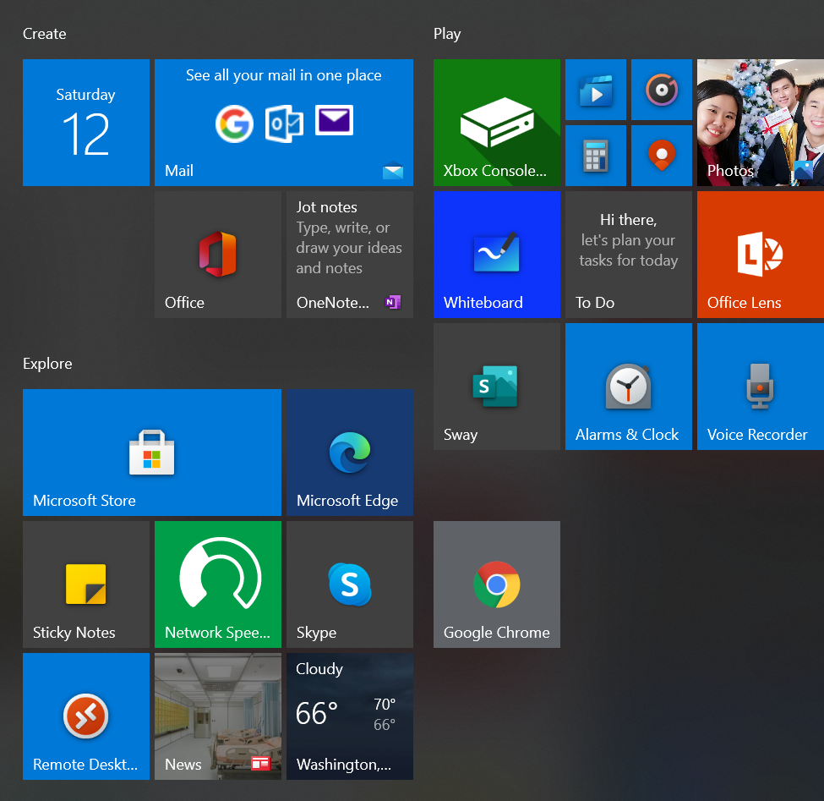
2.Reduce the User’s Memory Load
Method 4: The visual layout of the interface should be based on a real-world metaphor.

Slide 27
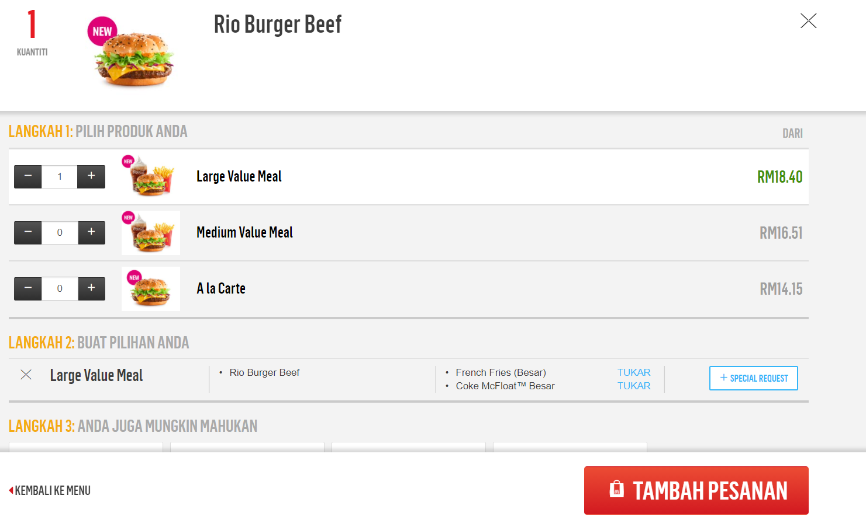
2.Reduce the User’s Memory Load
Method 5: Disclose information in a progressive fashion.

Slide 28
3. Make the Interface Consistent
This includes organization of visual information according to design rules common to all types of screens, defining and implementing mechanisms for navigation from task to task consistently etc.

Slide 29
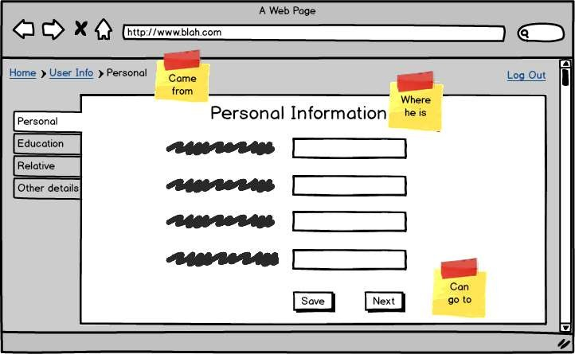
3.Make the Interface Consistent
Method 1: Allow the user to put the current task into a meaningful context.
The interface must be in a way that enables the users to know the context of the current task. So, there should be some indicators which say from which task did the user come here and to which task he/she can go from here.

Slide 30
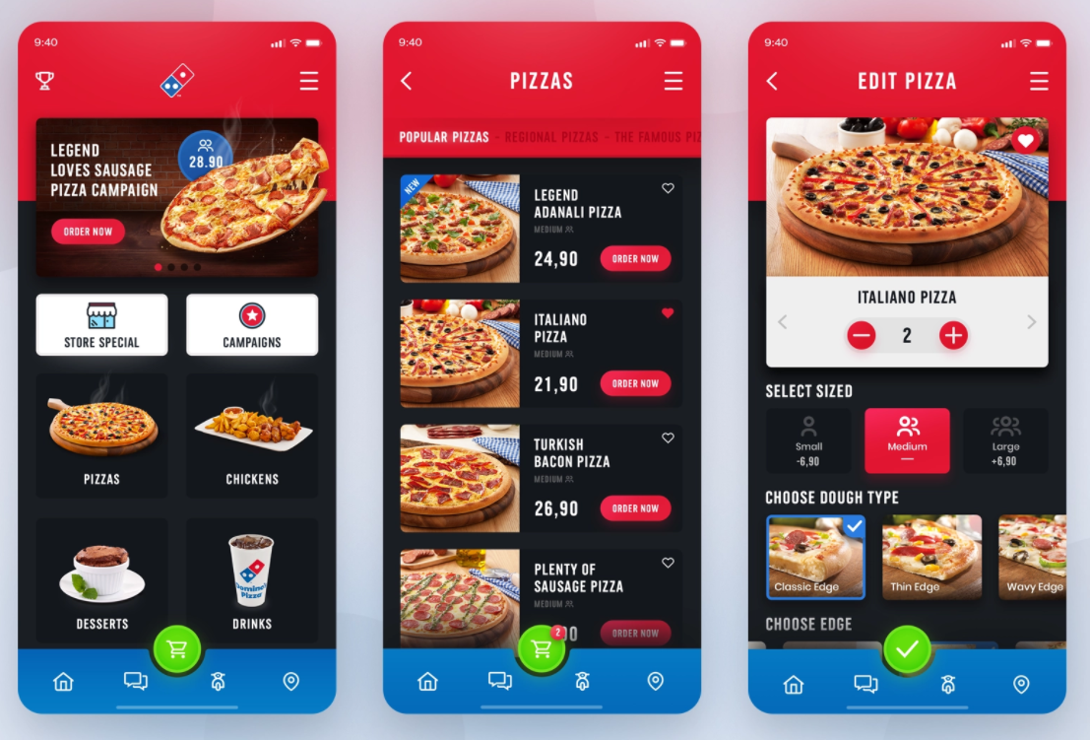
3. Make the Interface Consistent
Method 2: Maintain consistency across a complete product line.

Slide 31
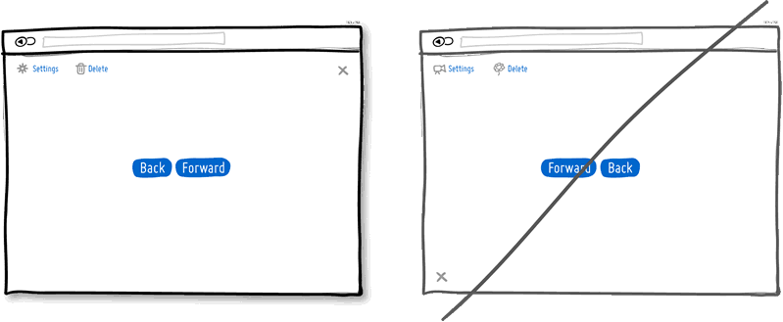
3. Make the Interface Consistent
Method 3:
If past interactive models have created user expectations, do not make changes unless there is a compelling reason to do so.
Suppose a special feature or an UI is provided in a previous version of the software application and its popular among its users, do not try to remove it or change it.

Slide 32
Summary
Golden Rules:
Place the user in control
Reduce the user’s memory load
Make the interface consistent

