Slide 1

CSE3033N Software Engineering Topic: Software Measurements and Metrics

Slide 2
Topic Learning Objectives
By the end of the lecture, you should be able to understand:
Software Measurements
Software Metrics

Slide 3
Nothing can be more true than the saying “which can’t be measured can’t be controlled.” Metrics and measurement are crucial part for executing the software projects successfully.

Slide 4
Measurement
Measurement is a process or the result by which numbers or symbols are assigned to attributes of entities in the real world in such a way as to describe them in order to clearly defined rules.
What do we usually measure?
Length
Weight
Distance
Temperature

Slide 5
Software Measurement
Software measurement is a quantified attribute of a characteristic of a software product or the software process.
The content of software measurement is defined and governed by ISO Standard ISO 15939 (software measurement process).
Number of code (LOC)
Number of classes and interfaces
Complexity of the program

Slide 6
Importance of Software Measurement (EXAM***)
To Understand What We Do, Audit performance:
It helps to understand the past by measuring the product and the process already executed and thereby helps to compare different process and product. It also helps to understand the process and the product on hand.
For Realistic Planning (Future Prediction):
To plan and predict the future based on the past measurements.
For Increased Control Over Projects:
To compare the actual parameter values against the planned values and take necessary actions if there is deviation.

Slide 7
Importance of Software Measurement
To Improve the Process and Product:
Measurement provides baseline measures for making improvements in the process and the product.
Benchmarking:
Software metrics help to create benchmarks with similar kind of organizations.
Cost Reduction:
Cost reduction is possible only after measurement of the current cost.
To Define Quality Level:
We need measurement on software so that we can understand and agree on product quality.

Slide 8
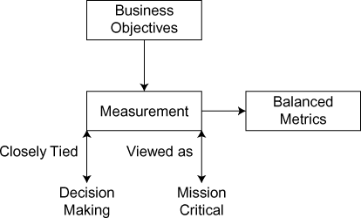
Characteristics of Effective Measurement Program
Aligned with the organization business objectives,
Tied to decision making at lowest level possible,
Balanced metrics at all levels,
Focused on measuring processes,
Viewed as mission critical.

Slide 9
Types of Measurements
Direct Measures:
It is measured directly in terms of the observed attribute (usually by counting). Examples: length of source-code written, time taken for a process execution, and number of defects discovered in a particular phase of the project.
Indirect Measures:
It is calculated from other direct and indirect measures.
Example 1: Module defect density = Number of defects discovered/
length of source.
Example 2: Temperature (usually derived from the length of a liquid column).

Slide 10
Types of Measurements
True Performance Measures:
Customers – use “true” performance measures. True performance measures are used by the customer to measure the performance of the product they use, in their own language as per their own view.
Example 1: A true measure of a book may be “easy to read.”
Example 2: A true measure of software may be “fast response.”
True performance measures typically vary from customer to customer. The parameter and the calculation logic also changes form the customer to customer.

Slide 11
Types of Measurements
Substitute Performance Measures:
Producers – use “substitute” performance measures. Substitute measures are quantifiable units.
Example: A substitute measure of a book may have “less grammatical mistakes,” “less number of pages,” and “covering full syllabus.”
A true measure of software may be “average response time.”

Slide 12
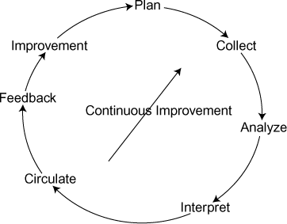
Activities of a Measurement Process

Slide 13
Activities of a Measurement Process
Plan: First decide what needs to be measured and the unit of measurement. Identify the mechanism to collect the data. Identify tools if any to collect the metrics and analyze the metrics.
Collect: Accumulate the data required to derive the formulated metrics using the tool if any.
Analyze: The computation of the metrics and also the application of tools to analyze the metrics happen here. This step combines various metrics data and also use the filtration of metrics based on the plan. It is better to automate the data collection and analyze process.

Slide 14
Activities of a Measurement Process
Interpret: Actual interpretation of the metrics to give a meaningful thought and also steps/actions to be taken based on the analyzed metrics happen here. Interpretative guidelines and recommendations should be established well before for each metrics so that interpretation happens in a methodological way. Target dates should be defined against each action points.
Circulate: Interpretation along with the steps/actions is passed on to the software development team for taking necessary actions as defined.

Slide 15
Activities of a Measurement Process
Feedback: Get feedback from the team to gain insight into the effectiveness of the measurement/ metrics along with the effectiveness of the action taken to produce the desired results.
Improvement: Continuous improvement of the measurement process based on the feedback received incorporating changes in the process and the metrics if required.

Slide 16
Types of Metrics
Product Metrics
Process Metrics
Resources Metrics
External Metrics
Internal Metrics
Direct Metrics
Indirect Metrics
Metrics that are related to the product (LOC).
Metrics that are related to the process of development (length of the iteration).
Metrics that are related to the usage of personnel and resources and their properties (developer productivity).
Measured with respect to environment/context (productivity, usability).
Not dependent on the environment/context (LOC).
Directly measurable (LOC, FP – function points).
Not measurable directly (code quality, defect density, temperature).

Slide 17
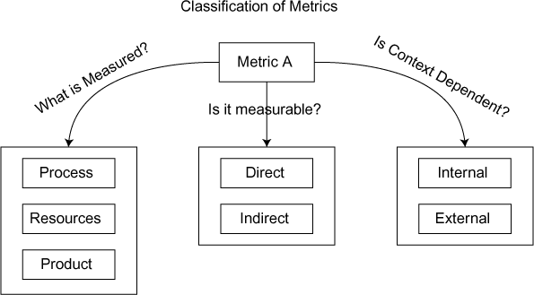
Classification of Metrics

Slide 18
Process Metrics
Metrics that are related to the software development process is called Process Metrics. Set of process creates a product.
Flaw in the process will affect the product, and hence it is required to watch the process metrics continuously and take appropriate action at appropriate time.

Slide 19
Metrics for the Analysis Model
How many functionalities the system will deliver? – Functionality delivered.
What is the size of the system to be developed? – Size of the system to be developed.
What is the quality level of the requirement? – Quality of the requirement (level of completeness).

Slide 20
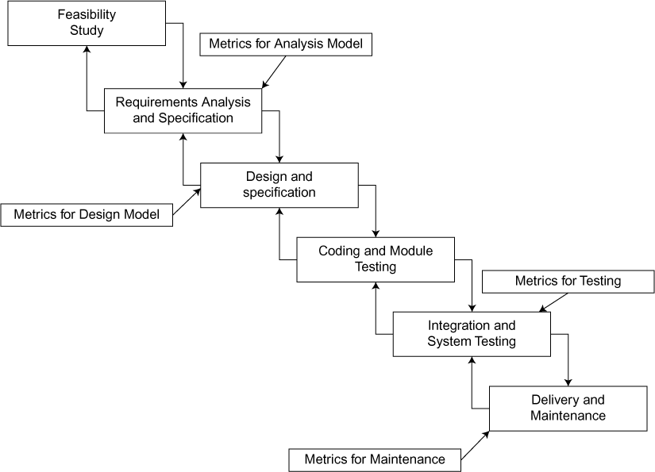
Metrics for the Design Model
Architectural metrics: Provide an indication of the quality of the architectural design.
Component-level metrics: Measure the complexity of software components and other characteristics that have a bearing on quality.
Interface design metrics: Focus primarily on usability.
Specialized object-oriented design metrics: Measure characteristics of classes and their communication and collaboration characteristics
Notes:
https://www.keycdn.com/blog/website-performance-metrics
https://www.userzoom.com/ux-library/what-metrics-and-kpis-do-the-experts-use-to-measure/

Slide 21
Interface Design Metrics - Usability
Success rate (whether users can perform the task at all)
The time a task requires,
The error rate, and
Users‘ subjective satisfaction.

Slide 22
Metrics for Testing
Examples of testing-related metrics are:
Defect removal effectiveness
Response time for fixing
Productivity metrics
Defect-related metrics: focus on defects (i.e., bugs) found rather than on the tests themselves.
Testing effectiveness metrics: provide a real-time indication of the effectiveness of tests that have been conducted.
In-process metrics: process-related metrics that can be determined as testing is conducted.
Statement and branch coverage metrics: lead to the design of test cases that provide program coverage.

Slide 23
Metrics for Maintenance
Software maturity index (SMI): It provides an indication of the stability of a software product based on changes that occur for each release.
SMI = (Total Modules – Changed Modules)/Total Modules
SMI will go down if the changes occur in higher number of modules.
Changed modules include number of added module + number of changed module + number of deleted modules.
Product is stable when SMI is nearby 1. The average time to produce a release can be proportional to SMI. When SMI is near 0, it will take more time to deliver the changes.

Slide 24
Productivity Metrics
Line of Code (LOC)/hours used to write the Code
Function Point (FP)/person-month used to write the Code
Average Person- days/Number of Classes (in object metrics)

Slide 25
Resource Metrics
Metrics that are related to the resources (including human resources) are called as Resource Metrics.
Example:
Effort per FP per resource
Cost per FP per resource
Defects per FP per resource
* FP = function points

Slide 26
Activity – Discussion Board in Open Learning
Task 1:
Find an apps in your smart phone which you think that it has good UI design. Provide the screenshots and justify with at least 3 points. Can apply any golden rules of UI or design metrics.
Task 2:
Find a website which you think it has bad UI design and poor user experience. Provide the screenshots and justify with at least 3 points. Can apply any golden rules of UI or design metrics.
Submit your work as new post reply.

