Slide 1

CSE3033N Software Engineering Topic: Project Management – SCRUM

Slide 2
Topic Learning Objectives
By the end of the lecture, you should be able to understand:
SCRUM Ceremonies and artefact development (UOL Slides)
Capturing requirements
Checking your user stories with INVEST criteria and SMART goals
Product Backlog and burn down chart
Cost estimation (next week video!)

Slide 3
Requirements should be:
Complete
Consistent
Precise
Concise
We want to make sure that we write down all of the requirements.
We don't want to deliver a product that's missing important functionality
Not contradicting with other functionalities
What it is we want the system to do and there's natural in precision.
Clearly and succinctly capture what it is the system can do.
And not bury the team in requirements

Slide 4
User Stories
User stories are short concrete documents that capture:
who a feature is for,
what its value is,
what's involved in creating that feature,
what its costs are, and
how long it will take to build.

Slide 5
Benefit of User Stories
These documents provide the customer a really concrete understanding of what it is that the development team is going to do when they're building out a future.
They also provide a bunch of data back to the customers so they can understand the overall costs and trade offs of adding a feature to their systems.
It increases the cohesion between customer and product owner and the developer team.

Slide 6
User Stories – 5 parts
Role
Limitations
Definition of Done
Engineering task
Effort Estimate
Explain what the customer is really thinking about
scoped down the role-goal-benefit to apply it only in this subset of situations that matter for this feature.
Giving the development team a concrete understanding of how the customer will be validating whether or not the feature that they're delivering is actually done, complete, and correct.
Keep track of how this feature interacts with other features within the system or other subsystems.
captures the overall costs of the feature.

Slide 7
User Story Format
As a [kind of stakeholder],
I want to [do some task],
So that [I can achieve some goal].
Notes:
© Copyright Showeet.com – Free PowerPoint Templates

Slide 8
User Stories
As a user, I can backup my entire hard drive.
This is huge. It’s called an epic.
You will need to break this down

Slide 9
Splitting User Stories
As a power user, I can specify files or folders to backup based on file size, date created and date modified.
As a user, I can indicate folders not to backup so that my backup drive isn't filled up with things I don't need saved.

Slide 10
More Examples of User Stories
User stories for a website
Basically this site allows you to create a profile, show some news, display some events, FAQs, resources and display jobs

Slide 11
Sample User Stories for Creating Profiles
As a site member, I can fill out an application to become a Practitioner.
As a Practitioner, I want my profile page to include additional details about me (i.e., some of the answers to my Practitioner application).

Slide 12
Sample User Stories for Displaying News on a Website
As a site visitor, I can read current news on the home page.
As a site visitor, I can access old news that is no longer on the home page.

Slide 13
Sample User Stories for Courses and Events
As a site visitor, I can see a list of all upcoming “Certification Courses.” I can page through them if there are a lot.
As a site visitor, I can see a list of all upcoming “Other Courses” (non-certification courses). I can page through them if necessary.
As a site visitor, I can see a list of all upcoming “Events.” (Events are things such as the Scrum Gathering, conferences, free seminars, etc.)

Slide 14
Sample User Stories for FAQs
As a site visitor, I can read FAQs.
As a site editor, I can maintain an FAQ section.

Slide 15
Sample User Stories for Jobs
As someone who wants to hire, I can post a “help wanted ad”.
As a site admin, I need to approve each help wanted ad before it gets to the site.
As a site admin, I am emailed whenever a job is submitted (so that I am aware of it and can decide if I want to post it).

Slide 16
Evaluating User Stories with SMART
SMART stands for
specific
measurable
achievable
relevant
time boxed
Notes:
© Copyright Showeet.com – Free PowerPoint Templates

Slide 17
SMART Goal 1: Specific
Explain why is this feature vague? Correct this statement.
User can search for a movie
Notes:
© Copyright Showeet.com – Free PowerPoint Templates

Slide 18
SMART Goal 2: Measurable
Adding Measurable to Specific means that each story should be testable, which implies that there are known expected results for some good inputs.
Explain why this feature is not measurable and correct it.
RottenPotatoes should have good response time.
Notes:
© Copyright Showeet.com – Free PowerPoint Templates

Slide 19
SMART Goal 3: Achievable
Ideally, you implement the user story in one Agile iteration.
If you are getting less than one story per iteration, then they are too big and you need to subdivide these stories into smaller ones.
Notes:
© Copyright Showeet.com – Free PowerPoint Templates

Slide 20
SMART Goal 4: Relevant
A user story must have business value to one or more stakeholders.
To drill down to the real business value, one technique is to keep asking “Why.”
Using as an example a ticket-selling app for a regional theatre, suppose the proposal is to add a Facebook linking feature.
Notes:
© Copyright Showeet.com – Free PowerPoint Templates

Slide 21
SMART Goal 4: Relevant
Here are the “Five Whys” in action with their recursive questions and answers:
Why add the Facebook feature? As box office manager, I think more people will go with friends and enjoy the show more.
Why does it matter if they enjoy the show more? I think we will sell more tickets.
Why do you want to sell more tickets? Because then the theater makes more money.
Why does theater want to make more money? We want to make more money so that we don’t go out of business.
Why does it matter that theater is in business next year? If not, I have no job.
Notes:
© Copyright Showeet.com – Free PowerPoint Templates

Slide 22
SMART Goal 5: Timeboxed
Time boxing means that you stop developing a story once you’ve exceeded the time budget.
Either you give up, divide the user story into smaller ones, or reschedule what is left according to a new estimate.
If dividing looks like it won’t help, then you go back to the customers to find the highest value part of the story that you can do quickly.
Notes:
© Copyright Showeet.com – Free PowerPoint Templates

Slide 23
Which SMART guideline(s) does the feature below violate?
RottenPotatoes should have a good user interface.
Revise the user story accordingly using SMART.
Answer?

Slide 24
INVEST CRITERIA
INVEST that was developed to help engineers and customers write effective user stories.
INVEST stands for
Independent
Negotiable
Valuable
Estimable
Small
Testable

Slide 25
INVEST Guidelines
Independent→ each user stories should be independent from each other as much as possible
Negotiable→ extra features or details you want to add
Valuable→ the value of the feature. This will change if the product change, customer expectations change, etc. so the team can revaluate the value of the feature that they are building.
Estimable → able to provide an effective costing for their feature. If the feature is really big, it should be broken down so that it can be a set of features that can be estimable.
Small→ small features are easier to estimate and able to help drive other features.
Testable→ stories can be tested. Customer and developer can make sure that the feature is developed in an agreed way.

Slide 26
Evaluating user stories using INVEST
INVEST stands for
Independent
Negotiable
Valuable
Estimable
Small
Testable
Example of a food apps:
As a Manny’s food service customer, I need to save my list so that later I can save a copy, print, or email the list for other uses.

Slide 27
Evaluating user stories using INVEST
INVEST stands for
Independent
Negotiable
Valuable
Estimable
Small
Testable
Example of a food apps:
As a Manny’s food service customer, I need to save, copy, print, and email my list so that I can edit it again, check a received shipment against a printed list, and send the list to a restaurant.

Slide 28
Evaluating user stories using INVEST
INVEST stands for
Independent
Negotiable
Valuable
Estimable
Small
Testable
Example of a food apps:
As a developer, I want to finalize the database table changes and additions for the release so that we don’t have to make changes to the model later.

Slide 29
Evaluating user stories using INVEST
INVEST stands for
Independent
Negotiable
Valuable
Estimable
Small
Testable
Example of a food apps:
As a Manny’s food service customer, I want to see different food item types displayed in different colors—RGB = #FF0000 for meats, #A52AFA for grains, and #808000 for vegetables and fruits—so that I can quickly identify my food items by food type.

Slide 30
Evaluating user stories using INVEST
INVEST stands for
Independent
Negotiable
Valuable
Estimable
Small
Testable
Example of a food apps:
As a business user, I would like a report of item profitability so that I can identify and highlight profitable items and consider what to do about underperforming items.

Slide 31
Evaluating user stories using invest
INVEST stands for
Independent
Negotiable
Valuable
Estimable
Small
Testable
Example of a food apps:
As a the marketing manager, I would like logins to time out and log off after a preset number of seconds in case users leave their computers unattended.

Slide 32
Evaluating user stories using invest
INVEST stands for
Independent
Negotiable
Valuable
Estimable
Small
Testable
Example of a food apps:
As the system, I need to store customer account info and their order lists in the database.

Slide 33
Evaluating user stories using invest
INVEST stands for
Independent
Negotiable
Valuable
Estimable
Small
Testable
Example of a food apps:
As a customer ordering food, I want to locate previous food order lists so that I can see all the lists that I have.

Slide 34
Evaluating user stories using invest
INVEST stands for
Independent
Negotiable
Valuable
Estimable
Small
Testable
Example of a food apps:
As a tester, I want to have detailed test plans so that when the system is completed, I can test the system.

Slide 35
Activity 1: Create User Stories
Assume that you are creating a new apps to cater for car wash center. Create as many stories as possible for the apps to be created. The user stories must cover all aspects of users such as owner of the center, apps administrator, and customer.
Keep your user stories, we will use it for the next activities.
20 minutes: Put your answer at:
https://padlet.com/phithuan_tan/CSE3033

Slide 36
Product Backlog
In the simplest definition the Scrum Product Backlog is simply a list of all things that needs to be done within the project.
It replaces the traditional requirements specification artifacts.
These items can have a technical nature or can be user-centric e.g. in the form of user stories. The owner of the Scrum Product Backlog is the Scrum Product Owner.
The Scrum Master, the Scrum Team and other Stakeholders contribute it to have a broad and complete To-Do list.

Slide 37
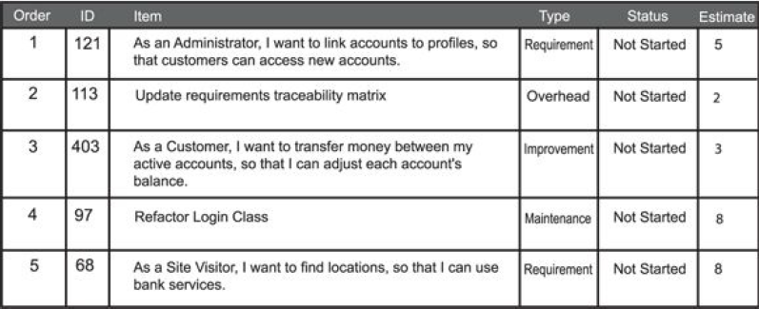
Product Backlog sample

Slide 38
Product Backlog
Specific order number (priority slot in the product backlog; although product backlog items may be similar in priority, they cannot be worked on at exactly the same time).
Description
Estimate of the effort required to complete.
ID number (optional).
Status (optional).
Type of item (optional). This could be a requirement, overhead, maintenance, or improvement (see the following section).

Slide 39
Type of backlog item
Requirement: What functionality needs to be developed for the end user? “The customer will be able to do . . .”
Maintenance: Design improvements for the code, such as fundamentally rethinking a login class that can’t be tactically tweaked anymore. Maintenance items reduce the technical debt of the project.
Improvements: Based on results from the sprint retrospective, what can be done differently in the process? For example, “Expand automated testing skills.”
Overhead: Companies often have overhead items that they just like to see, such as a requirement traceability matrix, and most companies don’t add the matrix into the equation. They assume that it’s free, but it costs time and money.

Slide 40
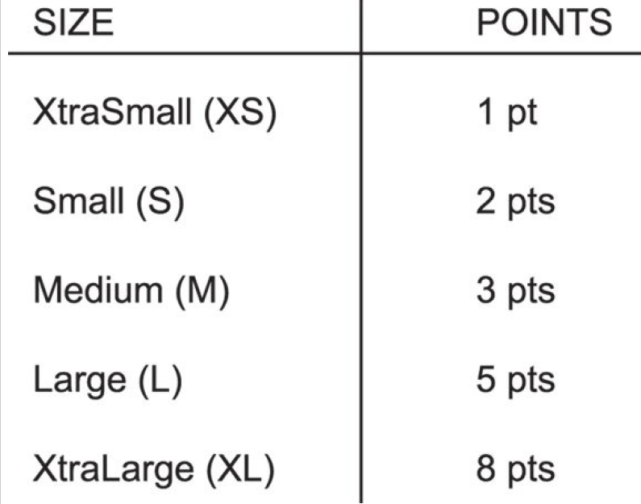
Story Points - Estimation Poker
A story point is a metric used in agile project management and development to estimate the difficulty of implementing a given user story.
It is an abstract measure of effort required to implement it.
It gives points to each requirements in the product backlog.
This is done based on the complexity of the feature.
This number can also be an estimate of the hours needed to develop this feature.
Example: shirt size to represent points

Slide 41
What do you mean by DONE?
Developed: The product has been fully developed by the development team.
Tested: The development team fully tested the product to make sure that it functions in the required environment without any glitches.
Integrated: The product has been fully integrated within the product as a whole and any related systems.
Documented: The development team created whatever documentation is needed. Just remember that the goal with all things agile is “barely sufficient.”

Slide 42
Velocity
At the end of the sprint, a scrum team looks at the requirements that were done to completion and adds their story points together.
If the requirement is complete then you get all the story points. If it is not complete, then the incomplete part goes back to the product backlog and reassigned to another sprint.
The entire team gets lesser story points for that sprint.

Slide 43
Burndown chart
Burndown charts are a way to visually represent progress achieved within the sprint. They depict the amount of work accomplished versus the amount left to go.
Your sprints will show a diagonal line from the upper-left corner to the lower right, which represents what an even and consistent burn would look like — though in reality, you won’t have a perfectly even burndown.
Some burndown charts also have a line showing the outstanding story points. This allows you to quickly and easily see the status of your sprint from both time and relative estimation perspectives.

Slide 44
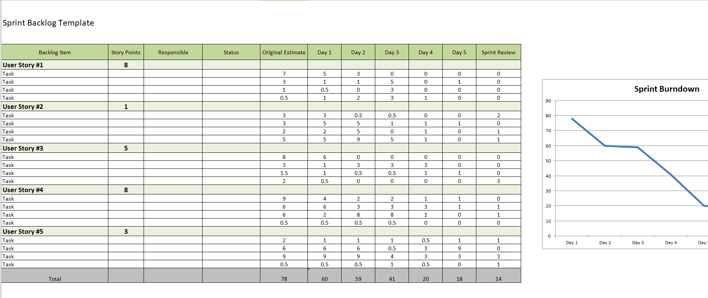
Burndown Chart
You can do this in excel

Slide 45
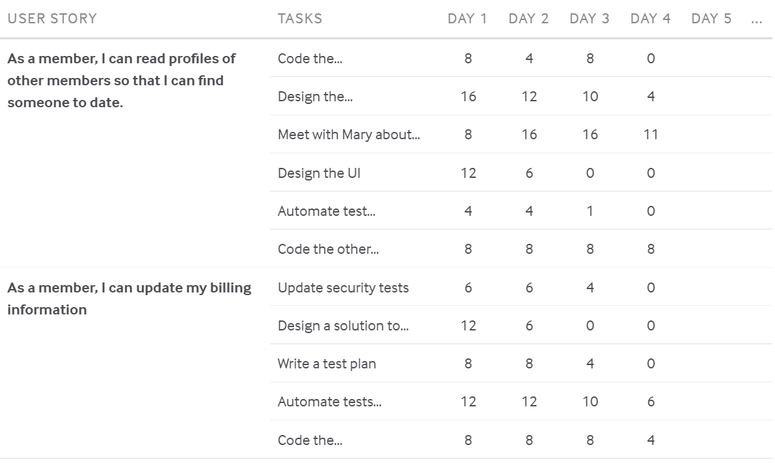
https://www.mountaingoatsoftware.com/agile/scrum/scrum-tools/sprint-backlog

Slide 46
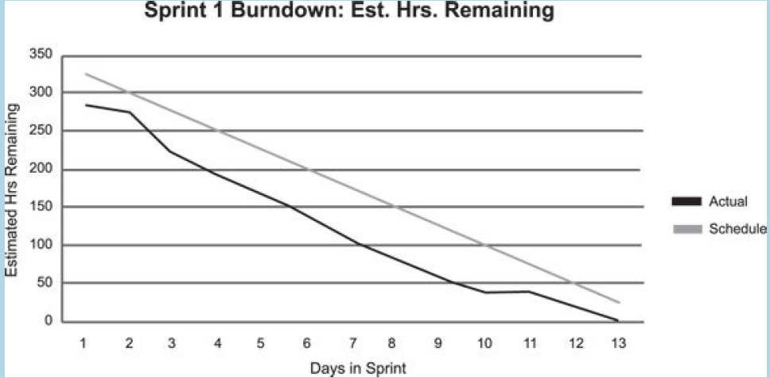
Burndown chart with actual and estimate
The chart can be indicated like this

Slide 47
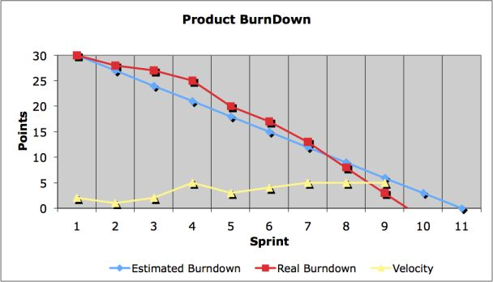
Burndown Chart with Velocity

Slide 48
Activity 2
Based on the user stories which you derive in activity 1:
Derive a sprint backlog table
Create a burndown chart based on the sprint backlog table details
Submit your sprint backlog table and chart in https://padlet.com/phithuan_tan/CSE3033.

Slide 49
Software to Produce Kanban / Project Review
https://hygger.io/
https://trello.com/
https://www.projectmanager.com/blog/burndown-chart-what-is-it

