Slide 1

CSE3033N Software Engineering Topic: Software Project Management – Project Cost Estimation

Slide 2
Topic Learning Objectives
By the end of the lecture, you should be able to understand:
Describe the options for cost and effort estimation
Discuss size estimation
Identify the sub-model in COCOMO II model
Understand the calendar time estimation

Slide 3
Project Cost Estimation Techniques
Delay estimation
Delay estimation until late in the project (it is obvious that we can gain 100% accurate estimation after the project is complete).
Follow previous or similar project
Doing software project estimation based on similar projects that have already been completed.
Decomposition technique
Use relatively simple decomposition technique to generate project cost and effort estimates.

Slide 4
Project Cost Estimation Techniques
Estimation Techniques
Algorithmic Model
based on size of project, type of software, software team, software attributes and process being used.
Examples: COCOMO Model, Putnam Model and Function points based model.
Non-Algorithmic Model
by using the previous projects previous experiences which is similar to the under estimate project
Examples: Analogy Technique, Expert Judgment, Parkinson’s Law, Pricing to Win

Slide 5
Algorithmic Models
for estimating effort in a software development are mostly based on a simple formula.
Characteristics:
Uses Mathematical formula
Prediction is based on estimates of project size, type of software, software team, software attributes and process being used.
Use the closest fit formula

Slide 6
Algorithmic Cost Modelling
Effort = A × Size^{B} × M
A = constant factor which depends on local organisational practices and the type of software that is developed.
Size = assessment of the code size of the software or a functionality estimate expressed in function or application points.
B = lies between 1 and 1.5
M = multiplier made by combining process, product and development attributes such as dependability requirements for the software and the experience of the development team.

Slide 7
Algorithmic Cost Modelling
Effort = A × Size^{B} × M
According to Sommerville (2010), all algorithmic models have similar process:
It is often difficult to estimate Size at an early stage in a project, when only the specification is available.
The estimates of the factors contributing to B and M are subjective. Estimates vary from one person to another, depending on their background and experience of the type of software project.

Slide 8
Algorithmic Cost Modelling
A common metric used in algorithmic cost modelling . Usually used to estimate the value of B in the formula.
Estimation by comparison with other projects.
Estimation by converting function or application points to code size.
Estimation by ranking the sizes of the system components.
Using a known reference component to estimate the component size or it may simply be a question of engineering judgement.
Effort = A × Size^{B} × M
Read more from slides 23 (self-reading).

Slide 9
COCOMO II Model (Constructive Cost Model)
Emphasizes on
Application composition model – current practice!
Early design model
Reuse model
Post-architecture model

Slide 10
COCOMO II Model (Constructive Cost Model)
It is used to support the estimation of effort required for prototyping projects.
Application composition model weight the estimate using application point.
The weight that been counted as application point such as:
The number of separate screens that are displayed
The number of reports that are produced
The number of modules in imperative programming language
The number of lines of programming code

Slide 11
COCOMO II Model (Constructive Cost Model)
PM = (NAP X (1 - %reuse / 100)) / PROD
PM = the effort estimate in person month
NAP = the total number of application points in the delivered system
%reuse = an estimate of the amount of reused code in the development
PROD = the application point productivity

Slide 12
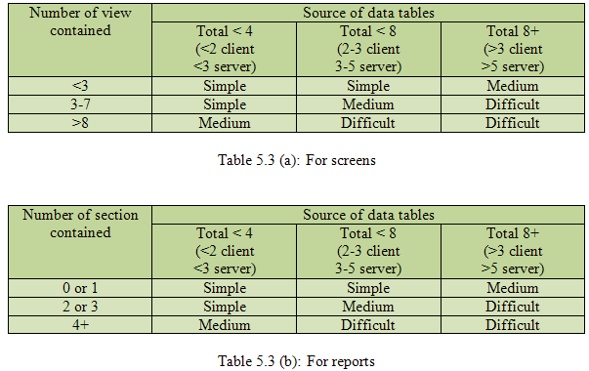
The application composition model
PM = (NAP X (1 - %reuse / 100)) / PROD
There are several steps that you need to follow for the estimation of effort in person months.
Assess application count: estimate the number of screen, reports and 3GL (third Generation Language) components that will comprise this application.
Classification of complexity level: The screens are classified on the basis of number of views and sources and reports are on the basis of number of sections and sources.

Slide 13
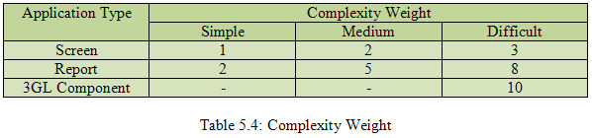
The application composition model
PM = (NAP X (1 - %reuse / 100)) / PROD
Assign complexity weight for each application: The weights are used for three application types.
Determine application points: Add all the weight application instances to get one number and this number is known as application point count.
Compute new application point (NAP): we have to estimate object reuse. Depending on the percentage reuse, the new application points are counted.
NAP = (application point)*(100-%reuse)
100
NAPs are the application point that will need to be developed and differ from the application point count because they may be reuse.

Slide 14
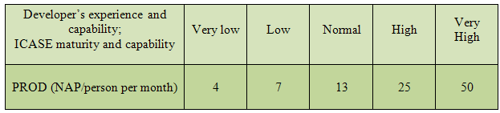
The application composition model
PM = (NAP X (1 - %reuse / 100)) / PROD
Calculation productivity rate: the productivity rate can be calculated as:
Productivity rate (PROD): NAP/ Person Month.
Productivity depends on the developer’s experience and capability. The capability include with the capabilities of the software tools (ICASE) that used to support the project.
Application Point Productivity
Compute the effort in person per month: When PROD is known, you can estimate effort person per month as:
PM = NAP
PROD

Slide 15
Cost estimation solution
Based on the application composition model in
COCOMO II Model (Constructive Cost Model)

Slide 16
Question
Consider a database application project with the following characteristics:
1. The application has five screens and five views each and seven data tables for three servers and four clients.
2. The application may generate two reports of three sections each from seven data tables for two servers and three clients. There is 20% reuse of application points.
3. The developer’s experience and capability in this subject are low. The maturity of the company in terms of capability is also low.
Calculate the application point count, new application points and effort to develop such a project.

Slide 17
Step by step
PM = (NAP X (1 - %reuse / 100)) / PROD
The project comes under the category of application composition estimation model.
Number of screens = 5 with 5 views each (seven data tables for three servers and four clients)
Number of reports = 2 with 3 sections each (seven data tables for two servers and three clients)

Slide 18
Step by step
PM = (NAP X (1 - %reuse / 100)) / PROD
Number of screens
= 5 with 5 views each
(seven data tables for three servers and four clients)
Number of reports
= 2 with 3 sections each
(seven data tables for two servers and three clients)
So, we know that each screen and report will be of medium complexity.

Slide 19

Step by step
PM = (NAP X (1 - %reuse / 100)) / PROD
Using Table 5.4 of complexity weights, we may calculate
application point count = 5 × 2 + 2 × 5 = 20

Slide 20
Step by step
According to application composition model
PM = (NAP X (1 - %reuse / 100)) / PROD
This is how you get NAP
NAP = (application point)*(100-%reuse)
100
NAPs are the application point that will need to be developed and differ from the application point count because they may be reuse.
NAP = 20 * (100 – 20)
100
= 16

Slide 21
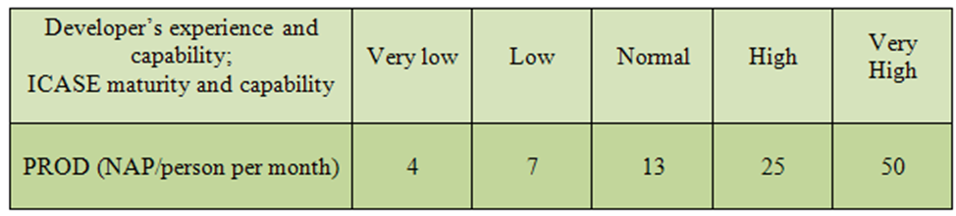
Step by step
Table 5.5 shows that the low value of productivity (PROD) is seven.

Slide 22
Step by step
Compute the effort in person per month:
When PROD is known, you can estimate effort person per month as:
PM = NAP = 16 = 2.286 PM
PROD 7

Slide 23
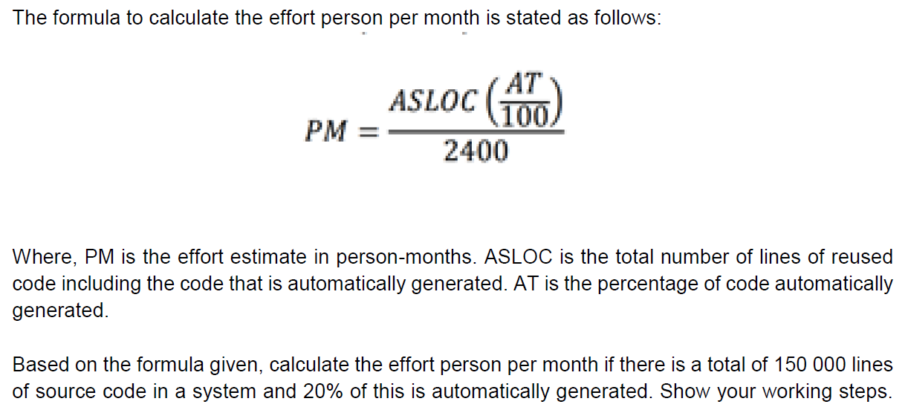
Another way of calculation: Reuse Model
Can you try this out and get the answer? We shall discuss this on Friday!

Slide 24
More on your own reading – understanding the history of algorithm model of estimation techniques

Slide 25
The early design model
The estimate is based on function points.
The estimates produced are based on the formula for algorithmic models as follow:
Effort = A X Size^{B} X M
Where,
A = Boehm proposed that the coefficient A should be 2.94 based on his own large data set.
Size= The size of the system is shown in KSLOC means the number of thousand of lines of source code. You will calculate KSLOC by estimating the number of function points in software. After that use standard tables that relates software size to function points for different programming languages to compute a preliminary estimate of the system size in KSLOC.

Slide 26
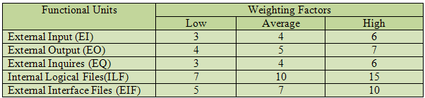
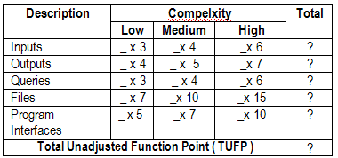
The early design model
Below are several steps to find the size;
You need to determine the Unadjusted Function Points (UFP) using predefined weight for each function that shown in table below:
Functional Units with weighting factors
For calculating the UFP, it shown as below table:
UFP Calculation Table

Slide 27
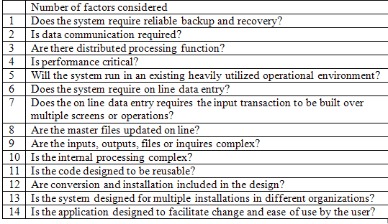
The early design model
After the TUFP had been defined, you need to calculate the adjustment factor which determined by considering 14 aspects of processing complexity shown in table below:
Aspects of processing complexity

Slide 28

The early design model
You need to rate each factor on a scale of 0 to 5 such as shown in figure below:
Factor of scale
To calculate the adjustment factor will be,
Complexity Adjusment Factor (CAF) = 0.65 + (0.01 X (total processing complexity))
Now you can calculate the function point after TUFP and CAF had been defined. The calculation is,
FP = CAF X TUFP
Once you receive the value of FP, you need to convert the number of function points into the lines of code that will be required to build the system. The number of codes depends on the programming language you choose to use. Table 5.9 represent a very rough conversion guide for some popular language.

Slide 29
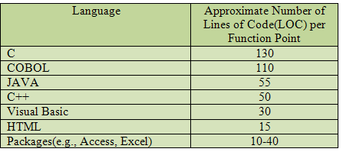
The early design model
Converting from function points to Lines of Code
For example, a system consists of 224 function points. If you were to develop the system in COBOL, it would typically require,
Size = FP X LOC per function point
= 224 X 110
= 24640
The exponent B shown the increased effort required as the size of the project increases. If B<1, the rate of increase of effort decreases as the size of the product increases. If B>1.0, the rate of increase of effort increases as the size of the product increases. The value B is computed on the basis of scaling factors that may cause drop in productivity with increase in size.

Slide 30
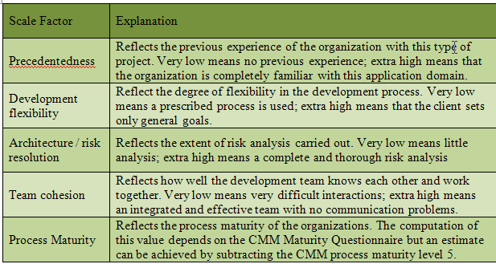
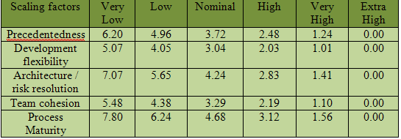
The early design model
Scaling factors
Data for Compute value B

Slide 31
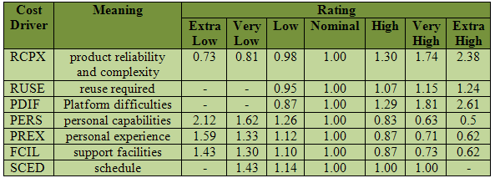
The early design model
The value B can calculated as,
B = (total of scaling factor) /100 + 1.01
When all the scaling factor of a project are rated as extra high, the best value of B is obtained and is equal to 0.91. When all the scaling factors are very low, the worst value of B is obtained and is equal to 1.23. Therefore, the value of B may vary from 0.91 to 1.23.
M = It is based on seven project and process attributes that increase or decrease the estimates.
Cost driver with rating
Therefore, to count M is,
M = PERS x RCPX x RUSE x PDIF x PREX x FCIL x SCED

Slide 32
The Reuse Model
It is used to compute the effort required to combine the reusable components and then generated the program code.
The reuse model is used to estimate the effort required to combine reusable or generated code.
COCOMO II has two types of reused code such as:
‘Black box’ codes – code that can be reused without understand the code or make change to the code.
‘White box’ codes – code that need to be adapted to combine with new or reuse code.
PM= (ASLOC X AT / 100) / ATPROD
ASLOC = total number of lines of reused code including the code that auto-generated
AT = the percentage of reused code that is automatically generated
ATPROD = the productivity of engineers in integrated the code
PM = effort estimate in person-months

Slide 33
The Reuse Model
Boehm, et al. (2000) has measured ATPROD to be about 2400 source statements per month.
Therefore, if there are a total of 20000 lines of reused source code in a system and 30% of this is automatically generated, then the effort required to integrate the generated code is:
(20000 X 30/100) / 2400 = 2.5 person-months
So, the effort required to integrate the code is 2.5 person-months.

Slide 34
The Post Architectural Model
This is the most detailed model in COCOMO II model.
It is used for development effort based on system design specification based on number of line of source code.
Post architectural model involves with actual development and maintenance of a software product.
The starting point for estimates produced at the post-architecture level is the same formula used in the early design estimates:
PM = A x Size^{B} x M
The difference between early design and post architectural formula is the cost driver for finding the value M.
In early design, only 7 cost driver that been identified.
Post architectural model have 17 cost drivers that mapped from the & early design cost drivers.

Slide 35
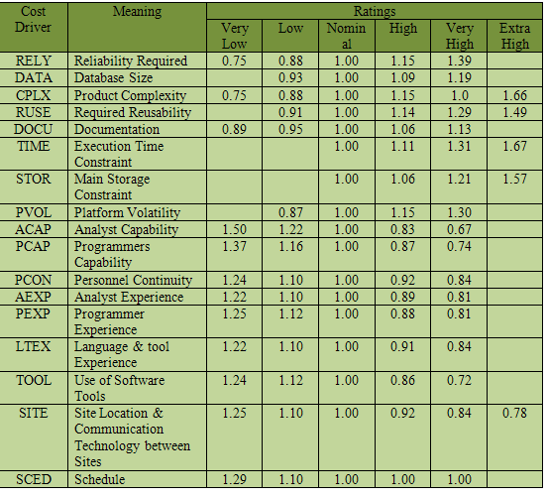
The Post Architectural Model
Cost Driver involved in Post Architectural Model

Slide 36
Project duration and Staffing
organizations prefer shorter development duration so that they can bring the product to market before their competitors.
The COCOMO models have a formula that can estimate the calendar time required to complete a project:
TDEV = 3 X (PM) ^{(0.33 + 0.2*(B-1.01))}
TDEV = the nominal schedule for the project, in calendar months, ignoring any multiplier that is related to project schedule.
PM = the effort computed by the COCOMO model
B = the complexity-related component

Slide 37
Project duration and Staffing
By dividing the total effort you cannot simply estimate the number of people needed in development team.
Typically, a small group of people are required at the start of the project to carry out the initial design.
The development team then builds up to a peak during the development and testing of the system and then declines in size as the system is prepared for deployment.
Project leaders must avoid adding so many staff to a project early in its lifetime so that it can maintain the expected level in project schedule.

Slide 38
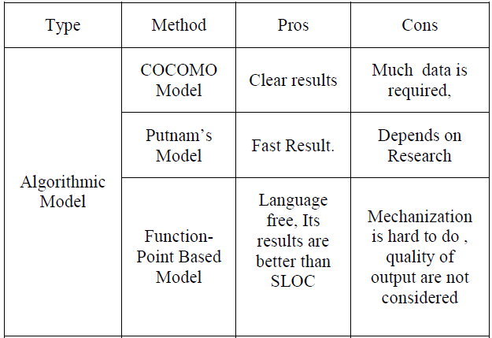
Comparison of Pros & Cons for Estimation Techniques

Slide 39
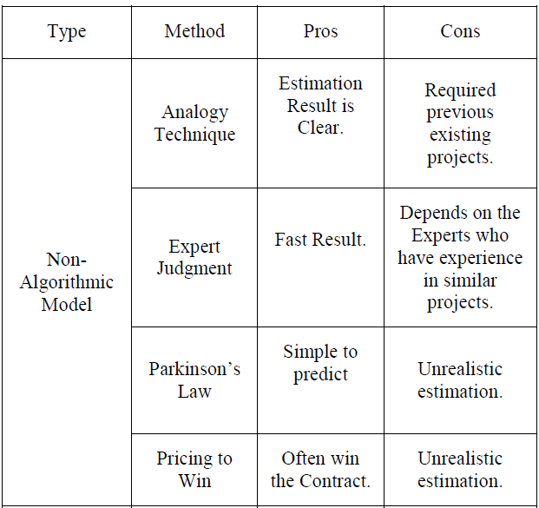
Comparison of Pros & Cons for Estimation Techniques

Slide 40
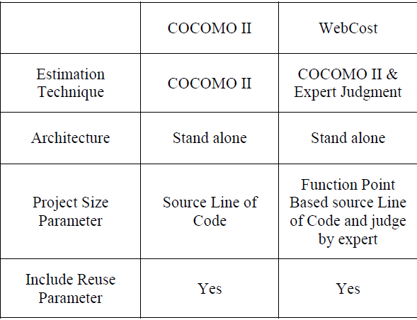
COMPARISION WITH EXISTING TOOL

Slide 41
Source:
Nerkar, L.R. and Yawalkar, P.M., 2014. Software Cost Estimation using Algorithmic Model and Non-Algorithmic Model a Review. Int J Comput App, 2, pp.4-7.

