Slide 1

CSE3033N Software Engineering Topic: Software Implementation OOP Concepts A Quick Walkthrough

Slide 2
Topic Learning Objectives
By the end of the lecture, you should be able to understand:
Important areas of object-oriented design in software implementation

Slide 3
What is an OBJECT
An instance of a CLASS
Contains meaningful data
Concepts that occupy memory space at runtime are, according to the definition, objects
If not, they are CLASSES
For example: data type vs. double

Slide 4

A little quiz
Which one is the class ? Which one is the instance of the class ?
Dog
Scooby-Doo
Notes:
Dog is a generalization of Scooby-Doo

Slide 5
What about Animal class?
Animal
Dog
Scooby-Doo

Slide 6
What about Animal class?
Animal
Dog
Scooby-Doo

Slide 7
Characteristics of OOD
Objects are abstractions of real-world or system entities and manage themselves
Objects are independent and encapsulate state and representation information.
System functionality is expressed in terms of object services
Shared data areas are eliminated
Objects communicate by message passing
Objects may be distributed
Objects may execute sequentially or in parallel

Slide 8
Advantages of OOD
Easier maintenance. Objects may be understood as stand-alone entities.
Objects are appropriate reusable components.
For some systems, there may be an obvious mapping from real world entities to system objects

Slide 9
Object-oriented development
Object-oriented analysis, design and programming are related but distinct.
OOA is concerned with developing an object model of the application domain.
OOD is concerned with developing an object- oriented system model to implement requirements.
OOP is concerned with realising an OOD using an OO programming language such as Java or C++.

Slide 10

Em p loyee
nam e: string addres s: s tring dat eOfBirth: Dat e
em ployeeN o: integer
s ocialSec urity No: s tring department: Dept
ma nager: Employ ee s alary : integer
s tatus: {current, left, retired} t axC ode: integer
. . .
join () leav e () retire ()
c hangeDet ails ()
Objects are entities in a software system which represent instances of real- world and system entities
Object classes are templates for objects
Object classes may inherit attributes and services from other object classes

Slide 11
Object Communication
Conceptually, objects communicate by message passing .
Messages
The name of the service requested by the calling object.
Copies of the information required to execute the service and the name of a holder for the result of the service.
In practice, messages are often implemented by procedure (a.k.a. method) calls
Name = method name
Information = parameter list
Result holder = method return value

Slide 12
Message Examples
// Call a method associated with a buffer
value
// object that returns the next
// in the buffer
v = circularBuffer.Get() ;
// Call the
method associated object that sets
with a the
// thermostat
// temperature to be maintained
thermostat.setTemp(20) ;

Slide 13
Generalisation and Inheritance
Objects are members of classes which define attribute types and operations.
Classes may be arranged in a class hierarchy where one class (a super-class) is a generalisation of one or more other classes (sub-classes).
A sub-class inherits the attributes and operations from its super class and may add new methods or attributes of its own.
It is a reuse mechanism at both the design and the programming level.
Inheritance introduces complexity and this is undesirable, especially in critical systems.

Slide 14





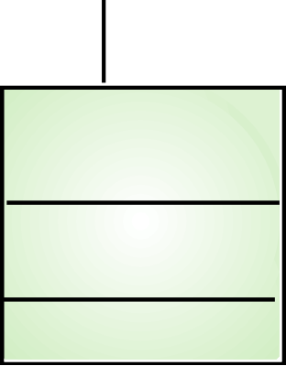
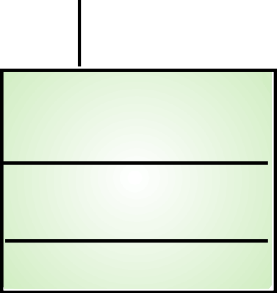

A Generalisation Hierarchy
Employee
Manager
Programmer
budgetsControlled dateAppointed
project progLanguage
Project Manager
Dept.
Manager
dept
Strategic Manager
responsibilities
projects

Slide 15



Object Relationships
Objects and object classes participate in relationships with other objects and object classes
In UML, such a relationship is indicated by an association
Associations may be annotated with information that describes the association
Employee
Department
is-member-of
is-managed-by
manages
Manager

Slide 16
Object Identification
Identifying objects (or object classes) is the most difficult part of object oriented design.
There is no “magic formula” for object identification
It relies on the skill, experience and domain knowledge of system designers.
Object identification is an iterative process.

Slide 17
Approaches to Identification
Use a grammatical approach based on a natural language description of the system .
Base the identification on tangible things in the application domain.
Use a behavioural approach and identify objects based on what participates in what behavior.
Use a scenario-based analysis – the objects, attributes and methods in each scenario are identified.

Slide 18
Object Interface Specification
Object interfaces have to be specified so that the objects and other components can be designed in parallel.
Designers should avoid designing the interface representation but should hide this in the object itself.
Objects may have several interfaces which are viewpoints on the methods provided.

Slide 19
Examples of Design Models
Sub-system models that show logical groupings of objects into coherent subsystems
UML package diagrams
Sequence models that show the sequence of object interactions
UML sequence diagrams
State machine models that show how individual objects change their state in response to events
UML statechart diagrams
Other models include use-case models, aggregation models, generalisation models,etc.
20

Slide 20




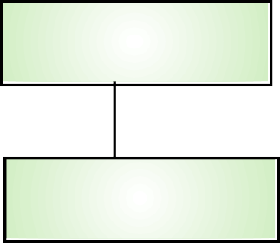





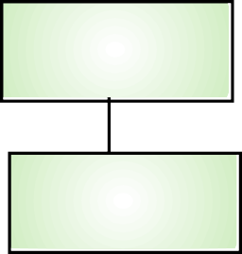



Weather Station Subsystems
«subsystem» Interface
«subsystem» Data col ection
CommsControl er
WeatherData
Instrument Status
WeatherStation
«subsystem» Instruments
Air thermometer
RainGauge
Anemometer
Ground thermometer
Barometer
WindVane

Slide 21









Weather station - data collection sequence
:CommsControle :WeatherStation
:WeatherData
r
request (report)
acknowledge ()
report ()
summarise ()
send (report)
reply (report)
acknowledge ()

Slide 22
Relationships Between Classes
Inheritance
Aggregation
Dependency

Slide 23
Inheritance
Is-a relationship
Relationship between a more general class (superclass) and
a more specialized class (subclass)
Every savings account is a bank account

Slide 24
Aggregation
Has-a relationship
Objects of one class contain references to objects of another class
Use an instance variable
A tire has a circle as its boundary:
Every car has a tire (in fact, it has four)
class Tire
{
. . .
private String rating; private Circle boundary;
}
class Car extends Vehicle
{
. . .
private Tire[] tires;
}

Slide 25
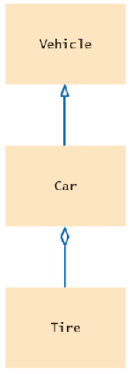
UML Notation for Inheritance and Aggregation
class Car extends Vehicle
{
. . .
private Tire[] tires;
}
Inheritance
class Tire
{
. . .
private String rating; private Circle boundary;
}
Aggregation

Slide 26
Dependency
Uses relationship
Example: many of our applications depend on the Scanner class to read input
Aggregation is a stronger form of dependency
Use aggregation to remember another object between method calls

Slide 27
UML Relationship Symbols
Relationship | Symbol | Line Style | Arrow Tip
Inheritance |  | Solid | Triangle
Interface |  | Dotted | Triangle
Aggregation |  | Solid | Diamond
Dependency |  | Dotted | Open

Slide 28
Hands on Session!

Slide 29
Self Check
Consider the Bank and BankAccount classes. How are they related?
Consider the BankAccount and SavingsAccount objects. How are they related?
Consider the BankAccountTester class. Which classes does it depend on?

Slide 30
Answers
Through aggregation. The bank manages bank account objects.
Through inheritance.
The BankAccount, System, and PrintStream classes.

Slide 31
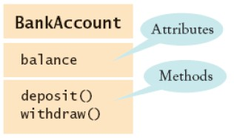
Attributes and Methods in UML
Attributes and Methods in a Class Diagram

Slide 32
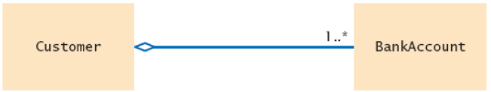
Multiplicities
any number (zero or more): *
one or more: 1..*
zero or one: 0..1
exactly one: 1
An Aggregation Relationship with Multiplicities

Slide 33
Aggregation and Association
Association: more general relationship between classes.
Use early in the design phase.
A class is associated with another if you can navigate from objects of one class to objects of the other.
Given a Bank object, you can navigate to Customer objects.

Slide 34
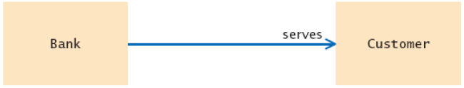
Aggregation and Association
An Association Relationship

Slide 35
Rule of Simplicity
The best designs usually involve the least complex code but not necessarily the fewest number of classes or methods.
Minimizing complexity should be the goal, because that produces the most easily maintained and enhanced application.
In an object-oriented system, the best way to minimize complexity is to use inheritance and the system’s built-in classes and to add as little as possible to what already is there.

Slide 36
Uncoupled Design
Coupling is a measure of the strength of association established by a connection from one object or software component to another.
Interaction coupling
amount and complexity of messages between components.
Preferred to be minimal
What happens when high and low ?
Inheritance coupling
coupling between super and sub classes coupling in terms of attributes and methods
Preferred to be high
What happens when high and low ? { override all, unused methods }

Slide 37
Cohesion
Cohesion reflects the “single-purposeness” of an object.
Highly cohesion ➔ Lower coupling
Method cohesion: method carrying one function.
A method that carries multiple functions is undesirable.
Class cohesion: All the class’s methods and attributes are highly cohesive, meaning to be used by internal methods or derived classes’ methods.

Slide 38
Single Purpose
Every class should be clearly defined and necessary in the context of achieving the system’s goals.
When we document a class, we should be able to explain its purpose in a sentence or two.
If we cannot, then the class should be subdivided into independent pieces.
Each method must provide only one service.
Each method should be of moderate size, no more than a page; half a page is better.

Slide 39
Achieving Multiple Inheritance
What is Single inheritance?
What is the problem with Multiple Inheritance ?
What is the ideal case for MI ?
In C++ objects can inherit behavior from unrelated areas of the class tree.
How to determine which behavior to get from which class, particularly when several ancestors define the same method.
Virtual Inheritance !!??

Slide 40
Class Visibility
Purpose of Access Specifiers ?
Difference between C++ struct and class ?
The class’s protocol or the messages that a class understands, can be hidden from other objects (private protocol) or made available to other objects (public protocol).
Public protocols define the functionality and external messages of an object.
Private protocols define the implementation of an object.
The lack of well-designed protocol can manifest itself as encapsulation leakage. It happens when details about a class’s internal implementation are disclosed through the interface

Slide 41
What is SOLID?
S
SRP
Single Responsibility Principle
O
OCP
Open/Closed
Principle
L
LSP
Liskovs Substitution Principle
I
ISP
Interface Segregation Principle
D
DIP
Dependency Inversion Principle

Slide 42
Single Responsibility Principle
“A class should have one and only one reason to change”

Slide 43
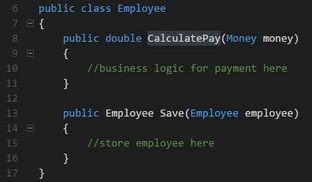

Single Responsibility Principle
Business logic
Persistence
There are two
responsibilities

Slide 44

Single Responsibility Principle
How to solve this?

Slide 45
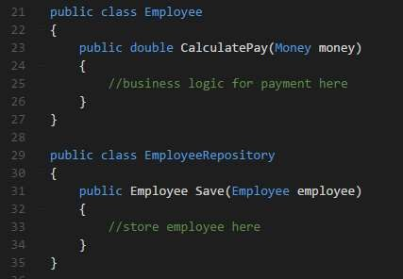

Single Responsibility Principle
Just create two different
classes

Slide 46
Open/Closed Principle
“Software entities should be open for extension, but closed for modification.”

Slide 47
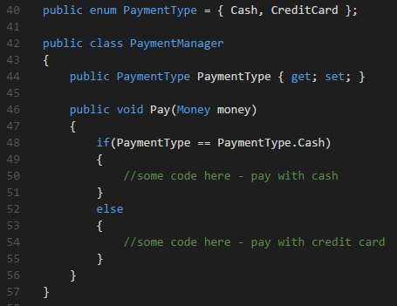
Open/Closed Principle
Humm...and if I need to add a new payment type?
You need to modificate this class.

Slide 48
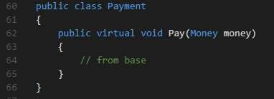
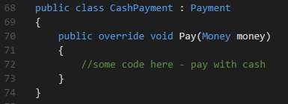
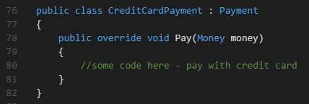
Open/Closed Principle
open for extension
close for modification

Slide 49

Liskov Substitution Principle
“Let q(x) be a property provable about objects x of type T. Then q(y) should be provable for objects y of type S where S is a subtype of T”
What do you say?

Slide 50
Liskov Substitution Principle
“A subclass should behave in such a way that it will not cause problems when used instead of the
superclass.”

Slide 51
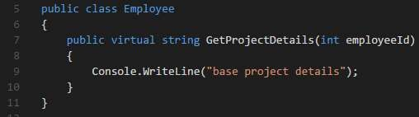
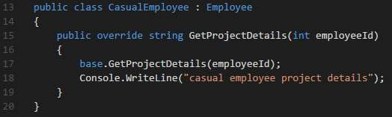
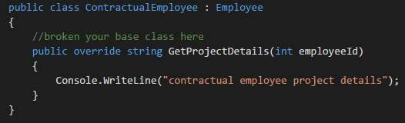

Liskov Substitution Principle

Slide 52
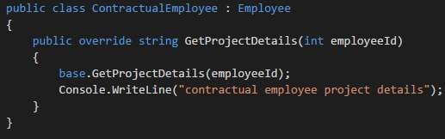

Liskov Substitution Principle
Much better

Slide 53
Interface Segregation Principle
“Clients should not be forced to depend upon interfaces
that they don't use”

Slide 54
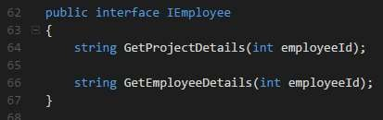
Interface Segregation Principle

Slide 55
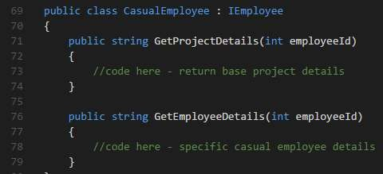
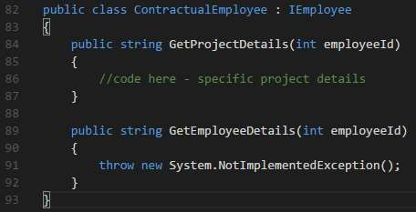

Interface Segregation Principle
WHY?????
I don’t need you!!

Slide 56
Interface Segregation Principle
How to solve this?

Slide 57


Interface Segregation Principle
You need to create two interfaces

Slide 58
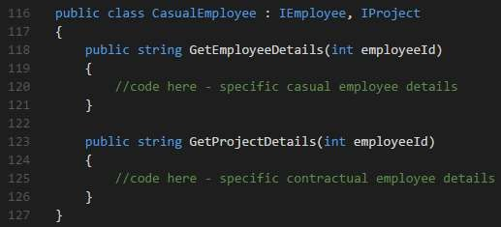
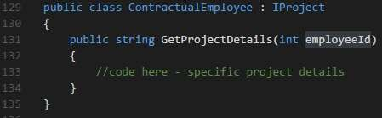
Interface Segregation Principle

Slide 59
Dependency Inversion Principle
“High-level modules should not depend on low-level modules.
Both should depend on abstractions.”
“Abstractions should not depend upon details. Details should depend upon abstractions.”

Slide 60
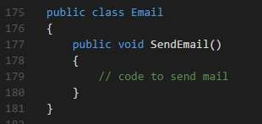
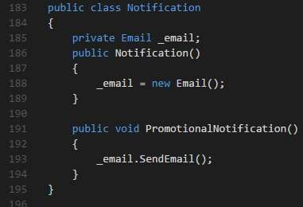

Dependency Inversion Principle
And if I need to send a notification by SMS?
You need to change this.

Slide 61

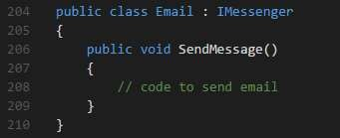
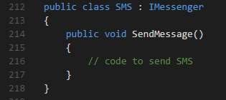
Dependency Inversion Principle
So, I create an interface and now?

Slide 62
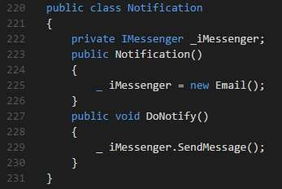
Dependency Inversion Principle

Slide 63
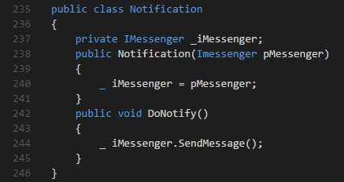
Dependency Inversion Principle
Constructor injection:

Slide 64
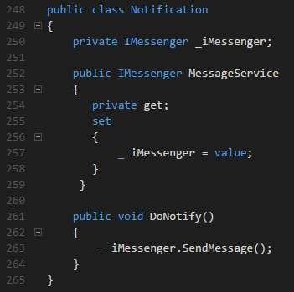
Dependency Inversion Principle
Property injection:

Slide 65
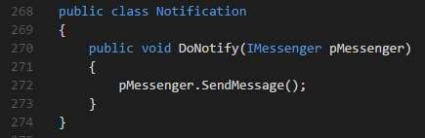
Dependency Inversion Principle
Method injection:

Slide 66
Keep in mind
DRY - Don’t repeat yourself
+
SLAP - Single layer abstraction principle
+ SOLID

Slide 67
Enjoy code and Keep it simple!

