Slide 1

CSE3033N Software Engineering Topic: Software Implementation 2

Slide 2
Topic Learning Objectives
By the end of the lecture, you should be able to understand:
Programming Principles
Programming Guidelines
Coding Conventions (Programming Practices)

Slide 3
Introduction
Software coding is the core aspect of software engineering that acts as a catalyst for creating the software product.
In a typical waterfall model, coding is done after the requirement clarification and design.

Slide 4
Steps involved in coding
Conversion of detailed design specification into the actual software code is called as coding.
It converts functional aspects into technical aspects using design.
It is performed by people called as coders or programmers.
The coding phase usually takes lesser time than the design phase.
Lots of sophisticated tools are available to write the code easily.

Slide 5
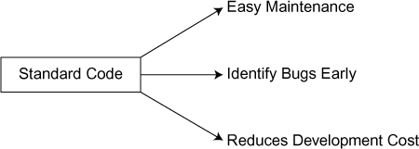
Benefits of writing standard codes
Writing standardized code for software not only helps to maintain it properly once it is completely deployed into production but also helps to enhance the code easily at a later point of time.
It also helps to identify and fix the bugs quickly and easily. So writing the proper working code alone is not enough, but focus should also be on writing a standard code.
Writing a standard code also reduces the cost of development over a period of time. Standard code helps to reuse the same code for some other similar purposes, thereby reducing the cost of development.

Slide 6
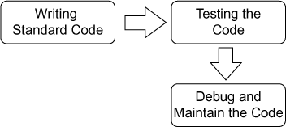
Programming Principles
Computer programming is directly associated with writing a standard code.
Computer programming means writing a standard code, testing the written code, and debugging and maintaining the code.

Slide 7
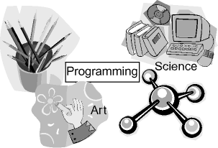
Points to ponder
Programming can be considered as both art and science. Programming is a science as it needs to follow set of engineering principles and guidelines.
It is also being classified as art because there are lots of possibilities of using creative and innovative minds.

Slide 8
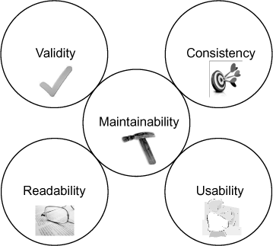
Five general programming principles **exam*
Validity:
The program must give the correct result which is valid. For example, let us consider a program intended to add two numbers say add (x, y).
When we pass the value (4, 5), it should give the value 9 as output and when we pass the value (–4, 5), it should give the value 1 as output.
Consistency:
The program must do repeatedly what it intends to do. The program should give the output consistently.
For example, if add (4.2, 5.4) gives the output as 10, add (5.4, 4.2) also should give the output as 10.

Slide 9
Five general programming principles
Maintainability:
The program must be easily changeable (addition and modification) and should have proper documentations.
Readability:
The program must be easily readable so that it is easily maintainable.
Usability:
The program must be usable for the specific purpose without any trouble.

Slide 10
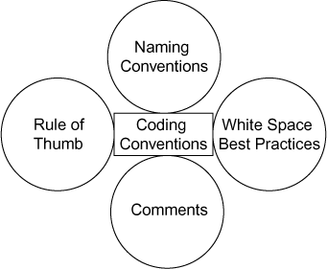
Programming Guidelines
Guideline means best practices.
Programming best practices (guidelines) includes:
programming practices (coding conventions),
naming conventions,
comments, and
programming principles rule of thumb.

Slide 11
Programming guidelines
Programming guidelines will vary across programming languages, but still there are general guidelines that can be followed across the languages.
Writing a standardized code for software not only helps to maintain it properly once it is completely deployed into production but also helps to enhance the code easily at later point of time.
Standard coding also helps to identify and fix the bugs quickly and easily and so writing the proper working code alone is not enough. Focus should also be on writing a standard code.
Coding conventions can be documented in a central place so that the team can follow it; it can also be informal. Not following some or all of the rules (guidelines) will not impact the output (functionality) of the code.

Slide 12
CODING CONVENTIONS (PROGRAMMING PRACTICES)
Coding conventions are a set of best practices that helps to write the software code in an efficient manner.
Coding conventions cover the aspects of programming style, programming practices, and methods.
This will vary from one programming language to another.
For example, Java programming language has a set of programming practices and Visual basic has its own set of programming practices and guidelines.

Slide 13
Advantages of coding conventions
Code becomes reusable saving money for all.
It is easy to maintain.
Enhancing the code becomes easy.
It saves cost for the company.
It helps to identify coding problems quickly.
Knowledge transfer becomes easy.

Slide 14

Coding conventions covers

Slide 15
Naming conventions
File name
Folder name
Variable name
Function (method) name
Length of the identifiers
Letter case and numerals
Multiple word identifiers
Hybrid conventions
Many companies nowadays define their own coding conventions to be used across all projects.
A= B × C is syntactically correct, but the purpose of this code snippet is not known.
We can write the same code as below, which has more meaning and conveys the purpose.
Work = Duration × Number of resources

Slide 16
Length of identifiers
Shorter identifiers are preferred over lengthy ones (difficult to identify and remember).
Longer identifiers are preferred because it is easy to encode them.
Extremely short identifiers (example: a, b, c) are very difficult to distinguish each other.
Longer identifiers may not be preferred because of visual clutter.

Slide 17
Letter case and numerals
Some naming conventions limit the letter case of the variable to be only in uppercase or lowercase (WEIGHT or weight).
Some naming conventions do not limit the letter case of the variable but attach a defined meaning with the letter case (Chair Weight).
Some naming conventions specify that the variable name should start with an upper case and should use at least one numeric within (password characters have this kind of restrictions).

Slide 18
Multiple word identifier
A single word may not be enough to specify the clear purpose and meaning of an identifier, and we may need to use a combination of identifiers to make it meaningful (e.g., Chair Weight).
When we use a combination of words for a single identifier, it is called as “compound identifier” (which contains more than one word).
Most programming languages do not allow white spaces in the identifiers and so we need a delimiter in between for that purpose.

Slide 19
Delimiter-separated Words
Using delimiters in between to separate the words (in an identifier) helps to understand the meaning easier.
Underscore (“_”) and Hyphen (“-”) are most commonly used delimiters (e.g.,: Chair_Weight or Chair-Weight)

Slide 20
Letter-case-separated Words
Without using delimiters in between (in an identifier), we can use uppercase characters for words that help to understand the meaning easier.
It is also called as CamalCase (e.g.,: Chair Weight). Sometimes, instead of using big names, we can also use acronyms such as “XML”.

Slide 21
Hybrid Convention
Some naming conventions in addition to its name also represent a set of principles defined by the architecture, underlying programming language, or any cross-project methodology.
Composite word scheme (OF Language), Hungarian notation, and positional notation are the types of hybrid conventions

Slide 22
Programming Principles and Rule of Thumb
Choose appropriate and sufficient data type for a variable ensuring the size is not large (use integer data type, short data type and ﬂoat data type appropriately).
Try to avoid declaring all variables as global variable.
Avoid vague name for variables and methods
Use and keep variables and methods for one and only purpose and try to avoid multipurpose variable and methods.

Slide 23
Programming Principles and Rule of Thumb
Avoid writing “public class” for security purpose.
While using database connection, create the connection object as late as possible and release it as early as possible.
Avoid using database connection using specific user’s credentials. We cannot reuse those connections.
Avoid using forced data conversion (converting integer to long or ﬂoat to be avoided).
Release object references wherever not being used to release memory usage for some other object.

Slide 24
Comments
Properly commented code serves no purpose for the compilation as well as executing the code, but it improves the readability of the code.

Slide 25
White Space Best Practices
improve the readability of the code. It logically sub-divides the codes.
Blank Lines
Two blank lines can be used between sections within the source code
Two blank lines can be used between class definitions within the source Code
Two blank lines can be used between interface definitions within the source code
One blank line can be used between methods before a block within the soruce Code
Blank Spaces
A blank space should always be placed after comma in any argument list. Any keyword followed by a parenthesis must be separated by a space. Binary operators should be separated by blank spaces for readability.

Slide 26
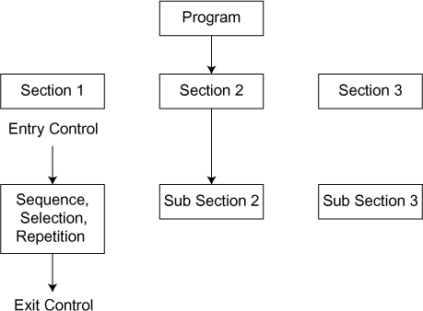
Structured Programming
It represents the usage of a logical structure on the program being written to make it more readable, efficient, reliable, and easily maintained.
In a typical structured programming language, the overall program is divided into logical structure for meaningful implementation.
Common functions across the structures are taken out and coded in a separate module (or separate program) itself so that the functions can be reused and memory usage also minimized.
Modules are tested separately before fitting into the overall programming structure. Unstructured programming (BASIC, FORTRAN) relies upon the discipline of the software developer to avoid structural problems.
Certain programming languages such as Pascal, COBOL, C, C++, Java, and dBASE are designed with features that enforce a logical program structure.

Slide 27
Object oriented programming
Object-oriented programming structure (OOPS) is a type of structured programming that uses structured programming techniques for program ﬂow and adds more structure for class, object, and data to the model.

Slide 28
Control structures
There are three types of control namely sequence, selection, and repetition.
Sequence refers to the orderly execution of statements one by one.
Selection refers to the selection of statements based on some conditions. This is usually expressed with keywords such as if..then..else..endif, switch, or case.
Repetition refers to the same statement executed repeatedly depending on a condition such as for loop, while loop, and do loop.

Slide 29
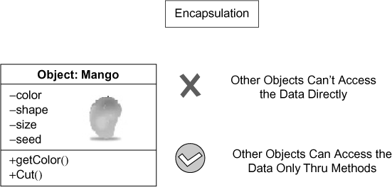
Information hiding
Users will be exposed to only the required details. For example, while we use any software (say Microsoft Word), we (users) know only how to use that software not how it was built and its related software.
Encapsulation
uses the principle of information hiding. No object can access the other object’s data directly; instead, data are accessed only by sending the messages to the other object requesting for the information.
This means the user need not know what is happening inside the object but can only use the object by calling the object’s methods. This will provide insulation for the data inside the object from accidental manipulation by another object or user.

Slide 30
Information hiding in OOP
In a good OO design/code, the object should reveal its data only through the specified interfaces or methods, and the other objects can only use this interface or methods to interact with the object.
The attributes which are only for the internal use of the object and not to be revealed are completely hidden from other objects. In those cases, the attributes are declared as “private”.
This also protects the object attributes getting changed erroneously while some other attributes are getting changed.

Slide 31
Example
For example, in the class Car engine, there are many parts (attributes) inside it.
Everyone applies a common technique in accessing the engine functionalities no matter how the engine is made of.
The detail and design of the engine are hidden from the knowledge of the driver.

Slide 32
Benefits of information hiding
Information hiding technique reduces complexity and increases usability and maintainability.
Information hiding principle is used to prevent other programmers or other program to change this program – intentionally or unintentionally.

Slide 33
Advantages of coding standards
Reusability (easy to reuse parts of code as it is written in standard code)
Maintainability (easy to identify bugs, easy to add new features)
Readability (coding standard increases easy reading)
Understand ability (easy to understand – this is not the same as readability, e.g., repetitive code may be is readable, but not understandable)
Robustness (code that can handle unexpected inputs and conditions)
Reliability (code i.e., unlikely to produce wrong results)

Slide 34
Common guidelines
Write comments before writing the code
Use meaningful names for varibles and functions. (Try to avoid single character varible names and function names)
Avoid extremely long names
Format the code properly using the standards specific to the programming language
Use tools to improve coding standards if possible.
Prefix “is” for Boolean variable - For Example: is Open+ True

Slide 35
Common guidelines
Comment should explain “Why” instead of “How” (Why a particular algorithm was chosen)
Comments should be blended into the code
Avoid deeply nested code
Never use “Go To” Statement
Don’t duplicate the code
Avoid using multiple inheritance

Slide 36
Top-down vs bottom up coding
Top-down coding: Here the implementation starts with the top of the hierarchy. The top main module is written first before writing the bottom submodules.
Testing top-down coding: Top main module is written first and hence the test cases are written completely for it. A stub is written in place of bottom submodules.
Bottom-up coding: It is the reverse of top-down coding, and here the implementation starts with the bottom submodules. The top main module is written after that until it reaches the top of the hierarchy.
Testing bottom-up coding: Bottom submodules are written first, and hence the test cases are written completely for it. A driver module is written to involve those modules under testing.

Slide 37
Incremental development of code
Project delivery is divided into parts – analyze, design, code, test, and deliver product (release).
The delivery of product is also divided into parts. Initially, a part of the product is released and then, additional developments are made based on feedback.
These developments are linked and the overall solution is finally completed.
The solution from each part is reviewed and tested. Results from the testing are assessed, and any required changes are incorporated into the next stage (next part) of solution development.

Slide 38
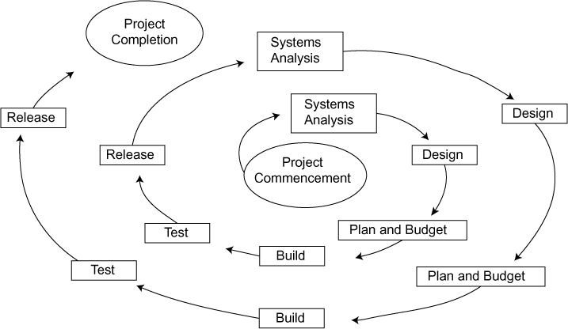
Incremental life cycle model
Advantages of incremental life cycle model:
Quick feedback loop from business stakeholders
Focus on customer feedback
Customer feels the product early.
Disadvantages of incremental life cycle model:
Even though the final product is given in pieces, tracking and monitoring is difficult.
Testing needs to be exhaustive in each part.

Slide 39
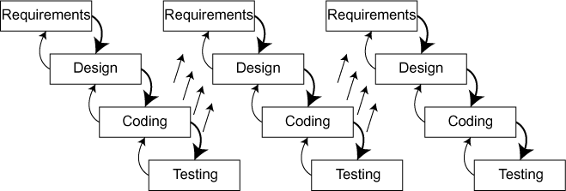
Iterative life cycle model
The early iterations produce a small system, which gradually expands over a series of iterations to become the overall complete system.
Feedback is implemented from one iteration to the next iteration.
During iteration, activities from all Project Management Process Groups will be performed.
At the end of each iteration, a set of deliverables will be completed

Slide 40
Advantages/Disadvantages of iterative life cycle model
Advantages of iterative life cycle model:
Quick feedback loop from business stakeholders.
Focus on customer feedback.
Focus on getting the highest priority features first.
Ability to validate pieces of deliverables incrementally.
Disadvantages of iterative life cycle model:
Getting feedback from customer on time is difficult.
Even though deliverables are given in pieces, tracking and monitoring is difficult.
Project may not proceed further if customer is not cooperating.
The fully developed solution requires the partial developments to be implemented, and this is often complicated and costly.

Slide 41
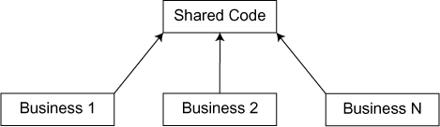
Code sharing
Code share concept is famous in aviation business arrangement where one ﬂight is shared by different airline operators. Tickets are sold by different operators (marketing carriers), and the ﬂight will be operated by another operator (operating carrier).
In software engineering also, third-party codes are being used (integrated) while writing the code. For example, credit card payment gateway is a commonly used code share. PayPal integration is also another example of code share.

Slide 42
Code review
Code review is a systematic process which is also called as peer review which is used to find and fix the mistakes in the early phase of the coding.
Code reviews happens in the form of:
Formal inspection
Lightweight code review
Pair programming
Automatic code reviewing software

Slide 43
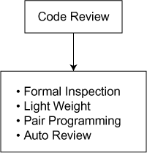
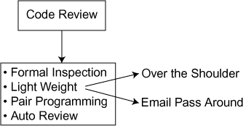
Code review forms
Code review light weight
Code review forms

Slide 44
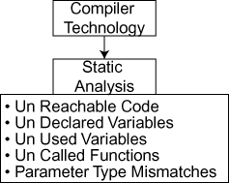
Static program analysis
Static program analysis is the analysis of computer software that is performed without actually executing programs.
Static program analysis tool is being used by the developers.
The term is usually applied to the analysis performed by an automated tool.
Static program analysis is an extension of compiler technology.
It can find possible faults such as unreachable code, undeclared variables, unused variables, parameter type mismatches, uncalled functions and procedures, possible array bound violations, etc.

Slide 45
Symbolic Execution
Symbolic execution refers to the analysis of programs by tracking symbolic rather than actual value.
In symbolic execution, the data are replaced by symbolic values. A set of expressions, one expression per output variable, is produced.
Symbolic execution has a variety of potential uses.
It may be used in path domain checking, test data generation, program proving, program reduction, and symbolic debugging.
There are few limitations to symbolic execution such as it cannot be used for path exploration and is also program dependent.

Slide 46
Programming productivity
Rapid Prototyping
In Rapid prototyping (RP), the prototype is being created automatically (rapidly) using three dimensional computer-aided design (CAD).
It required just 3 to 72 hours building an object which saves a lot of time (without CAD, it takes months to build the same object).
Computer-aided machine (CAM) is used to convert the prototype into real product using layered material deposition.

Slide 47
Example steps in Rapid Prototyping using CAD
Create the design of the product using CAD.
Convert CAD model into STL format (stereo lithography).
Slice STL format file into cross-sectional layers.
Covert each layer into a model.
Finish and fine tune the model (fabrication).
Postprocessing (cleaning).

Slide 48
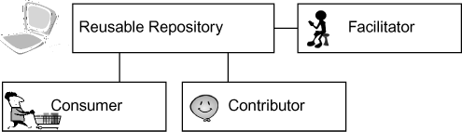
Software Reuse
Reusability is the ability to reuse parts of code to create new code.
Reusable part includes entire code, functions, classes, and data structures (database). Writing a standard code helps to reuse the same code for some other similar purposes, thereby reducing the cost of overall software development.
There are three types of stakeholders in reusing area:
Consumer
Contributor
Facilitator

Slide 49
Types of software reuse
There are two reusability types: internal reuse and external reuse
In internal reuse, the team uses the repository internally for its own purpose, whereas in the external reuse the team licenses the code to outsiders also.
Contributor-reusability process steps:
Register-reusable component
Classify reusable component
Review reusable component
Quantify value
Approve registration

Slide 50
Register-reusable component
Register-reusable component:
In this step, a contributor needs to fill in a registration form which has the basic details of the reusable component submitted to the repository.
Registration form contains the basic details such as name of the component submitted, description of the component, domain involved, technology involved, name of the contributor, how to use the component, etc.

Slide 51
Classify reusable component
Classify reusable component:
In this step, the facilitator tries to classify the reusable component based on its usage, domain, and technology.
In this step, the facilitator also identifies suitable reviewer of the component who will check, validate, and certify this component.

Slide 52
Review reusable component
Review reusable component:
In this step, the reviewer of the component (who got identified in the previous step) will check, validate, and certify this component based on a standard set of guidelines.

Slide 53
Review reusable component
Quantify value:
The reviewer may also ask the contributor to do some minor changes in the submitted component before it is completely accepted and which will also ensure that a quantified value is attached to the component.

Slide 54
Review reusable component
Approve registration:
The reviewer will once again check the component for completeness before approving the registration after which the component will get entry into the reusable repository and will also become searchable. The component may get rejected if it is not meeting the basic criteria.
Consumer-reusability process steps:
Search reusable component
Look for fitment
Register and procure

Slide 55
How to choose the right component
Register and procure:
Proper registration needs to be done on the system so that facilitator can provide the required components and other files to the consumer.
Depending on the situation and policy, the component will be deployed for use.
Reuse-oriented development:
The reuse-oriented model (ROD) is also called as ROD.
It is a method of software development in which a program code is refined by producing a sequence of various prototypes.
Each prototype is derived from the preceding one according to a sequence of defined rules.
ROD reduces the overall development cost as we use prototype instead of various types of documents.
It also saves time as it reduces lot of rework.
It also reduces the overall number of bugs in the system as we keep on refining the prototypes continuously.

Slide 56
Are you ready to become a better software engineer now?

