Slide 1

CSE3033N Software Engineering Topic: Type of Code Smells

Slide 2
Topic Learning Objectives
By the end of the lecture, you should be able to understand:
Definition of code smells
Types of code smells

Slide 3
What is code smells again ? ***** exam
Code smells are key signs that refactoring is necessary. In the process of refactoring, we get rid of smells, enabling further development of the application with equal or greater speed.
The lack of regular refactoring, can lead to a complete paralysis of a project over time, wasting a few years of development and requiring you to spend several more years to rewrite it from scratch.
Therefore, it is necessary to get rid of code smells while they are still small.
Notes:
What is code smell, give example (actual question in coming finals)

Slide 4
Bloaters
Object oriented Abusers
Change preventers
Dispensables

Slide 5

Bloaters
Bloaters are code, methods and classes that have increased to such gargantuan proportions that they are hard to work with.
Usually these smells do not crop up right away, rather they accumulate over time as the program evolves (and especially when nobody makes an effort to eradicate them).
Long Method
Large Class
Primitive Obsession
Long Parameter List
Data Clumps

Slide 6
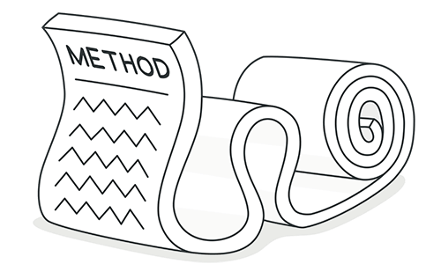
Long method
A method contains too many lines of code (generally, any method that is longer than ten lines should make you start asking questions).

Slide 7
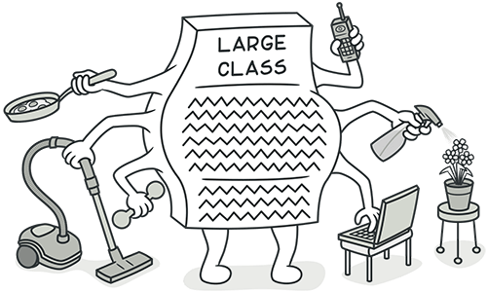
Large Class
A class contains many fields/methods/lines of code.

Slide 8
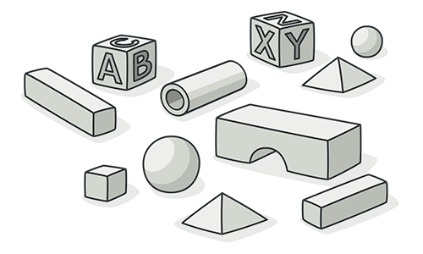
Primitive Obsession
Use of primitives instead of small objects for simple tasks (such as currency, ranges, special strings for phone numbers, etc.)
Use of constants for coding information (such as a constant USER_ADMIN_ROLE = 1 for referring to users with administrator rights.)
Use of string constants as field names for use in data arrays.

Slide 9
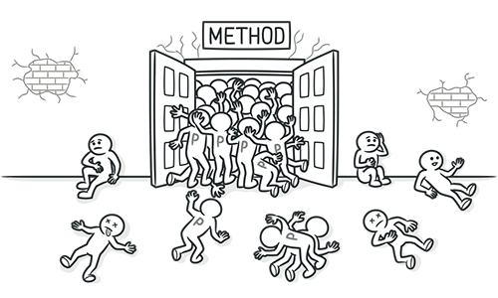
Long parameter list
More than three or four parameters for a method.

Slide 10
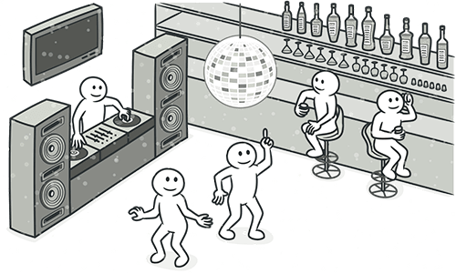
Data Clumps
Sometimes different parts of the code contain identical groups of variables (such as parameters for connecting to a database).
These clumps should be turned into their own class.
Rule of thumb:
Delete one of the data values and see whether the other values still make sense. If this is not the case, this is a good sign that this group of variables should be combined into an object.

Slide 11
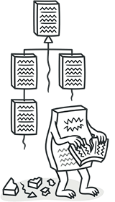
Object Oriented Abusers
All these smells are incomplete or incorrect application of object-oriented programming principles.
Switch Statements
Temporary Field
Refused Bequest
Alternative Classes with Different Interfaces

Slide 12
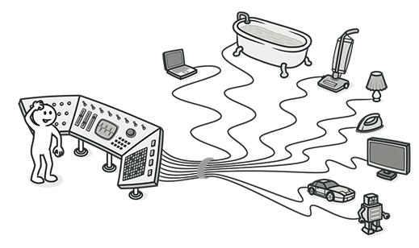
CODE Smell 1: Switch Statements
You have a complex switch operator or
sequence of IF statements
Reasons for the problem
Relatively rare use of switch and case operators is one of the hallmarks of object-oriented code.
Often code for a single switch can be scattered in different places in the program. When a new condition is added, you have to find all the switch code and modify it.
As a rule of thumb, when you see switch, you should think of polymorphism.

Slide 13

Treatment 1
ISOLATE SWITCH OPERATOR
To isolate switch and put it in the right class, you may need Extract Method and then Move Method.

Slide 14
Problem
class Order {
// ...
public double calculateTotal() {
double total = 0;
for (Product product : getProducts()) {
total += product.quantity * product.price;
}
// Apply regional discounts.
switch (user.getCountry()) {
case "US": total *= 0.85; break;
case "RU": total *= 0.75; break;
case "CN": total *= 0.9; break;
// ...
}
return total;
}
To isolate switch and put it in the right class, you may need Extract Method and then Move Method.
Problem
You have a code fragment that can be grouped together.

Slide 15
Solution
class Order {
// ...
public double calculateTotal() {
double total = 0;
for (Product product : getProducts()) {
total += product.quantity * product.price;
}
total = applyRegionalDiscounts(total);
return total;
}
public double applyRegionalDiscounts(double total) {
double result = total;
switch (user.getCountry()) {
case "US": result *= 0.85; break;
case "RU": result *= 0.75; break;
case "CN": result *= 0.9; break;
// ...
}
return result;
}
Solution
Move this code to a separate new method (or function) and replace the old code with a call to the method.

Slide 16
Solution
class Order {
// ...
public double calculateTotal() {
// ...
total = Discounts.applyRegionalDiscounts(total, user.getCountry());
total = Discounts.applyCoupons(total);
// ...
}
class Discounts {
// ...
public static double applyRegionalDiscounts(double total, string country) {
double result = total;
switch (country) {
case "US": result *= 0.85; break;
case "RU": result *= 0.75; break;
case "CN": result *= 0.9; break;
// ...
}
return result;
}
public static double applyCoupons(double total) {
}
Create a new method in the class that uses the method the most, then move code from the old method to there.
Turn the code of the original method into a reference to the new method in the other class or else remove it entirely.

Slide 17
Treatment 2 - Replace Conditional with Polymorphism
Problem
You have a conditional that performs various actions depending on object type or properties.
Solution
Create subclasses matching the branches of the conditional. In them, create a shared method and move code from the corresponding branch of the conditional to it. Then replace the conditional with the relevant method call. The result is that the proper implementation will be attained via polymorphism depending on the object class.

Slide 18
Example
abstract class Bird {
// ...
abstract double getSpeed();
}
class European extends Bird {
double getSpeed() {
return getBaseSpeed();
}
}
class African extends Bird {
double getSpeed() {
return getBaseSpeed() - getLoadFactor() *
numberOfCoconuts;
}
}
class NorwegianBlue extends Bird {
double getSpeed() {
return (isNailed) ? 0 : getBaseSpeed(voltage);
}
}
// Somewhere in client code
speed = bird.getSpeed();
class Bird {
// ...
double getSpeed() {
switch (type) {
case EUROPEAN:
return getBaseSpeed();
case AFRICAN:
return getBaseSpeed() - getLoadFactor() * numberOfCoconuts;
case NORWEGIAN_BLUE:
return (isNailed) ? 0 : getBaseSpeed(voltage);
}
throw new RuntimeException("Should be unreachable");
}
}

Slide 19
Advantage of code refactoring
Improved code organization

Slide 20
When to Ignore
If the switch statement is simple , thee is no need to change the code.
Often switch statements are used to generate objects in the factory design patterns.

Slide 21
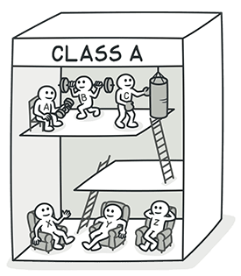
Code Smell 2: Temporary Field
Temporary fields get their values (and thus are needed by objects) only under certain circumstances. Outside of these circumstances, they're empty.
Reasons for the problem
Oftentimes, temporary fields are created for use in an algorithm that requires a large amount of inputs.
So instead of creating a large number of parameters in the method, the programmer decides to create fields for this data in the class. These fields are used only in the algorithm and go unused the rest of the time.

Slide 22

Treatment - Extract Temporary Fields and Related Behaviors
Temporary fields and all code operating on them can be put in a separate class via Extract Class.
In other words, you're creating a method object, achieving the same result as if you would perform Replace Method with Method Object.
Introduce Null Object and integrate it in place of the conditional code which was used to check the temporary field values for existence.

Slide 23
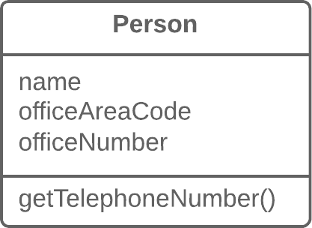
Extract Class
Temporary fields and all code operating on them can be put in a separate class via Extract Class.
In other words, you're creating a method object, achieving the same result as if you would perform Replace Method with Method Object.
Problem
When one class does the work of two, awkwardness results.

Slide 24
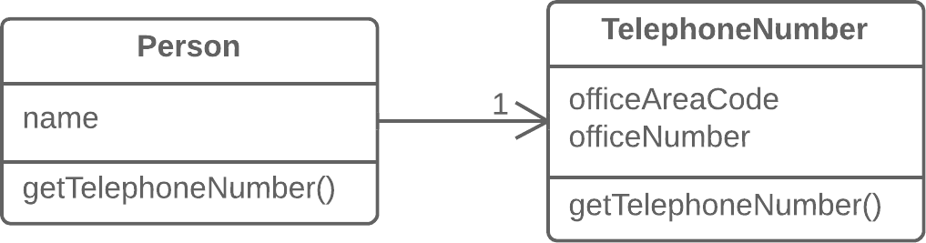
Solution
Instead, create a new class and place the fields and methods responsible for the relevant functionality in it.

Slide 25
Replace Method with Method Object
Problem
You have a long method in which the local variables are so intertwined that you can't apply Extract Method.
class Order {
// ...
public double price() {
double primaryBasePrice;
double secondaryBasePrice;
double tertiaryBasePrice;
// Perform long computation.
}
}

Slide 26
Solution
class Order {
// ...
public double price() {
return new PriceCalculator(this).compute();
}
}
class PriceCalculator {
private double primaryBasePrice;
private double secondaryBasePrice;
private double tertiaryBasePrice;
public PriceCalculator(Order order) {
// Copy relevant information from the
// order object.
}
public double compute() {
// Perform long computation.
}
}
Transform the method into a separate class so that the local variables become fields of the class.
Then you can split the method into several methods within the same class.
class Order {
// ...
public double price() {
double primaryBasePrice;
double secondaryBasePrice;
double tertiaryBasePrice;
// Perform long computation.
}
}

Slide 27
Introduce NULL Object
Introduce Null Object and integrate it in place of the conditional code which was used to check the temporary field values for existence.
Problem
Since some methods return null instead of real objects, you have many checks for null in your code.
if (customer == null) {
plan = BillingPlan.basic();
}
else {
plan = customer.getPlan();
}

Slide 28
Solution
Instead of null, return a null object that exhibits the default behavior.
class NullCustomer extends Customer {
boolean isNull() {
return true;
}
Plan getPlan() {
return new NullPlan();
}
// Some other NULL functionality.
}
// Replace null values with Null-object.
customer = (order.customer != null) ? order.customer : new NullCustomer();
// Use Null-object as if it's normal subclass.
plan = customer.getPlan();

Slide 29
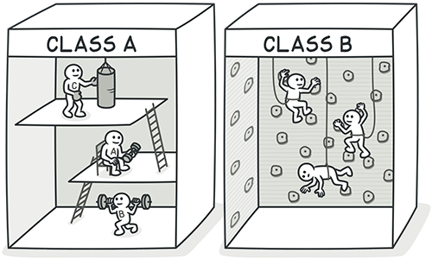
Advantage
Better Code Quality and organization

Slide 30
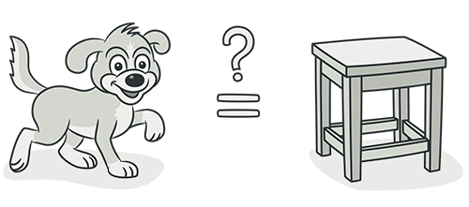
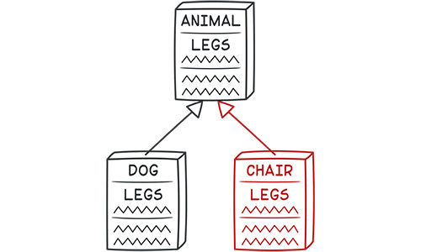
Code Smell 3: Refused Bequest
If a subclass uses only some of the methods and properties inherited from its parents, the hierarchy is off-kilter (weird).
The unneeded methods may simply go unused or be redefined and give off exceptions.
Reasons for the problem:
Someone was motivated to create inheritance between classes only by the desire to reuse the code in a superclass. But the superclass and subclass are completely different.

Slide 31
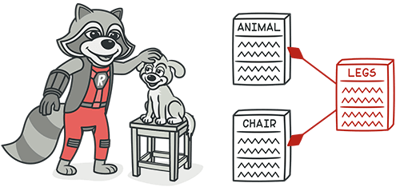
Treatment
Two types of treatment
Replace inheritance with delegation
Extract superclass

Slide 32
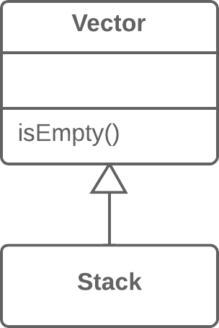
Replace Inheritance with Delegation
If inheritance makes no sense and the subclass really does have nothing in common with the superclass, eliminate inheritance in favor of Replace Inheritance with Delegation.
Problem
You have a subclass that uses only a portion of the methods of its superclass (or it's not possible to inherit superclass data)

Slide 33
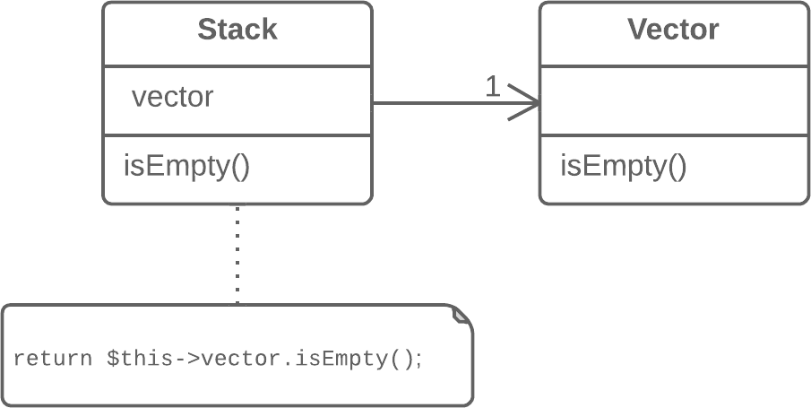
Solution
Create a field and put a superclass object in it, delegate methods to the superclass object, and get rid of inheritance.

Slide 34
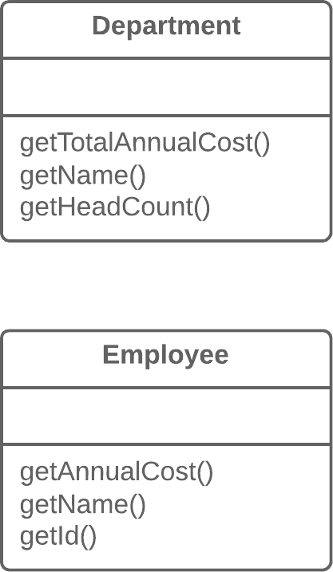
Extract superclass
If inheritance is appropriate, get rid of unneeded fields and methods in the subclass.
Extract all fields and methods needed by the subclass from the parent class, put them in a new subclass, and set both classes to inherit from it (Extract Superclass).
Problem
You have two classes with common fields and methods.

Slide 35
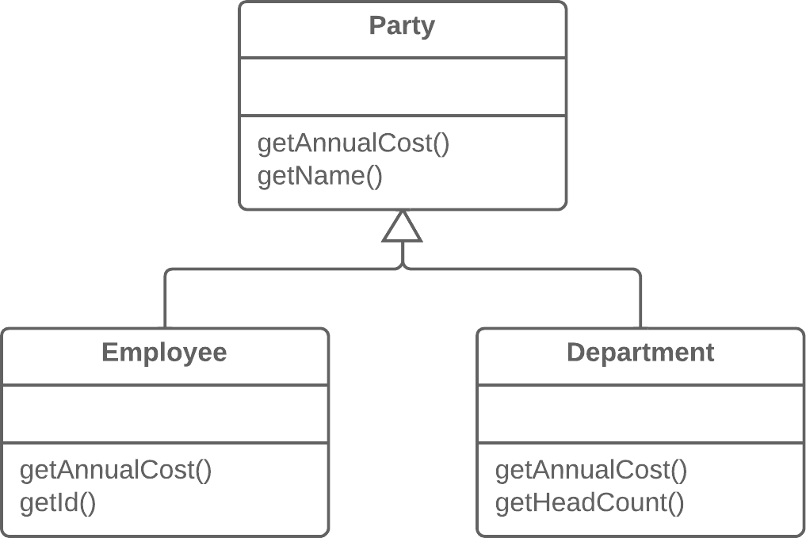
Solution
Create a shared superclass for them and move all the identical fields and methods to it.

Slide 36
Advantage
Improves code clarity and organization.

Slide 37

Change preventers
These smells mean that if you need to change something in one place in your code, you have to make many changes in other places too.
Program development becomes much more complicated and expensive as a result.
Divergent Change
Shotgun Surgery
Parallel Inheritance Hierarchies

Slide 38
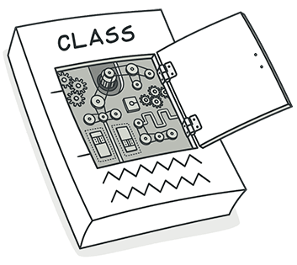
Code Smell 4: Divergent Change
You find yourself having to change many unrelated methods when you make changes to a class.
For example, when adding a new product type you have to change the methods for finding, displaying, and ordering products.
Reasons for the problem
Often these divergent modifications are due to poor program structure or "copypaste programming”.

Slide 39
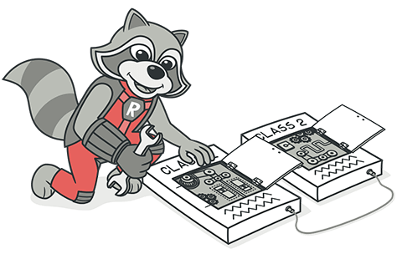
Treatment
Split up the behavior of the class via Extract Class.
If different classes have the same behavior, you may want to combine the classes through inheritance (Extract Superclass and Extract Subclass).

Slide 40
Treatment 1 - Extract class
Problem
When one class does the work of two, awkwardness results.

Slide 41
Solution
Instead, create a new class and place the fields and methods responsible for the relevant functionality in it.

Slide 42
Treatment 2 - Combine classes through inheritance
If different classes have the same behavior, you may want to combine the classes through inheritance (Extract Superclass and Extract Subclass).
Problem
You have two classes with common fields and methods.

Slide 43
Solution
Create a shared superclass for them and move all the identical fields and methods to it.

Slide 44
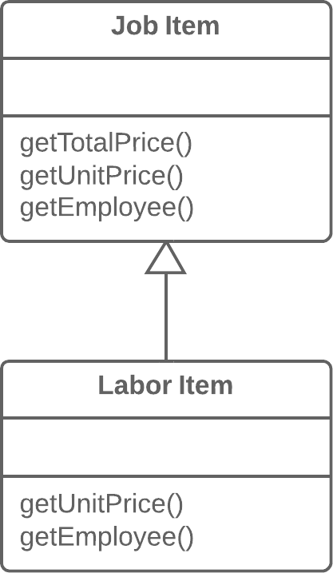
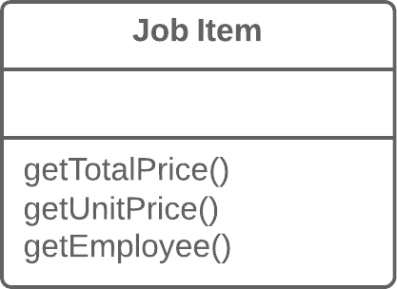
Problem
Solution
Create a subclass and use it in these cases.
A class has features that are used only in certain cases.

Slide 45
Payoff
Improves code organization

Slide 46
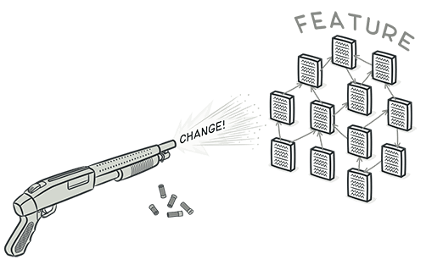
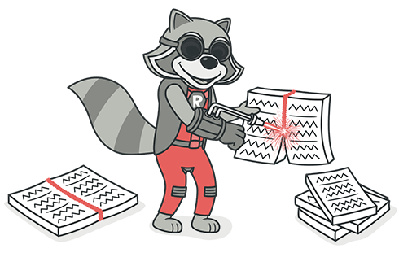
Code Smell 5: Shortgun Surgery
Making any modifications requires that you make many small changes to many different classes.
Reason for the problem
A single responsibility has been split up among a large number of classes.
This can happen after overzealous application of Divergent Change.

Slide 47
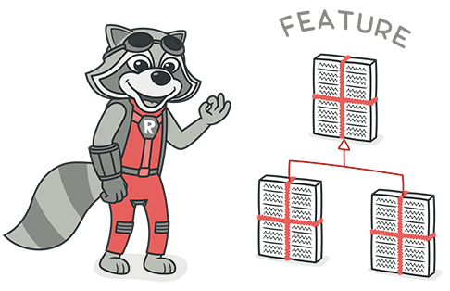
Treatment
Consolidate responsibility in a single class
Use Move Method and Move Field to move existing class behaviors into a single class.
If there's no class appropriate for this, create a new one.
If moving code to the same class leaves the original classes almost empty, try to get rid of these now-redundant classes via Inline Class.

Slide 48
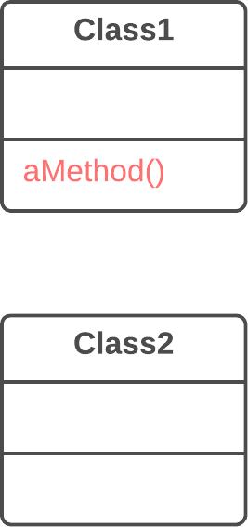
Move Method
Problem:
A method is used more in another class than in its own class

Slide 49
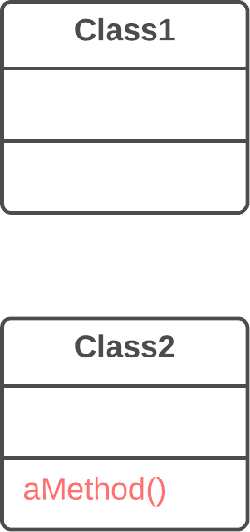
Solution
Create a new method in the class that uses the method the most, then move code from the old method to there.
Turn the code of the original method into a reference to the new method in the other class or else remove it entirely.

Slide 50
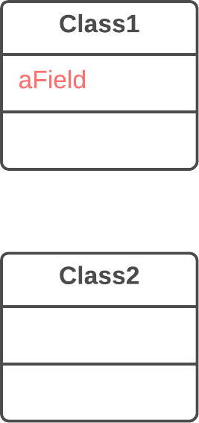
Move field
Problem:
A field is used more in another class than in its own class.

Slide 51
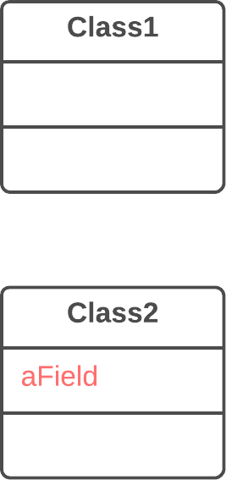
Solution
Create a field in a new class and redirect all users of the old field to it.

Slide 52
Inline class
Problem :
A class does almost nothing and isn't responsible for anything, and no additional responsibilities are planned for it.

Slide 53
Solution
Move all features from the class to another one.

Slide 54
Advantage
Better organization

Slide 55
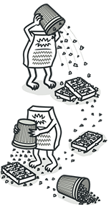
Dispensables
A dispensable is something pointless and unneeded whose absence would make the code cleaner, more efficient and easier to understand.
Comments
Duplicate Code
Dead Code
Data Class
Lazy Class
Speculative Generality

Slide 56
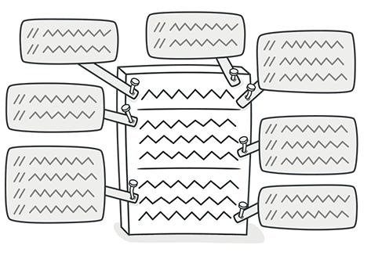
Code Smell 6: Comments
A method filled with explanatory comments
Reasons for the problem :
Comments are usually created with the best of intentions, when the author realizes that his or her code isn't intuitive or obvious. In such cases, comments are like a deodorant masking the smell of fishy code that could be improved.
The best comment is a good name for a class or method
If you feel that a code fragment can't be understood without comments, try to change the code structure in a way that makes comments unnecessary.

Slide 57
Treatment 1 - Extract variable
If a comment is intended to explain a complex expression, the expression should be split into understandable subexpressions using Extract Variable.
Problem:
You have an expression that's hard to understand.
void renderBanner() {
if ((platform.toUpperCase().indexOf("MAC") > -1) &&
(browser.toUpperCase().indexOf("IE") > -1) &&
wasInitialized() && resize > 0 )
{
// do something
}
}

Slide 58
Solution
Place the result of the expression or its parts in separate variables that are self-explanatory.
void renderBanner() {
final boolean isMacOs = platform.toUpperCase().indexOf("MAC") > -1;
final boolean isIE = browser.toUpperCase().indexOf("IE") > -1;
final boolean wasResized = resize > 0;
if (isMacOs && isIE && wasInitialized() && wasResized) {
// do something
}
}

Slide 59
Treatment 2 - Extract Method
If a comment explains a section of code, this section can be turned into a separate method via Extract Method. The name of the new method can be taken from the comment text itself, most likely.
Problem:
You have a code fragment that can be grouped together.
void printOwing() {
printBanner();
// Print details.
System.out.println("name: " + name);
System.out.println("amount: " + getOutstanding());
}

Slide 60
Solution
void printOwing() {
printBanner();
printDetails(getOutstanding());
}
void printDetails(double outstanding) {
System.out.println("name: " + name);
System.out.println("amount: " + outstanding);
}
void printOwing() {
printBanner();
// Print details.
System.out.println("name: " + name);
System.out.println("amount: " + getOutstanding());
}

Slide 61
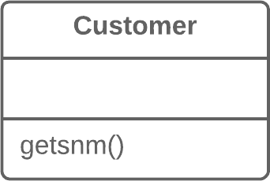
Treatment 2 - Rename method
If a method has already been extracted, but comments are still necessary to explain what the method does, give the method a self-explanatory name.
Use Rename Method for this.
Problem :
The name of a method doesn't explain what the method does.

Slide 62
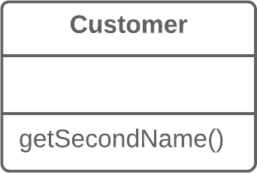
Solution : Rename the method

Slide 63
Treatment 3 - Introduce Assertion
If you need to assert rules about a state that's necessary for the system to work, use Introduce Assertion.
Problem:
For a portion of code to work correctly, certain conditions or values must be true.
double getExpenseLimit() {
// Should have either expense limit or
// a primary project.
return (expenseLimit != NULL_EXPENSE) ? expenseLimit :
primaryProject.getMemberExpenseLimit();
}

Slide 64
Solution: Replace these assumptions with specific assertion checks
double getExpenseLimit() {
// Should have either expense limit or
// a primary project.
return (expenseLimit != NULL_EXPENSE) ? expenseLimit :
primaryProject.getMemberExpenseLimit();
}
double getExpenseLimit() {
Assert.isTrue(expenseLimit != NULL_EXPENSE || primaryProject != null);
return (expenseLimit != NULL_EXPENSE) ?
expenseLimit:
primaryProject.getMemberExpenseLimit();
}

Slide 65
Payoff
Code becomes intuitive and obvious

Slide 66
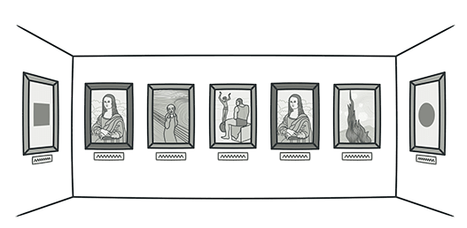
Code Smell 7: Duplicate code
Duplication usually occurs when multiple programmers are working on different parts of the same program at the same time.
Since they're working on different tasks, they may be unaware their colleague has already written similar code that could be repurposed for their own needs.

Slide 67
Reasons for the problem
There's also more subtle duplication, when specific parts of code look different but actually perform the same job. This kind of duplication can be hard to find and fix.
Sometimes duplication is purposeful. When rushing to meet deadlines and the existing code is "almost right" for the job, novice programmers may not be able to resist the temptation of copying and pasting the relevant code. And in some cases, the programmer is simply too lazy to de-clutter.

Slide 68
If it’s in the Same class then use Extract method
If the same code is found in two or more methods in the same class: use Extract Method and place calls for the new method in both places.
Problem:
You have a code fragment that can be grouped together.
void printOwing() {
printBanner();
// Print details.
System.out.println("name: " + name);
System.out.println("amount: " + getOutstanding());
}

Slide 69
Solution
Move this code to a separate new method (or function) and replace the old code with a call to the method
void printOwing() {
printBanner();
printDetails(getOutstanding());
}
void printDetails(double outstanding) {
System.out.println("name: " + name);
System.out.println("amount: " + outstanding);
}
void printOwing() {
printBanner();
// Print details.
System.out.println("name: " + name);
System.out.println("amount: " + getOutstanding());
}

Slide 70
If the same code is found in two subclasses of the same level
Use Extract Method for both classes, followed by Pull Up Field for the fields used in the method that you're pulling up.
Extract Method
void printOwing() {
printBanner();
printDetails(getOutstanding());
}
void printDetails(double outstanding) {
System.out.println("name: " + name);
System.out.println("amount: " + outstanding);
}
void printOwing() {
printBanner();
// Print details.
System.out.println("name: " + name);
System.out.println("amount: " + getOutstanding());
}

Slide 71
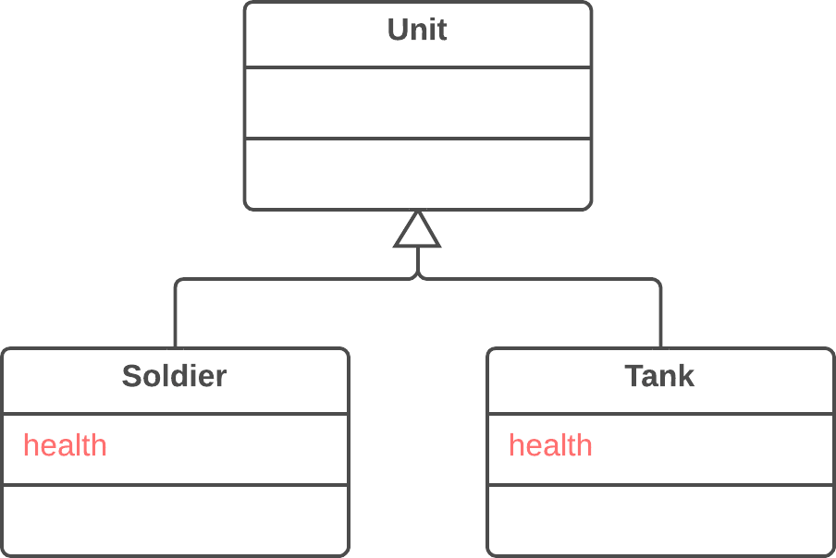
PullUpField
If the same code is found in two subclasses of the same level:
Use Extract Method for both classes, followed by Pull Up Field for the fields used in the method that you're pulling up.
Problem:
Two classes have the same field.

Slide 72
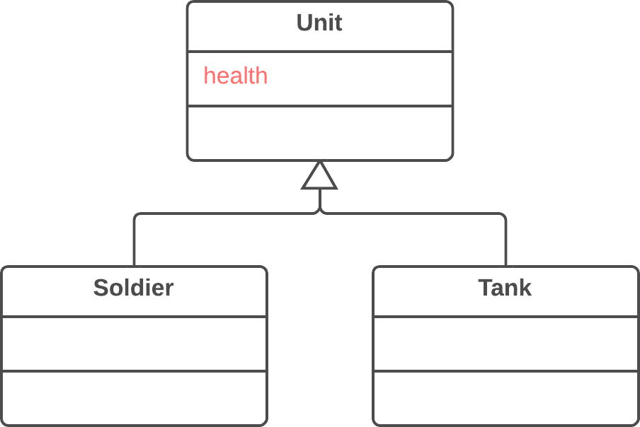
Solution- Remove the field from subclasses and move it to the superclass.

Slide 73
Pull up constructor body
If the same code is found in two subclasses of the same level
If the duplicate code is inside a constructor, use Pull Up Constructor Body.
Problem:
Your subclasses have constructors with code that's mostly identical.
class Manager extends Employee {
public Manager(String name, String id, int grade) {
this.name = name;
this.id = id;
this.grade = grade;
}
// ...
}

Slide 74
Solution
Create a superclass constructor and move the code that's the same in the subclasses to it. Call the superclass constructor in the subclass constructors.
class Manager extends Employee {
public Manager(String name, String id, int grade) {
this.name = name;
this.id = id;
this.grade = grade;
}
// ...
}
class Manager extends Employee {
public Manager(String name, String id, int grade) {
super(name, id);
this.grade = grade;
}
// ...
}

Slide 75
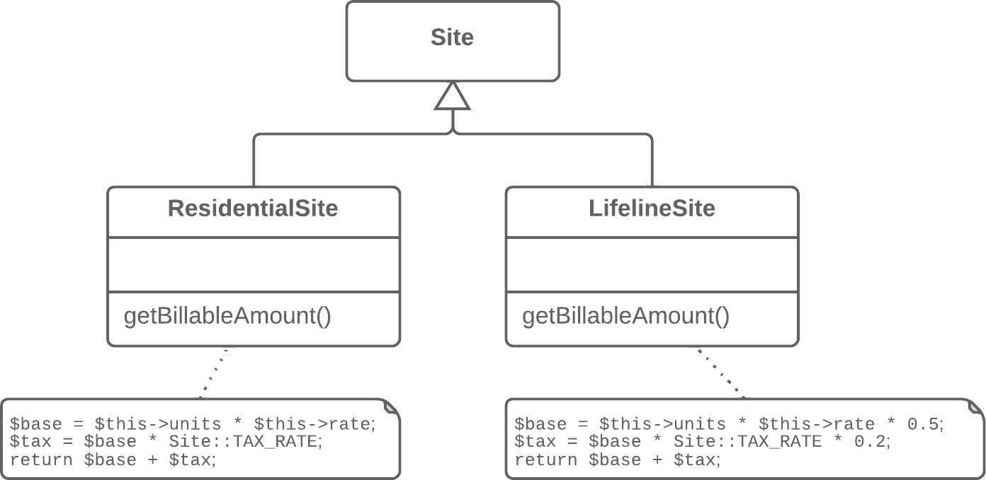
Form Template method
If the same code is found in two subclasses of the same level
If the duplicate code is similar but not completely identical, use Form Template Method.
Problem: Your subclasses implement algorithms that contain similar steps in the same order.

Slide 76
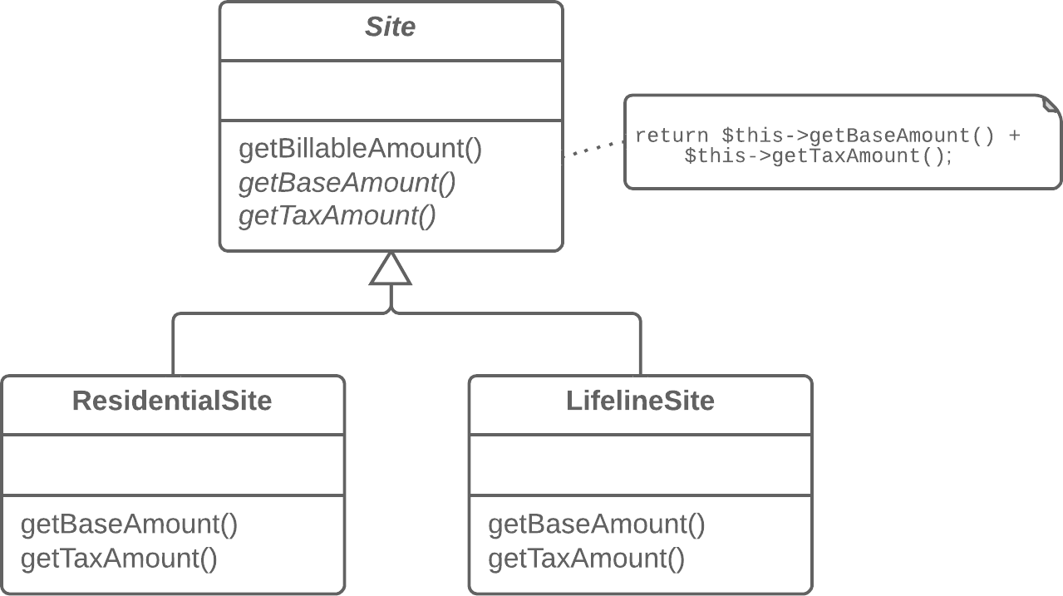
Solution
Move the algorithm structure and identical steps to a superclass, and leave implementation of the different steps in the subclasses.

Slide 77
Substitute Algorithm
If the same code is found in two subclasses of the same level
If two methods do the same thing but use different algorithms, select the best algorithm and apply Substitute Algorithm.
Problem:
So you want to replace an existing algorithm with a new one?
String foundPerson(String[] people){
for (int i = 0; i < people.length; i++) {
if (people[i].equals("Don")){
return "Don";
}
if (people[i].equals("John")){
return "John";
}
if (people[i].equals("Kent")){
return "Kent";
}
}
return "";
}

Slide 78
Solution
Replace the body of the method that implements the algorithm with a new algorithm.
String foundPerson(String[] people){
for (int i = 0; i < people.length; i++) {
if (people[i].equals("Don")){
return "Don";
}
if (people[i].equals("John")){
return "John";
}
if (people[i].equals("Kent")){
return "Kent";
}
}
return "";
}
String foundPerson(String[] people){
List candidates =
Arrays.asList(new String[] {"Don", "John", "Kent"});
for (int i=0; i < people.length; i++) {
if (candidates.contains(people[i])) {
return people[i];
}
}
return "";
}

Slide 79
Extract superclasses
If duplicate code is found in two different classes
Problem:
You have two classes with common fields and methods.
If the classes aren't part of a hierarchy, use Extract Superclass in order to create a single superclass for these classes that maintains all the previous functionality.
If it’s difficult or impossible to create a superclass, use Extract Class in one class and use the new component in the other.

Slide 80
Solution
Create a shared superclass for them and move all the identical fields and methods to it.

Slide 81
Advantages
Merging duplicate code simplifies the structure of your code and makes it shorter.
Simplification + shortness = code that's easier to simplify and cheaper to support.

Slide 82
Summary: What we have just learnt?
Code Smells:
Object-Orientation Abusers
Switch Statements,
Temporary Field,
Refused Bequest
Change preventers
Divergent Change
Shortgun Surgery
Dispensables
Comments
Duplicate code
Refactoring Techniques:
Composing methods
Moving features between objects
Organizing data
Simplifying conditional expression
Simplifying method calls
Dealing with generalization
Refer https://refactoring.guru/refactoring for more information.

