Slide 1

CSE3033N Software Engineering Topic: Software Testing

Slide 2





Lesson Coverage
By the end of the lecture, you should be able to understand:
Types of software Testing
Software Testing Plan and Test Case Preparation
Test Automation
Strategic Approach to Software Testing
Impacting Issues of Verification Testing

Slide 3
Testing Objectives
Avoid bugs
Bugs tend to create defects in the software that can derail the system from functioning completely
Follow Specification
Ensure that the system adheres to the system specification
Fit for purpose
Whether the software product is fit for the purpose it was designed.
This is more from an end user and usability perspective.

Slide 4
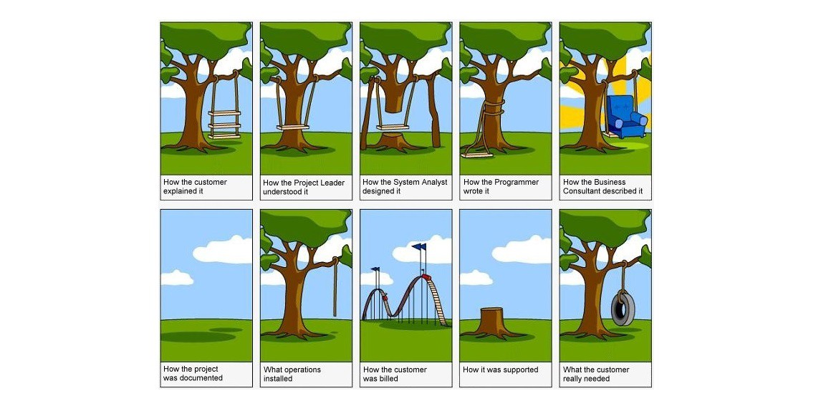
What happens when software does not meet with specification ?

Slide 5
Validation and defect testing
The first goal leads to validation testing
You expect the system to perform correctly using a given set of test cases that reflect the system’s expected use.
The second goal leads to defect testing
The test cases are designed to expose defects.
The test cases in defect testing can be deliberately obscure and need not reflect how the system is normally used.

Slide 6
Testing process goals
Validation testing
To demonstrate to the developer and the system customer that the software meets its requirements
A successful test shows that the system operates as intended.
Defect testing
To discover faults or defects in the software where its behaviour is incorrect or not in conformance with its specification
A successful test is a test that makes the system perform incorrectly and so exposes a defect in the system.

Slide 7
An input-output model of program testing

Slide 8
Techniques for validation - Review
It is a formal process in which the peers or stakeholders examine a piece of work to ensure correctness.
It could be a specifications document or a technical design or a piece of code, and the purpose is to uncover errors, ambiguity, or lack of expected standards.

Slide 9
Techniques for validation - Walkthroughs
It is a formal process where the person responsible for a specific unit of work formally presents his work to a group of reviewers.
The work has to be circulated to the group prior to the discussion giving ample time for the reviewers to examine, write comments, or prepare questions for the walkthrough meeting.
The presenter will go through the document line by line during the walkthrough explaining what has been done and why ambiguity, or lack of expected standards.

Slide 10
Techniques for validation - Inspections
It is the most formal type of review.
Each and every participant has to go through training to participate in the inspections.
The presenter has to learn from the owner along with his interpretations and then present it to other participants who are called as inspectors.
There could be roles like moderators and recorders also assigned to the participants.
Inspections have been found to be very effective in uncovering bugs for any software delivery specifically with respect to the design documents and the code.

Slide 11
Impacting issues of validation testing
Lack of time
Too much time taken for development
Planned test cases not executed and number of bugs not captured
Software crashes
Software is not in a stable state
Could bring down the system or crash
Missing critical defects
Tester too occupied with fundamental issues because of lack of time
Not able to focus on critical functions.

Slide 12
Validation Testing Basic Phases
There are various phases of development and the corresponding testing phases that could be planned in parallel.
1. Unit Testing
Smallest Testable units
Usually done by the developer
Black box testing or white box testing can be done only if applicable
2.Integration Testing
Testing of interactions between modules
Bugs are found at interfaces and communication points between the modules
3.Functional Testing
Verify end to end functionalities of the modules
Ensures business requirements are satisfied
4.System Testing
Comprehensive test where all components – system, hardware, interfaces are tested as per specification
Ensuring delivery of a full product
5. Acceptance Testing
Final phase of testing
Customer will execute the test case and decide to accept the product

Slide 13
Points to ponder
What is required to be tested?
What are the dependencies?
“
”
“
”
Why do we need to test it?
“
”

Slide 14
Points to ponder
Who are the stake holders and their roles?
What are the testing tools available?
“
”
“
”
What are the expectations of the stakeholders including the end users?
“
”

Slide 15
Points to ponder
What are the organizations standards for testing?
What is the size of the development team and the development delivery schedule?
“
”
“
”
What are the details of the development, test, and end-user environments’?
“
”

Slide 16
Test Strategy Areas
Management
How critical is the software application under study? What are the management expectations in terms of reporting and quality? Any existing standards for testing in the organization?
End user
Who will be the end user? Will there be multi country release across geography?
Development Methodology
What is the software development methodology followed in the application under study? What is the development project plan? What is the size of the team?

Slide 17
Test Strategy Areas
Infrastructure
What are the hardware and software facilities available? What are the limitations of the various environments?
Technical
What are the possibilities for test automation? What will be the ROI for automation? What are the performance requirements?
Business
What are the key business functionalities? How are the current activities done without the new software or updates? How does business expect the new software or updates to help them?

Slide 18
Types of software testing – White Box Testing
Structural or white box testing is based on knowledge of internal structure and logic of programs, the coverage of specifications is validated in the code.
White box testing can be quite complex depending upon the application.
A small application that performs a few simple operations could be white box tested quickly in minutes, while larger programming applications take days, weeks, and even longer.

Slide 19
Types of software testing – Black Box Testing
Involves testing the application like an external or end user by validating the outputs received from the application based on certain inputs given to it.
The internal technical mechanisms, such as the programs and the code infrastructure of the application are not considered in this type of testing.
The tester has no access to the source code, nor is expected to be knowledgeable of the programming language and code structure behind the application.

Slide 20
Black Box Testing: Introduction
Test Engineers have no access to the source code or documentation of internal working.
The “Black Box” can be:
A single unit.
A subsystem.
The whole system.
Tests are based on:
Specification of the “Black Box”.
Providing inputs to the “Black Box” and inspect the outputs.
Inputs
Component Under Test
Outputs

