Slide 1

CSE3033N Software Engineering Topic: Software Methodologies

Slide 2
Topic Learning Objectives
By the end of the lecture, you should be able to:
Explain the activities of software process
Describe software process models

Slide 3
What is a Software Process?
The software process is a description of steps that guides software engineers as they work by identifying their roles and tasks.
It is a set of ordered tasks: a sequence of steps involving activities, constraints, resources that produce and maintain a software product.
A software process also establishes the technical and management framework for applying methods, tools and people to the software engineering activities.

Slide 4
Common Activities in All Software Processes
Requirements Analysis
Design specification
Implementation
Testing
Maintenance

Slide 5
Characteristics of a Good Process
Understandability
Visibility
Supportability
Acceptability
Reliability
Robustness
Maintainability
Rapidity

Slide 6
Software Process Models / Software Methodologies
Software Process Models
Waterfall model process
Iterative and incremental development
Prototyping model
Spiral model

Slide 7
The Waterfall Model Process
Requirements
System specification
Design
Software design
Implementation
Software system
Testing
Final product
Maintenance

Slide 8
Waterfall Model
Advantages | Disadvantages
Simple and easy to use | Lack of parallelism
Well-established and hence, well practiced | No feedback of system by project stakeholders until after testing phase
Easy to manage | Hard to estimate reliably
Facilitates allocation of resources | Inefficient use of resources
Documentation is produced at each phase | Major problems with system are usually not discovered until late in process
Suitable for smaller projects where requirements are well understood and unlikely to change rapidly | Requirements must be known upfront, and should not change greatly

Slide 9
Iterative and Incremental Development
An iterative process is typically a repeated execution of the waterfall phases resulting in better understanding of the requirements, design and implementation (Braude and Bernstein, 2011).
An iterative is incremental if each cycle or iteration is relatively small. At the end of each phase, project artifacts such as plans, specifications and code are produced.

Slide 10
Iterative and Incremental Development
Advantages
Disadvantages
Clearer and more manageable objectives
Reduce project complexity
Distribute total project cost
Minimal team members required
Early correction of errors
Early feedback from project stakeholders
Clearer requirements
Testing becomes easier
Reduce overall project risk
Reduce risk of project failure
Higher total development cost
Need to develop well-defined interfaces
Need well-defined project planning
Higher cost for testing

Slide 11
Prototyping Model
A prototype is an early sample or a model built to test a concept or process.
is used to
Customer Feedback/
Requirements
Design/Develop/Refine Prototype
results into
used for
Testing of Prototype by Customer

Slide 12
Prototyping
Advantages
Disadvantages
Early feedback from project stakeholders
Requirements become clearer
Easily accommodate new requirements
Useful for non-IT-literate people
Gain more confidence from project stakeholders
Flexibility in design and development
Reduces risk of failure
Conducive development environment
Shorter delivery time
Funding from prospective investors
Cost may be high
Slow process
Too much involvement of customer
Sub-optimal solutions
Lose interest in project
Poor documentation

Slide 13
When Should Prototyping Model be Used?
When requirements of the system are not clearly understood or are unstable.
When requirements are changing quickly.
For developing systems with complex algorithms and user interfaces.
To demonstrate technical feasibility of the product.

Slide 14
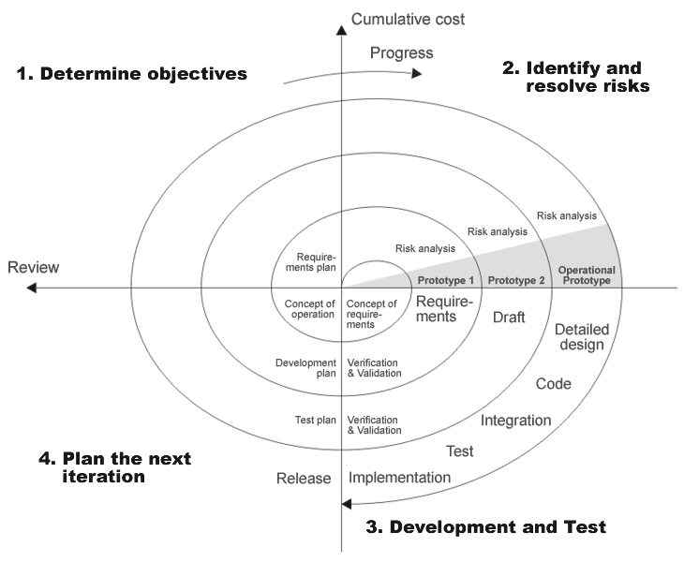
Spiral Model
The Spiral model is a type of iterative software development model proposed by Boehm in 1988.
The model is generally implemented in large, complicated and high risk projects.
Boehm’s
Spiral model

Slide 15
Note
Each iteration in the cycle represents a development phase in the process which is similar to the phases in the waterfall model. There is no fixed number of iterations as it depends on the project size and complexity.
Each iteration has four sections:
Determine objectives, alternatives, constraints of the project
Evaluate alternatives, and identify and resolve risks to achieve the objectives
Develop, verify next level product
Plan next phases

Slide 16
How to Apply the Model
Steps in applying the Spiral model:
Identify and prioritise risks.
Develop a series of prototypes for the risks identified, starting with the highest risk.
For each development cycle, apply the Waterfall model.
If a risk is resolved successfully, plan the next cycle.
If at some stage risk cannot be resolved, terminate project.

Slide 17
Spiral Model
Advantages
Disadvantages
Flexible
Easy and effective project monitoring:
Built-in risk management:
Cope well with changes:
More realistic project estimates:
Suitable for high risk projects:
Develop highly customised product:
High cost
Complicated approach
Need expertise
Difficult to follow rules and protocols:
Difficult to reuse prototype:
Unsuitable for low risk projects:
Difficult to meet budgetary and scheduling requirements
Huge amount of documentation:

Slide 18
The Rational Unified Process (RUP)
RUP is normally described from three perspectives (Sommerville, 2004):
Dynamic perspective
It shows the phases of the model.
Static perspective
It shows the process activities that are performed.
Practice perspective
It recommends good practices to be used during the process.

Slide 19
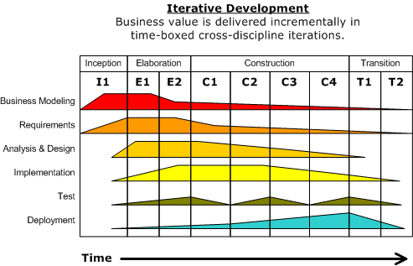
Workflows in RUP
RUP defines workflows in
each phase.
Business modelling
Requirements
Analysis and Design
Implementation
Test
Deployment

Slide 20
Best practices in RUP
Develop software iteratively
Manage requirements
Use component-based architectures
Visually model software
Verify software quality
Control changes to software

Slide 21
Phase 1: Inception
Goal:
Establish the business case for the system to justify the feasibility of the project.
Evaluation Criteria relate to:
Resolving the scope of the system
Resolving requirements ambiguity
Establishing a candidate architecture
Mitigating critical risks
Judging the worth of the initial business case

Slide 22
Phase 1: Inception
Products:
List of features
First version of business model for context of system
First cut of models of use-cases, analysis and design. These may also include basic implementation and test models.
First draft of candidate (or potential) architecture description
Possibly a proof-of-concept prototype
Initial risk list
Draft plan for project
First draft of business case including success criteria

Slide 23
Phase 2: Elaboration
Goals:
Develop an understanding of the problem domain.
Establish an architectural framework for the system.
Develop the project plan.
Identify key project risks.

Slide 24
Phase 2: Elaboration
Evaluation criteria relate to:
Extending the requirements
Establishing a basic architecture
Mitigating significant risks
Judging worth of business case

Slide 25
Phase 2: Elaboration
Products:
Complete business model
New versions of all models
Executable architectural framework
Architecture description
Updated risk list
Project plan
Preliminary user manual
Complete business case including costing

Slide 26
Phase 3: Construction
Goal:
To produce software product ready for initial operational release (a ‘beta’).
Evaluation criteria now relate to:
The use-cases already outlined
User material produced during this phase
Training material produced

Slide 27
Phase 3: Construction
Products:
All models of system
Executable release (beta)
Architecture description
Project plan for next phase
Preliminary user manual to guide beta users
Business case reflecting state at end of phase

Slide 28
Phase 4: Transition
Goal:
Establish product in operational environment and monitor feedback.
Evaluation criteria now relate to:
Has beta release covered key functionality?
Did system pass acceptance test?
Are training material and user documentation satisfactory?

Slide 29
Phase 4: Transition
Products:
Executable software including installation software
Legal and commercial documents
Project guideline models of system
User manual to guide beta users
Business case reflecting state at the end of phase

Slide 30
More reading:
Look for Self-Reading 2 - UOL - SW Methodologies in Canvas Lesson 1.

Slide 31
A scenario
You are working as a software engineer in a software house. Your software lead assigned you to a new software project. The project aims to design an educational audio learning apps which guides kindergarten kids from age 6 to learn basic English, according to the structured English learning syllabus.
Answer the questions below based on the scenario above.
Your software lead insisted that you should use spiral model to develop the software. In your opinion, do you agree with your proposal. Give three points to support your arguments.
b) Explain how the following issues affect the software engineer in designing new software. i) Heterogeneity
ii) Business and social change
iii) Security and trust

Slide 32
Any Question?
Next Lesson – Software Process, Agile Software Development Process

