Slide 1
CSS3133/N Knowledge Management Unit 01: Introduction to Knowledge Management (KM)

Slide 2
Learning outcomes
Define the concepts of KM using a clear framework and language
Give an overview of the history of KM and its key milestones
Describe the key roles and responsibilities required for KM application

Slide 3
What is KM?
Defining KM can be like the story of the blind men and the elephant.
Basic definition – “the process of applying a systematic approach to the capture, structuring, management, and dissemination of knowledge through an organization to
work faster,
reuse best practices,
and reduce costly rework from project to project”.
Wide definition – “KM encompasses everything to do with knowledge”.
Narrow definition – “IT systems that dispenses organizational know-how”.
KM can also be defined from
The business perspective
The cognitive science or knowledge science perspective
The process/technology perspective
KM is all these and more…
Consensus: KM is highly multidisciplinary.

Slide 4
Multidisciplinary nature of KM
KM draws upon a vast number of diverse fields:
Organizational science
Cognitive science
Computer science
Linguistics and computational linguistics
Information technologies
Information and library science
Technical writing and journalism
Anthropology and communication studies
Collaborative technologies
Web technologies

Slide 5
What is knowledge?
Knowledge is a more subjective way of knowing something…
Data vs information vs knowledge
Data: Content that is directly observable or veriﬁable
Information: Content that represents analyzed data
Knowledge: Dealing with information using experiential or individual values, perceptions, and experience

Slide 6
Types of knowledge
2 major types of knowledge:
Tacit knowledge:
Knowledge that is difﬁcult to articulate and also difﬁcult to put into words, text, or drawings (difficult to transfer, share).
Ability to adapt, to deal with new and exceptional situations
Expertise, know-how, know-why, and care-why
Ability to collaborate, to share a vision, to transmit a culture
Coaching and mentoring to transfer experiential knowledge on a one-to-one, face-to-face basis
Explicit knowledge:
Knowledge represented by content that has been documented, captured in some tangible form such as words, audio recordings, or images.
Ability to disseminate, to reproduce, to access, and to reapply throughout the organization
Ability to teach, to train
Ability to organize, to systematize; to translate a vision into a mission statement, into operational guidelines
Transfer of knowledge via products, services, and documented processes

Slide 7
KM focus
Common misconception: KM focuses on rendering tacit into explicit or tangible forms.
In fact, KM’s focus is broader → includes leveraging the value of organizational knowledge and know-how that accumulates over time.
e.g. gathering and documenting successful knowledge sharing examples as best practices.
A number of attributes combine to make up what KM should be.
Using the concept analysis technique is a good way to identify these attributes.

Slide 8
The Concept Analysis Technique
Concept analysis uses a “formula” to generate deﬁnitions and descriptive phrases for highly complex terms.
This approach obtains consensus on three major dimensions of a given concept:
A list of key attributes that must be present in the deﬁnition, vision, or mission statement.
A list of illustrative examples.
A list of illustrative non-examples.

Slide 9
Concept Analysis Template
Key Attributes | Examples: Concept is… | Non-examples: Concept is NOT…
Being green
-3 principles of recycle reuse reprod. -human quality -helps keep environment clean -increase research time on sustainable resources -reduce material waste | No Littering Reduce electricity usage Reduce water usage | Littering Wasting electricity Wasting water Deforestation Printing mass amount of paper cash

Slide 10
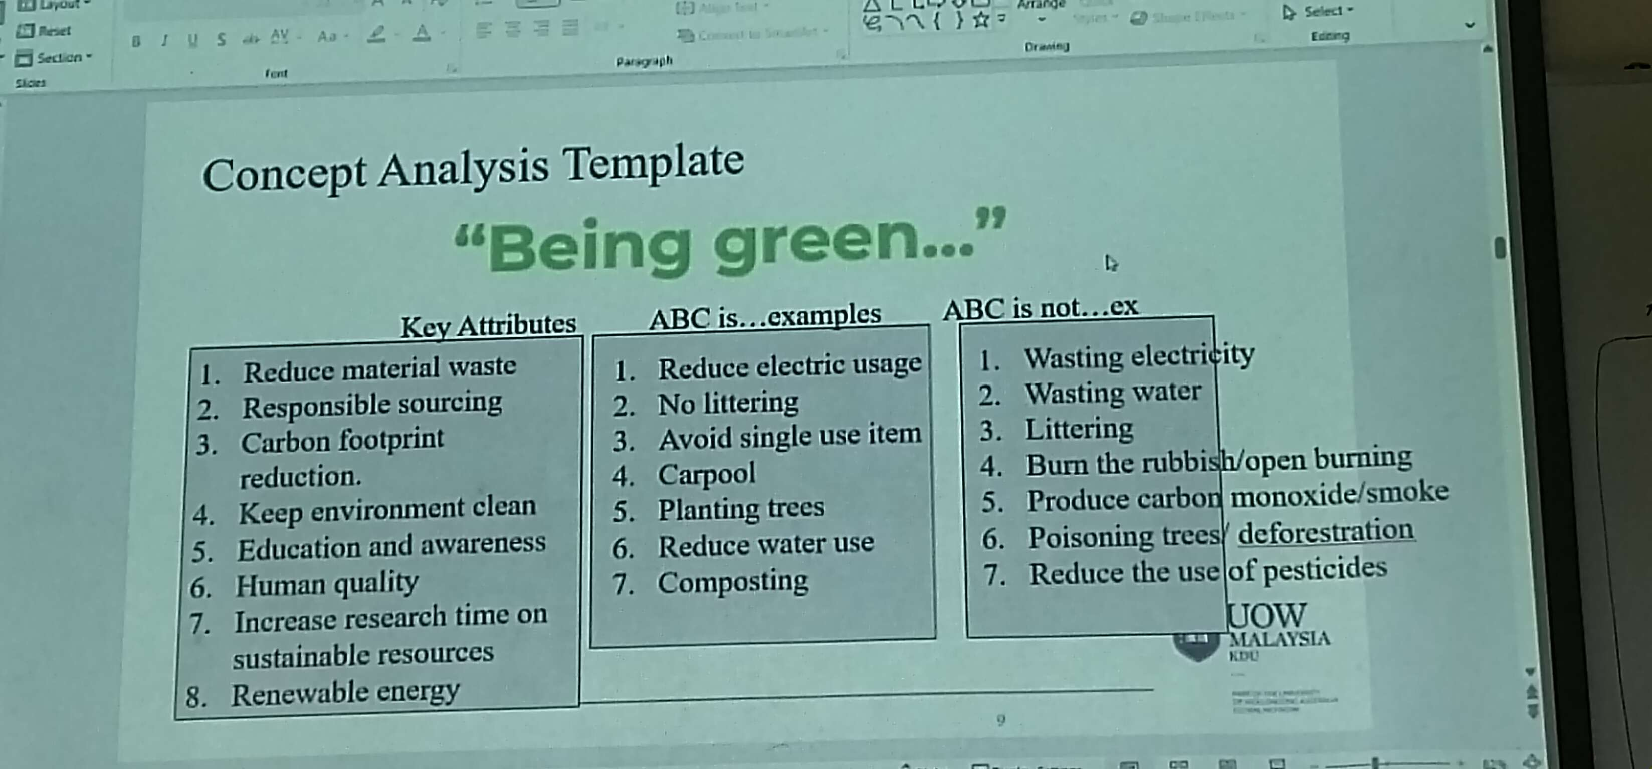

Slide 11
Key attributes of knowledge management (1)
Using concept analysis, Ruggles and Holtshouse (1999) identiﬁed the following key attributes of knowledge management: GAUFERTM
Generating new knowledge.
Accessing valuable knowledge from outside sources.
Using accessible knowledge in decision making.
Facilitating knowledge growth through culture and incentives.
Embedding knowledge in processes, products, and/or services.
Representing knowledge in documents, databases, and software.
Transferring existing knowledge into other parts of the organization.
Measuring the value of knowledge assets and/or impact of knowledge management.

Slide 12
Key attributes of knowledge management (2)
Other recurring attributes of knowledge management:
The notion of added value (the “so what?” of KM).
The notion of application or use of the knowledge that has been captured, codiﬁed, and disseminated (the impact of KM).

Slide 13
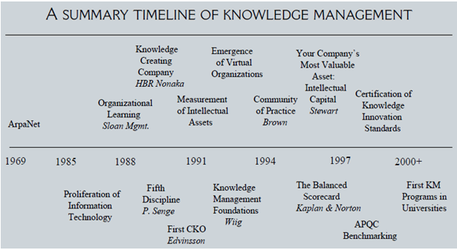
History of KM

Slide 14
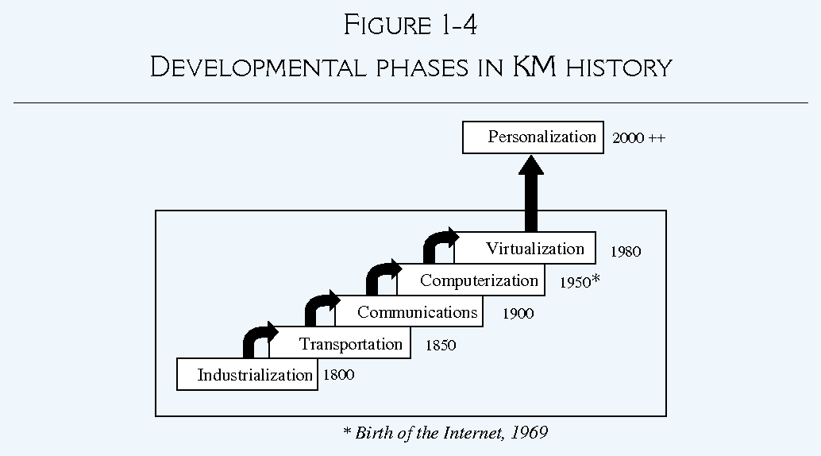
Developmental phases in KM history

Slide 15
KM in the information age
Technology enables valuable knowledge to be “remembered” via organizational learning and corporate memory.
KM is offered as a course in universities around the world, and as a degree program in many business and library schools.
As a result, KM is considered a core competency in performance and promotion evaluation by many HR departments.
KM is now even recognized as an organizational resource to be managed under ISO Standard 9001:2015.

Slide 16
From physical to knowledge assets
Knowledge has become increasingly more valuable than the more traditional physical or tangible assets.
Airlines consider the SABRE passenger reservation system as more valuable than their airplanes.
In the manufacturing sector, Just-In-Time (JIT) inventory systems is rapidly providing more value that the inventory themselves.
Human talent are also increasingly considered more valuable to physical assets
This has led to a change in focus to the useful lifespan of a valuable piece of knowledge (knowledge asset).
Content analysis and cost-beneﬁt analyses are needed to manage these “intellectual capital” in the best possible way.

Slide 17
Intellectual capital (Just tacit knowledge lmao)
This is the difference between the book value and the market value of an organization (often referred to as goodwill).
The value of these knowledge assets is at least equal to the cost of re-creating this knowledge.
Intellectual assets may be found at the strategic, tactical, and operational levels of an organization.
Examples of intellectual capital include:
Competence: the skills necessary to achieve a certain (high) level of performance.
Capability: strategic skills necessary to integrate and apply competencies.
Technologies: tools and methods required to produce certain physical results.

Slide 18
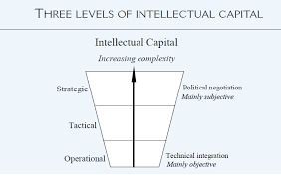
Levels of intellectual capital

Slide 19
Organizational Perspectives on Knowledge Management
Wiig (1993) considers knowledge management in organizations from three perspectives, each with different horizons and purposes:
Business Perspective – focusing on why, where, and to what extent the organization must invest in or exploit knowledge. (Planning when to use knowledge?)
Strategies, products and services, alliances, acquisitions, or divestments should be considered from knowledge-related points of view.
Management Perspective – focusing on determining, organizing, directing, facilitating, and monitoring knowledge-related practices and activities required to achieve the desired business strategies and objectives. (Designing and conducting knowledge practices to achieve business goals)
Hands-on Perspective – focusing on applying the expertise to conduct explicit knowledge-related work and tasks. (Applying tacit knowledge explicitly to tasks)
The business perspective easily maps onto the strategic layer, the management perspective to the tactical layer, and the hands-on perspective may be equated with the operational level.
As with KM, there is no best perspective, instead added value can come from combining 2 perspectives to get the most out of KM.

Slide 20
Why is KM important today?
The major business drivers behind today’s increased interest in and application of KM lie in four key areas:
Globalized business: organizations today are more global (multisite, multilingual, and multicultural) in nature.
Leaner organizations: We are doing more and we are doing it faster, but we also need to work smarter as knowledge workers, adopting an increased pace and workload.
Corporate amnesia: We are more mobile as a workforce, which creates problems of knowledge continuity for the organization and places continuous learning demands on the knowledge worker. We no longer expect to spend our entire work life with the same organization.
Technological advances: We are more connected. Advances in information technology not only have made connectivity ubiquitous but have radically changed expectations. We are expected to be “on” at all times, and the turnaround time in responding is now measured in minutes, not weeks.
Easier to identify vulnerabilities

Slide 21
KM in the work environment
Today’s work environment is more complex due to the increase in subjective knowledge items.
Knowledge workers are increasingly being asked to think on their feet,” with little time to digest and analyze the sheer volume of incoming data and information.
KM is considered as a significant response to managing this challenge due to its ability to handle both explicit and tacit knowledge.
Still, it took 3 generations of KM to get to where it is today.

Slide 22
Iterations of KM
We are now entering the third generation of knowledge management.
1st generation: the emphasis was placed on KM being containers of knowledge or IT (Intranets and internal knowledge management systems).
2nd generation: the emphasis swung to focus on the human and cultural dimensions of KM, forming communities of practice.
3rd generation: currently the focus is on the importance of shared context. This is characterized by the advent of metadata to describe the content in addition to the format of content, content management, and knowledge taxonomies.

Slide 23
KM for Individuals, Communities, and Organizations
This 3-tiered view of KM helps emphasize why KM is important today:
For the individual, KM:
Helps people do their jobs and save time through better decision making and problem solving.
Builds a sense of community bonds within the organization.
Helps people to keep up to date.
Provides challenges and opportunities to contribute.
For the community of practice, KM:
Develops professional skills.
Promotes peer-to-peer mentoring.
Facilitates more effective networking and collaboration.
Develops a professional code of ethics that members can follow.
Develops a common language.
For the organization, KM:
Helps drive strategy.
Solves problems quickly.
Diffuses best practices.
Improves knowledge embedded in products and services.
Cross-fertilizes ideas and increases opportunities for innovation.
Enables organizations to stay ahead of the competition better.
Builds organizational memory.

Slide 24
Critical KM challenges
Actually managing content effectively
Facilitate collaboration
Help knowledge workers connect and ﬁnd experts
Help the organization to learn and make decisions based on complete, valid, and well-interpreted data, information, and knowledge.

Slide 25
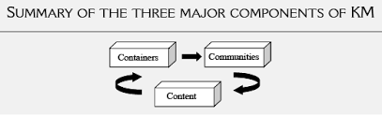
Components of KM

Slide 26
Summary
KM is not necessarily “completely new” but has been practiced in a wide variety of settings for some time now, albeit under different monikers.
Knowledge is more complex than data or information; it is subjective, often based on experience, and highly contextual.
There is no generally accepted deﬁnition of KM, but most practitioners and professionals concur that KM treats both tacit and explicit knowledge with the objective of adding value to the organization.
Each organization should deﬁne KM in terms of its own business objectives; concept analysis is one way of accomplishing this.
KM is all about applying knowledge in new, previously unencumbered or novel situations.
KM has its roots in a variety of different disciplines.
The KM generations to date have focused ﬁrst on containers, next on communities, and ﬁnally on the content itself.

Slide 27
Unit checkpoint
Use concept analysis to clarify the following terms:
Intellectual capital versus physical assets.
Tacit knowledge versus explicit knowledge.
Community of practice versus community of interest.
“Knowledge management is not anything new.” Would you argue that this statement is largely true or false? Why or why not? Use historical antecedents to justify your arguments.
What are the three generations of knowledge management to date? What was the primary focus of each?
What are the different types of roles required for each of the above three generations?

