Slide 1

Week 10: Location Services
CET3013: Mobile application development

Slide 2
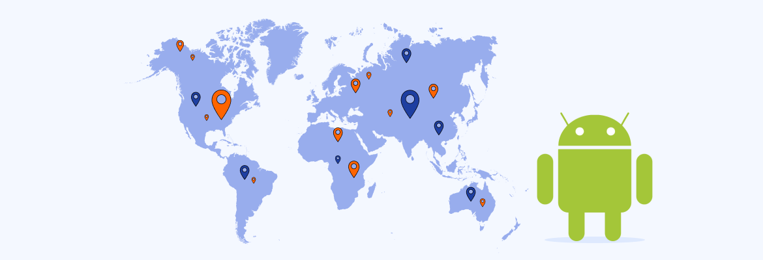
Today's Topics
Overview
Setting up Google Play services
Location permissions
Get device location
Geocoding and reverse geocoding
Creating a LocationRequest object
Working with user settings
Requesting location updates

Slide 3
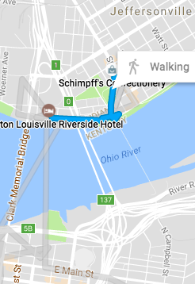
Introduction
Mobile phones – key word is MOBILE
Users move around and go places
Your app can detect and use the device location to customize the experience for the user

Slide 4
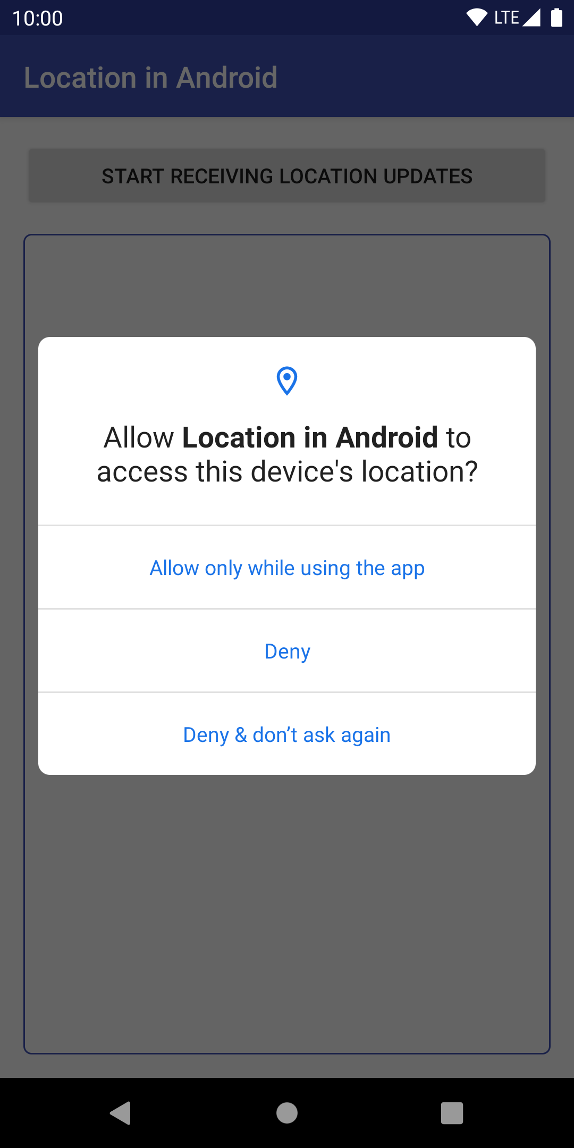
Using location in your app
Check if location permission has been granted
Ask for permission if necessary
Request most recent location
Request location updates
Notes:
High level; we look at each of these steps in detail

Slide 5
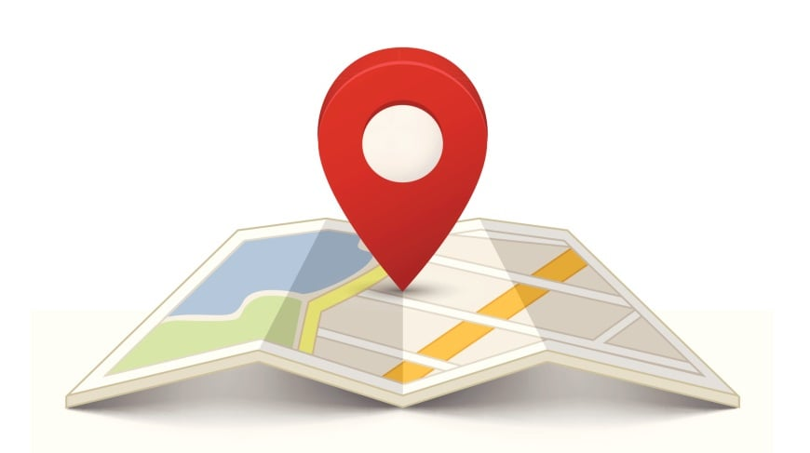
Get the device location
Use FusedLocationProviderClient
Makes location requests combining GPS, Wi-Fi, and cell network
Balances fast, accurate results with minimal battery drain
Returns Location object with latitude and longitude

Slide 6

Get the device location
Use Geocoder to convert lat/long location to physical address
Latitude 51.5
Longitude -0.078
Tower Bridge, Tower Bridge Rd, London SE1 2UP
UK

Slide 7
Setting up Google Play services
Location services are provided by Google Play Services
Install Google Repository in Android Studio
Select Tools > Android > SDK Manager
Select the SDK Tools tab
Expand Support Repository
Select Google Repository and click OK

Slide 8
Adding Google Play to your project
Add to dependencies in build.gradle (Module: app):
xx.x.x is version number, such as 18.0.0.
Replace with new version number, if Android Studio suggests it

Slide 9
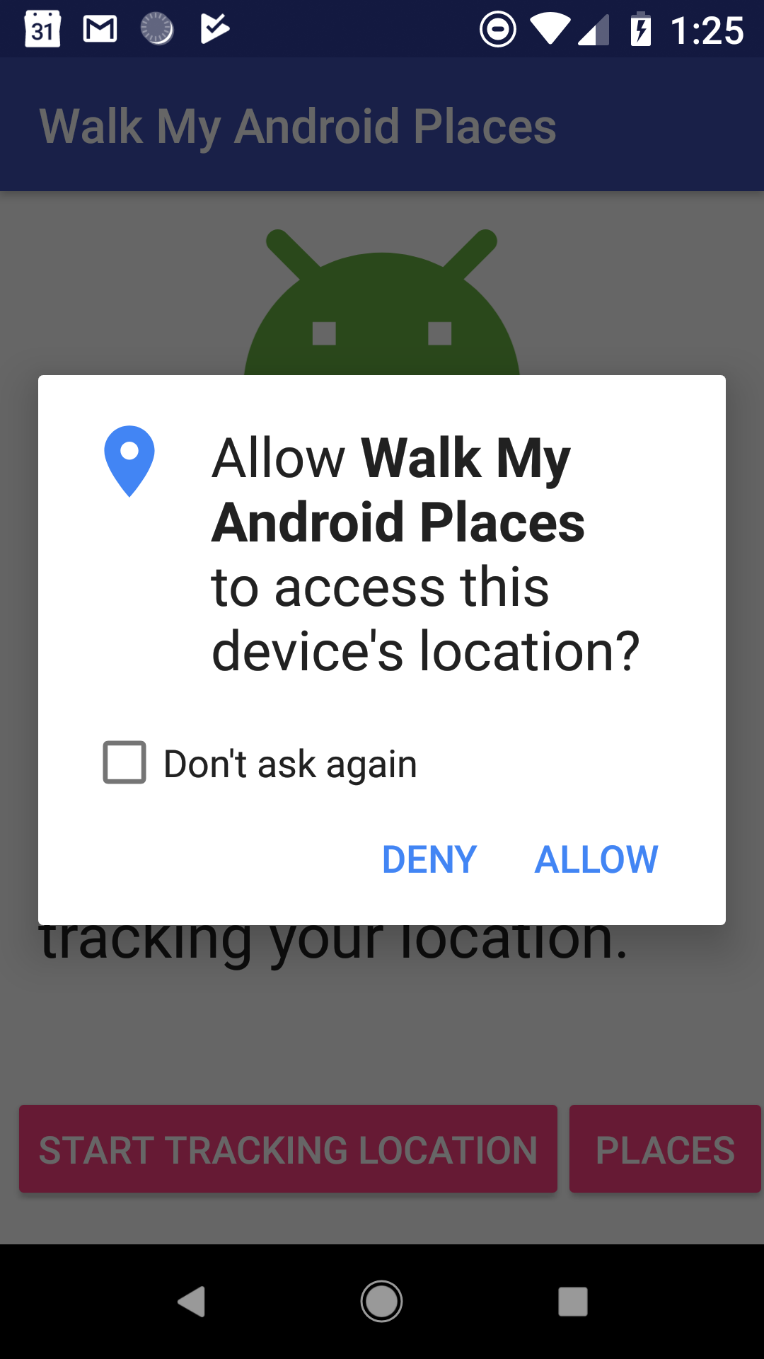
Users choose to share their location
From Marshmallow onwards:
Users grant or deny access to their location for each app
Users can change access permission at any time
Your app can prompt user to grant permission to use location

Slide 10
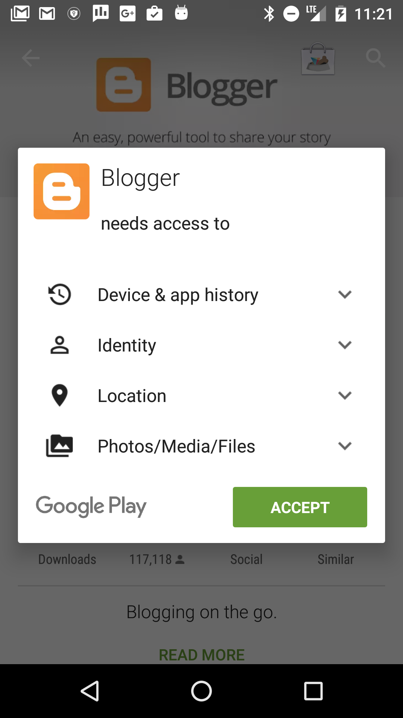
Users choose to share their location
For apps created before Marshmallow:
users grant permission before installing
after installation, user cannot change access permission
your app can check if permission has been granted

Slide 11
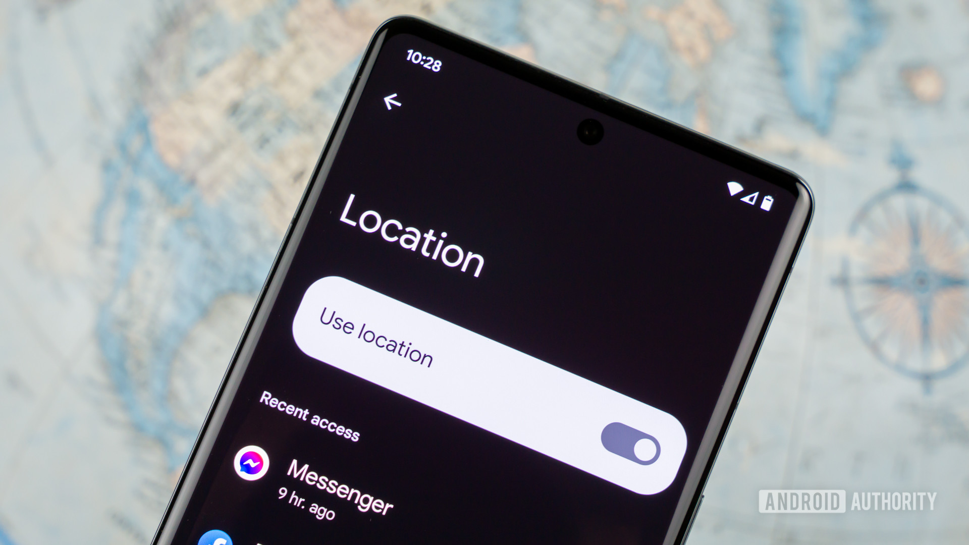
Requesting location permission
Types of location access:
Category: Either foreground location or background location.
Accuracy: Either precise location or approximate location.

Slide 12
Requesting location permission
Foreground location
Shares or receives location information only once.
Defined amount of time, then that feature requires foreground location access
Allows users to share their current location with another user.
It's recommended that you declare a foreground service type of location

Slide 13
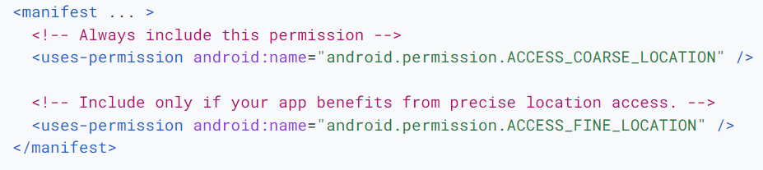
Requesting location permission
Apps must request location permission for foreground location
ACCESS_COARSE_LOCATION for location accurate to within a city block
ACCESS_FINE_LOCATION for get precise location

Slide 14
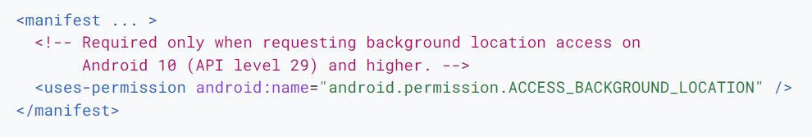
Requesting location permission
Background Location:
An app requires background location access if a feature within the app constantly shares location with other users or uses the Geofencing API.
On Android 10 (API level 29) and higher, you must declare the ACCESS_BACKGROUND_LOCATION permission in your app's manifest in order to request background location access at runtime.

Slide 15
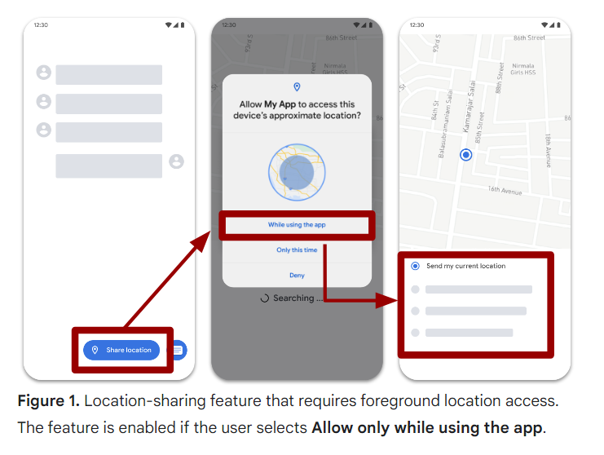
Requesting location permission

Slide 16
Requesting location permission
On Android 12 (API level 31) or higher, users can request that your app retrieve only approximate location information, even when your app requests the ACCESS_FINE_LOCATION runtime permission.
On Android 12 and higher, users can navigate to system settings to set the preferred location accuracy for any app, regardless of that app's target SDK version.

Slide 17
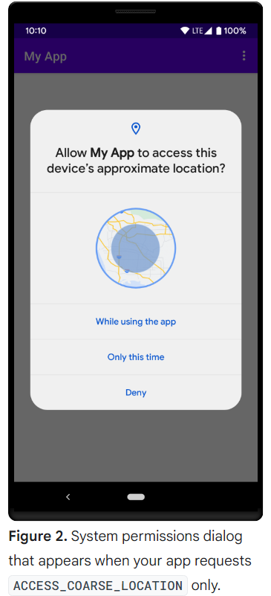
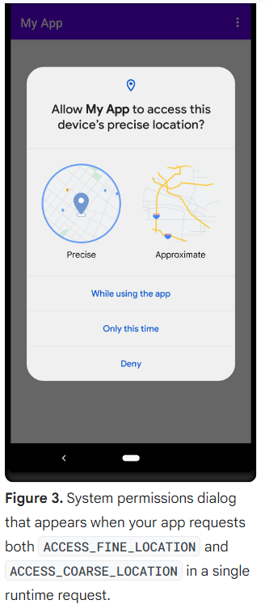
Requesting location permission

Slide 18
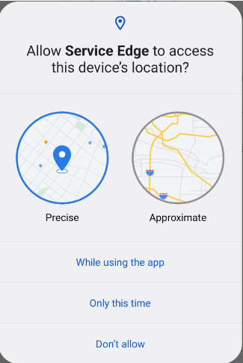
Requesting permission at run time
User can revoke permission at any time
Check for permission each time your app uses location
Details and examples: Requesting Permissions at Runtime

Slide 19
Steps to check/request permission
Use checkSelfPermission() to see if permission granted
Use requestPermissions() to request permission
Check user response to see if request was granted

Slide 20
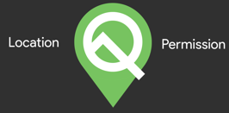
Check/request permission
if (ActivityCompat.checkSelfPermission(this,
Manifest.permission.ACCESS_FINE_LOCATION) !=
PackageManager.PERMISSION_GRANTED) {
ActivityCompat.requestPermissions(this,
arrayOf(Manifest.permission.ACCESS_FINE_LOCATION)},
REQUEST_LOCATION_PERMISSION)
} else {
Log.d(TAG, "getLocation: permissions granted")
}

Slide 21
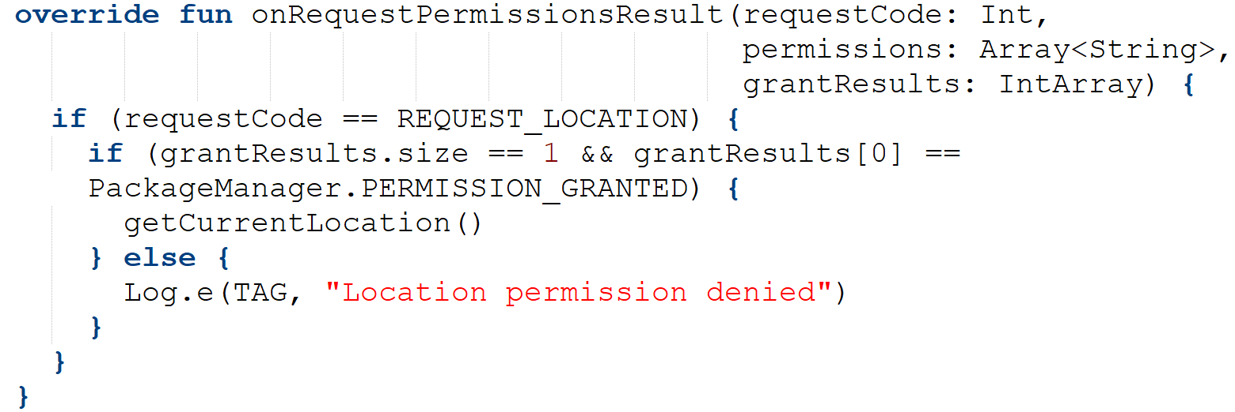
Get user's response
Override onRequestPermissionsResult() to check if user granted permission
Response is returned in permissions array
Compare grantResults parameter to PackageManager.PERMISSION_GRANTED

Slide 22


FusedLocationProviderClient
Use FusedLocationProviderClient to request last known location
Usually, last known location is same as current location

Slide 23
Get FusedLocationProviderClient
To get FusedLocationProviderClient:
private lateinit var fusedLocationClient: FusedLocationProviderClient
override fun onCreate(savedInstanceState: Bundle?) {
// ...
fusedLocationClient =
LocationServices.getFusedLocationProviderClient(this)
}

Slide 24
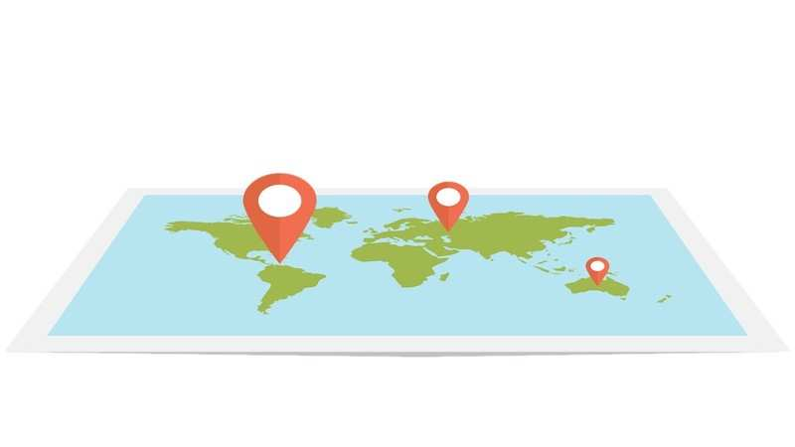
Requesting last known location
Call FusedLocationProviderClient getLastLocation()
Returns Task object representing async task to fetch Location object
Task supplies methods for adding success and failure listeners
Retrieve latitude and longitude from Location object

Slide 25
Requesting last known location
fusedLocationClient.lastLocation .addOnSuccessListener { it : Location? ->
val location = it.result
if (location != null) {
val latLng = LatLng(location.latitude, location.longitude)
val time = location.time
} else {
Log.e(TAG, "No location found")
}
}

Slide 26
Geocoding and reverse geocoding
Geocode: Convert human-readable street address into latitude/longitude
Reverse geocode: Convert lat/long into human-readable street address
Latitude 51.5
Longitude -0.078
Tower Bridge, Tower Bridge Rd, London SE1 2UP
UK

Slide 27
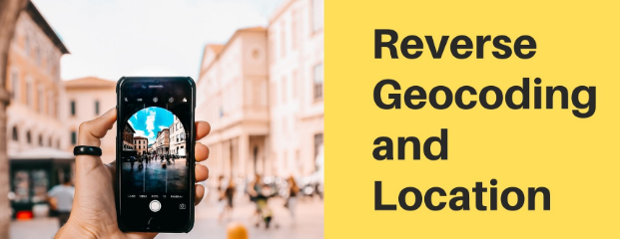
Use the Geocoder class
Use Geocoder for geocoding and reverse geocoding
val geocoder = Geocoder(applicationcontext,
Locale.getDefault())
Methods make network request—don't call on main thread

Slide 28

Geocoder backend service
Geocoder requires backend service that are not included in core Android framework
Use isPresent() to check if implementation exists
Geocoder query methods return empty list if no backend service exists

Slide 29
Reverse geocoding coordinates
getFromLocation( double latitude, double longitude, int maxResults)
Returns list of Address objects:
val addresses:List<Address> = geocoder.getFromLocation(
lat,lng,1)
* This method is deprecated in Android API 33

Slide 30
Geocoding address into coordinates
getFromLocationName(
String locationName, int maxResults)
Returns list of Address objects with latitude/longitude coordinates:
val addresses: List<Address> = geocoder.getFromLocationName(
"731 Market St, San Francisco, CA 94103", 1)
val firstAddress = addresses[0]
val latitude = firstAddress.latitude
val longitude = firstAddress.longitude
* This method is deprecated in Android API 33

Slide 31
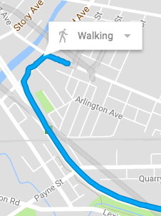
Getting location updates
Your app can get the last known location.
It can also ask for regular updates to track location
Use LocationRequest to set parameters for location update requests

Slide 32
LocationRequest parameters
Set LocationRequest parameters to control location requests
interval: Sets how frequently your app needs updates
fasterInterval: : Sets limit to the update rate to prevent flicker/data overflow
priority: Sets request priority and sources

Slide 33
Request priority values
PRIORITY_BALANCED_POWER_ACCURACY | Precise to within city block (100 meters); uses only Wi-Fi and cell network, to consume less power
PRIORITY_HIGH_ACCURACY | Uses GPS if available
PRIORITY_LOW_POWER | City-level precision (10 km)
PRIORITY_NO_POWER | Updates when triggered by other apps (zero additional power)

Slide 34
Create LocationRequest example
fun getLocationRequest(): LocationRequest {
val locationRequest: LocationRequest = LocationRequest()
locationRequest.interval = 10000
locationRequest.fastestInterval = 5000
locationRequest.priority =
LocationRequest.PRIORITY_HIGH_ACCURACY
return locationRequest
}

Slide 35
Requesting location updates
Use LocationRequest with FusedLocationProviderClient
Accuracy of location determined by:
Available location providers (network and GPS)
Location permission requested
Options set in location request

Slide 36
Steps to start location updates
Create LocationRequest object
Override LocationCallback.onLocationResult()
Use requestLocationUpdates() on FusedLocationProviderClient to start regular updates

Slide 37
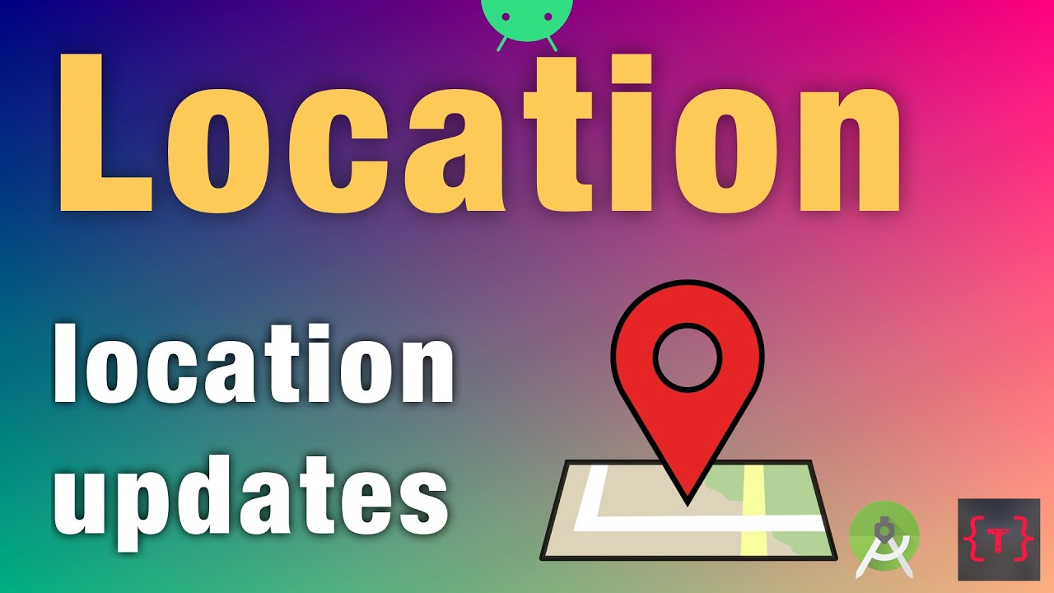
Steps to start location updates
Use requestLocationUpdates() to start regular updates
Pass in LocationRequest and LocationCallback
Location updates are delivered to onLocationResult()

Slide 38
Using LocationCallback
private var locationRequest: LocationRequest? = null locationRequest = LocationRequest.create()
...
val locationCallback = object : LocationCallback() {
override fun onLocationResult(locationResult:
LocationResult?) {
getCurrentLocation()
}
}
fusedLocationClient.requestLocationUpdates(locationRequest,
locationCallback, null)

Slide 39
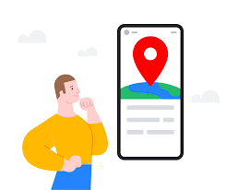
THE END

