Slide 1

Week 11: Camera Services
CET3013: Mobile application development

Slide 2

Today's Topics
Using Camera
Camera Development Issues
Camera X

Slide 3
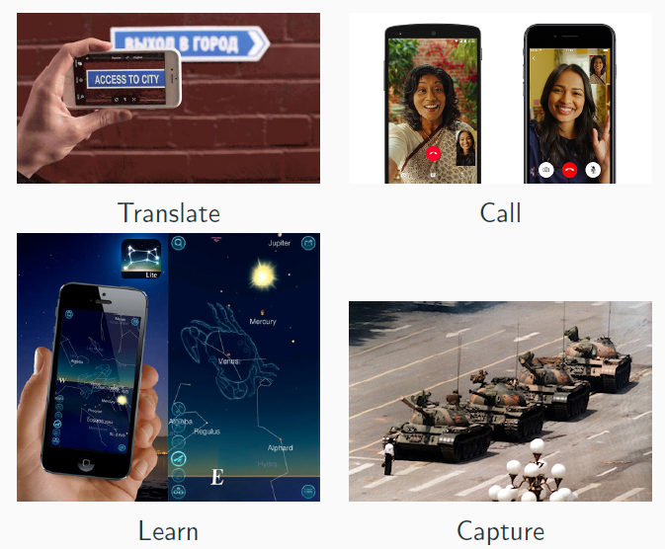
Using the camera
Why use the camera?

Slide 4
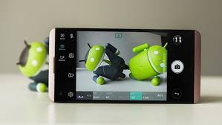
Using the camera
Two ways to include the camera sensor in your application:
Wrap camera app with intent (Old method)
Use the Camera/Camera2 API (Some)
Use the CameraX (new Jetpack library)

Slide 5
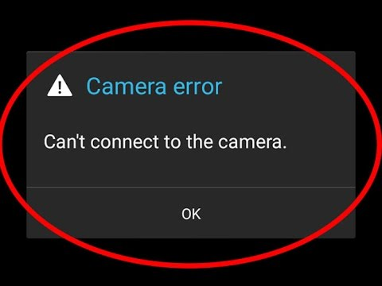
Camera Development Issues
Supporting different API versions.
Providing consistency across devices.
Understanding the complex camera API.

Slide 6
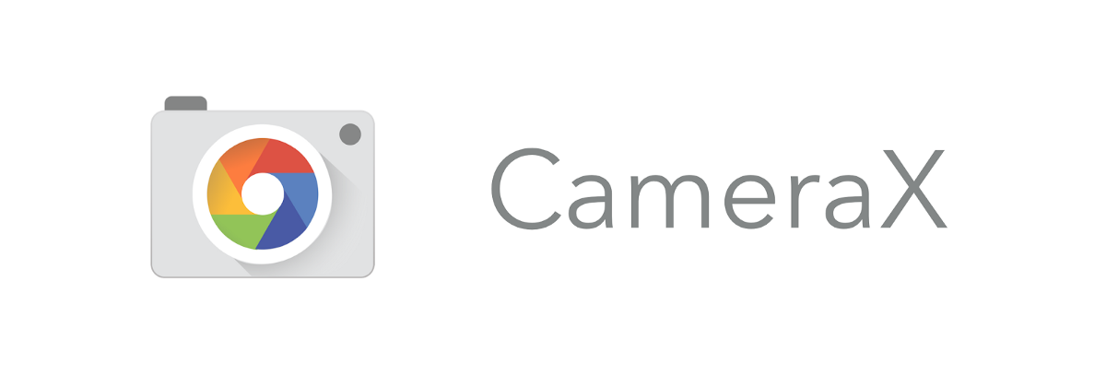
CameraX Overview
CameraX is a Jetpack support library, built to help you make camera app development easier.
It provides a consistent and easy-to-use API surface.

Slide 7

CameraX Benefits
CameraX is designed to support devices running Android 5.0 (API level 21) and higher (94% devices).
Consistent behaviour across devices.
Easy to use APIs

Slide 8
CameraX Requirements
Your app will need the CAMERA permission.
To save images to files, it will also require the WRITE_EXTERNAL_STORAGE permission, except on devices running Android 10 or later.
<uses-permission android:name="android.permission.CAMERA" />
<uses-permission android:name="android.permission.WRITE_EXTERNAL_STORAGE"/>
<uses-permission android:name="android.permission.READ_EXTERNAL_STORAGE"/>
<uses-feature android:name="android.hardware.camera.any"/>

Slide 9
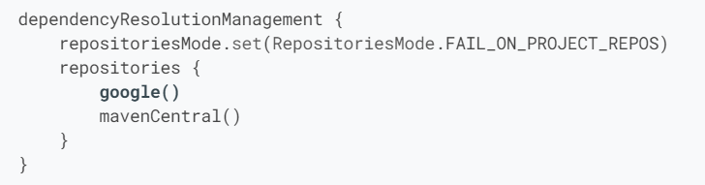
CameraX Requirements (cont..)
You must add the Google Maven repository to your project (setting gradle file).

Slide 10
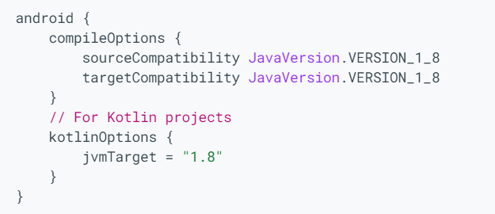
CameraX Requirements (cont..)
Compile options must run on Java version 1_8.
Add the following to the gradle file:
Install JDK 8.0

Slide 11
CameraX Requirements (cont..)
Add the following to each module’s build.gradle file for an app:
dependencies { def camerax_version = "1.2.2" implementation "androidx.camera:camera-core:${camerax_version}" implementation "androidx.camera:camera-camera2:${camerax_version}" implementation "androidx.camera:camera-lifecycle:${camerax_version}" implementation "androidx.camera:camera-video:${camerax_version}" implementation "androidx.camera:camera-view:${camerax_version}" implementation "androidx.camera:camera-extensions:${camerax_version}" }

Slide 12
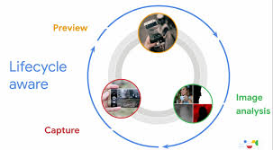
CameraX Structure
Developers use CameraX to interface with a device’s camera through an abstraction called a use case. There are 4 use cases in CameraX:
Preview
Image Analysis
Image Capture
Video Capture

Slide 13
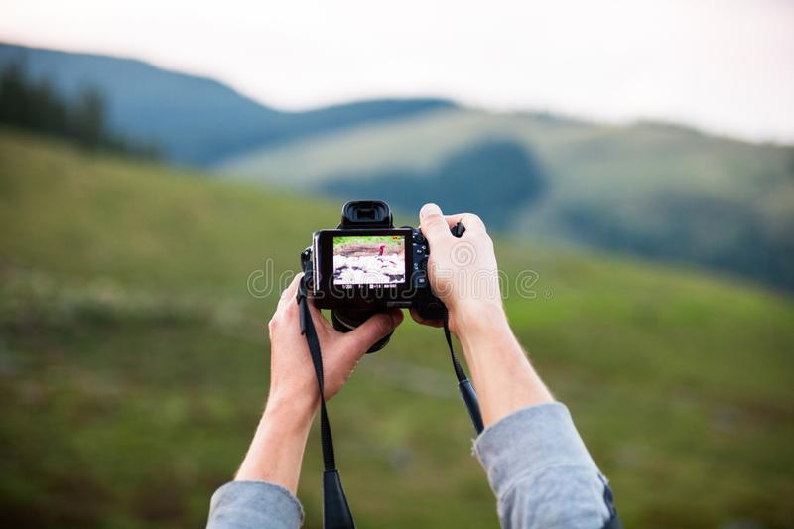
Preview Use Case
Accepts a surface for displaying a preview, such as a PreviewView.
It is a View that can be cropped, scaled, and rotated for proper display.

Slide 14
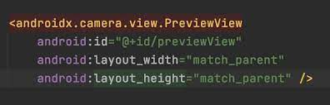
Preview Use Case
Steps in Preview Use Case
Optionally configure a CameraXConfig.Provider
Add a PreviewView to your layout.
Request a ProcessCameraProvider.
On View creation, check for the ProcessCameraProvider.
Select a camera and bind the lifecycle and use cases.

Slide 15
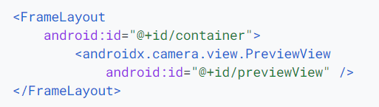
Preview Use Case
Step 2: Add a Preview to the Layout

Slide 16
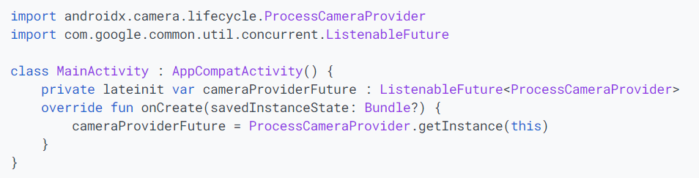
Preview Use Case
Step 3: Request a CameraProvider

Slide 17
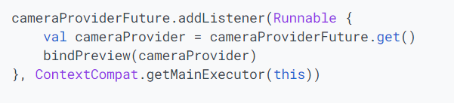
Preview Use Case
Step 4: Check for CameraProvider Availability

Slide 18

Preview Use Case
Select a camera and bind the lifecycle and use cases.
Create a Preview.
Specify the desired camera LensFacing option.
Bind the selected camera and any use cases to the lifecycle.
Connect the Preview to the PreviewView.

Slide 19
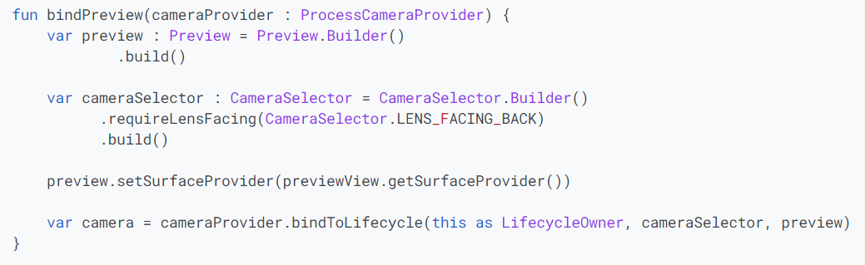
Preview Use Case
Note that bindToLifecycle() returns a Camera object.

Slide 20

Image Capture Use Case
The image capture use case is designed for capturing high-resolution and high-quality photos.
Two methods use in capturing images:
takePicture(Executor, OnImageCapturedCallback): This method provides an in-memory buffer of the captured image.
takePicture(OutputFileOptions, Executor, OnImageSavedCallback): This method saves the captured image to the provided file location.

Slide 21
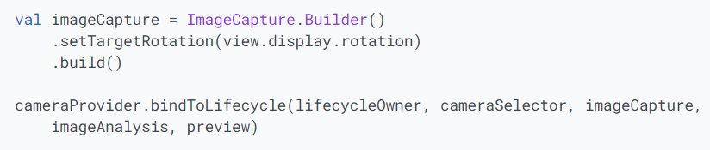

Image Capture Use Case
Create the image capture object:

Slide 22
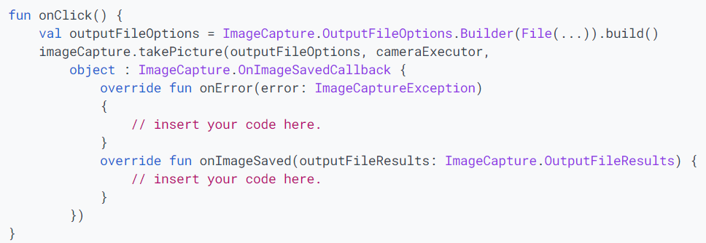
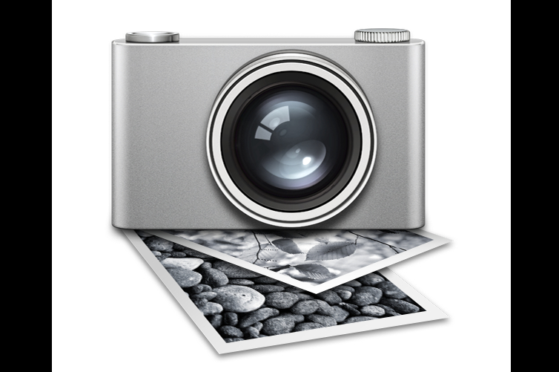
Image Capture Use Case
Once you've configured the camera, the following code takes a photo based on user action:

Slide 23

Image Analysis Use Case
The image analysis use case provides your app with a CPU-accessible image on which you can perform image processing, computer vision, or machine learning inference.
The application implements an analyze() method that is run on each frame.

Slide 24
Image Analysis Use Case
To use image analysis in your application, follow those steps:
Build an ImageAnalysis use case.
Create an ImageAnalysis.Analyzer.
Set your analyzer to your ImageAnalysis.
Bind your lifecycle owner, camera selector, and ImageAnalysis use case to the lifecycle.

Slide 25
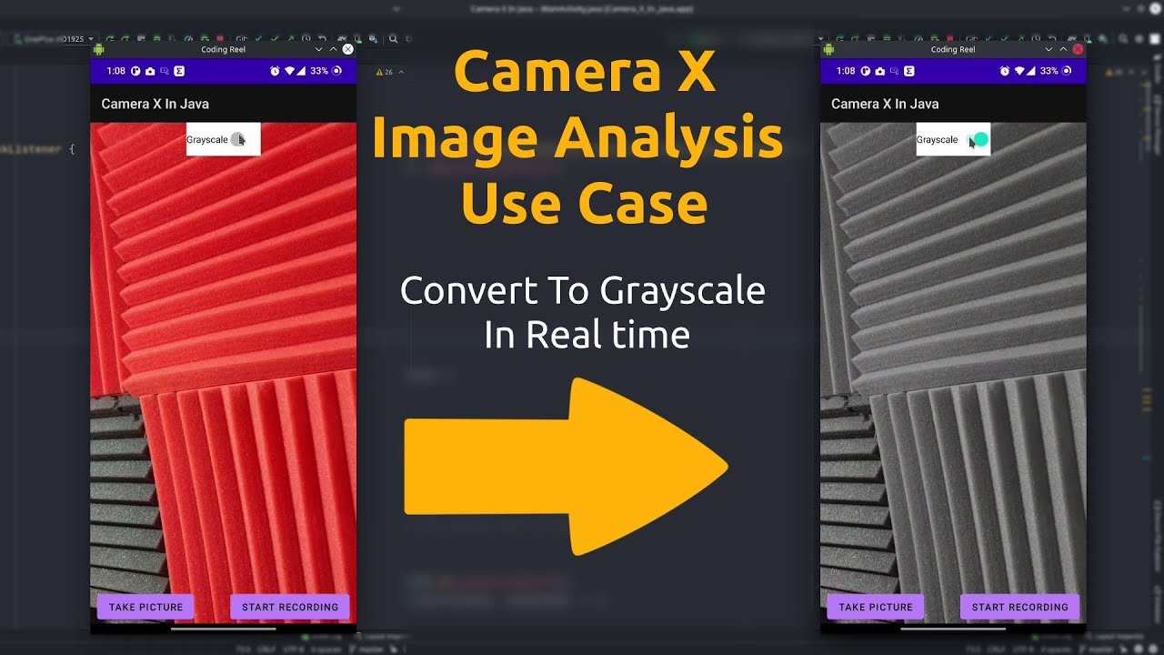
Image Analysis Use Case
Use ImageAnalysis.Builder to build an ImageAnalysis object.
A few parameters in ImageAnalysis.Builder.
Format: CameraX supports YUV_420_888 (default) and RGBA_8888
Resolution and AspectRatio
Rotation
Target name (for debugging purposes)

Slide 26

Image Analysis Use Case
The following example combines everything from the previous steps, binding CameraX ImageAnalysis and Preview use cases to a lifeCycle owner:

Slide 27
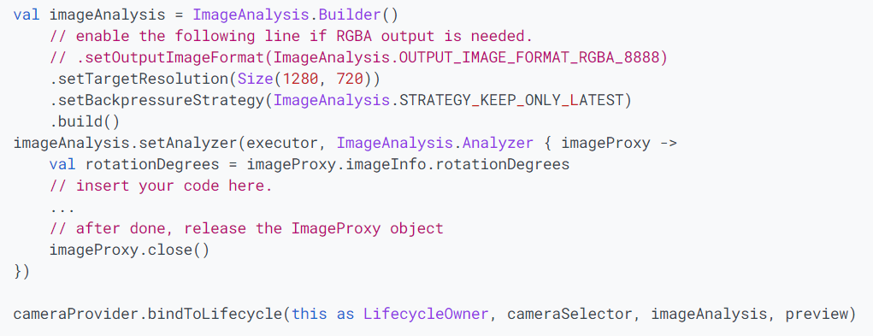
Image Analysis Use Case

Slide 28

Video Capture Use Case
VideoCapture is a CameraX use case that works well on its own or when combined with other use cases.

Slide 29
Video Capture Use Case
The VideoCapture API consists of the following objects:
VideoCapture
It is the top-level use case class
Recorder
It is used to perform the video and audio capturing
PendingRecording
Configures a recording, providing options like enabling audio
Recording
Performs the actual recording

Slide 30

Video Capture Use Case
The CameraX Video Capture API is not final and is subject to change.

Slide 31

CameraX
CameraX published in year 2019 (now in beta version).
It is a powerful framework and still in development process.
The library provides a number of compatibility fixes and workarounds to help make the developer experience consistent across many devices.

