Slide 1

Week 11: Android Sensors
CET3013: Mobile application development
Notes:
***EXAM

Slide 2
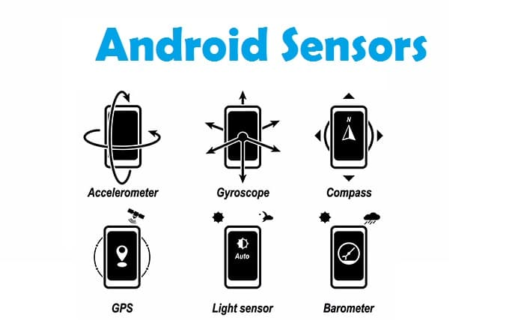
This Week
Android sensors
Using sensors
Motion sensors
Position sensors
Environment sensors
Location-based services
Using Maps

Slide 3
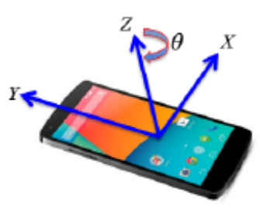
Sensor Types
Android sensor framework lets you access many types of sensors.
Hardware-based
Software-based
Hardware-based sensors
Physical components built into a handset or tablet device.
Directly measure specific environmental properties, such as acceleration, geomagnetic field strength, or angular change.

Slide 4
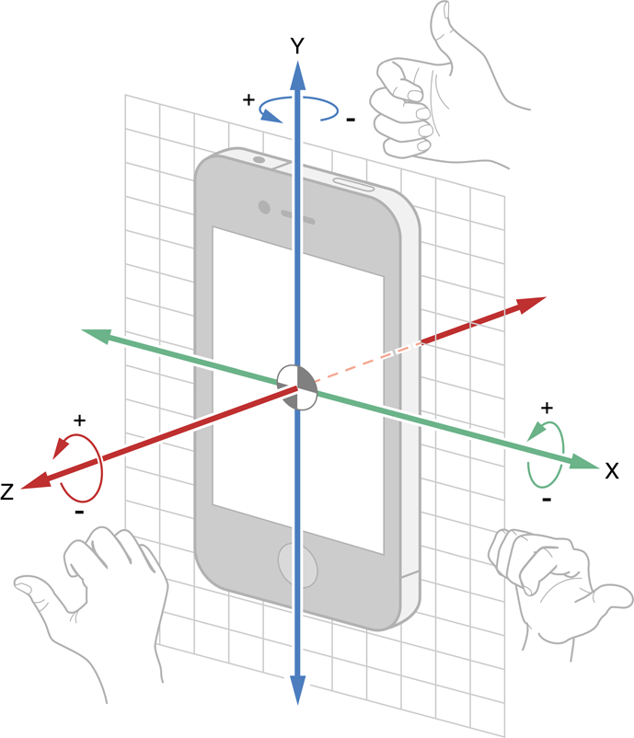
Sensor Types
Software-based sensors
Not physical devices, although they mimic hardware-based sensors.
Derive their data from one or more of the hardware-based sensors (“Virtual Sensors”)
Examples
Linear acceleration sensor
Gravity sensor

Slide 5
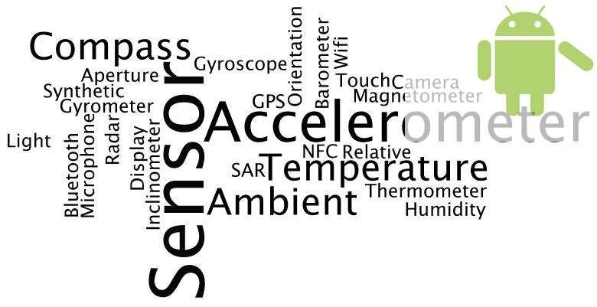
Sensor Types
Motion sensors
measure acceleration forces and rotational forces along three axes.
includes accelerometers, gravity sensors, gyroscopes, and rotational vector sensors.
Environmental sensors
measure various environmental parameters,
E.g. ambient air temperature and pressure, illumination, and humidity.
includes barometers, photometers, and thermometers.
Position sensors
measure the physical position of a device.
includes orientation sensors and magnetometers
Most devices have small subset of these

Slide 6
Sensor Types
Sensor | Type | Description | Common Uses
TYPE_ACCELEROMETER | Hardware | Measures the acceleration force in m/s² that is applied to a device on all three physical axes (x, y, and z), including the force of gravity. | Motion detection (shake, tilt, etc.).
TYPE_AMBIENT_TEMPERATURE | Hardware | Measures the ambient room temperature in degrees Celsius (°C). See note below. | Monitoring air temperatures.
TYPE_GRAVITY | Software or Hardware | Measures the force of gravity in m/s² that is applied to a device on all three physical axes (x, y, z). | Motion detection (shake, tilt, etc.).
TYPE_GYROSCOPE | Hardware | Measures a device's rate of rotation in rad/s around each of the three physical axes (x, y, and z). | Rotation detection (spin, turn, etc.).

Slide 7
Sensor Types
Sensor | Type | Description | Common Uses
TYPE_PROXIMITY | Hardware | Measures the proximity of an object in cm relative to the view screen of a device. This sensor is typically used to determine whether a handset is being held up to a person's ear. | Phone position during a call.
TYPE_RELATIVE_HUMIDITY | Hardware | Measures the relative ambient humidity in percent (%). | Monitoring dewpoint, absolute, and relative humidity.
TYPE_ROTATION_VECTOR | Software or Hardware | Measures the orientation of a device by providing the three elements of the device's rotation vector. | Motion detection and rotation detection.
TYPE_PRESSURE | Hardware | Measures the ambient air pressure in hPa or mbar. | Monitoring air pressure changes.

Slide 8
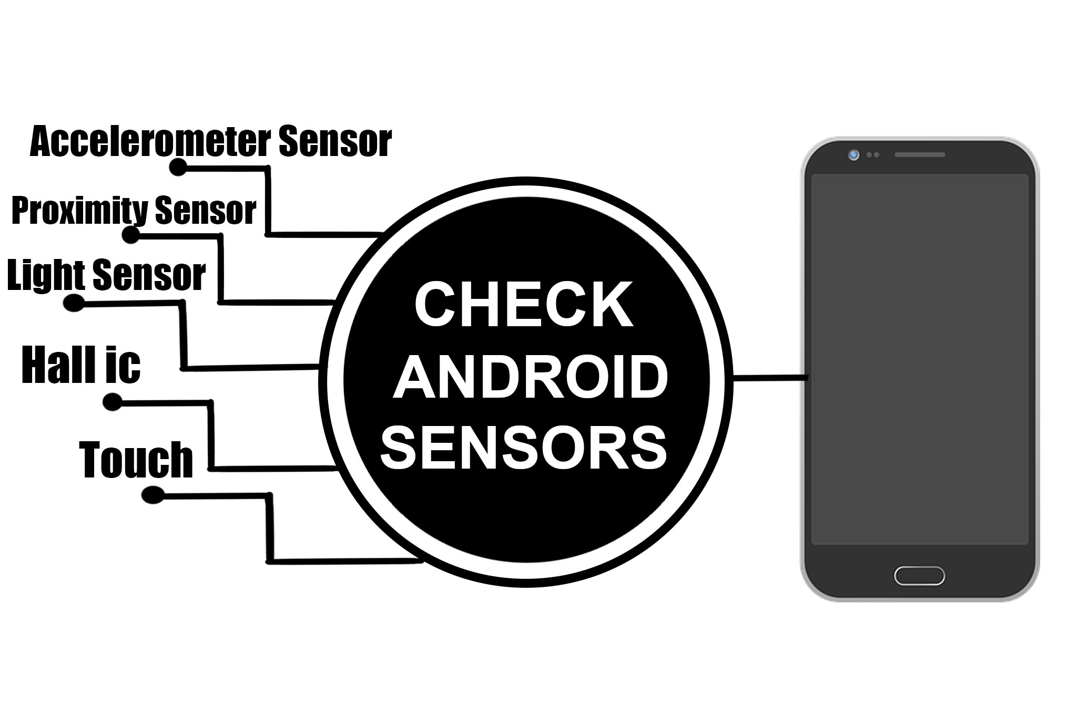
Sensor Framework
Software Framework to manage sensors
Allows you to:
Determine which sensors are available on a device.
Determine an individual sensor's capabilities, such as its maximum range, manufacturer, power requirements, and resolution.
Acquire raw sensor data and define the minimum rate at which you acquire sensor data.
Register and unregister sensor event listeners that monitor sensor changes.

Slide 9
Managing Sensors
Given that the sensors supported by devices vary, how can we find out what the device our app is running on supports?
Use getSystemService() to get an instance of SensorManager and use that.
private lateinit var sensorManager: SensorManager
...
sensorManager = getSystemService(Context.SENSOR_SERVICE) as SensorManager

Slide 10
Managing Sensors
Now we can use the SensorManager’s getSensorList() method and tell it what type of sensors we’re looking for.
We can specify the various TYPE... Constants to list all the sensors of a specified type.
val deviceSensors: List<Sensor> =
sensorManager.getSensorList(Sensor.TYPE_ALL)

Slide 11
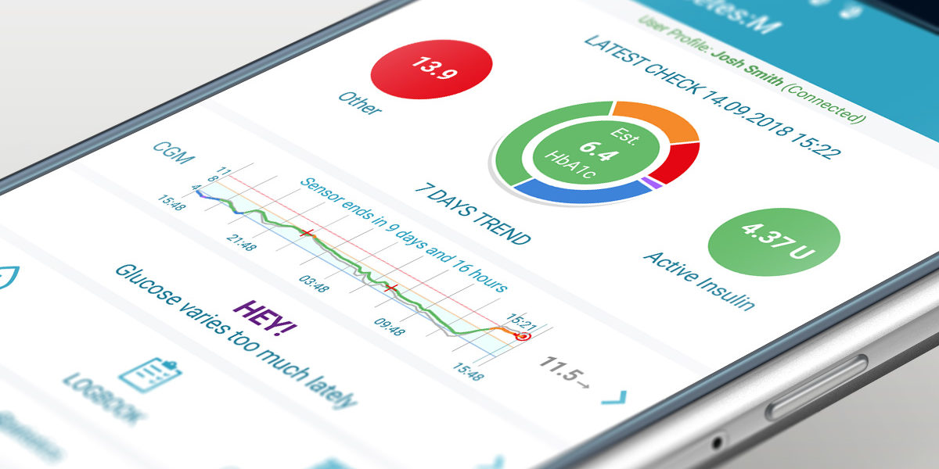
Managing Sensors
If there are several sensors of a specified type, one must always be the default sensor
One way of finding out if there is ANY instance at all of a particular type of sensor is to use the getDefaultSensor() method, specifying the type of sensor we’re looking for
It returns null if there is no such sensor

Slide 12
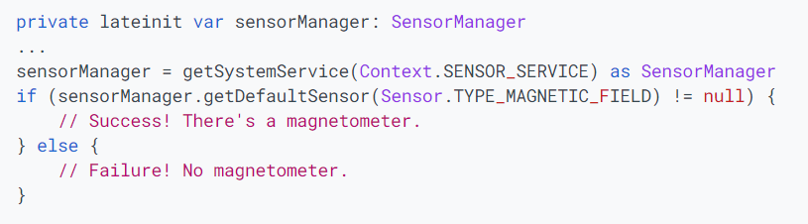
Managing Sensors

Slide 13
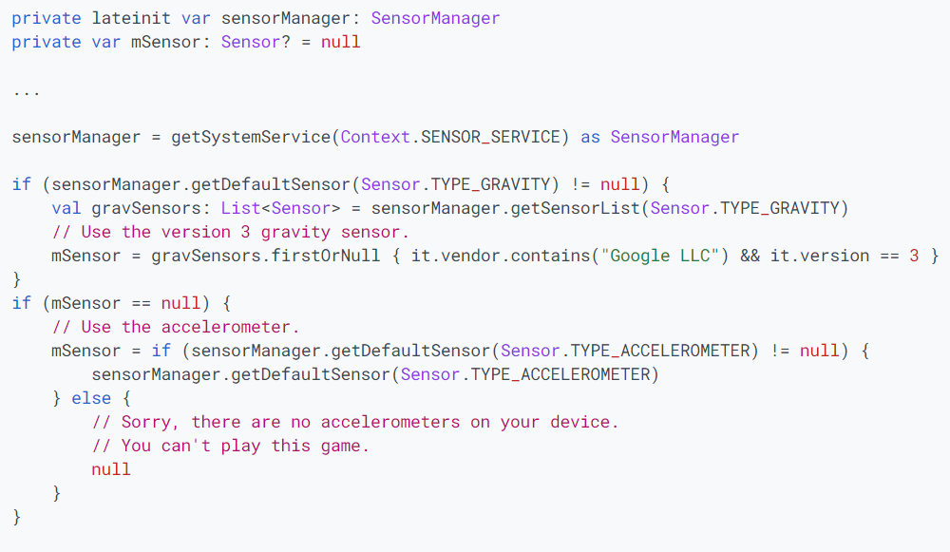
Managing Sensors

Slide 14
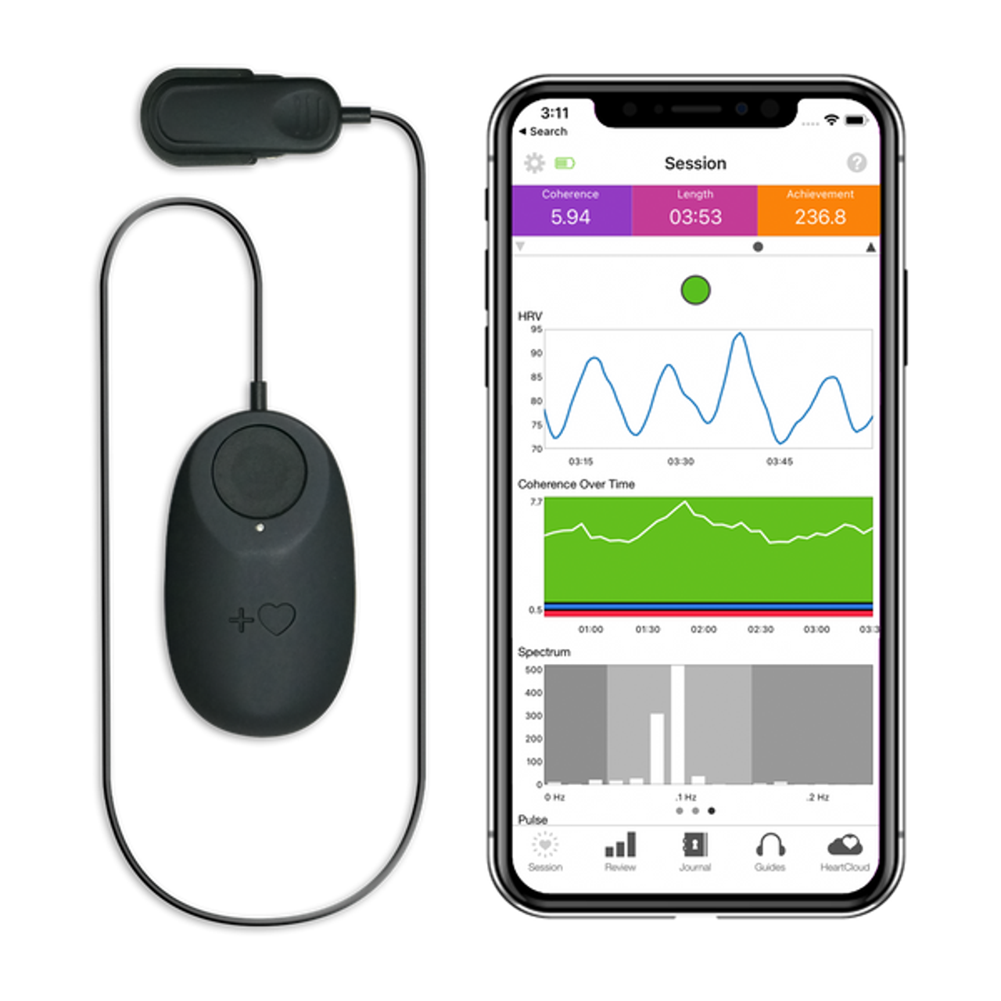
Other Sensor Methods
getResolution()
obtain a sensor's resolution
getMaximumRange()
obtain maximum range of measurement
getPower()
Obtain a sensor's power requirements
getMinDelay()
Returns the minimum time interval (in microseconds) a sensor can use to sense data

Slide 15

Handling Events
Need to implement the SensorEventListener interface. Has two methods:
onAccuracyChanged(Sensor, value)
value is one of:
SENSOR_STATUS_ACCURACY_LOW
SENSOR_STATUS_ACCURACY_MEDIUM
SENSOR_STATUS_ACCURACY_HIGH
SENSOR_STATUS_UNRELIABLE
These are defined in the SensorManager class

Slide 16
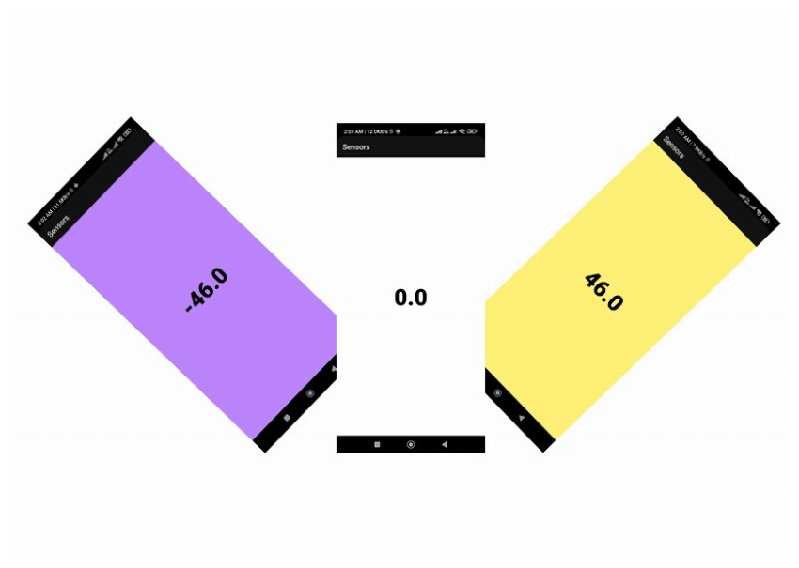
Handling Events
Type | Field | Purpose
public int | accuracy | The accuracy of this event.
public Sensor | sensor | The sensor that generated this event.
public long | timestamp | The time in nanoseconds at which the event happened
public final float[] | values | The length and contents of the values array depends on which sensor type is being monitored.
onSensorChanged(SensorEvent)
SensorEvent Has four public fields

Slide 17
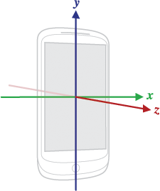
Co-Ordinate System
Based on the default orientation of the device
The axes do not change if the device is rotated
Can’t assume that the default orientation is portrait

Slide 18
The values field
Has either 3 elements (x, y, z) or just 1, depending on the sensor
For the accelerometer, the acceleration due to gravity influences things
If the device is sitting on a table, the acceleration is 9.81m/s²
If the device is sitting on a table, and pushed from the left side towards the right, then the x value of acceleration is positive
Formally, the reported acceleration is
where G_{dir} is the component of gravitational acceleration in that
direction (dir = X, Y or Z)

Slide 19
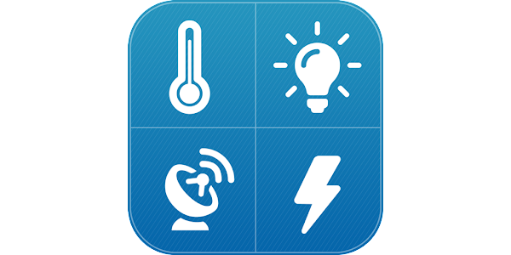
The values field
The accelerometer reports accelerations in m/s²
The magnetometer reports x, y and z values in μT
The proximity sensor reports a distance in cm
Some proximity sensors can only detect “near” and “far”
These report their maximum range in the “far” state and some smaller value in the “near” state

Slide 20
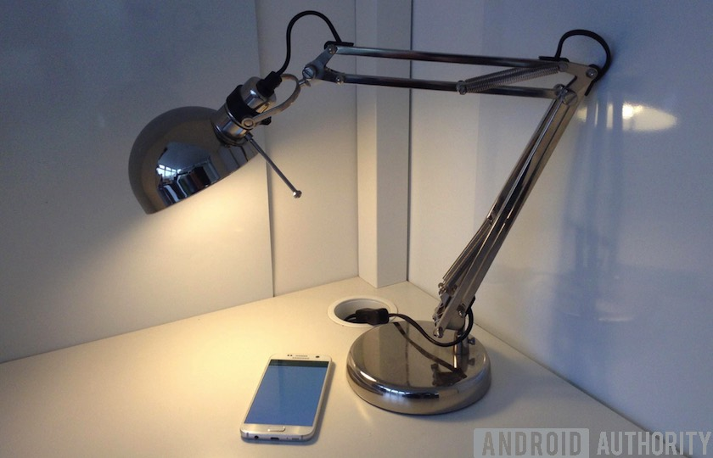
The values field
The light sensor reports a value in lux for the ambient illumination

Slide 21

Handling Events (continued)
The way of adding listeners is different from most other events.
Sensors consume battery power. What implications does this have?
We don’t want to be listening for events if our activity is paused
So we register the event listener (in onResume) and unregister it (in onPause)

Slide 22
Event Handling Example
class SensorActivity : Activity(), SensorEventListener {
private lateinit var sensorManager: SensorManager
private var mLight: Sensor? = null
public override fun onCreate(savedInstanceState: Bundle?) {
super.onCreate(savedInstanceState)
setContentView(R.layout.main)
sensorManager = getSystemService(Context.SENSOR_SERVICE) as
SensorManager
mLight = sensorManager.getDefaultSensor(Sensor.TYPE_LIGHT)
}
...
}

Slide 23
Event Handling Example
override fun onAccuracyChanged(sensor: Sensor, accuracy: Int) {
// Do something here if sensor accuracy changes.
}
override fun onSensorChanged(event: SensorEvent) {
// The light sensor returns a single value.
// Many sensors return 3 values, one for each axis.
val lux = event.values[0]
// Do something with this sensor value.
}

Slide 24
Event Handling Example
override fun onResume() {
super.onResume()
mLight?.also { light ->
sensorManager.registerListener(this, light,
SensorManager.SENSOR_DELAY_NORMAL)
}
}
override fun onPause() {
super.onPause()
sensorManager.unregisterListener(this)
}

Slide 25
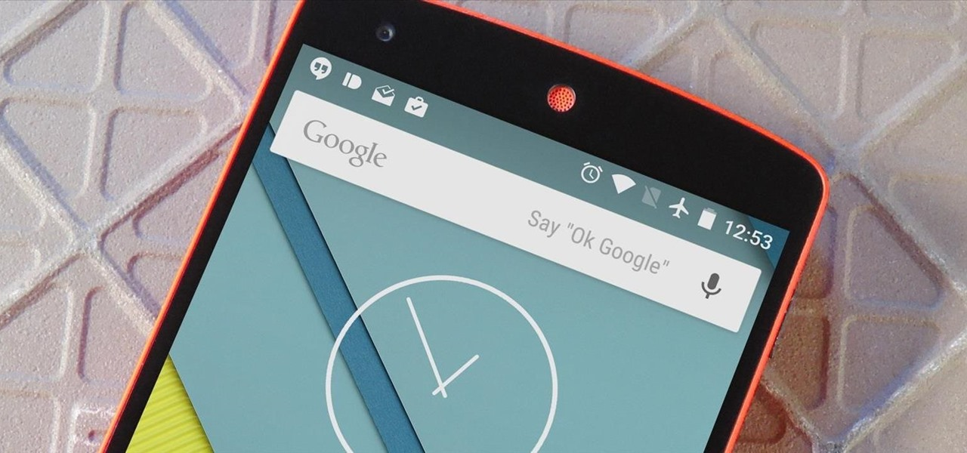
Data Delays
Constant | Delay
SENSOR_DELAY_NORMAL | 200,000 μs
SENSOR_DELAY_GAME | 20,000 μs
SENSOR_DELAY_UI | 60,000 μs
SENSOR_DELAY_FASTEST | 0 μs
The delays are only suggestions; Android will often use a shorter delay
Should specify the longest possible delay—why?
If you want to determine the rate at which events are being sent, you will need to make use of the associated timestamps
Notes:
Using a larger delay imposes a lower load on the processor and therefore uses less power.

Slide 26
Handling different sensor configurations
Devices differ, and the sensors they have differ
There are two main options
Enable and disable functionality at runtime depending on what sensors are present
Only allow the app to be installed if certain sensors are present

Slide 27

Runtime checking
private lateinit var sensorManager: SensorManager
...
sensorManager = getSystemService(Context.SENSOR_SERVICE) as SensorManager
if (sensorManager.getDefaultSensor(Sensor.TYPE_PRESSURE) != null) {
// Success! There's a pressure sensor.
} else {
// Failure! No pressure sensor.
}

Slide 28
Android Manifest checking
<uses-feature android:name="android.hardware.sensor.accelerometer" android:required="true" />
If you add this element and descriptor to your application's manifest, users will see your application on Google Play only if their device has an accelerometer.
Set the descriptor to android:required="false“
Ensure that devices can install your app even if they do not have that particular sensor

Slide 29
The Orientation Sensor
Monitors the position of a device with respect to magnetic north. Returns three values
Field | Quantity | Meaning
0 | azimuth | Angle between device y-axis and magnetic north; rotation about z-axis (0 to 360)
1 | pitch | Rotation about the x-axis (180 to -180)
2 | roll | Rotation about the y-axis (90 to -90)

Slide 30
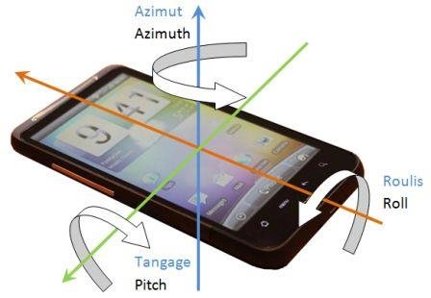
The Orientation Sensor

Slide 31

Special Note
The orientation sensor is a software sensor
It uses the accelerometer and the magnetometer
In practice it is unreliable if roll is non-zero
DEPRECATED in Android 2.2
Instead you should use the following SensorManager methods:
getRotationMatrix
getOrientation

Slide 32

Also Note
All sensors use battery power
Some use a lot, but the accelerometer uses least (and almost all devices have one)
The emulator can’t be used to test most sensors (they simply return 0)
There are sensor simulators you can use but you generally need to modify your code
Work best when using a real device

Slide 33

Summary
Android-powered devices have sensors that let you provide users with contextual information about their surroundings, including location awareness, motion, position, and qualities of the physical environment.

