Slide 1

Week 1: Android Platform
CET3013: Mobile application development

Slide 2
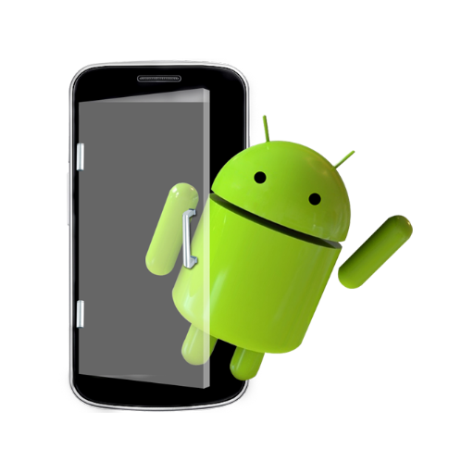
Today's lecture
The mobile ecosystem
Android basics
Android Architecture
Development Guidelines
Android Development Tools
Application Processes

Slide 3

What is Android?
Android is called as the first complete, open, and free mobile platform.
Complete: allows for rich application development opportunities.
Open: It is provided through open source licensing.
Free: Android applications are free to develop.

Slide 4
Android EcoSystem
The Android ecosystem is made up of a combination of three components:
A free, open source operating system for embedded devices
An open source development platform for creating applications
Devices that run the Android operating system

Slide 5
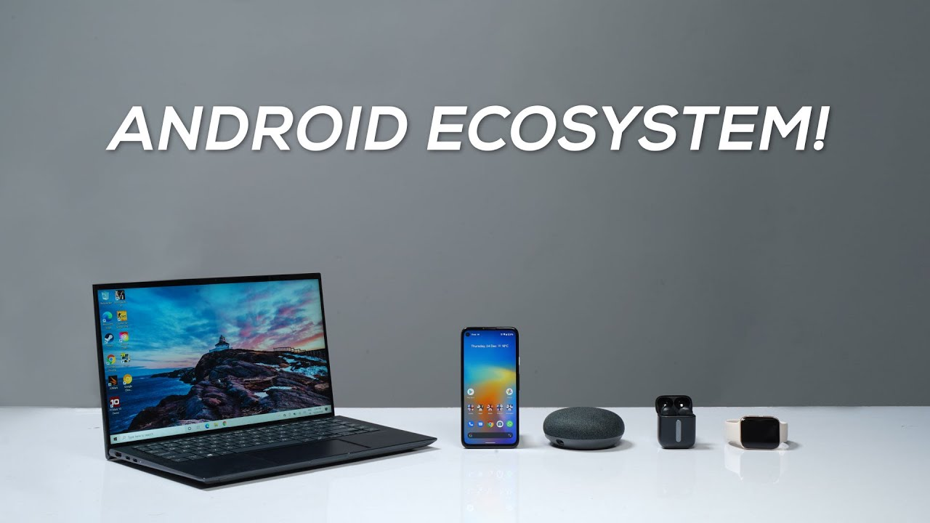
Android EcoSystem
Smartphones–using WiFi, 4G, 5G
Apple iPhone
Android (Samsung, HTC, LG, Huawei, …..)
Tablets
iPad, and many Android hardware vendors
Watches, Cars, TVs
5

Slide 6
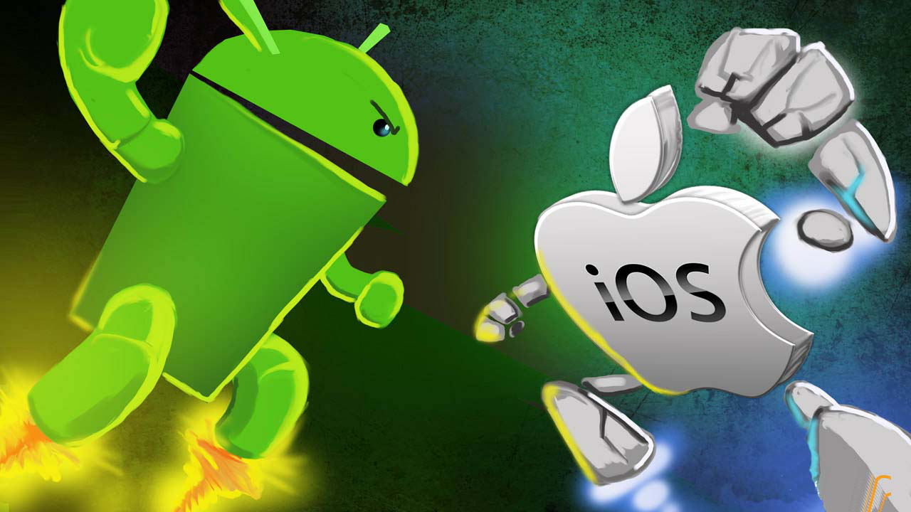
Android vs iOS development
What do you think are the most likely diﬀerences?
Programming language (Java/Kotlin/C++ vs Objective-C/SWIFT)
More “open” development—don't need a licence
MUCH more variety in handsets
This means that dealing with the variety is a real challenge

Slide 7
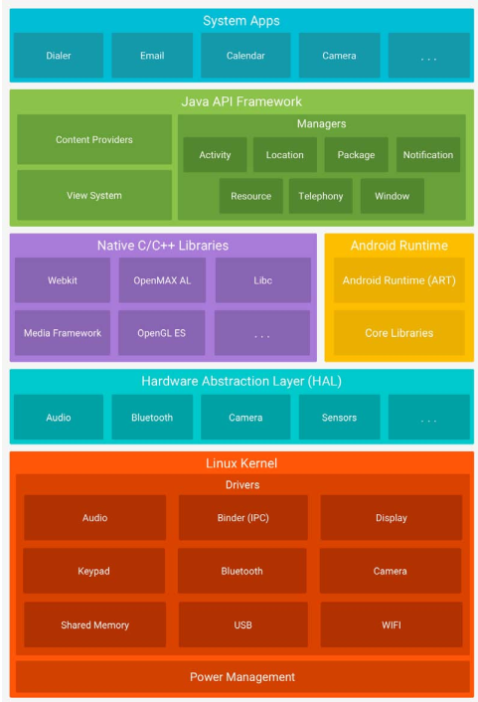

Android Architecture
Notes:
**IMPORTANT

Slide 8

The Linux Kernel
The foundation of the Android platform is the Linux kernel.
- Threading
- Low level memory management
- Security features

Slide 9

Hardware Abstraction Layer
Provide standard interfaces that expose device hardware capabilities to the higher-level Java API framework.

Slide 10

Android Runtime
For devices running Android version 5.0 (API level 21) or higher, each app runs in its own process and with its own instance of the Android Runtime (ART).
Run multiple virtual machines on low-memory devices by executing DEX files (byte code).
Ahead-of-time (AOT) and just-in-time (JIT) compilation.
Optimized garbage collection (GC)
Better debugging support
Notes:
Responsible for compile Java/Kotlin language to bytecode

Slide 11
Native C/C++ Libraries
Many core Android system components are built from native code that requires native libraries written in C and C++.
Can access OpenGL ES through the Android framework’s Java OpenGL API to add support for drawing and manipulating 2D and 3D graphics.

Slide 12
Java API Framework
The entire feature-set of the Android OS is available to you through APIs written in the Java language.
A rich and extensible View System you can use to build an app’s UI.
A Resource Manager, providing access to non-code resources such as localized strings, graphics, and layout files.
A Notification Manager that enables all apps to display custom alerts in the status bar.
An Activity Manager that manages the lifecycle of apps.
Content Providers that enable apps to access data from other apps.

Slide 13
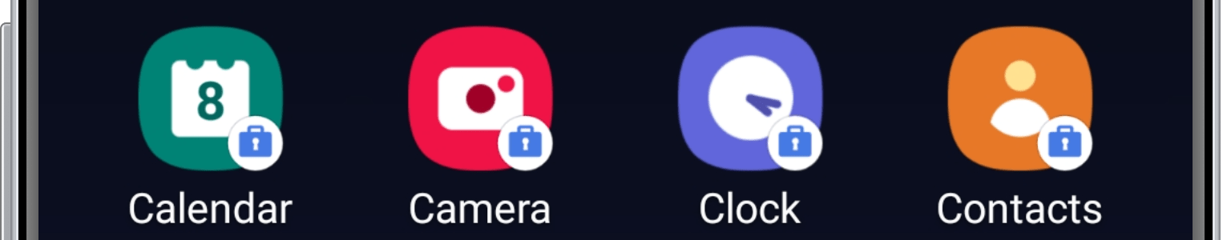
System Apps
Android comes with a set of core apps for email, SMS messaging, calendars, internet browsing, contacts, and more.

Slide 14
Developing for mobile devices
Principle diﬀerences between developing desktop applications versus developing applications for a mobile device?
Low processing power
Small screens, lower resolution
Different mobile devices with various specifications
Data transfer has high costs
Slower transfer rates with high latency
Unreliable data connections
Limited battery life
Running on the emulator doesn't necessarily match the performance on the device

Slide 15

Factors Affect App Development Time
-Design
-Compatibility
-Complexity
-Security
-Resources used
-Third-party integration
-Optimization
- User Interface & User Experience
- Resource availability
- App security and publishing the app
- App designing
- Number of screens/devices/platforms/operating systems
- Third party integration
- Features
- Complexity of the App

Slide 16
Eﬀiciency
Hardware developers proritising small size and battery life over power.
You will always need to optimise your code to run quickly and responsively.
Efficiency is particularly important for limited devices like mobile ones.
Don't do work that you don't need to do
Don't allocate memory if you can avoid it

Slide 17
Costs
Using features costs money! You need to think about how much it will cost users to use the functionality you’re providing, and to keep costs down as much as possible.
Any interaction with the outside world is likely to have an associated cost. So:
Transfer as little data as possible.
Cache data and (e.g.) GPS results.
Stop all data transfers and GPS updates if your app is not visible.
Keep refresh rates as low as possible.

Slide 18
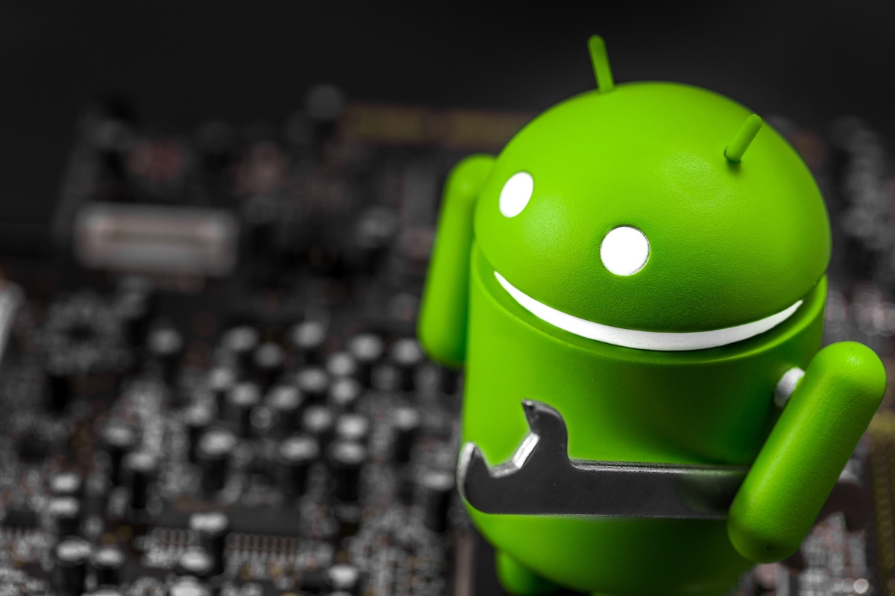
Android Development Guidelines
Performance
Responsiveness
Security
Seamlessness
Freshness
Accessibility

Slide 19
Performance
Even if it runs "fast enough", it may drain the batteries.
Users will know if your app is to blame!
Using the right data structures and algorithms helps more than anything else

Slide 20
Performance
Don't create objects you don't need to.
Particularly temporary objects (strings are a major culprit here).
Slice multi-dimensional arrays into parallel one-dimension arrays.
Creating a lot of objects forces garbage collection

Slide 21
Performance
Don't call getters or setters internally.
It takes 3 to 7 times as long if you do.
If a method doesn't access object variables, make it static.
Performance gain of 15-20%.

Slide 22
Performance
Avoid using inner classes which access members of outer classes.
Android VM 'feature' makes this expensive.
Avoid floating points when you can
2 x slower than integer arithmetic.
Library routines will normally be faster than an equivalent implementation.
For performance advice check:
https://developer.android.com/training/articles/perf-tips.html

Slide 23
Performance
Know and Use Libraries
Library code is likely safer and more optimized than hand-written code
The system can replace library calls with hand-coded assembler
Using System.arraycopy() is 9x faster on a Nexus One with JIT than a hand-coded copy loop (selfmade for loop)

Slide 24
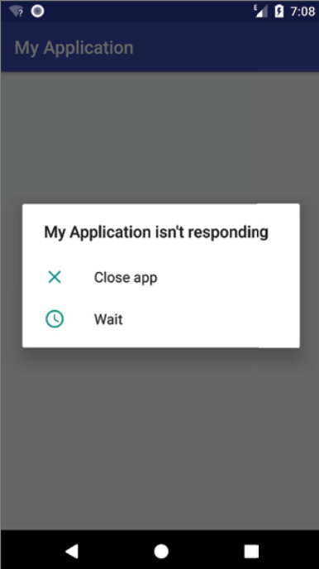
Responsiveness
Must respond to an event within 5 seconds.
BroadcastReceiver must return from its onReceive handler within 10 seconds.
Culprits
- Network Access
- Complex Processing
- File I/O

Slide 25

Security
Google Play is open (contrast the iPhone App Store).
Users need to be careful in accepting permissions requests.
From a development point of view:
Don't request permissions you don't need.
Require permissions from users if you publish Services or broadcast Intents.
Take care with input from external sources.

Slide 26
Seamlessness
Don't have a background process display a dialog–use a Notification instead.
Don't drop data.
Don't start Activities from Services or Broadcast Receivers. Use System Themes.
Support multiple screen resolutions.
Save the battery.
Don't do work you don't need to do.
Don't use the network if you don't need to.

Slide 27

Freshness
How often will update its data and apps.
Minimize the time users are waiting for refreshes or updates.
Job Scheduler to update application in background.

Slide 28

Accessibility
Support for users with disabilities.
- People with visual, physical, or age related disabilities
Facilities to help these users navigate their devices: - text-to-speech
- haptic feedback
- Trackball or D-pad navigation

Slide 29

Development Tools
The Android Virtual Device Manager and Emulator
- To create and manage AVDs, virtual hardware
The Android SDK Manager
- Download SDK packages
Gradle
- manages the compilation, packaging and deployment of your applications
Vector Asset Studio
- Generates bitmap files for each screen density

Slide 30

Development Tools
Logcat
- A utility used to view and filter the output
SQLite
- A database tool that you can use to access the SQLite database files
Android Debug Bridge (ADB)
Link between your host computer and virtual and physical Android devices \
Lint
- A static analysis tool that analyzes your application and its resources

Slide 31
Application Basic
By default, every application runs in its own Linux process.
Android starts the process when any of the application’s components need to be executed, then shuts down the process when it’s no longer needed or when the system must recover memory for other applications.

Slide 32
Application Life Cycle
Applications have a lot less control over their life cycles than in most other environments.
They need to be prepared to listen for changes in the application state and react accordingly.
Untimely termination is a likely

Slide 33
Application Priority
Android does whatever it takes to remain responsive.
Processes are killed – often without warning -- to free resources for higher-priority processes.
Generally high-priority processes are those interacting with the user—usually only one.
An application’s priority is equal to that of its highest-priority component.
If one application depends on resources provided by another, the secondary application has at least as high a priority.

Slide 34
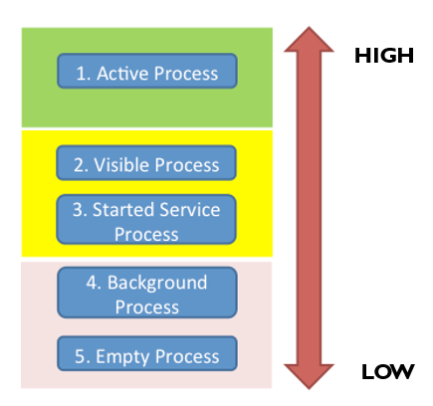
Application Priority
Active Process
- Have a component interacting with the user.
- Few in number (often only one).
Visible Process
- Component visible but
not in foreground (partially obscured).

Slide 35
Application Priority
Started Service Process
- Hosting a service which has been started.
- Supports processing that doesn’t require a UI.
Background Process
- Not interacting, not a running service.
- Killed if necessary.
Empty Process
- Hosted application has terminated.

Slide 36
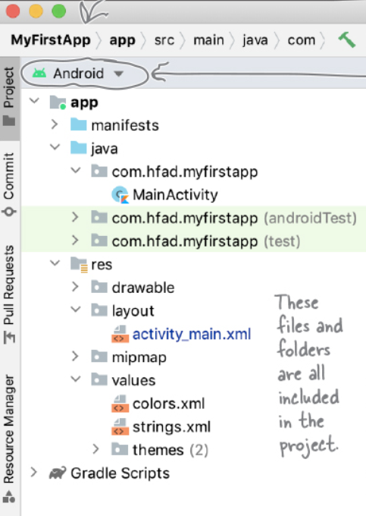
Resources
In Android development, “resources” are usually defined in XML files instead of code.
What are resources? They include:
Values: Strings, Colours and Arrays
Menus
Layouts
“Drawables” (bitmap graphics)
Others…

