Slide 1

Android Application Development
CET3013

Slide 2

What is Android?
Phone Brand
Operating System
Ecosystem
Platform

Slide 3








Some Android History
2003 | Founded by Android Inc.
2005 | Acquired by Google
2007 | Launch of Open Handset Alliance

Slide 4
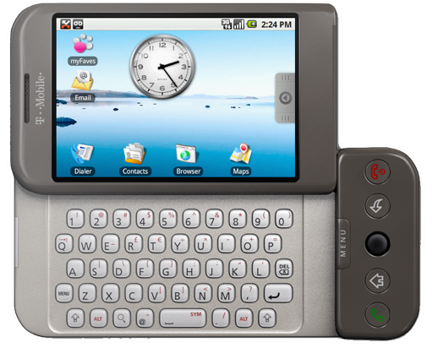
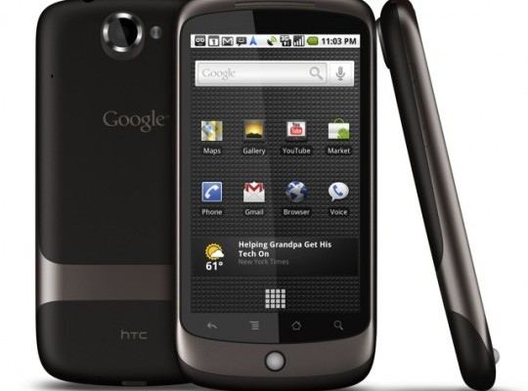
Some Android History
2008 | First Android Device (HTC Dream / G1) 528Mhz ARM 256mb RAM 3.2" screen at 320x480px
2010 | First Nexus Device (Nexus One) 1Ghz Scorpion 512mb RAM 3.7" screen at 480x800px

Slide 5
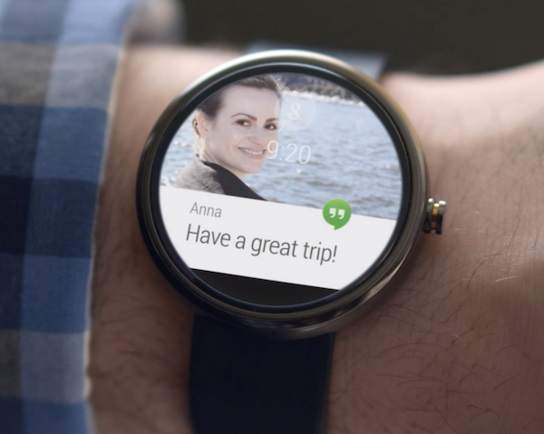
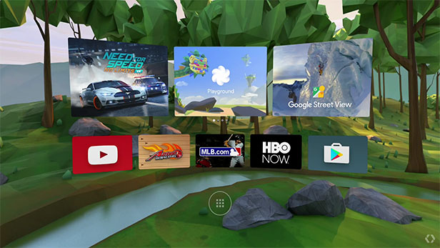
Some Android History
2014 | Android Wear
2016 | Daydream ("Android VR")

Slide 6
Android Versions
Date | Version | Nickname | API Level
Sep 2008 | 1.0 | Android | 1
Apr 2009 | 1.5 | Cupcake | 3
Sep 2009 | 1.6 | Donut | 4
Oct 2009 | 2.0 | Eclair | 5
May 2010 | 2.2 | Froyo | 8
Dec 2010 | 2.3 | Gingerbread | 9
Feb 2011 | 3.0 | Honeycomb | 11
Oct 2011 | 4.0 | Ice Cream Sandwich | 14
July 2012 | 4.1 | Jelly Bean | 16
Oct 2013 | 4.4 | KitKat | 19
Nov 2014 | 5.0 | Lollipop | 21
Oct 2015 | 6.0 | Marshmallow | 23
Aug 2016 | 7.0 | Nougat | 24
Aug 2017 | 8.0 | Oreo | 26
Aug 2018 | 9.0 | Pie | 28
Sep 2019 | 10.0 | Android 10 (Quince Tart) | 29
Sep 2020 | 11.0 | Android 11 (Red Velvet Cake) | 30
Oct 2021 | 12.0 | Android 12 (Snow Cone) | 31
Aug 2022 | 13.0 | Android 13 (Tiramisu) | 33
Q3 2023 | 14.0 | Android 14 (Upside Down Cake) | 34

Slide 7
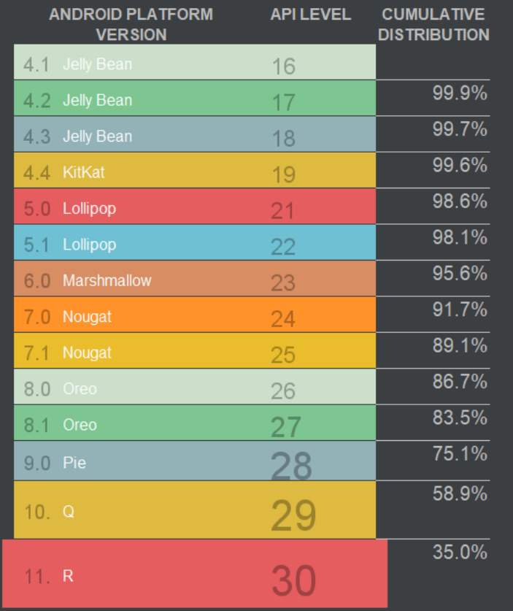
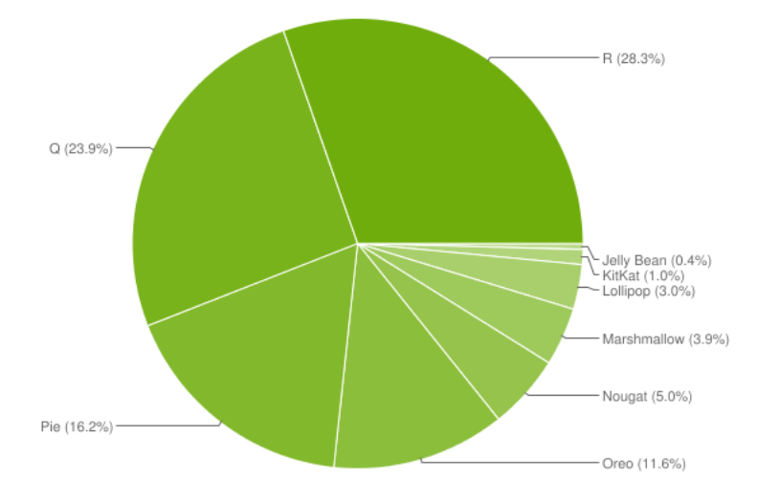
Android Versions
https://9to5google.com/2022/05/20/android-2022-distribution-numbers-chart/

Slide 8

https://source.android.com/

Slide 9
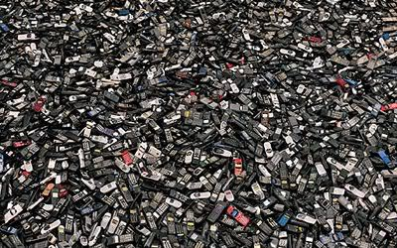
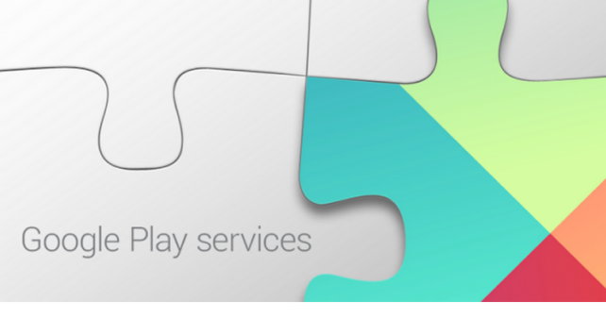
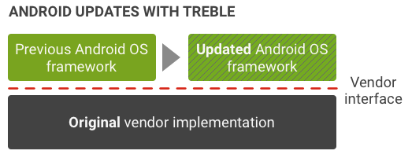
Upgrading Versions
Updates through purchasing new devices
Reliant on carriers… but some work to change that

Slide 10

Legal Battles
vs.
Claim: Java API is copyrighted, so Google violated that by using it in Android (see EFF)

Slide 11


Slide 12
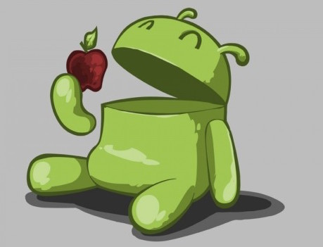

Slide 13
Building Apps: Dalvik
Dalvik Pre-Lollipop (5.0)
Register-based architecture
bytecode stored in DEX or ODEX files
Just-In-Time compilation to native code
Java Code
compile
DVM bytecode
JVM bytecode
"dexing"

Slide 14
Building Apps: ART
Android RunTime (ART) Post-Lollipop
Compile into native code on installation ("Ahead Of Time")
Accepts DEX bytecode (for backwards compatibility)
https://source.android.com/devices/tech/dalvik/

Slide 15

Packaging Apps: APKs
Basically .zip files
Cryptographically signed
"side-load" or upload to Play Store

Slide 16
Building Process
Generate Java source files (e.g., R) from the XML resource files
Compile the Java code into JVM bytecode
“dex” the JVM bytecode into Dalvik bytecode
Pack code and other assets into an .apk
Cryptographically sign the .apk file to authorize it
Transfer the .apk to your device, install, and run it!

