Slide 1

Week 1: Introduction to Kotlin
CET3013: Mobile application development

Slide 2
Kotlin Programming
A statically typed language that is interoperable with Java
Developed and maintained by IDEA
v1.0 (stable) released in Feb 2016. Officially supported in Android Studio Oct 2017

Slide 3
Kotlin Programming
Kotlin is built into Android Studio, but only in the context of writing Android software.
Options for running "stand-alone" Kotlin include:
Android Studio ("Tools > Kotlin > Kotlin REPL")
https://try.kotlinlang.org/ online sandbox
IntelliJ Community Edition IDE
On the command line with (gradle)

Slide 4
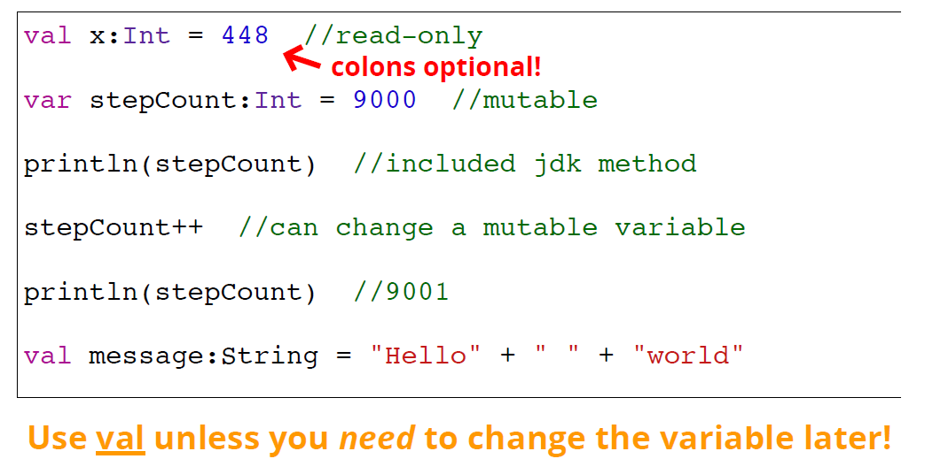
Kotlin Programming
Kotlin variables are declared with val (for immutable variables) or var (for mutable variables). Type is declared after the variable name, following a colon:

Slide 5
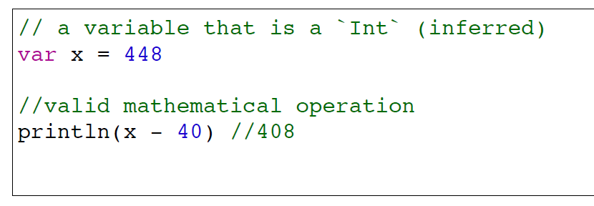
Kotlin Programming
The Kotlin compiler can often infer (automatically determine) type from an assigned value, so the type may be omitted. But it is useful to annotate all of your variables.

Slide 6
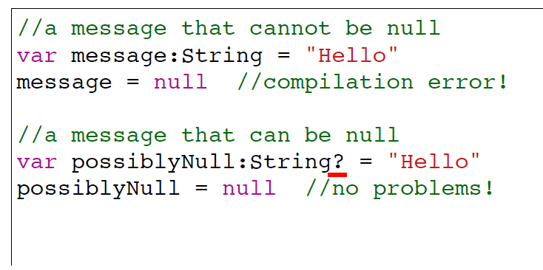
Kotlin Programming
Kotlin boasts support for null safety (avoiding NullPointerExceptions). Null values will cause compiletime errors unless explicitly allowed with a ?

Slide 7
Kotlin Programming
//Conventional way in Java
if (shareActionProvider != null) {
shareActionProvider.setShareIntent(shareIntent);
}
//Simplify way
shareActionProvider?.setShareIntent(shareIntent)

Slide 8
Kotlin Programming
If you’re sure a nullable reference is not null, feel free to use the !! operator to dereference your object.
val message = textObject!!.text

Slide 9
Kotlin Programming
The Elvis Operator (?:) looks like the ternary conditional operator in Java but works differently.
val len: Int
if(coverId?.length != null) {
len = coverId?.length
} else {
len = 0
}
val len = coverId?.length ?: 0

Slide 10
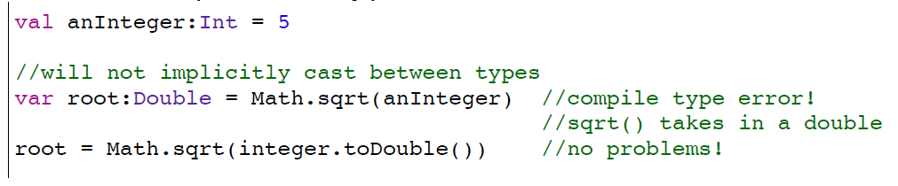
Kotlin Programming
Kotlin uses mostly the same basic data types as Java.
Numeric values are instances of the Int and Double classes, not primitive types.

Slide 11
Kotlin Programming
Built-in Data Types
Number
Character
String
Boolean
Array

Slide 12
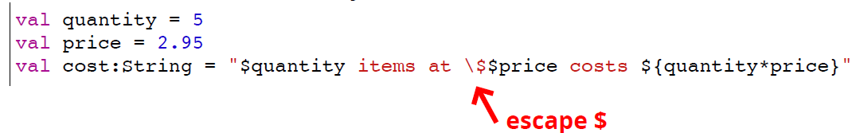
Kotlin Programming
Strings support string template ; variables prepended with a $ will automatically be evaluated.

Slide 13
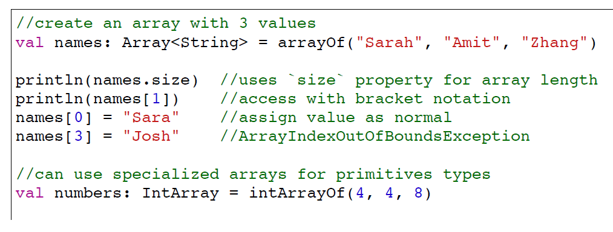
Kotlin Programming
Kotlin arrays are represented by the Array<T> class (similar to the ArrayList class, but fixed length).
The arrayOf() function is usually used to create arrays.
Note that because Array<T> is a class, it has methods!

Slide 14
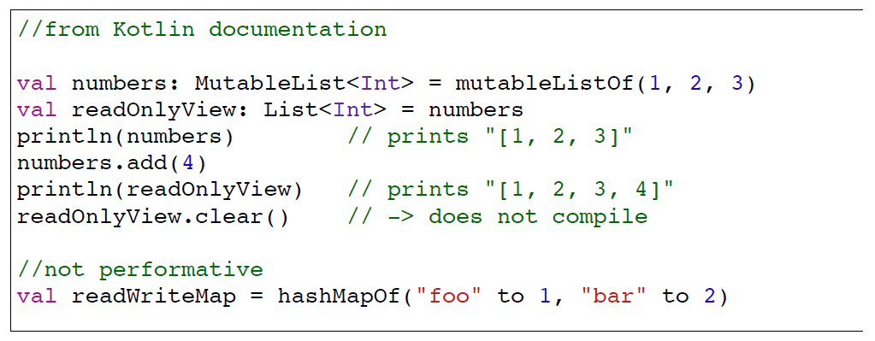
Kotlin Programming
Kotlin also provides a List<T> class representing a variable-length list (like an ArrayList), and a Map<K,V> class representing a map (like a HashMap). There are mutable versions of each (MutableList<T>)

Slide 15
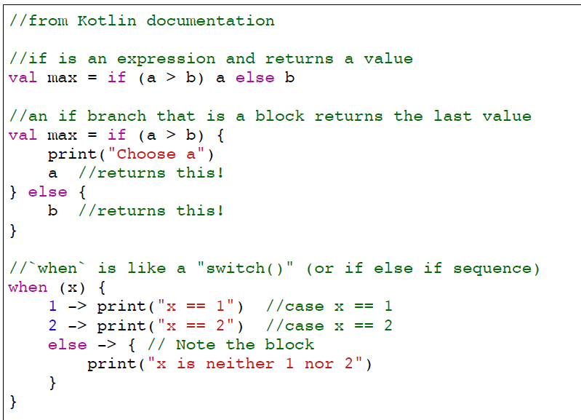
Kotlin Programming
Kotlin has same control structures as Java, with a few additional options

Slide 16
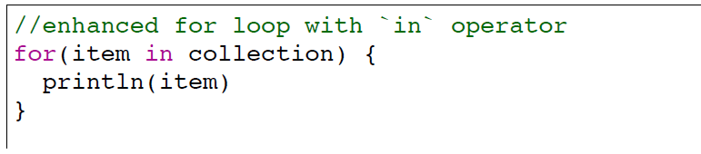
Kotlin Programming
Kotlin has a nicer "enhanced for loop" for iterables.

Slide 17
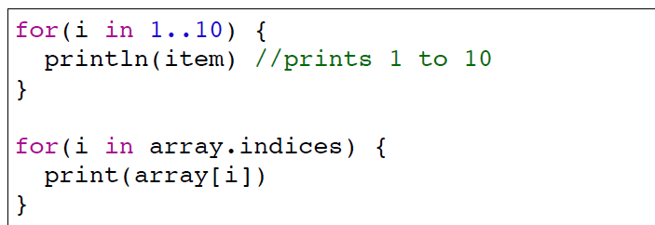
Kotlin Programming
Kotlin supports of numbers (e.g., 1,2,3,4,5) created with the .. operator. The indices property of an array is a range. These are very useful with for loops.

Slide 18
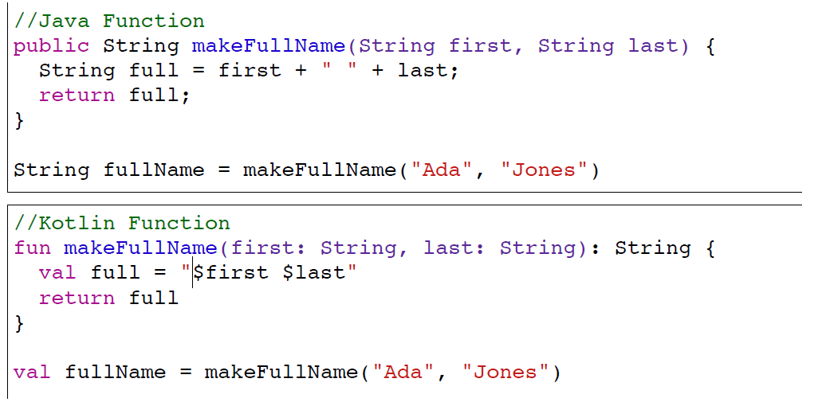
Kotlin Programming
Kotlin functions are declared with the fun keyword, and list return type after the parameter list.

Slide 19
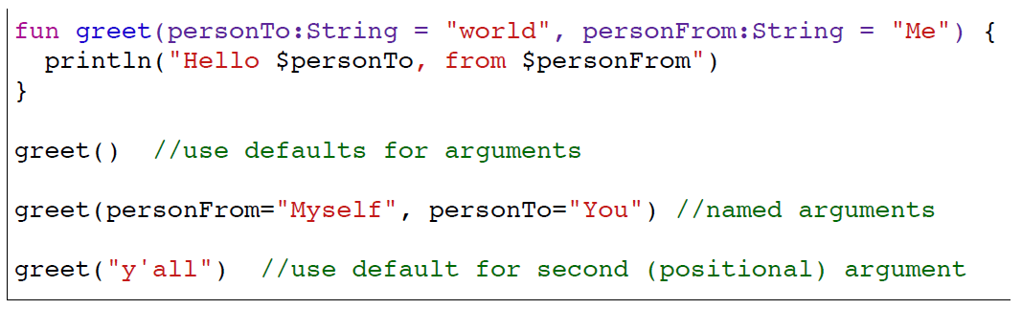
Kotlin Programming
Kotlin supports named arguments, specifying a default value for that argument variable. Named arguments may be given out of order. Defaults are used if a positional argument is omitted.

Slide 20
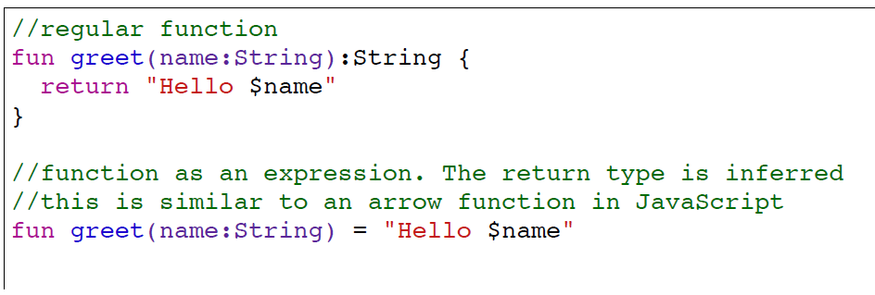
Kotlin Programming
What makes Kotlin functions hard is how much of the syntax can be omitted if the compiler can infer information. This includes data types, but even things like blocks (so functions can be written as expressions)

Slide 21
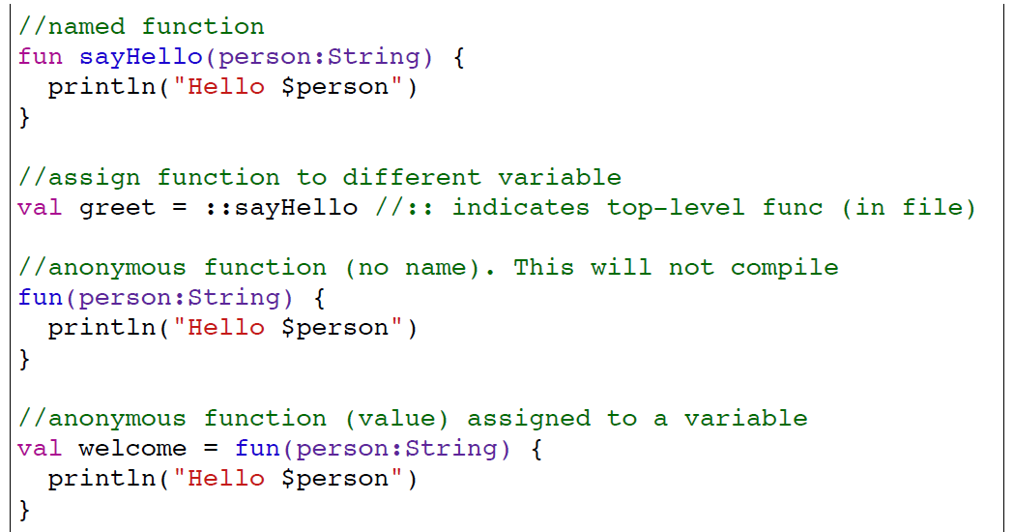
Kotlin Programming
Like JavaScript, Kotlin supports higher order anonymous functions, which can be assigned to variables or passed into functions. Make it anonymous by omitting the name

Slide 22
Kotlin Programming
Kotlin also supports Java 8 style lambda functions, which are like "function literals" (anonymous functions that are immediately passed in. Lambda are written in {}, with an arrow -> used to separate the value and the block.

Slide 23
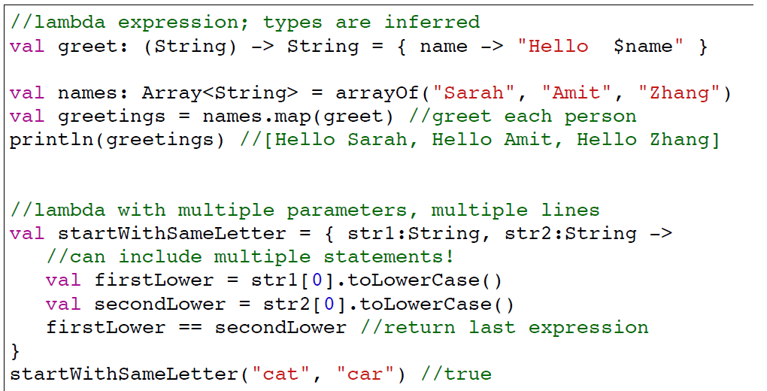
Kotlin Programming

Slide 24
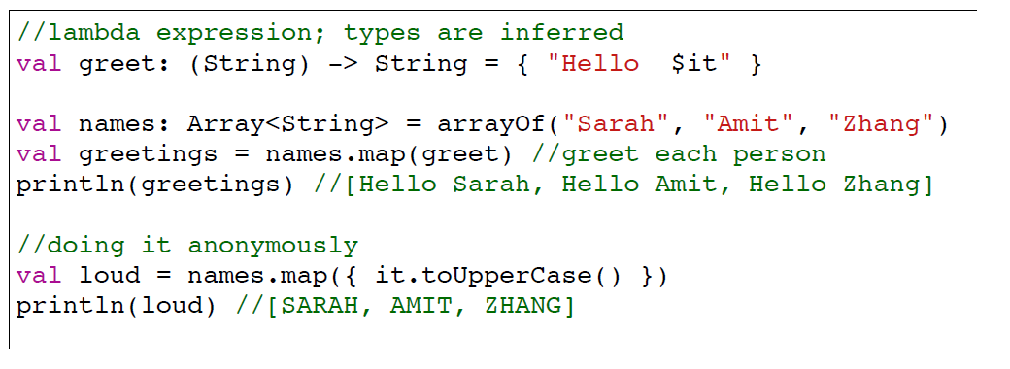
Kotlin Programming
Lambdas often only have a single parameter, and if the compiler can infer its type, you can leave off the parameter list and refer to that param as it.

Slide 25
Kotlin Programming
Kotlin classes have a primary constructor, the parameters of which can be included as part of the class declaration.
//declares a class `Dog` whose constructor takes two parameters
class Dog(name:String, breed:String) {
var name = name //assign to properties
var breed = breed
}
//shortcut way
class Dog(var name:String, var breed:String) {
}

Slide 26
Kotlin Programming
Objects in Kotlin are instantiated by simply calling the constructor as a normal function, without the new keyword.
//declares a class `Dog` whose constructor takes two parameters
val myDog = Dog("Fido","mutt") //no new keyword!
myDog.name //"Fido"
myDog.breed //"mutt"

Slide 27
Kotlin Programming
We can specify a classes inheritance by putting the parent type after a colon (:) in the declaration.
//Inheritance
class Dog(name:String, breed:String) : Animal {
}

Slide 28
Kotlin Programming
Kotlin requires us to explicitly mark classes as “subclassable” (they are otherwise compiled to final classes). We do this by using the open keyword as an annotation in the class declaration.
//declare class as open
open class Animal(var name:String) { }
//constructor parameters can be passed to parent constructor
class Dog(var name:String) : Animal(name) { }

Slide 29
Kotlin Programming
Data Classes are declared using the data keyword as an annotation in the class declaration. These are classes that do nothing but hold data.
//declare class as open
data class Ball(var x:Int, var y:Int, val color:String)
val myBall = Ball(30,30,"red")
print(myBall) //Ball(x=30, y=30, color=red)
The compiler will automatically provide implementations of toString() and equals() for these classes!!!

Slide 30
Kotlin Programming
Anonymous classes (called Object expressions) can be created with the object keyword in place of a class and the class name.
//declare class as open
button.addActionListener(object : ActionListener() {
//class definition (including methods to override) goes in here!
override fun actionPerformed(ActionEvent event) {
//...
}
});

Slide 31
Kotlin Programming
A Kotlin class can also contain a companion object. A companion object contains methods and variables that are common to all instances of the class. It is similar to static member in Java.
//Java
class MyClass {
public static int counter = 1;
public static void showCount() { System.out.println("counter = " +
counter) } }
//Kotlin
class MyClass { fun showCount() { println("counter = " + counter) } companion object { var counter = 1 } }

Slide 32
Kotlin Programming
The End

