Slide 1

Week 2: Creating Application
CET3013: Mobile application development

Slide 2

Today’s Topics
An Android Application?
Activities
Layouts
UI design and views

Slide 3
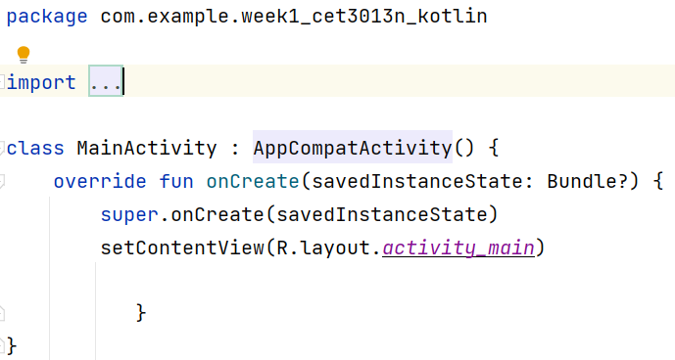
Main Template Launch Code
This file is in MainActivity.kt
What's an Activity?
Where's the main method?
Where does it say to print "Hello World!” ?

Slide 4
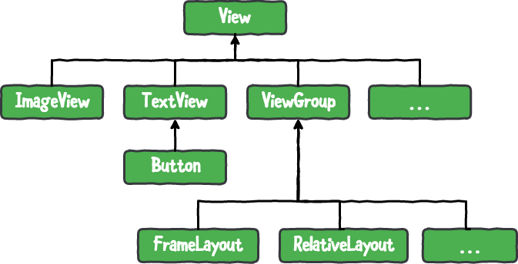
Views, ViewGroups & Layouts
A View is the Android term for a user-interface element.
  - We’ll see more about Views later.
A ViewGroup is a special kind of View that can have one or more children.
Layouts are subclasses of ViewGroup.

Slide 5
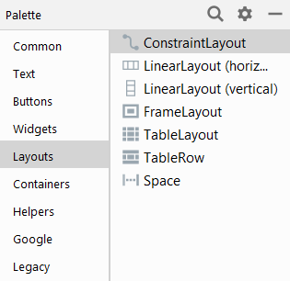
Layouts
Similar to the layout managers in Swing.
There are:
  AbsoluteLayout
  LinearLayout -> Like FLowLayout
  RelativeLayout-> Location, my left hand side
  ConstraintLayout, etc (linking->spring tight)
In best practice, they are defined in XML.
Layouts can be nested.

Slide 6
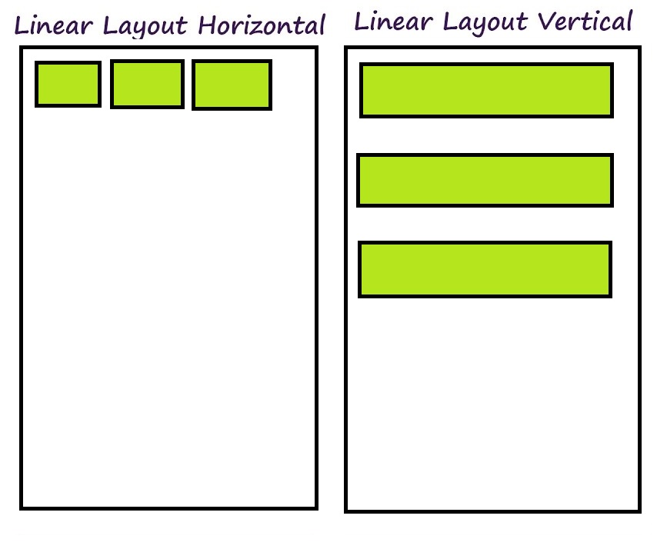
LinearLayout
Has any number of children, all arranged in the same direction
  Depending on the orientation: horizontal or vertical.
No matter how many children there are, there will only ever be one row or column, no matter the sizes of the individual views.
It respects, for its children:
  Margins
  Gravity
    Right, Centre or Left Alignment

Slide 7
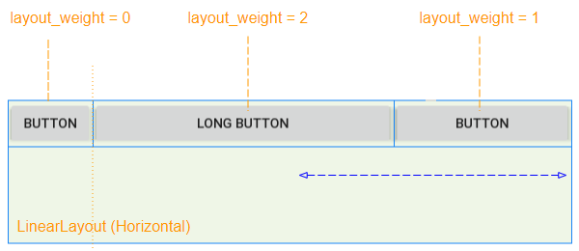
LinearLayout
We can assign a weight to individual children.
Determines how much space they take up.
Example:
  Three buttons, weights 0, 2, and 1
    The first button only takes up the space required by its content.
    The second and third buttons take up the remaining space.

Slide 8
RelativeLayout
Child positions are specified relative to other children, using their IDs.
Flexibile, powerful but rather more complex.
GridBagLayout in Swing (ever used it?)

Slide 9
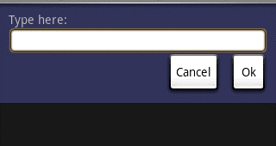
RelativeLayout Example

Slide 10
Constraint Layouts
New in Studio 2.2!
ConstraintLayout is a view group available in the Constraint Layout library,
  Claimed should never need to edit the XML by hand.
Constraint-based layout system allows you to build most layouts without nested any view groups.
Recommended you should convert older layouts to ConstraintLayout for improved layout performance,

Slide 11
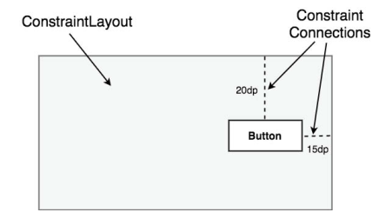
Constraint Layouts

Slide 12
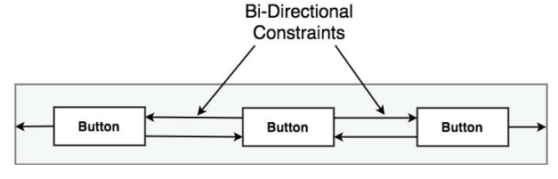
Constraint Layouts
ConstraintLayout chains provide a way for the layout behavior of two or more widgets to be defined as a group.
Chains can be declared in either the
vertical or horizontal axis and configured to define how the widgets in the chain are spaced and sized.

Slide 13
Constraint Layouts
ConstraintLayout class currently supports the following chain layout styles:
  Spread Chain
  Spread Inside Chain
  Weighted Chain
  Packed Chain

Slide 14
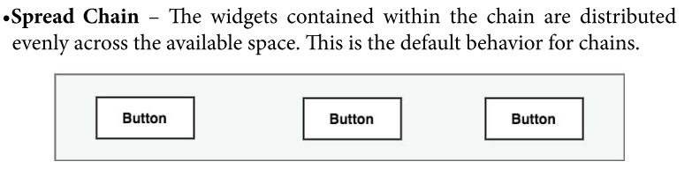
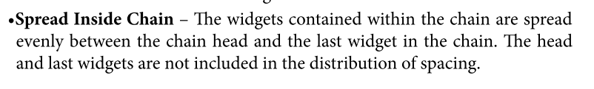
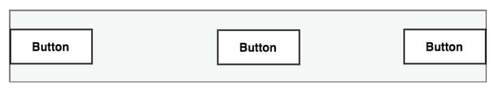
Constraint Layouts

Slide 15
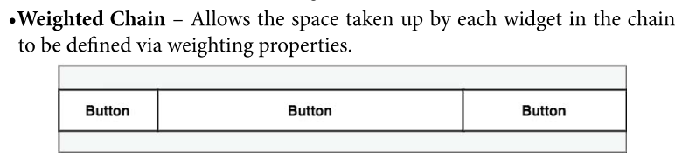
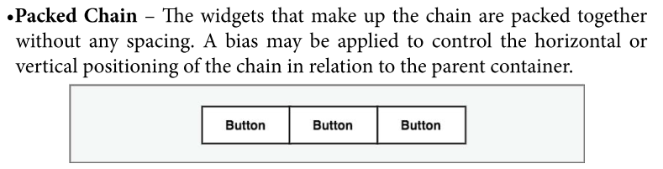
Constraint Layouts

Slide 16

Advantages of Constraint Layouts
ConstraintLayout provides a level of flexibility and reduce nedsted layout.
ConstraintLayout was also implemented with a view to addressing the wide range of Android device screen sizes available on the market today.
ConstraintLayout makes it easier for user interfaces to be designed that respond and adapt to the device on which the app is running.

Slide 17
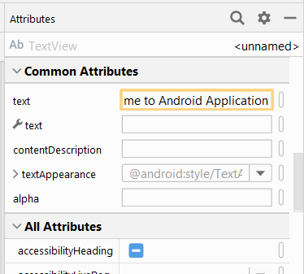
Specifying Layouts: Attributes
Views and ViewGroups have a number of attributes which can be set.
We will look at several of these.

Slide 18
Layout Attributes: ID
android:id="@+id/my_button"
Used to identify a View or ViewGroup.
  @ Parse the rest of the string.
  + Create a new ID in the R.java file.
This ID could be referred to in code:
val myButton = findViewById<Button>(R.id.my_button)

Slide 19
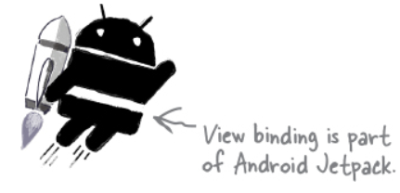
Android View Binding
Before Android Studio 3.6, the only option for gaining access to a view from within the app code involved writing code to manually find a view based on its id via a method named findViewById(). For example:
val exampleView = findViewById<TextView>(R.id.exampleView)

Slide 20
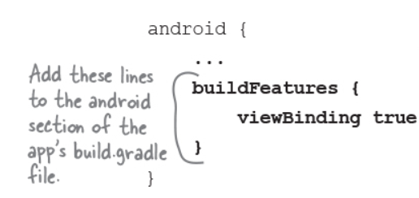
Android View Binding
When view binding is enabled in an app module the layout views can be accessed from within the code without the need to use findViewById.
Enable the view binding in build gradle file.

Slide 21
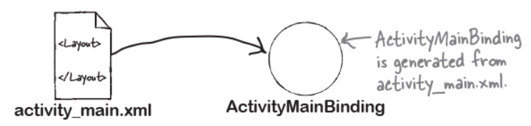
Android View Binding
The binding class name will be same as the layout file name but in “camel case”.

Slide 22
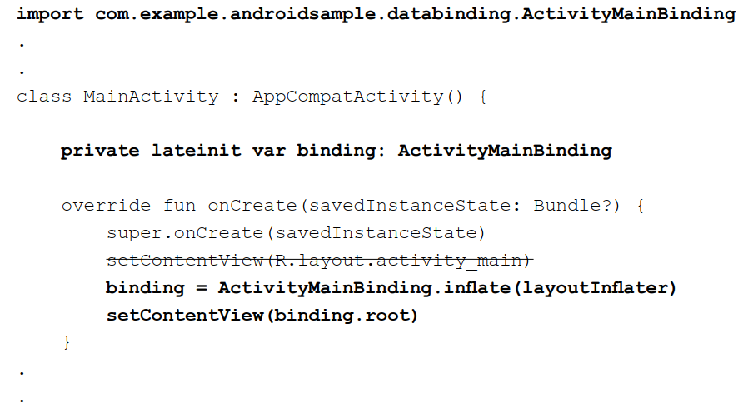
Android View Binding
Example:

Slide 23
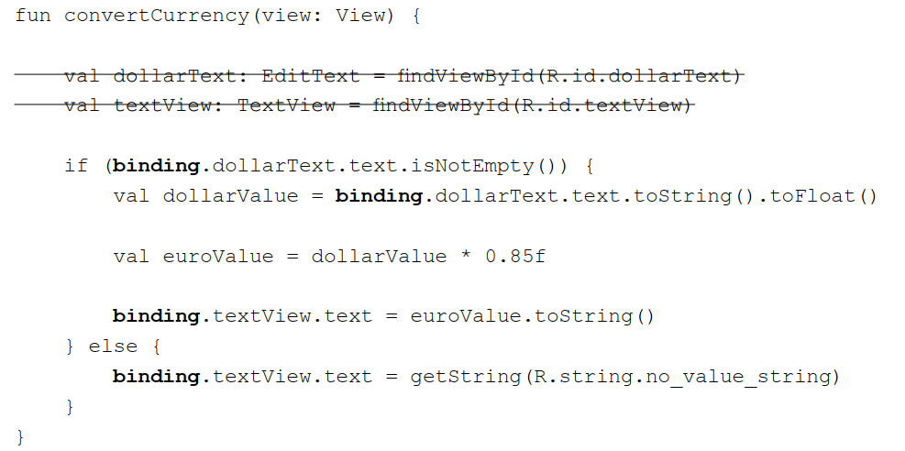
Android View Binding
Example:

Slide 24
Layout Attributes:
layout_width
layout_height
These need to be specified for all Views.
Most often we specify either:
wrap_content:
  The View is sized according to its content
match_parent:
  The view becomes as big as its parent allows it to be.

Slide 25
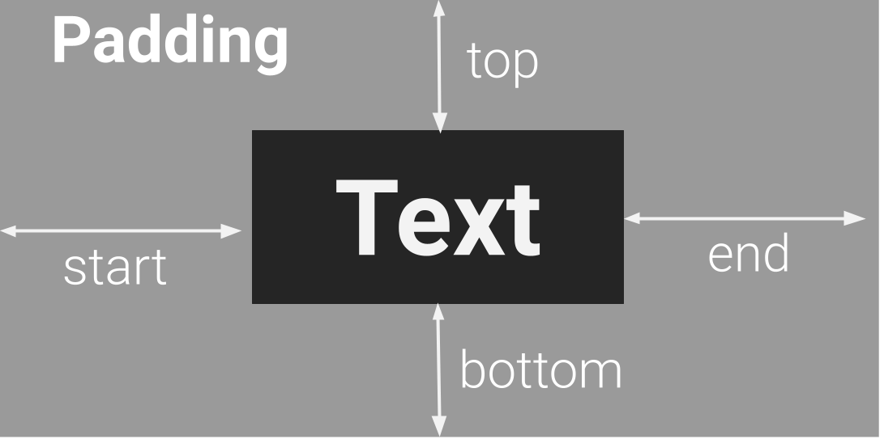
Layout Attributes: Padding
We can also specify padding—the amount of space around a view.

Slide 26

Views
Event Handling
Types of View
Examples
Alerts

Slide 27
Event Handling
Uses listeners in a similar way to Swing/AWT (although the events covered and the handler parameters are different).
It can often be a good idea not to create anonymous inner classes but to pass this to the add…Listener method.
Since all the event handlers have the View which received the event as a parameter you can use findViewById() to find which it was.

Slide 28
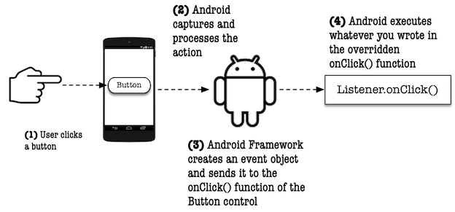
Event Handling
Source: https://workingdev.net/java/android/2020/04/23/event-handling-android.html

Slide 29
Principal Event Handlers
Listener | Details | Public Method to implement
onClickListener | Responds to a click | void onClick(View v)
onLongClickListener | Responds to a long click | boolean onLongClick(View v)
onKeyListener | Respond to a Key Event | boolean onKey(View v, int keyCode, KeyEvent event)
onTouchListener | Respond to a touch | boolean onTouch(View v, MotionEvent event)
Methods which return a boolean should return true if the event has been “consumed”.
There are a couple of others—and several additional ones for later versions of Android.
Notes:
Consuming an event—an event has been “consumed” if you’ve handled it and no further processing is required.
Others are for focus change and creation of a context menu. See http://developer.android.com/ for details.

Slide 30
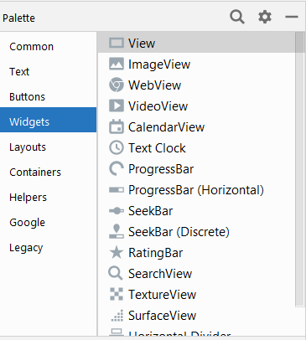
Types of View
TextView
EditText
ListView
Spinner
Button
CheckBox
RadioButton
RadioGroup
ViewFlipper
QuickContactBadge
AnalogClock, DigitalClock
KeyboardView
ProgressBar
DatePicker, TimePicker
ScrollView
WebView
There are several others too—some of which we will meet the labs.

Slide 31
EditText
This example uses an EditText to enable the user to enter a string of text.
When Return is pressed, the string is displayed using a Toast.
Notes:
A Toast is a short-lived pop-up message.

Slide 32
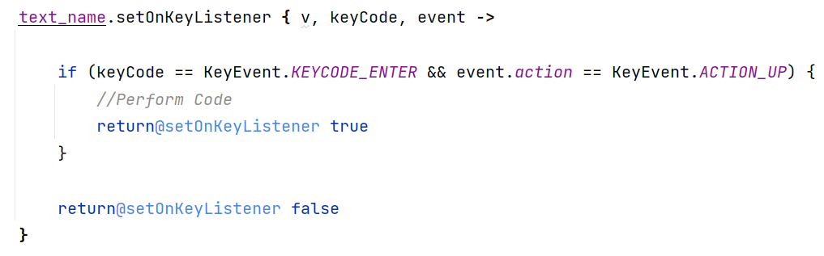
EditText

Slide 33
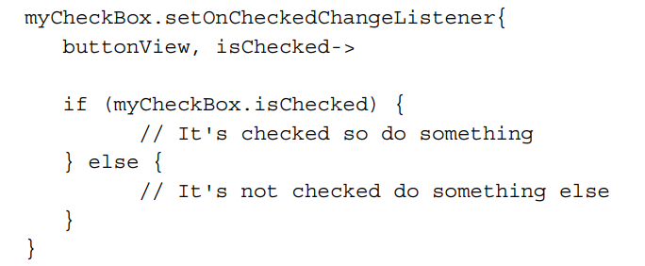
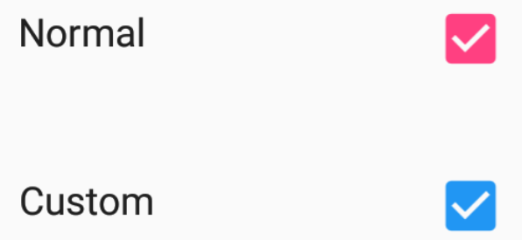
CheckBox

Slide 34
RadioButtons—Layout
<RadioGroup
android:layout_width="fill_parent"
android:layout_height="wrap_content"
android:orientation="vertical">
<RadioButton android:id="@+id/radio_red"
android:layout_width="wrap_content"
android:layout_height="wrap_content"
android:text="Red" />
<RadioButton android:id="@+id/radio_blue"
android:layout_width="wrap_content"
android:layout_height="wrap_content"
android:text="Blue" />
</RadioGroup>
Notes:
The RadioGroup element is used to make the two radio buttons mutually exclusive.

Slide 35


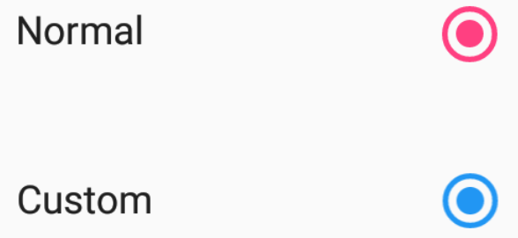

RadioButtons—Code
//TODO CODE:

Slide 36
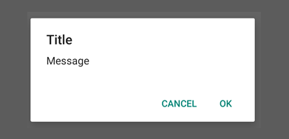
Alert Dialogs
Creating a dialog
  All of AlertDialog’s constructors are protected.
  What to do?
    Use AlertDialog.Builder.
  Should be created in an override of the Activity method onCreateDialog(int).
Showing a dialog
  Call showDialog(int), passing the ID of the dialog you want to show.

Slide 37
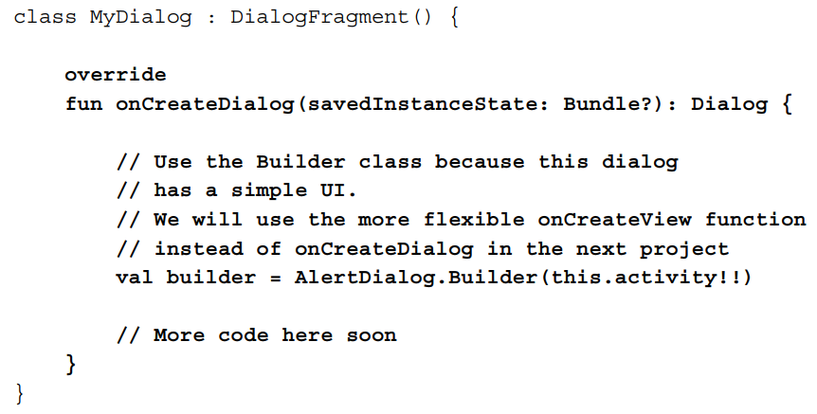
Alert Dialogs

Slide 38
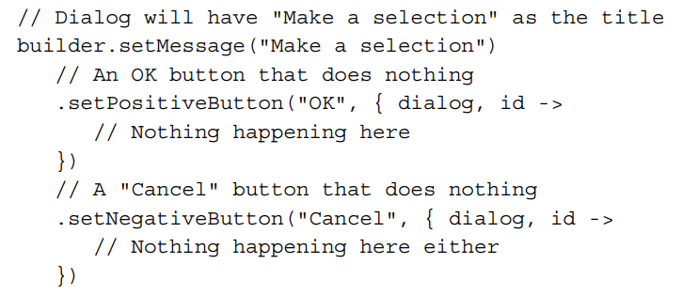

Alert Dialogs
More code here soon

Slide 39
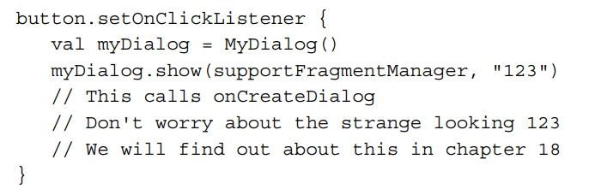
Alert Dialogs
Displaying Dialog

Slide 40
Resolution and Density Independence
Unlike (say) iDevices, there is a very wide range of Android devices with different capabilities.
We want our applications to run unmodified on as many as possible (why?)
Screen sizes from 3in to 10in
Different resolutions
Android offers support!

Slide 41
Resolution and Density Independence
Makes use of the optional sequences to resource files.
  Screen size: small, medium, large
  Resolution
    Ldpi – 120px
    Mdpi – 160px
    Hdpi – 240px
    Xhdpi – 320px

Slide 42
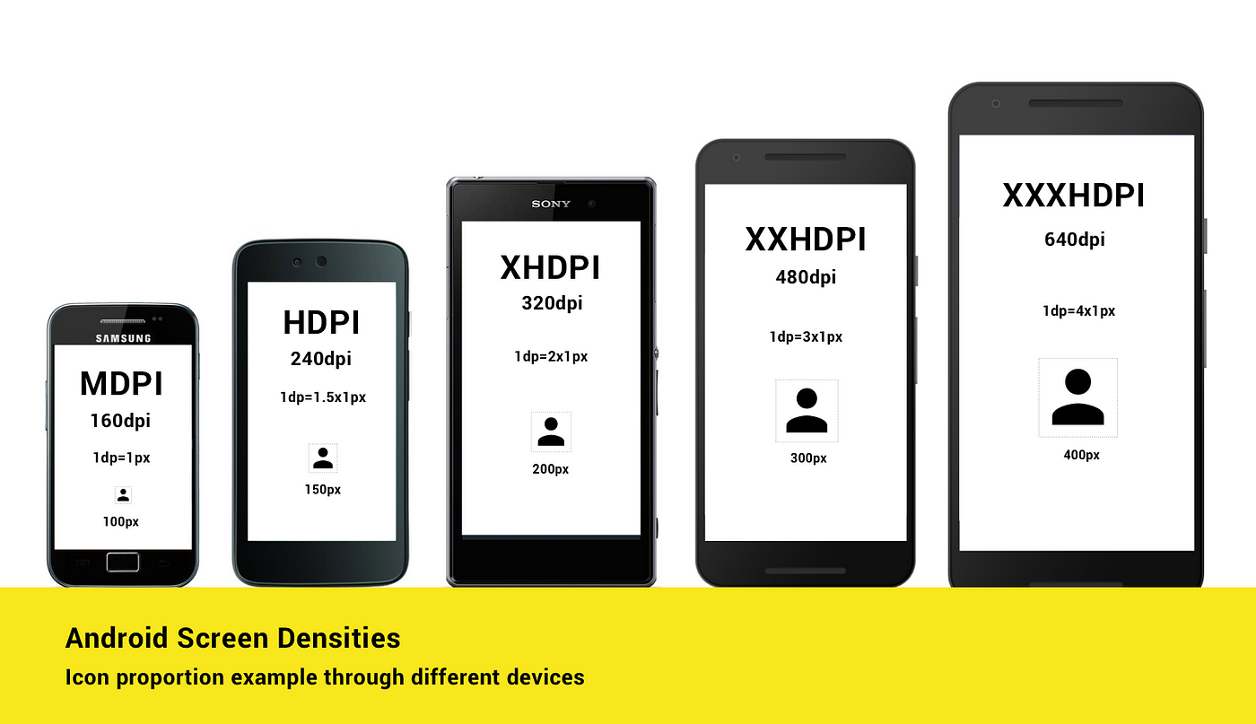
Resolution and Density Independence

