Slide 1

Week 3: Activity & Intent
CET3013: Mobile application development

Slide 2

Today’s Topics
Intents
Activities
The Android Manifest File
Activity Life Cycle

Slide 3

Intents
What they are
Starting activities
Implicit Intents
Returning results
Native actions

Slide 4
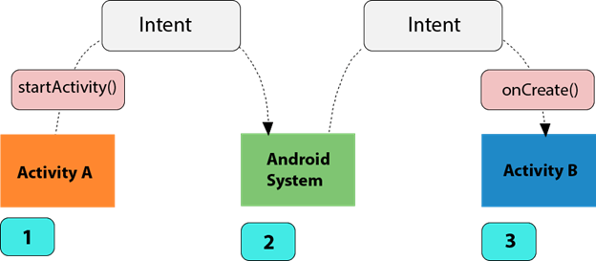
Intents
A message-passing mechanism which can:
Explicitly start an Activity or Service—not necessarily one in your application
Broadcast that something has happened
Request that an Activity or Service be started to perform a specific action with or on some data
“Intent resolution”

Slide 5
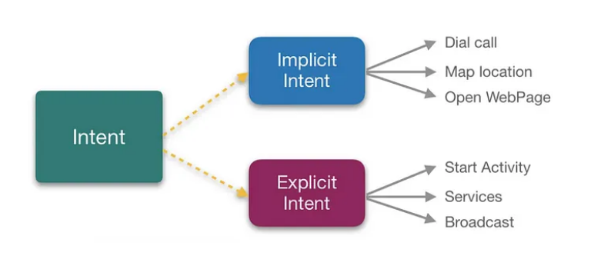
Intent
Source: https://alishabindal.medium.com/intents-in-android-9331dc8f5f81

Slide 6
Explicitly starting an Activity
Use startActivity method, passing an appropriate Intent.
Your Activity is not notified when the Activity which has been started completes.
If this matters then you use startActivityForResult instead.
Example
val intent = Intent(this, MyOtherActivity::class.java)
startActivity(intent)

Slide 7
Implicit Intents
Instead of specifying a specific Activity to start, you can simply specify an action to be performed with or on some data (tel no, email, url, text, images).
Android determines the Activity to start using “intent resolution”.
This is widely used by many of the native Android applications.

Slide 8

Implicitly starting an Activity
//Open browser to view the page
val intent = Intent(Intent.ACTION_VIEW, Uri.parse(“https://www.kdupg.edu.my”))
startActivity(intent)
//Open caller to dial the telephone number
if (somethingWeird && itDontLookGood) {
val intent = Intent(Intent.ACTION_DIAL, Uri.parse("tel:123-4567"))
startActivity(intent)
}

Slide 9
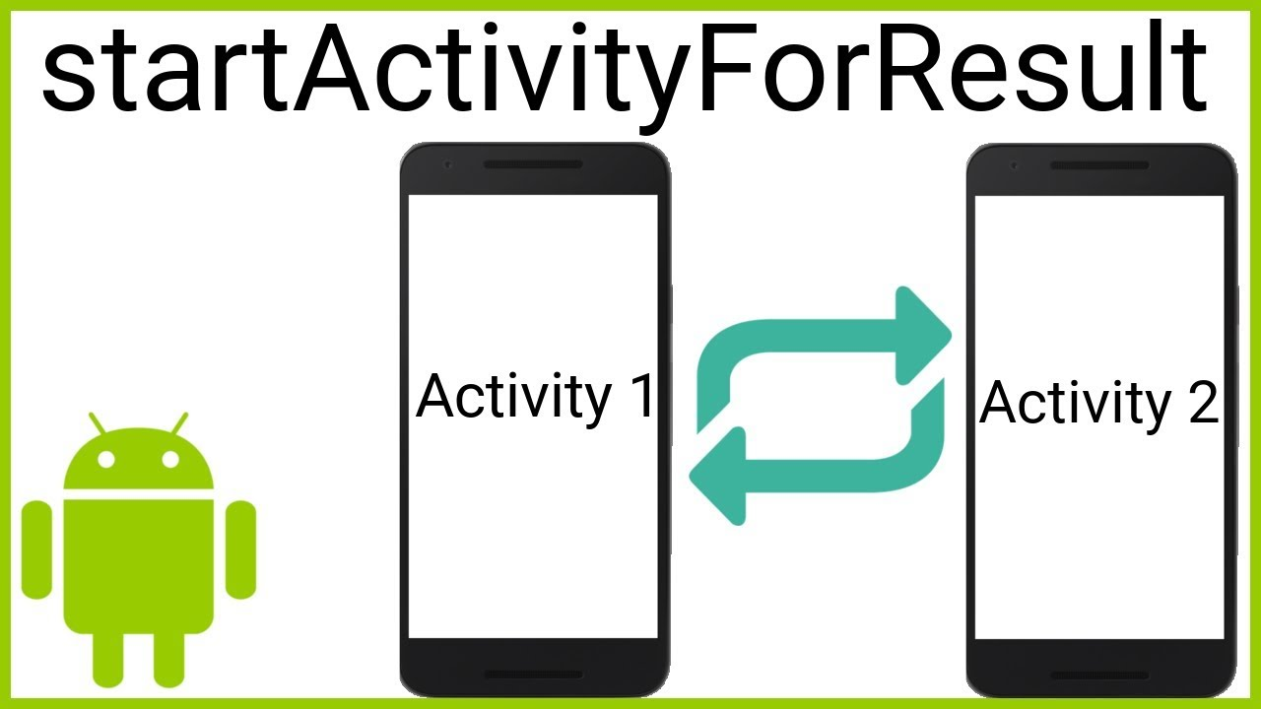
Returning results
If our Activity starts another using startActivity,
it isn’t notified when that Activity completes.
But we might often want to know this—especially if we are using an Activity as a “modal dialog”.
In the previous version of Android, we use startActivityForResult instead. It takes two parameters:
A request code (int) which is later used to identify the Activity concerned
The Intent (as before)

Slide 10
Returning results
When the started Activity completes, it first needs to call setResult(int, Intent) before calling finish()
The parameters to setResult are a result code and an Intent which represents the actual result
Typically includes a URI to refer to some data, may also include “extras”.
The calling Activity’s onActivityResult callback is then called—we need to override it

Slide 11
Returning results
However, in the new implementation of Android, startActivityForResult and onActivityResult methods are deprecated.
This means that we need to call registerForActivityResult() and declare a callback handler to be called when an Activity returns a result.

Slide 12
Returning results
registerForActivityResult()
takes an ActivityResultContract and an ActivityResultCallback
returns an ActivityResultLauncher which you will use to launch the other activity

Slide 13
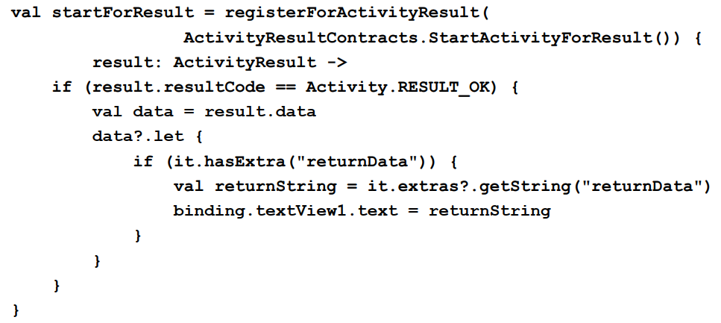
Examples: Registering Activities

Slide 14
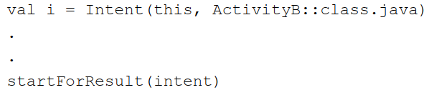
Examples: starting Activities
Once the launcher is ready, it can be called and passed the intent to be launched as follows:

Slide 15
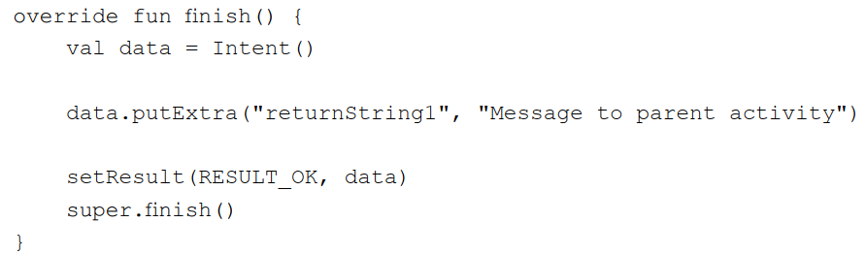
Examples: setting results
In the sub Activity, we have to implement the finish() method.
The finish() method is triggered when an activity exits.
Notes:
RESULT_OK and RESULT_CANCELED (note American spelling) are predefined constants in the Activity class.

Slide 16
Intent Filters
We’ve seen that we can use Intents to specify an Activity to be started implicitly, but how does Android know which Activity to start?
It uses Intent Filters.
Can register an Activity as being interested in a particular event.
This already happens—for the Activity created by the wizard…

Slide 17
Native Actions
All defined as constants in the Intent class. So refer to them as Intent.ACTION_VIEW and so on.
Action | Definition
ACTION_ANSWER | Open an Activity to handle an incoming call.
ACTION_CALL | Brings up a phone dialler and immediately calls the specified number. Bad practice: prefer ACTION_DIAL.
ACTION_DELETE | Start up an Activity to allow specified data to be deleted.
ACTION_DIAL | Start a phone dialler, pre-populated by the specified number.
ACTION_EDIT | Start up an Activity to allow specified data to be edited.
ACTION_PICK | Pick an item from a specified Content Provider. Requires startActivityForResult.
ACTION_SEARCH | Perform a search. Specified using an extra with the key SearchManager.QUERY.
ACTION_SENDTO | Send a message to a contact.
ACTION_VIEW | View data in the most appropriate manner.

Slide 18
The Android Manifest
Every application must have an AndroidManifest.xml file (with precisely that name) in its root directory.
The manifest file provides essential information about your app to the Android system, which the system must have before it can run any of the app's code.

Slide 19
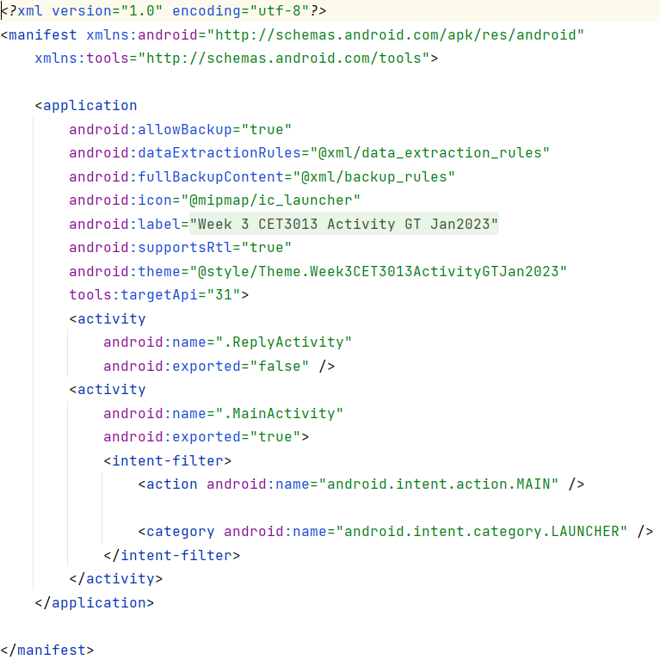
The Android Manifest

Slide 20
Application Life Cycle
Applications have a lot less control over their life cycles than in most other environments.
They need to be prepared to listen for changes in the application state and react accordingly.
Untimely termination is a likely thing to happen.
Each application runs:
In its own process (thread)
Under its own username
In a separate instance of the VM.

Slide 21
Application Priority
Android does whatever it takes to remain responsive.
Processes are killed—often without warning—to free resources for higher-priority processes.
Generally high-priority processes are those interacting with the user—usually only one.
An application’s priority is equal to that of its highest-priority component.
If one application depends on resources provided by another, the secondary application has at least as high a priority.

Slide 22
Application Priority
Active Process
Have a component interacting with the user.
Few in number (often only one).
Visible Process
Component visible but not in foreground (partially obscured).
HIGH
1. Active Process
2. Visible Process
3. Started Service Process
4. Background Process
5. Empty Process
LOW

Slide 23
Application Priority
Started Service Process
Hosting a service which has been started.
Supports processing that doesn’t require a UI.
Background Process
Not interacting, not a running service.
Killed if necessary.
Empty Process
Hosted application has terminated.
HIGH
1. Active Process
2. Visible Process
3. Started Service Process
4. Background Process
5. Empty Process
LOW

Slide 24
Runtime configuration changes
Changes to various aspects—particularly hardware—cause Android to terminate an activity within an application and restart it, reloading the resources.
These changes include:
orientation: rotating the screen
keyboardHidden: exposing or hiding a hardware keyboard
fontScale: the user has changed their preferred font size
Sometimes more than one event happens at the same time.

Slide 25
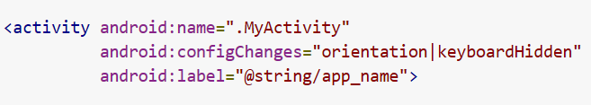
Runtime configuration changes
If we don’t want this to happen we can tell Android that’s the case.
To do this, we add an android:configChanges attribute to the Activity in the manifest file.
It’s a string. We can separate multiple values if we want by using a “|”
android.configChanges=“orientation|keyboardHidden”

Slide 26
Activities
An Activity in Android represents a screen
Like a JFrame in Swing, or a Form in .NET.
Extends android.App.Activity.
Need one for each UI screen.
Normally occupies whole screen, but can be semi-transparent or floating.
Needs an entry in the manifest.
The UI is created using the setContentView method.
Notes:
In other words, a View is a UI element. Android also includes View Groups (layouts).

Slide 27
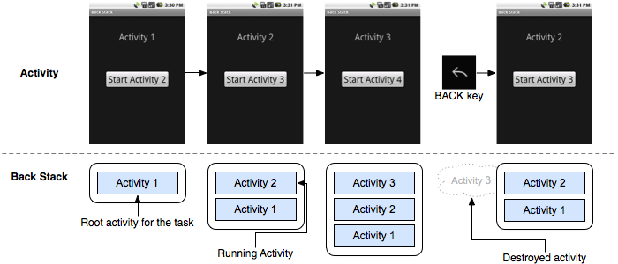
The Activity Stack

Slide 28
The Activity Stack
New Activity
Active Activity
Back button pressed or activity closed
New activity started
Last Active Activity
Activity
…
…
Previous Activities

Slide 29
Activity States
Active | Interacting with the user. In the foreground.
Paused | Visible but not interacting with the user i.e. partially obscured.
Stopped | No longer visible.
Inactive

Slide 30
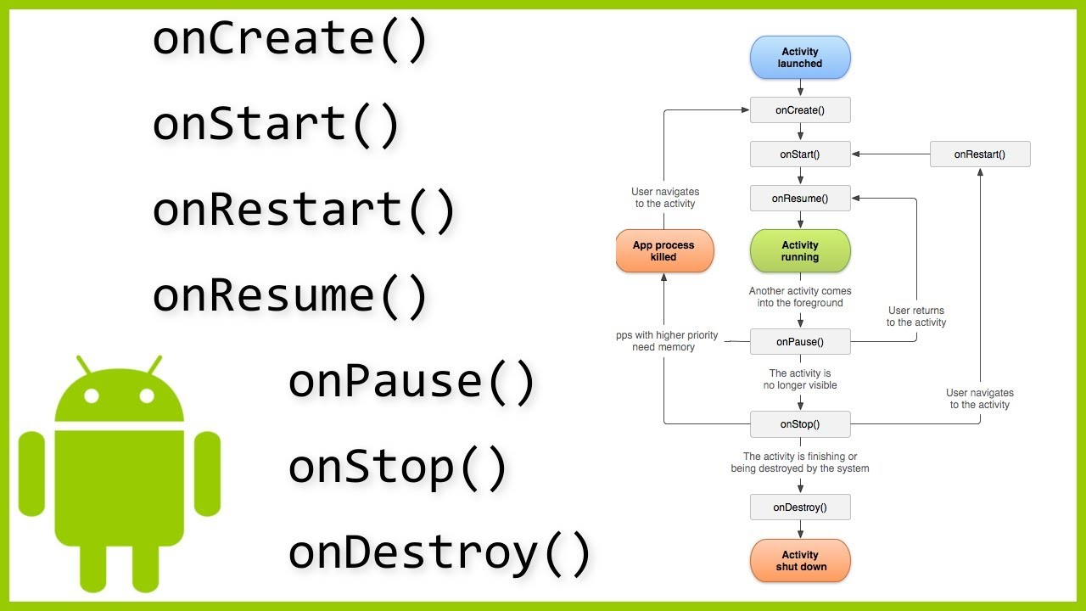
Activity Life Cycle

Slide 31
Activity Methods
Method | Reason to override
onCreate(Bundle) | Initialisation
onRestart() | Changes that need to be made if the activity has been visible before, now it is becoming visible again
onStart() | Changes that need to be made now the activity is visible
onResume() | Resume paused UI updates or paused threads Best place to restore persistent data
onPause() | Suspend UI updates, threads Probably the best place to save persistent data
onStop() | Might never be called.
onDestroy() | Might never be called.
onSaveInstanceState(Bundle) onRestoreInstanceState(Bundle) | Used to save and restore the state of controls (Usually the default implementation is fine)

Slide 32
Activity States (again)
Starting
onCreate()
onStart()
onRestoreInstanceState()
onResume()
onRestart()
onStart()
onResume()
Running
onSaveInstanceState()
onPause()
onResume()
Stopped
Paused
onSaveInstanceState()
onStop()
onDestroy()
Destroyed

Slide 33
Summary
Android Manifest
Application Life Cycle and Priority
Resources
Configuration Changes
Activities
Activity Stack
Activity States

