Slide 1

Week 4: Toolbar & Menu
CET3013: Mobile application development

Slide 2
Today's Topics
Toolbar
Menus
Options for User
Choices…

Slide 3
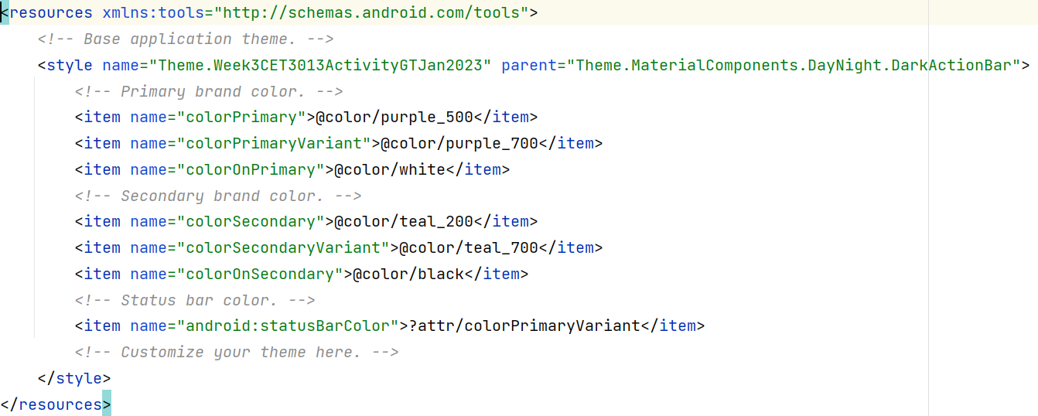
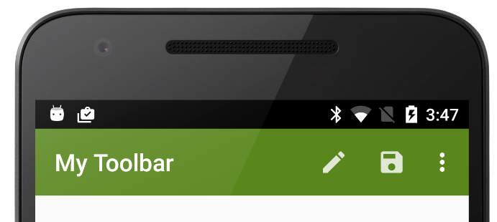
Toolbar
Prior to the Android Studio Flamingo, the default AppBar will be given under the themes.xml file.

Slide 4
Toolbar
No default toolbar was given in Android Studio Flamingo version because the default parent theme is set as below:
We have to add the Material Toolbar manually instead of using the default AppBar.

Slide 5
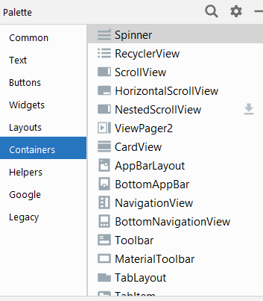
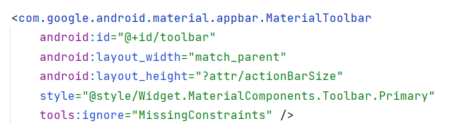
Toolbar
Add the MaterialToolbar to the activity_main.xml.

Slide 6

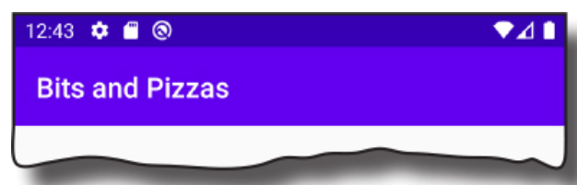
Toolbar
Add and display the Toolbar by calling the activity’s setSupportActionBar() method.

Slide 7
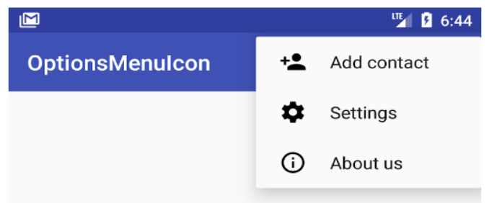
Menus
Menus don't fit so neatly on a smartphone or table as they do on a desktop, but they are still useful.
Android provides two main types of menu:
Options Menu
Context Menu

Slide 8
The Options Menu
The way in which the Options menu appears depends on the version of Android in use.
Android devices running Android 2.3 or lower had a hardware menu buton.
Pressing this displayed an icon menu with up to 6 items
If there are more than 6 items there will be a “More” buton which when tapped displays the expanded menu.
Current Android devices don't have a hardware menu button.
Menu items are added to the Action Bar or ToolBar
Normally they are displayed as an overflow item, three vertical dots, but you can change this.

Slide 9

Defining Menus
Best practice is to define menus in an XML menu resource file.
The default “Android Application Project” already has such a file, with one entry.
<menu xmlns:android="http://schemas.android.com/apk/res/android" >
<item
android:id="@+id/action_settings" android:orderInCategory="100" android:showAsAction="never" android:title="@string/action_settings"/>
</menu>

Slide 10
Showing the Menu
To associate a menu with an Activity, the Activity must override onCreateOptionsMenu(Menu menu).
The Activity that the wizard creates for you already does this.
The menu is in the file res/menu/main.xml.
override fun onCreateOptionsMenu(menu: Menu?): Boolean {
menuInflater.inflate(R.menu.options_menus, menu)
return true
}

Slide 11
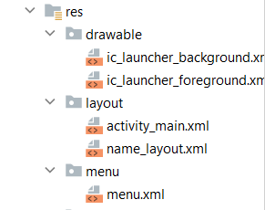
Menu Resource Files
The root element has the tag <menu>.
As always it must declare the xmlns:android atribute.
Items have the tag <item>.
Items can have the following atributes:
android:id
●
As before, it lets us refer to the menu resource in code.
– android:title
●
The text that is displayed for the menu item.
– android:icon
●
Reference to a Drawable resource to provide an icon for the item.
– android:showAsAction
●
Determines whether the menu item can appear in the Action Bar rather than the overflow item.

Slide 12
Menus: Event Handling
There is one event handler for all menu “click” events. Your Activity needs to override
onOptionsItemSelected(item:MenuItem)
You can find which item it was by using the itemId attribute of a MenuItem.
This is a Boolean method.
If you handle the menu event, you should return true.
Otherwise, return the superclass implementation of the method.

Slide 13
Menu Example: Resource File
<?xml version="1.0" encoding="utf-8"?>
<menu xmlns:android="http://schemas.android.com/apk/res/android">
<item android:id="@+id/new_game" android:icon="@drawable/ic_new_game" android:title="@string/new_game" android:showAsAction="ifRoom"/>
<item android:id="@+id/help"
android:icon="@drawable/ic_help" android:title="@string/help" />
</menu>

Slide 14
Menu Example: Event Handling
override fun onOptionsItemSelected(item: MenuItem): Boolean { when (item.itemId) { R.id.menu_dialog1 -> showDialog1() R.id.menu_dialog2 -> showCustomDialog() R.id.menu_date -> showDateDialog() R.id.menu_time -> {} R.id.menu_close -> showCloseDialog() } return super.onOptionsItemSelected(item) }

Slide 15
Context Menus
Associated with Views.
Any View can be used, but most ofen used with a ListView or GridView to provide actions for each item in the View.
If you wish to support earlier versions of Android, you must create a floating context menu.

Slide 16
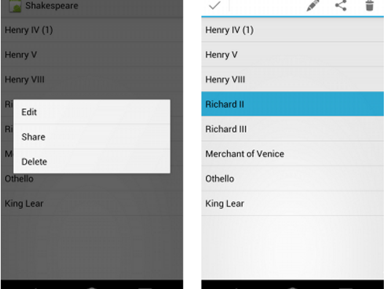
Example Context Menu

Slide 17
Creating a Context Menu
Call registerForContextMenu(), passing the View concerned as a parameter.
– If you're using a ListView (e.g.) and want the menu to be available for all items, then pass the ListView itself as the parameter.
Override onCreateContextMenu() in your Activity.
Override onContextItemSelected() to handle menu item selection.

Slide 18
Context Menu Creation
Need to call the superclass implementation of the method.
Otherwise prety similar to the creation of an options menu.
override fun onCreateContextMenu(
menu: ContextMenu?,v: View?,
menuInfo: ContextMenu.ContextMenuInfo?) {
super.onCreateContextMenu(menu, v, menuInfo)
menuInflater.inflate(R.menu.float_contextual_menu, menu)
}

Slide 19
Context Menu Event Handling
//handling click events in an float context menu items clicks
override fun onContextItemSelected(item: MenuItem): Boolean {
when (item.itemId) {
R.id.color -> {
var textView = findViewById<TextView>(R.id.textHappyCoding)
textView.setTextColor(Color.parseColor("#FF0000"))
Toast.makeText(this, "color changed", Toast.LENGTH_SHORT).show()
return true
}
else -> {
return super.onContextItemSelected(item)
}
}
}

Slide 20
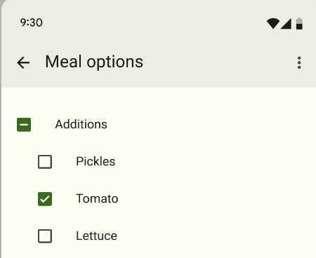
CheckBox
Checkboxes let the user select one or more options from a set.
Detect its state (checked or unchecked).

Slide 21
CheckBox
Checkboxes let the user select one or more options from a set.
Detect its state (checked or unchecked).

Slide 22
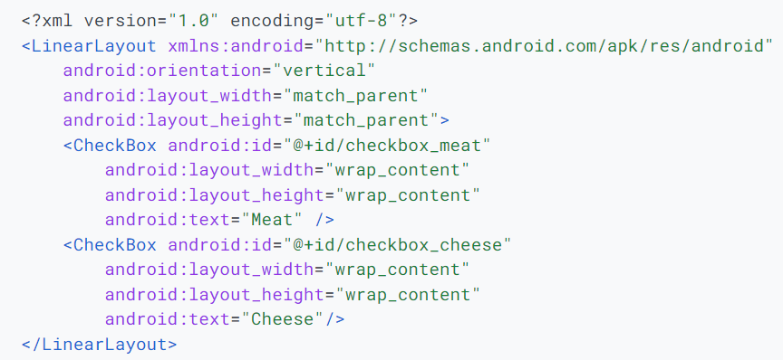
CheckBox - Layout

Slide 23
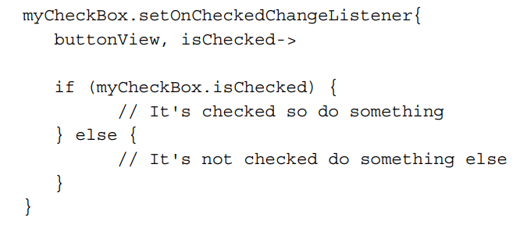
CheckBox Event Handling

Slide 24
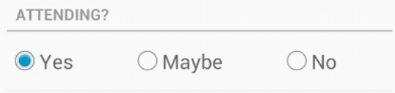
RadioButtons
Radio buttons allow the user to select one option from a set.
You must group them together inside a RadioGroup.
By grouping them together, the system ensures that only one radio button can be selected at a time.

Slide 25
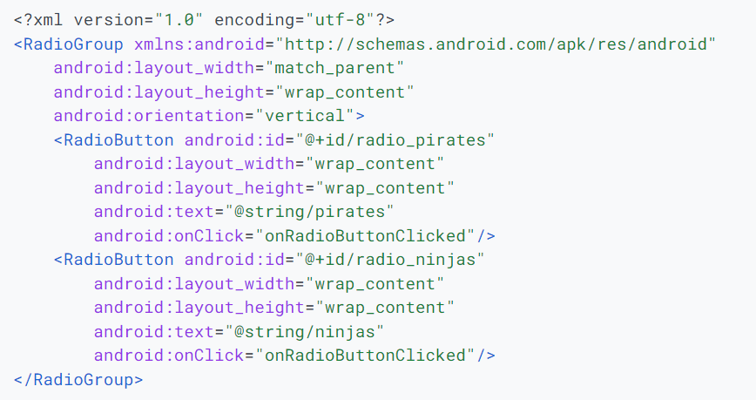
RadioButtons - Layout

Slide 26
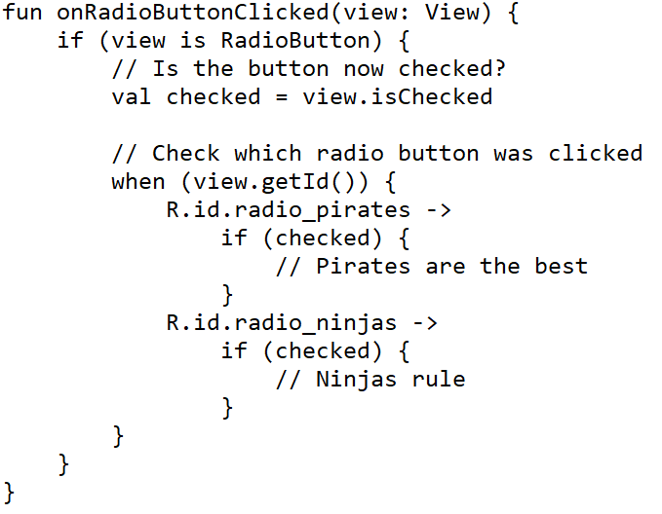
RadioButton Event Handling 1

Slide 27
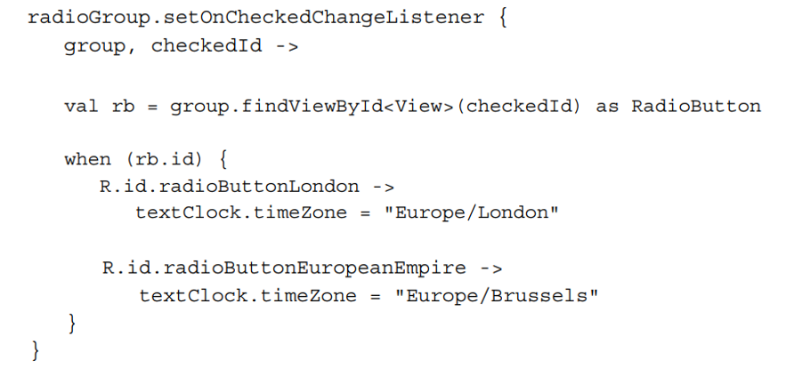
RadioButton Event Handling 2

Slide 28
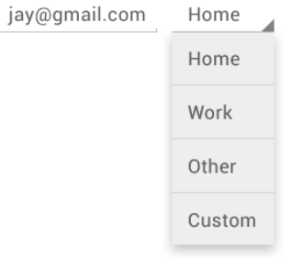
Spinners
Quick way to select one value from a set.
In the default state shows currently selected value.
Touching displays a dropdown menu available values

Slide 29
Spinners Resources
The choices you provide for the spinner can come from any source
string arrays in strings.xml resource file.
Normally works with SpinnerAdapter or ArrayAdapter.
Optional way by using the entries attributes.

Slide 30
Spinners Resources
<?xml version="1.0" encoding="utf-8"?> <resources> <string-array name="planets_array"> <item>Mercury</item> <item>Venus</item> <item>Earth</item> <item>Mars</item> <item>Jupiter</item> <item>Saturn</item> <item>Uranus</item> <item>Neptune</item> </string-array> </resources>

Slide 31
Spinner - Layout
<Spinner android:id="@+id/contact_plannet" android:layout_width="match_parent" android:layout_height="wrap_content“
android:entries = “@array/planets_array” />

Slide 32
Spinner – Event Handling
val spinner = findViewById<Spinner>(R.id.spinner)
val planets = resources.getStringArray(R.array.planets_array)
val adapter = ArrayAdapter(this, android.R.layout.simple_spinner_item, planets)
spinner.adapter = adapter
spinner.onItemSelectedListener = object :
AdapterView.OnItemSelectedListener {
override fun onItemSelected(parent: AdapterView<*>,
view: View, position: Int, id: Long) {
// write code to perform some action
}
override fun onNothingSelected(parent: AdapterView<*>) {
// write code to perform some action
}
}

Slide 33
Pickers
Like Spinners but are ready-to-use dialogs
Well known pickers include
Date Picker
Time Picker
Number Picker
Both Pickers and Spinners constrain User Input
Excellent way to limit errors

Slide 34
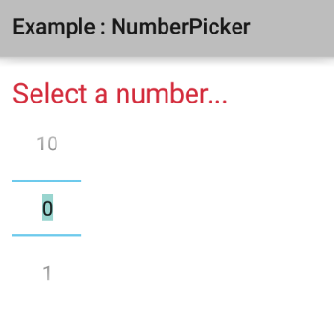
Number Picker
Ideal for range restricted numerics
Simple XML from Designer
Need to set setOnValueChangedListener
<NumberPicker android:id="@+id/numberpicker"
android:layout_width="wrap_content"
android:layout_height="wrap_content" />

Slide 35
Number Picker Event Handling
numberPicker.minValue = 0
numberPicker.maxValue = 10
numberPicker.wrapSelectorWheel = true
numberPicker.setOnValueChangedListener { picker, oldVal, newVal ->
val text = "Changed from $oldVal to $newVal"
Toast.makeText(this@MainActivity, text,
Toast.LENGTH_SHORT).show()
}

Slide 36
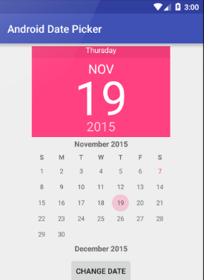
DatePicker
Android DatePicker is a user interface control which is used to select the date by day, month and year in our android application.
We recommend that you use DialogFragment to host each time or date picker.
The DialogFragment manages the dialog lifecycle for you and allows you to display the pickers in different layout configurations

Slide 37
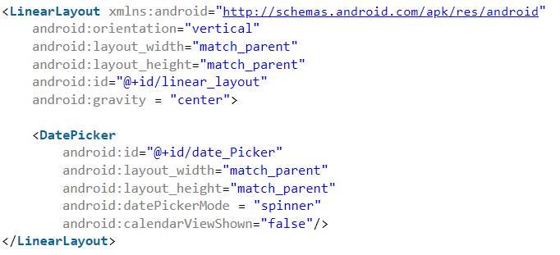
DatePicker - Layout

Slide 38
DatePicker Event Handling
val datePicker = findViewById<DatePicker>(R.id.date_Picker)
val today = Calendar.getInstance()
datePicker.init( today.get(Calendar.YEAR),
today.get(Calendar.MONTH),
today.get(Calendar.DAY_OF_MONTH))
{ view, year, month, day ->
val month = month + 1
val msg = "You Selected: $day/$month/$year"
Toast.makeText(this@MainActivity, msg, Toast.LENGTH_SHORT).show()
}

Slide 39
DatePicker – Using DialogFragment Part 1
class DatePickerFragment : DialogFragment(), DatePickerDialog.OnDateSetListener {
override fun onCreateDialog(savedInstanceState: Bundle): Dialog {
// Use the current date as the default date in the picker
val c = Calendar.getInstance()
val year = c.get(Calendar.YEAR)
val month = c.get(Calendar.MONTH)
val day = c.get(Calendar.DAY_OF_MONTH)
// Create a new instance of DatePickerDialog and return it
return DatePickerDialog(requireContext(), this, year, month, day)
}
override fun onDateSet(view: DatePicker, year: Int, month: Int, day: Int) {
// Do something with the date chosen by the user
}
}

Slide 40
DatePicker – Using DialogFragment Part 2
Showing DatePicker with the DialogFragment
fun showDatePickerDialog(v: View) { val newFragment = DatePickerFragment() newFragment.show(supportFragmentManager, "datePicker") }

Slide 41
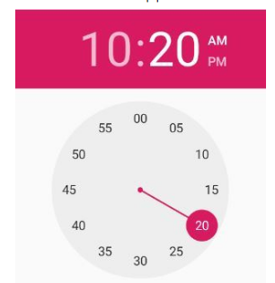
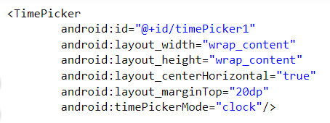
TimeDialog
Android TimePicker is a user interface control for selecting the time in either 24-hour format or AM/PM mode.

Slide 42
TimeDialog
Using the setOnTimeChangeListener to adjust the time frame.
val timePicker = findViewById<TimePicker>(R.id.timePickers)
timePicker.setOnTimeChangedListener { _, hour, minute -> var hour = hour
val msg = "Time is: $hour : $min $am_pm"
textView.text = msg
textView.visibility = ViewGroup.VISIBLE
}

Slide 43
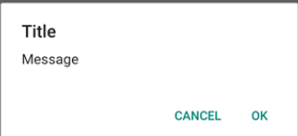
Alert Dialogs
Creating a dialog
All of AlertDialog’s constructors are protected.
What to do?
Use AlertDialog.Builder.
Should be created in an ovveride of the Activity method onCreateDialog(int).
Showing a dialog
Call showDialog(int), passing the ID of the dialog you want to show.

Slide 44
Alert Dialogs Example
val builder = AlertDialog.Builder(this)
builder.setTitle("Androidly Alert")
builder.setMessage("We have a message")
//builder.setPositiveButton("OK", DialogInterface.OnClickListener(function = x))
builder.setPositiveButton(android.R.string.yes) { dialog, which ->
Toast.makeText(applicationContext,
android.R.string.yes, Toast.LENGTH_SHORT).show()
}
builder.setNegativeButton(android.R.string.no) { dialog, which ->
Toast.makeText(applicationContext,
android.R.string.no, Toast.LENGTH_SHORT).show()
}
builder.setNeutralButton("Maybe") { dialog, which ->
Toast.makeText(applicationContext,
"Maybe", Toast.LENGTH_SHORT).show()
}
builder.show()

Slide 45
Summary
Toolbar
Menus
Radio buttons, Check boxes
Pickers

Slide 46
Template

