Slide 1

Week 5: Android Data Persistency
CET3013: Mobile application development

Slide 2
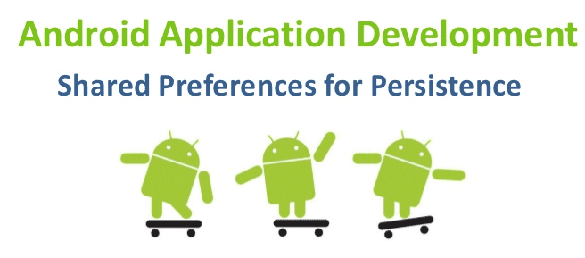
This Week
Saving preferences in Android
Saving application state—when and how
ViewModel in JetPack

Slide 3

Accessing data
Most applications need to be able to store and retrieve data.
Android oﬀers a number of possibilities:
A mechanism for storing key/value pairs, intended for application preferences
A means of saving and restoring application state
Access to the file system
Always bearing in mind limitations of Android

Slide 4
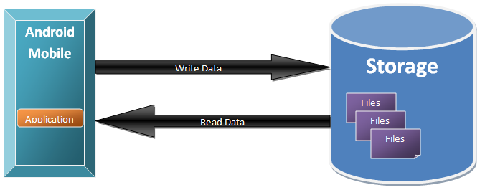
Accessing data
There are also some more sophisticated options.
Databases (SQLite)
ContentProviders—allow you to share data between applications (normally not possible)

Slide 5
Shared Preferences
Used to share data between application components, or between application sessions
Supports “simple” data types
int, long, float, boolean, String
Uses the SharedPreferences class
Obtain an instance using
getSharedPreferences(String, int)
Method of Context
Can pass this or use getContext()

Slide 6
getSharedPreferences(String, int)
Shared Preferences
String is the name of the preferences file
int is the file mode
Suggest 0 or MODE_PRIVATE
File will be created if not present, but only when an editor for the file has been opened (see below)
A SharedPreferences object lets us retrieve values, but not create or modify them
Need SharedPreferences.Editor

Slide 7

Example: Creating preferences
val sharedPreference = getSharedPreferences(“prefs",Context.MODE_PRIVATE)
var editor = sharedPreference.edit()
editor.putString("username","Lai")
editor.putInt("age",45)
editor.commit()

Slide 8

Example: retrieving preferences
fun loadPreferences() {
// Get the stored preferences
val mySharedPreferences = getSharedPreferences("prefs", 0)
// Retrieve the saved values.
val isTrue = mySharedPreferences.getBoolean("isTrue", false)
val lastFloat = mySharedPreferences.getFloat("lastFloat", 0f)
val wholeNumber = mySharedPreferences.getInt("wholeNumber", 1)
val aNumber = mySharedPreferences.getLong("aNumber", 0)
val stringPreference = mySharedPreferences.getString("textEntryValue", "")
}
The first parameter is the name of the preference.
The second parameter is the default value.

Slide 9
There’s More
So far, so good
Obviously, we need to provide a GUI to do this— and that means creating an Activity
As it happens Android provides a mechanism to simplify and standardise this
A special layout file
The class PreferencesActivity
An event listener:
onSharedPreferenceChangeListener

Slide 10


Example: preferences screen
<?xml version="1.0" encoding="utf-­‐8"?>
<PreferenceScreen xmlns:android="http://schemas.android.com/apk/res/android">
<PreferenceCategory
android:title="My Preference Category"/>
<CheckBoxPreference android:key="PREF_CHECK_BOX" android:title="Check Box Preference"
android:summary="Check Box Preference Description"
android:defaultValue="true"
/>
</PreferenceCategory>
</PreferenceScreen>
Stored as a separate file in the res/xml
- resources folder.

Slide 11
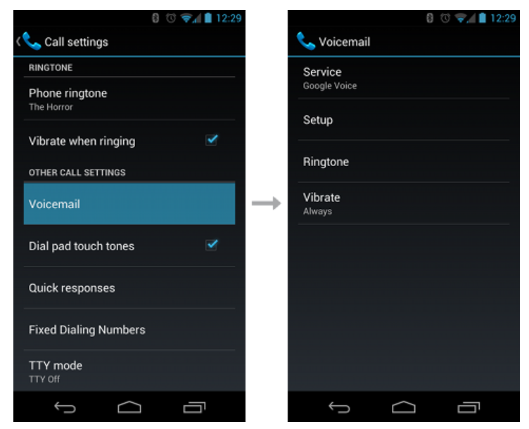
Example preferences screens

Slide 12
Types of preference
Type | Description
CheckBoxPreference | A check box, used to set a true or false value.
EditTextPreference | Allow users to enter a string value. (Displays dialog.)
ListPreference | Select from a list of values. (Displays dialog.)
RingtonePreference | Displays a list of the installed ringtones as a dialog.
You can also create your own type of preference by extending the Preference class or one of its subclasses.
Can be defined in XML or in code.
See hp://developer.android.com/reference/android/preference/Preference.html

Slide 13
Still more…
You can call on other applications’ setting screens
—even the system settings
You can make your application’s preferences screens available to other applications

Slide 14

And now…
The preferences from a PreferenceActivity are stored against the application context
– Retrieve this using applicationContext
Any component of the application can now get the
- SharedPreferences object as follows:
val myContext = applicationContext
val prefs =
PreferencesManager.getDefaultSharedPreferences(myContext)

Slide 15
Shared Preference Change Listeners
We can register a callback method which is invoked when a particular SharedPreferences object is altered.
Need to implement
- OnSharedPreferenceChangeListener
This means implementing a method:
- onSharedPreferenceChanged(SharedPreferences, String)

Slide 16
Example: Shared Preference Change Listeners
class MainActivity : AppCompatActivity(),SharedPreferences.OnSharedPreferenceChangeListener {
override fun onCreate(savedInstanceState: Bundle?) {
super.onCreate(savedInstanceState)
setContentView(R.layout.activity_main)
val prefs = PreferenceManager.getDefaultSharedPreferences(applicationContext)
prefs.registerOnSharedPreferenceChangeListener(this)
}
override fun onSharedPreferenceChanged(sharedPreferences: SharedPreferences, key: String) {
// IF YOU OVERRIDE IT, DON'T FORGET TO CALL IN THE FIRST LINE:
super.onSharedPreferenceChanged(sharedPreferences, key)
val pref = findPreference<Preference>(key)
if (pref != null)
//Do something here
}
}

Slide 17
Activity Preferences
Every Activity has an un-named
- SharedPreferences object which you can
use.
Returned using the getPreferences method of the Activity class.
Can be used to store values related to one Activity.
val activityPreferences =
getPreferences(Activity.MODE_PRIVATE);

Slide 18
Saving and restoring instance state
We can use onSaveInstanceState and onRestoreInstanceState for this
Notice in particular where the calls to the superclass implementations go
Before overriding these, make sure that the default implementation isn’t suitable—usually, it is

Slide 19
Examples: instance state
override fun onSaveInstanceState(outState: Bundle) { super.onSaveInstanceState(outState) Log.i(TAG, "onSaveInstanceState")
val userText = binding.editText.text outState.putCharSequence("savedText", userText) }

Slide 20
Examples: instance state
This leaves the developer with the choice of using either onCreate() or onRestoreInstanceState().
override fun onRestoreInstanceState(savedInstanceState: Bundle) { super.onRestoreInstanceState(savedInstanceState) Log.i(TAG, "onRestoreInstanceState")
val userText = savedInstanceState.getCharSequence("savedText") binding.editText.setText(userText) }

Slide 21

ViewModel
ViewModel is one of the modern components in Android JetPack.
The purpose of ViewModel is to separate the user interface-related data model and logic of an app from the code responsible for actually displaying and managing the user interface and interacting with the operating system.
A ViewModel used by an activity, for example, will remain in memory until the activity completely finishes which, in the single activity app, is not until the app exits.

Slide 22
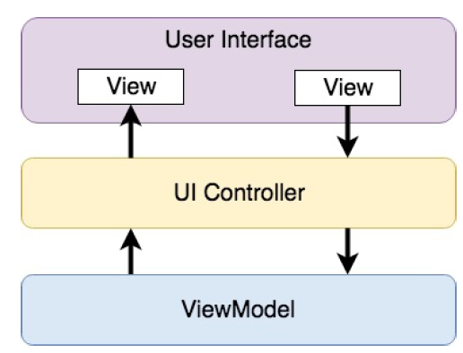
ViewModel (MVC)

Slide 23
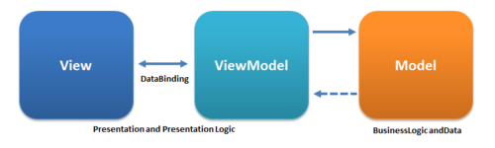
ViewModel
The ViewModel class comes from an Android Jetpack library called lifecycle-extensions
To use the class, you must first include the library in the list of dependencies for your project.
Add the lifecycle-extensions dependency to your app/build.gradle file

Slide 24
ViewModel Implementation
import androidx.lifecycle.ViewModel
class MainViewModel : ViewModel() {
private val rate = 0.74f
private var dollarText = ""
private var result: Float = 0f
fun setAmount(value: String) {
this.dollarText = value
result = value.toFloat() * rate
}
fun getResult(): Float {
return result
}
}

Slide 25
Applying ViewModel Object
A Fragment or Activity maintains references to the ViewModels on which it relies for data using an instance of the ViewModelProvider class.
A ViewModelProvider instance is created via a call to the ViewModelProviders.of() method from within the Fragment. When called, the method is passed a reference to the current Fragment or Activity and returns a ViewModelProvider instance as follows:
Once the ViewModelProvider instance has been created, the get() method can be called on that instance

Slide 26
Applying ViewModel Object
//get view model reference
val viewModel = ViewModelProvider(this).get(MainViewModel::class.java);
MainViewModel viewModel2 = new MainViewModel();
viewModel VS viewModel2?

Slide 27
LiveData in ViewModel
LiveData is a component in JetPack to provide the real time or updated data to your app.
LiveData allows UI controller to receive notification when a specific data item within a ViewModel changes.
LiveData is a data holder that allows a value to become observable. In basic terms, an observable object has the ability to notify other objects when changes to its data occur.

Slide 28
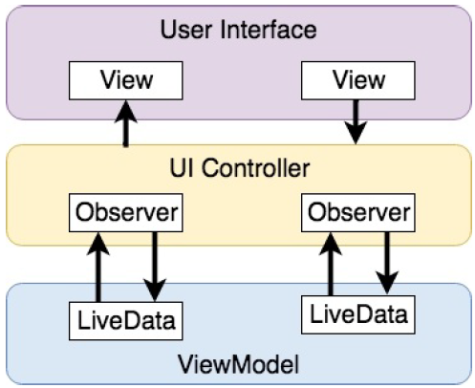
LiveData in ViewModel
For example, the stock price would be wrapped in a LiveData object within the ViewModel and the UI controller would assign an observer to the value, declaring a method to be called when the value changes.

Slide 29
Adding LiveData in ViewModel Part 1
package …;
import android.arch.lifecycle.ViewModel;
class MainViewModel:ViewModel (){
private val usd_to_eu_rate = 0.74F
private var dollarText = ""
private var result = 0f
private var result: MutableLiveData<Float> =
MutableLiveData ();
…
}

Slide 30
Adding LiveData in ViewModel Part 2
fun setAmount(value: String) { this.dollarText = value result = value.toFloat() * rate result.value = value.toFloat() * rate }
fun getResult(): Float { fun getResult(): MutableLiveData<Float> { return result }

Slide 31
Implementing the Observer
The Observer instance in UI controller declares the onChanged() method to receive notification when the result value had changed and display the latest data.
Add the observer to the result LiveData object, a reference to which can be obtained via a call to the getValue() method of the ViewModel object.

Slide 32
Adding LiveData in ViewModel
//Create Observer object in UI Controller class
val resultObserver = Observer<Float> { result ->
binding.resultText.text = result.toString() }
//Bind the ViewModel object with Observer object
viewModel.getResult().observe(viewLifecycleOwner, resultObserver)
//No need extra statement to set the data explicitly
resultText.text = (mViewModel.getResult().toString())

Slide 33
Summary
Data access options
Preferences
SharedPreferences
Preferences Screen and PreferenceActivity
Change Listeners
ViewModel
LiveData

