Slide 1

Week 7: Android Coroutines
CET3013: Mobile application development

Slide 2
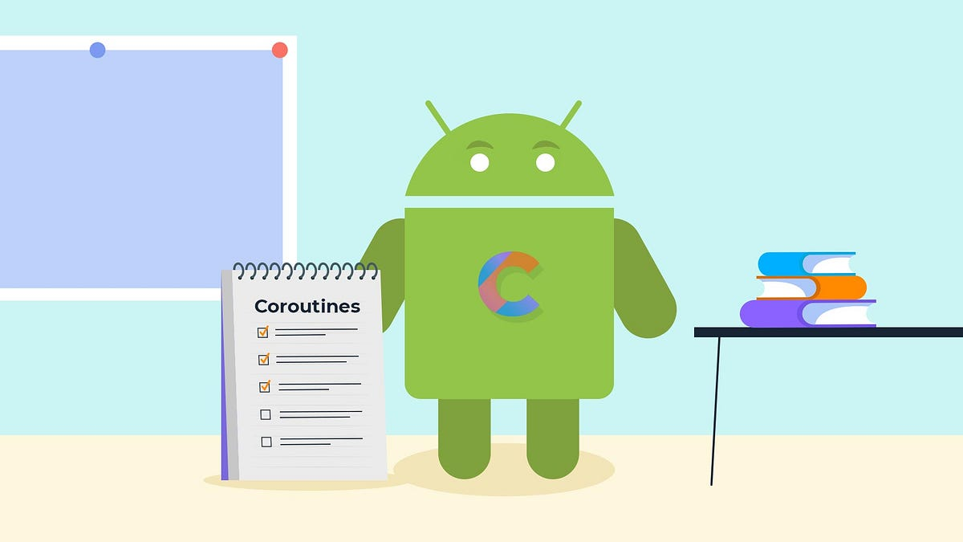
Today's lecture
Introduction of Coroutines
Coroutines Features
Coroutines Scope
Coroutines Dispatchers
Coroutines Builders
Coroutines Channels

Slide 3

Introduction of Coroutines
Android application is using the Main Thread in application running.
This main thread has many duties to perform like drawing the views, executing logical pieces of code in a sequential manner.
Make sure that we are not blocking the main thread.
We need a multi-threaded approach in some cases like performing network operations, heavy logical operations, etc.

Slide 4
Introduction of Coroutines
Coroutine stands for cooperating functions.
They are lightweight threads that help to write simplified asynchronous code that keeps the application responsive while maintaining heavy tasks like network calls and avoiding tasks from blocking.
fun main() = runBlocking { // this: CoroutineScope
launch { // launch a new coroutine and continue
delay(1000L) // non-blocking delay for 1 second (default time unit is ms)
println("World!") // print after delay
}
println("Hello") // main coroutine continues while a previous one is delayed
}

Slide 5

History of Coroutines
Coroutines used to be a popular concept in the programming languages of 1960s-1980s.
Was used in “The Art of Computer Programming” by Donald Knuth.
Python started adding coroutines as a mechanism for writing concurrent code in 2005.
Even the old guard, C++ has added async/await syntax in 2020.

Slide 6

Why Coroutines?
Using RxJava
it requires a lot of effort
Threads
hard to write and maintain
AsyncTasks
too many callbacks methods
Coroutines
Easy to write and simple (write asynchronous code sequentially)

Slide 7
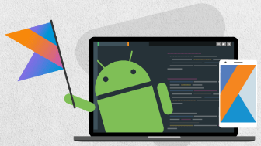
Coroutines Features
Lightweight
Can run many coroutines on a single thread, which doesn’t block the thread where the coroutine is running
Fewer memory leaks
Kotlin coroutines follow the structured concurrency, which is why there are very less memory leaks
Built-in cancellation support
Cancellation in coroutine is interactive (delay() & yield())
Jetpack integration
There are many libraries of Jetpack that
provide support for Coroutines (Android KTX)

Slide 8
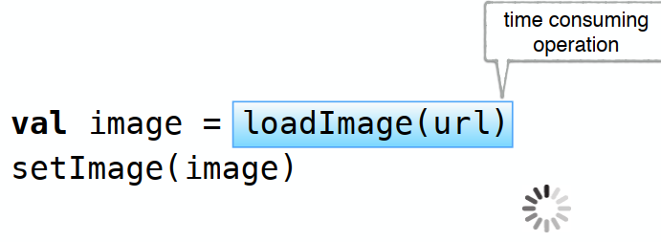
Loading Image: Run in MainThread

Slide 9
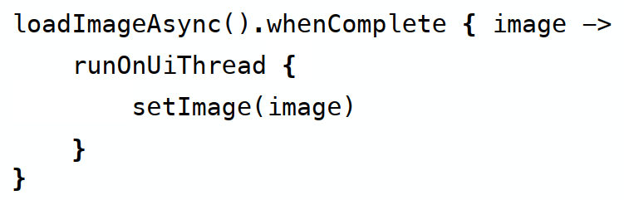
Loading Image: Run with Callbacks

Slide 10
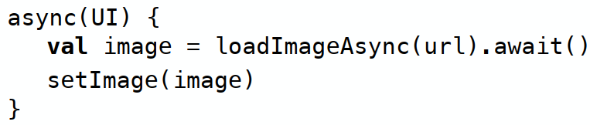
Loading Image: Run with async/await

Slide 11
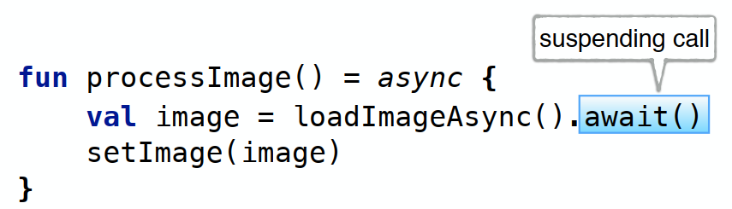
Loading Image: Run with Kotlin

Slide 12
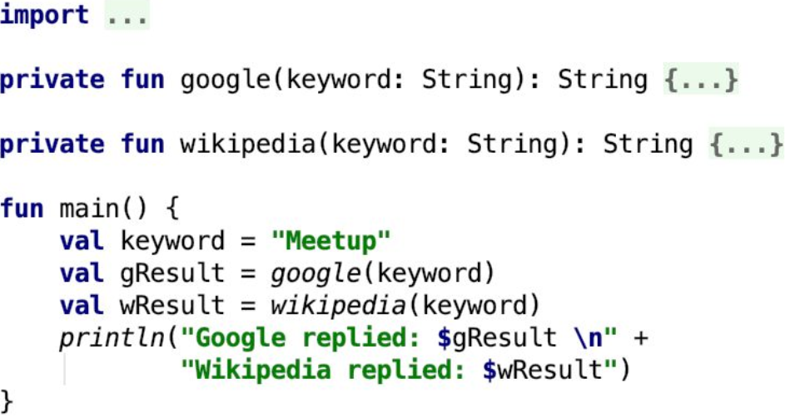
Synchronous – Sequential Code

Slide 13
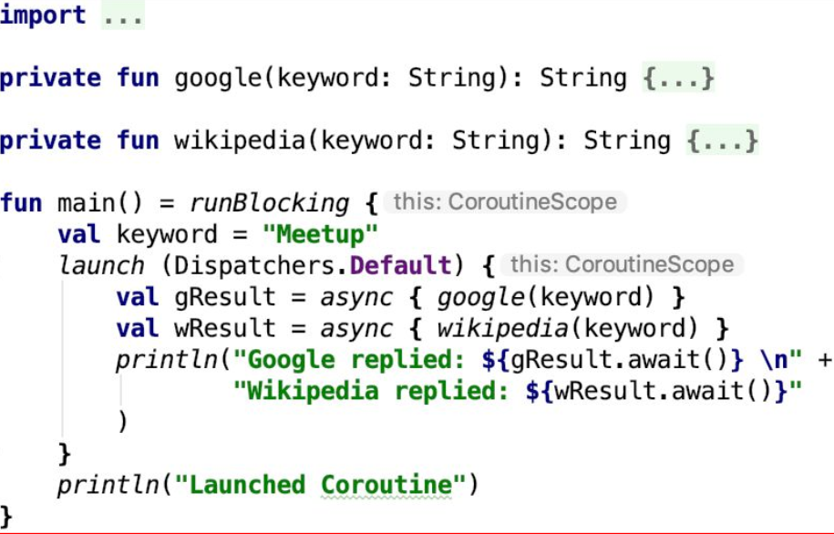
Asynchronous – Concurrent Code

Slide 14
Coroutines Scope
GlobalScope
GlobalScope is used to launch top-level coroutines which are tied to the entire lifecycle of the application. This scope is not recommended for use in Android applications.
ViewModelScope
Using the Jetpack architecture ViewModel component
LifecycleScope
This scope is canceled when the corresponding lifecycle owner is destroyed
Custom Scope

Slide 15
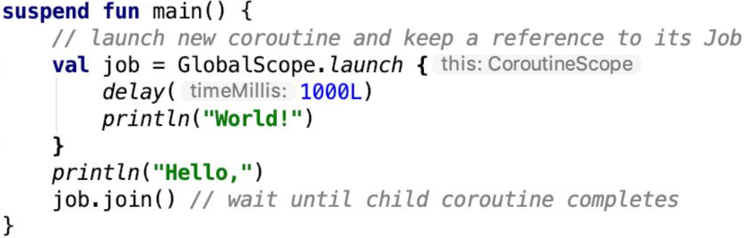
Example: GlobalScope

Slide 16
Coroutines Dispatchers
The dispatcher is responsible for assigning coroutines to appropriate threads and suspending and resuming the coroutine during its lifecycle.
Dispatchers.Main
Runs the coroutine on the main thread and is suitable for coroutines that need to make changes to the UI and as a general purpose option for performing lightweight tasks.
Dispatchers.IO
Recommended for coroutines that perform network, disk, or database operations.
Dispatchers.Default
Intended for CPU intensive tasks such as sorting data or performing complex calculations.

Slide 17
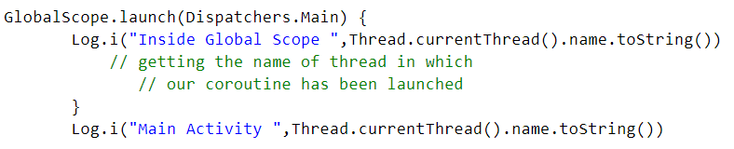
Example: Dispatchers

Slide 18
Coroutines Builders
Builders
launch | Starts a coroutine without blocking the current thread and does not return a result to the caller
async | Starts a coroutine and allows the caller to wait for a result using the await() function without blocking the current thread
withContext | Allows a coroutine to be launched in a different context from that used by the parent coroutine
coroutineScope | It is ideal for situations where a suspend function launches multiple coroutines that will run in parallel
runBlocking | Starts a coroutine and blocks the current thread until the coroutine reaches completion.

Slide 19
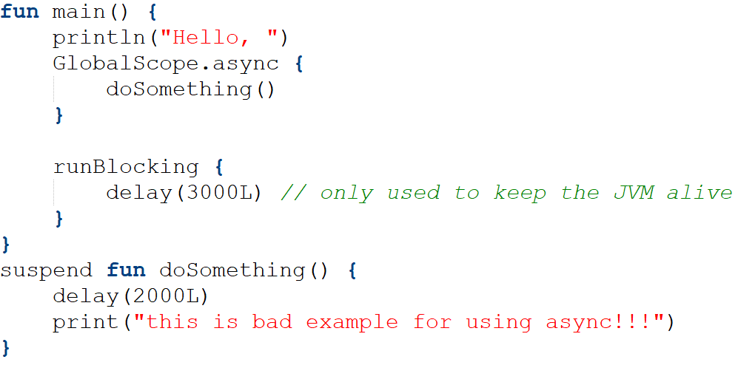
Example: Builders

Slide 20
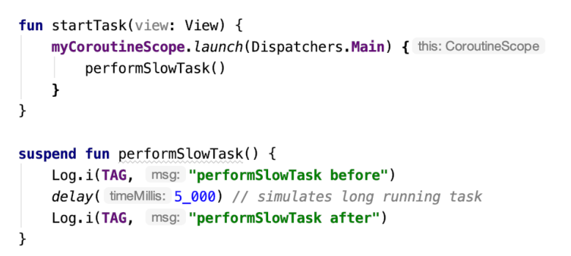
Coroutines-Suspending & Resuming
This function to call a suspend function named performSlowTask() using the Main coroutine dispatcher.

Slide 21
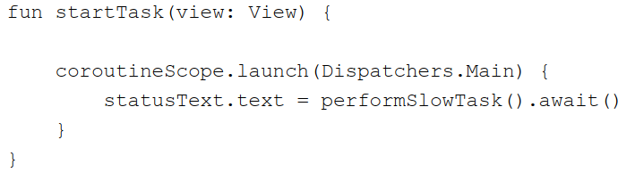
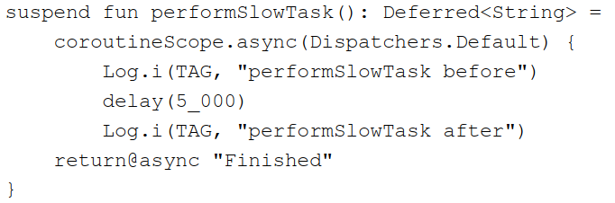
Coroutines-Returning Results

Slide 22
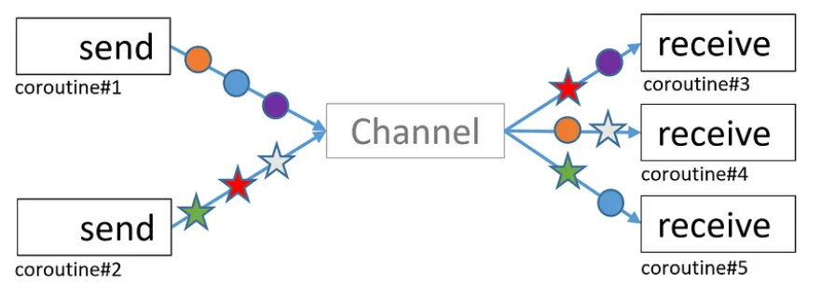
Coroutines Channel Communication
Channels provide a simple way to implement communication between coroutines including streams of data
Using send() method and receive() method to communicate under the same Channel instance.

Slide 23
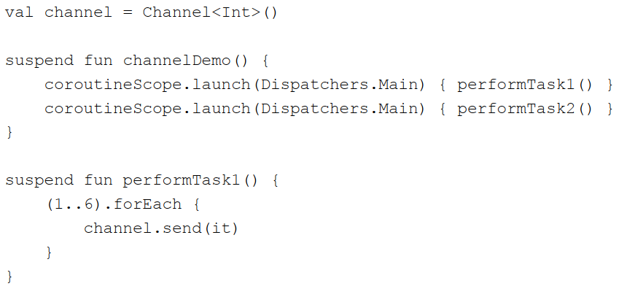
Example: Channel Communication

Slide 24
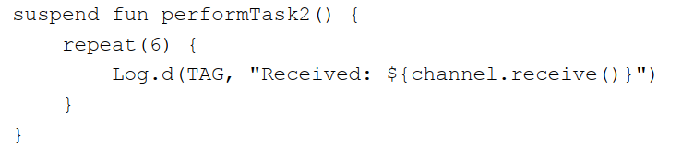
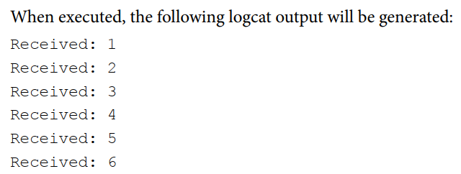
Example: Channel Communication

Slide 25
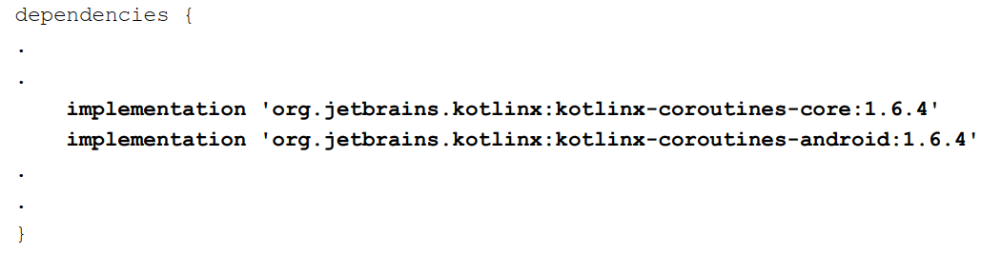

Coroutines in Android
Gradle:

Slide 26

Concurrency VS Parallelism
Parallelism is about the execution of multiple tasks at the same time.
Concurrency tries to break down tasks which we don’t necessarily need to execute at the same time. Concurrency's primary goal is structure, not parallelism.
Concurrency makes the use of parallelism easier.

Slide 27

Final Thoughts
Coroutines are NOT like threads
Force us to rethink the way
Intend to look like sequential code and hide the complicated stuff
Resource-wise are almost free
Coroutines are the cool new thing in the JVM/Android world

