Slide 1

Week 8: CardView & RecyclerView
CET3013: Mobile application development

Slide 2
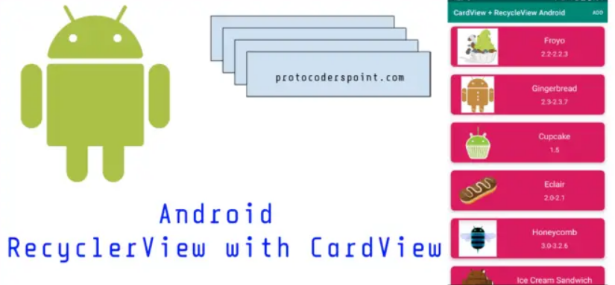
Today's Topics
CardView
RecyclerView

Slide 3
CardView
The CardView class is a user interface view that allows information to be presented in groups using a card metaphor.
Cards are usually presented in lists using a RecyclerView.
May configure the rounded corner along with a specific elevation and shadow effect.

Slide 4
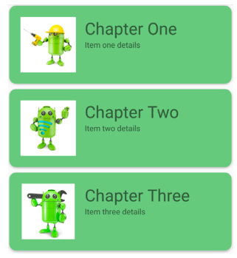
CardView
For example, shows three CardView instances configured to display a layout consisting of an ImageView and two TextViews:

Slide 5
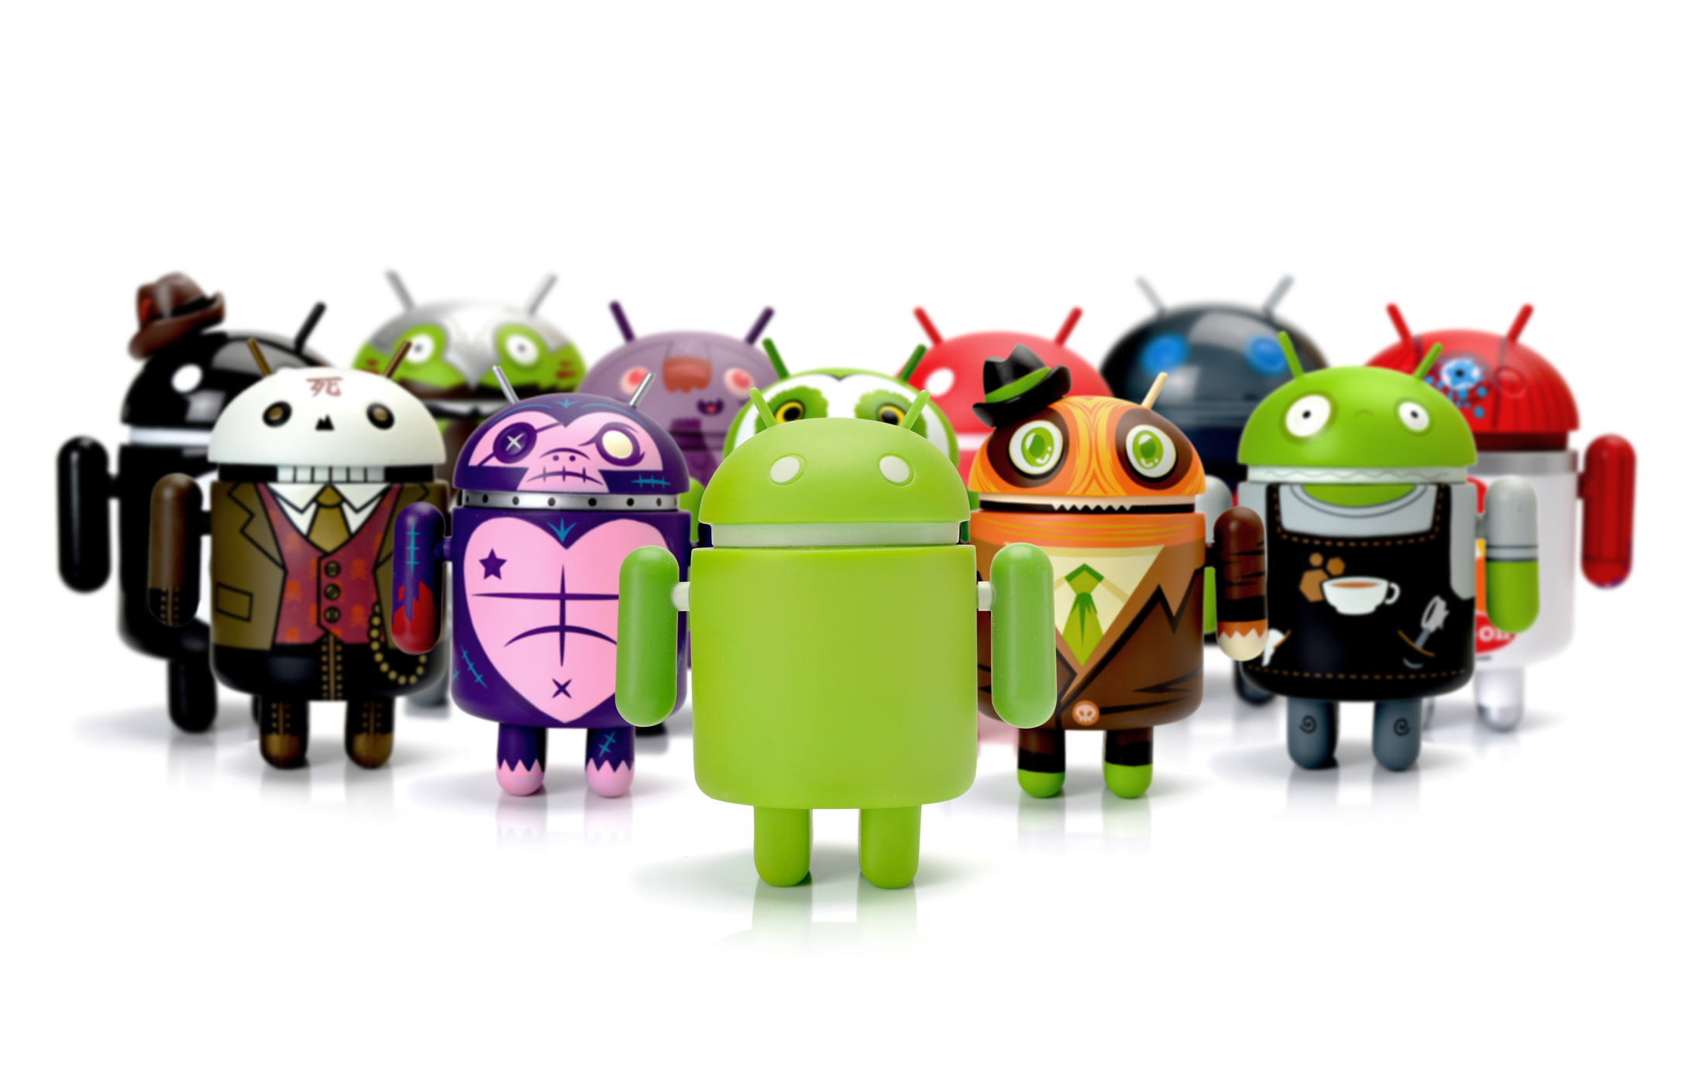
CardView
The CardView layout can contain a layout of any complexity using the standard layout managers such as RelativeLayout and LinearLayout.
CardView offers several properties to customize its appearance, including:
card_view:cardCornerRadius: Sets the corner radius in your layouts.
Card_view.setRadius: Sets the corner radius in your code.
card_view:cardBackgroundColor: Sets the background color of a card.
card_view:cardElevation: lower elevation would result in a lighter shadow

Slide 6
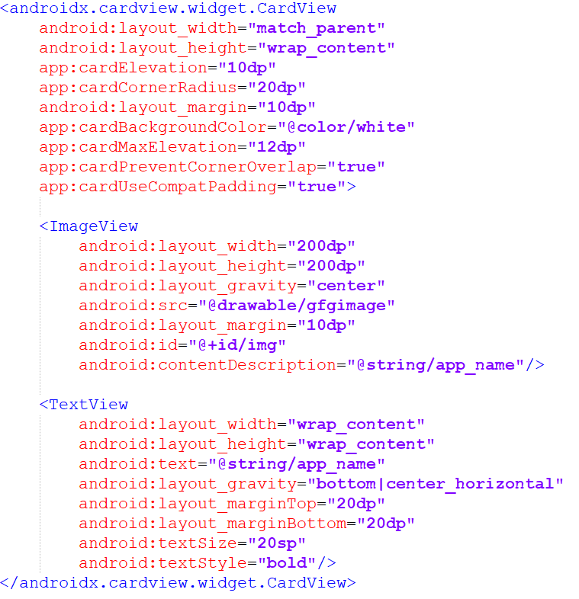
CardView Layout

Slide 7

RecyclerView
A recycler view is a more advanced and flexible way of displaying a list of data.
The RecyclerView provides a number of advantages over the ListView:
A rich UI for the list’s items.
A flexible way of positioning items.
You can use it for navigation.
It’s an efficient way to display large data sets.

Slide 8
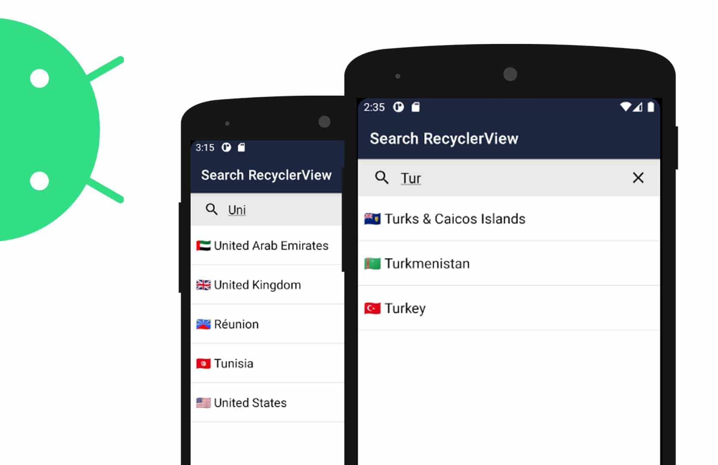
RecyclerView
The most significant performance issue with ListView is caused by creating new item objects for each item when scrolling.
RecyclerView is based on recycling the list items (the part that was optional in the ListView adapter).

Slide 9
RecyclerView
A recycler view accesses its data using an adapter.
Unlike a list view, however, it doesn’t use any of the built-in Android adapters such as array adapters. Instead, you have to write an adapter of your own that’s tailored to your data.
This includes specifying the type of data, creating views, and binding the data to the views.
Items are positioned in a recycler view using a layout manager.

Slide 10
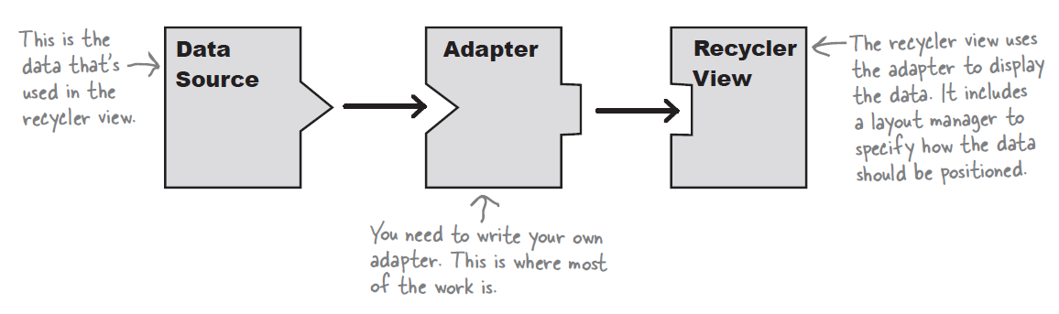
RecyclerView

Slide 11
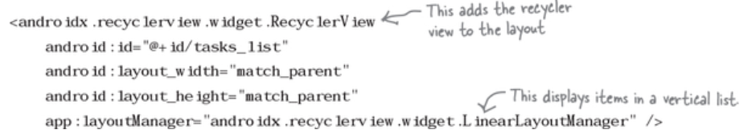

RecyclerView
Define RecyclerView in layout file:

Slide 12
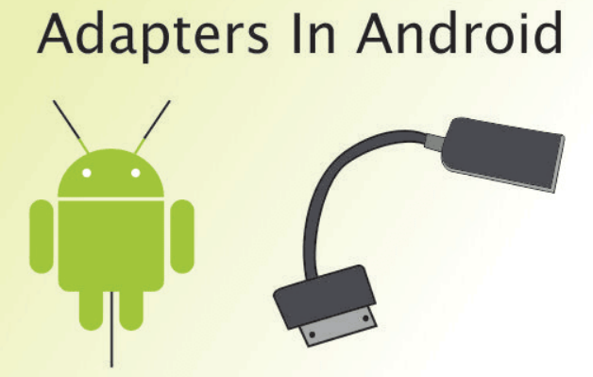
RecyclerView Adapter Class
Creating adapter class:
The adapter has two main jobs: to create each of the views that are visible within the recycler view, and to bind each view to a piece of data.
Steps in creating adapter class:
Specify what data the adapter should work with
Define the views the adapter should populate
Bind the data to the cards

Slide 13
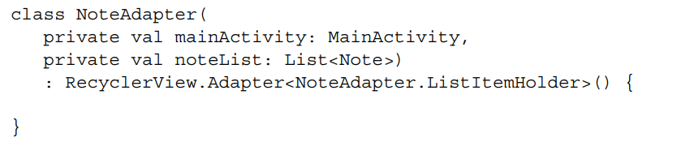
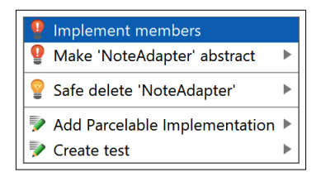
RecyclerView Adapter Class
Extends the adapter class with RecyclerView.Adapter class and overriding various methods.

Slide 14

RecyclerView Adapter Class
This process adds the following three methods:
The onCreateViewHolder method, which is called when a layout for a list item is required.
The onBindViewHolder method, which is called when the RecyclerAdapter is bound (connected/associated with) the RecyclerView in the layout.
The getItemCount method, which will be used to return the number of Note instances in the ArrayList. Now it just returns zero.

Slide 15
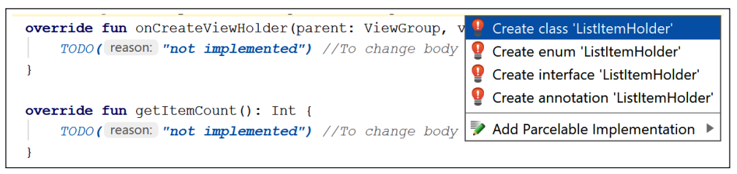
RecyclerView Adapter Class
However, we still have many errors due to the NoteAdapter.ListItemHolder class does not exist.
Click the error in the class declaration and select Create class 'ListItemHolder'.

Slide 16
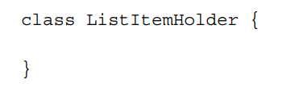
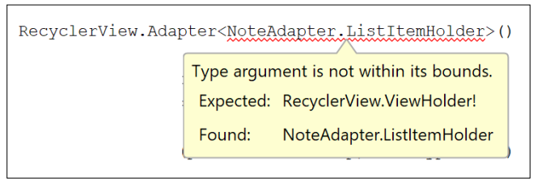
RecyclerView Adapter Class
The following code has been added to the NoteAdapter class:
But there is still one error with the class declaration

Slide 17


RecyclerView Adapter Class
We should extends the ListItem class with:
'android.recylerview.widget.RecyclerView.ViewHolder‘
Example:
Furthermore, ViewHolder doesn't provide a default constructor, so we need to do it.

Slide 18
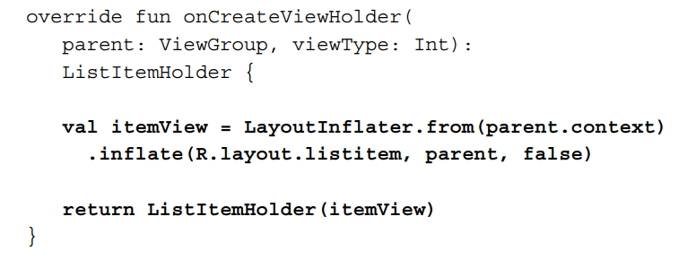
RecyclerView Adapter Class
Sample code in onCreateViewHolder:

Slide 19
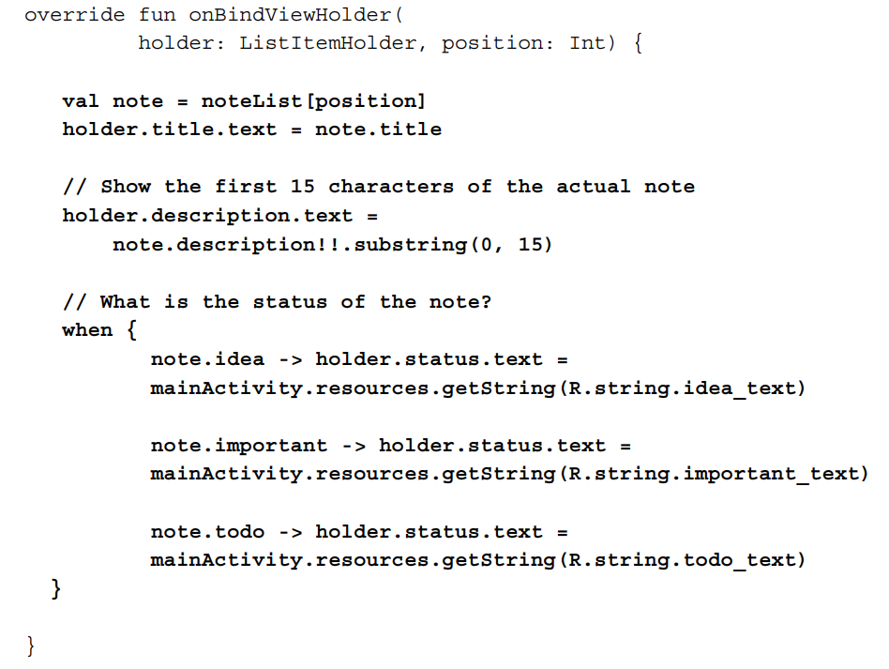
RecyclerView Adapter Class
Sample code in onBindViewHolder:

Slide 20
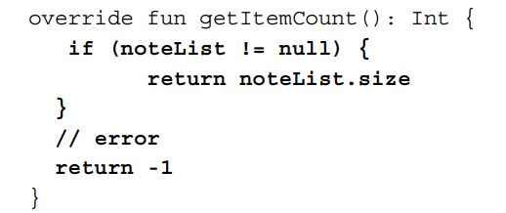
RecyclerView Adapter Class
Sample code in getItemCount:

Slide 21
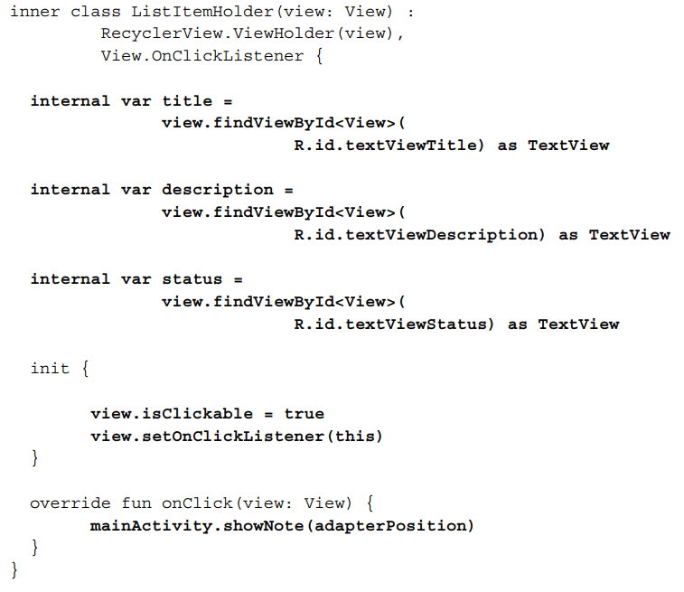
RecyclerView Adapter Class
Sample code in ListItemHolder class:

Slide 22
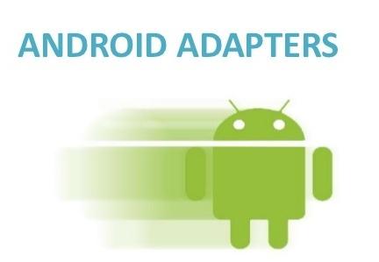
RecyclerView in MainActivity
We have to initialize the RecyclerView object in MainActivity class and assign appropriate layout using layoutManager.
The itemAnimator and addItemDecoration methods make each list item a little more visually enhanced with a separator line between each item in the list.
The last thing is to call adapter method to populate the data item.

Slide 23
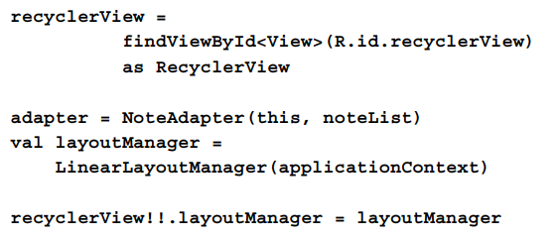
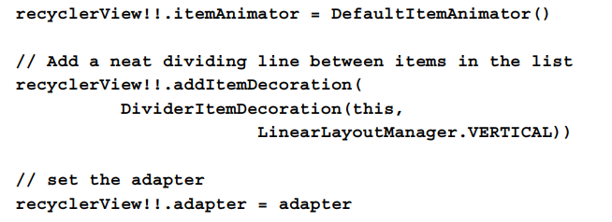
RecyclerView in MainActivity
Sample code in MainActivity

Slide 24

Summary
CardView
RecyclerView
ViewHolder class
Adapter class

