Slide 1

Week 9: Room Database
CET3013: Mobile application development

Slide 2
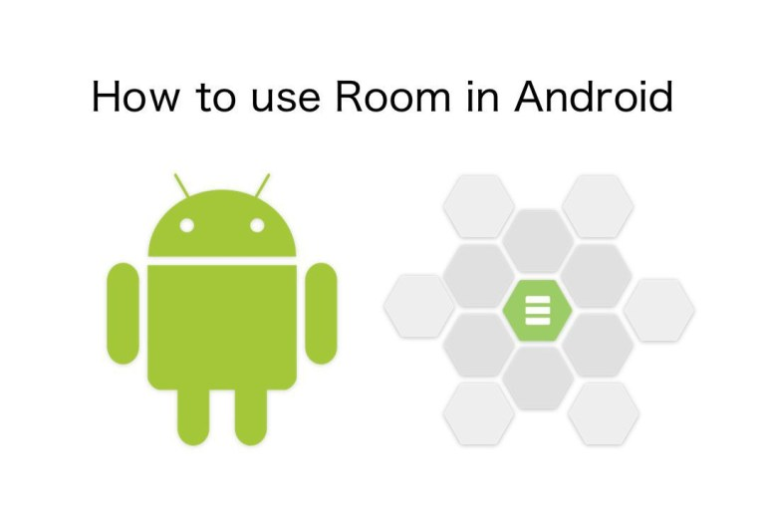
Today's Topics
Room Overview
Entity
Data Access Object
Room Database
View Model
Repository
LiveData

Slide 3

Room overview
Room is a robust SQL object mapping library
Generates SQLite Android code
Provides a simple API for your database

Slide 4
Components of Room
Entity: Defines schema of database table.
DAO: Database Access Object Defines read/write operations for database.
Database: A database holder. Used to create or connect to database
RoomDatabase
LiveData
LiveData
Entity
SQLite
DAO

Slide 5
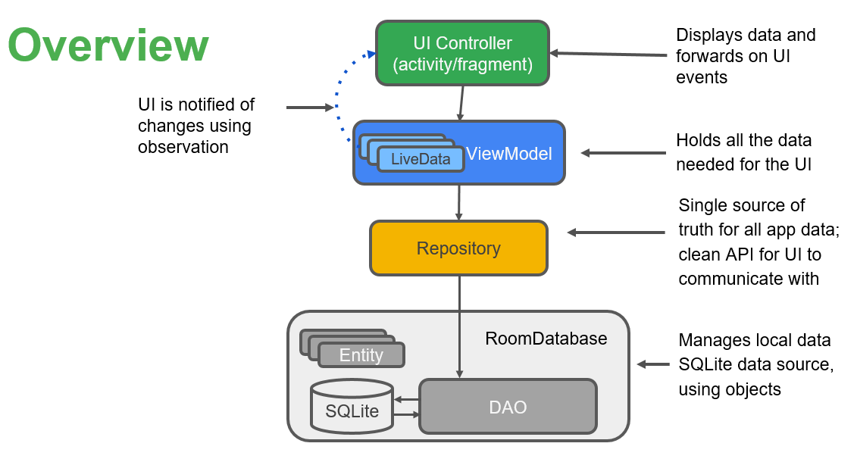
Room Database Architecture

Slide 6
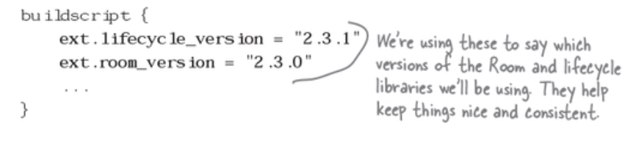
Room Configuration in Android Studio
Open the file build.gradle, and add the following lines (in bold) to the buildscript section (The version might be different)

Slide 7
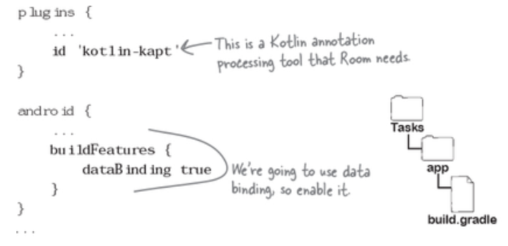
Room Configuration in Android Studio
In the app’s build.gradle file, we need to enable data binding, and add dependencies for the view model, live data, and Room libraries.

Slide 8
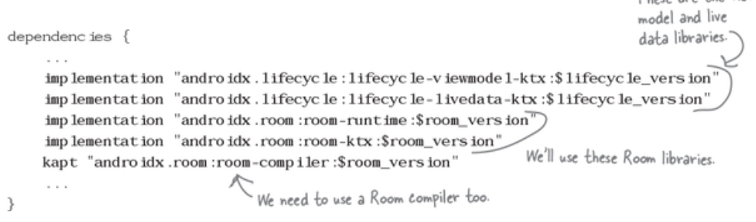
Room Configuration in Android Studio

Slide 9
Entity
Entity instance = row in a database table
Define entities as POJO classes
1 instance = 1 row
Member variable = column name
class Person {
var uid:Int
var firstName:String
var lastName:String
}
RoomDatabase
LiveData
LiveData
Entity
SQLite
DAO

Slide 10
Entity instance = row in a database table
class Person {
var uid:Int
var firstName:String
var lastName:String
}
uid | firstName | lastName
12345 | Aleks | Becker
12346 | Jhansi | Kumar

Slide 11
Annotate entities
@Entity
class Person {
@PrimaryKey (autoGenerate=true)
var uid:Int
@ColumnInfo(name = "first_name")
var firstName:String
@ColumnInfo(name = "last_name")
var lastName:String
// + getters and setters if variables are private.
}

Slide 12
Annotate entities for Data Class
@Entity
data class Person (
@PrimaryKey (autoGenerate=true)
var uid:Int,
@ColumnInfo(name = "first_name")
var firstName:String,
@ColumnInfo(name = "last_name")
var lastName:String
)

Slide 13
@Entity annotation
@Entity(tableName = "word_table")
Each @Entity instance represents an entity/row in a table
Specify the name of the table if different from class name

Slide 14

@PrimaryKey annotation
@PrimaryKey (autoGenerate=true)
Entity class must have a field annotated as primary key
You can auto-generate unique key for each entity
See Defining data using Room entities

Slide 15

@NonNull annotation
@NonNull
Denotes that a parameter, field, or method return value can never be null
Use for mandatory fields
Primary key must use @NonNull

Slide 16


@ColumnInfo annotation
@ColumnInfo(name = "first_name")
var firstName:String
@ColumnInfo(name = "last_name")
var lastName:String
Specify column name if different from member variable name
first_name
last_name

Slide 17

Getters, setters
Every field that's stored in the database must
be public
OR
have a "getter" method
… so that Room can access it

Slide 18

Relationships
users table
Use @Relation annotation to define related entities
Queries fetch all the returned object's relations
id
name
pet
pets table
id
name
owner
Notes:
Relationship example:
User and Pet, where Pet is its own object
Don't go into detail, the main point is that Room supports relationships

Slide 19
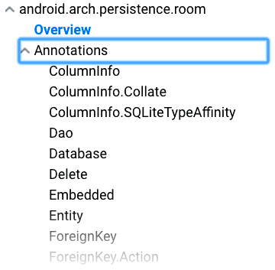
Many more annotations
For more annotations, see Room package summary reference

Slide 20
Data access object
Use data access objects, or DAOs, to access app data using the Room persistence library
RoomDatabase
LiveData
LiveData
Entity
SQLite
DAO

Slide 21
Data access object
DAO methods provide abstract access to the app's database
The data source for these methods are entity objects
DAO must be interface or abstract class
Room uses DAO to create a clean API for your code

Slide 22
Example DAO
@Dao
interface WordDao {
@Insert
fun insert(word:Word) //INSERT INTO<-NO NEED
@Update
fun updateWords(word:Word)
}
//... More queries on next slide...

Slide 23
Example queries
@Query("DELETE FROM word_table")
fun deleteAll()
@Query("SELECT * from word_table ORDER BY word ASC")
fun getAllWords(): List<Word>
@Query("SELECT * FROM word_table WHERE word LIKE :word ")
fun findWord(String word): List<Word>

Slide 24
Room
Room is a robust SQL object mapping library
Generates SQLite Android code

Slide 25
Room
Room works with DAO and Entities
Entities define the database schema
DAO provides methods to access database
RoomDatabase
LiveData
LiveData
Entity
SQLite
DAO

Slide 26
Creating Room database
Create public abstract class extending RoomDatabase
Annotate as @Database
Declare entities for database schema and set version number
@Database(entities = {Word.class}, version = 1)
abstract class WordRoomDatabase: RoomDatabase() {}

Slide 27

Room class example
Entity defines
DB schema
@Database(entities = {Word.class}, version = 1)
abstract class WordRoomDatabase :RoomDatabase {
abstract fun wordDao(): WordDao
companion object {
private var INSTANCE: WordRoomDatabase?=null
// ... create instance here
}
}
DAO for database
Create database as singleton instance

Slide 28
Use Database builder
Use Room's database builder to create the database
Create DB as singleton instance
private var INSTANCE: WordRoomDatabase?=null
INSTANCE = Room.databaseBuilder(...)
.build();

Slide 29
Specify database class and name
Specify Room database class and database name
INSTANCE = Room.databaseBuilder(
context.applicationContext,
WordRoomDatabase::class.java, "word_database")
//...
.build()

Slide 30
Specify onOpen callback
Specify onOpen callback
INSTANCE = Room.databaseBuilder(
context.applicationContext,
WordRoomDatabase::class.java, "word_database")
.addCallback(callback)
//...
.build()

Slide 31
Specify migration strategy
Specify migration strategy callback
INSTANCE = Room.databaseBuilder(
context.getApplicationContext(),
WordRoomDatabase::class.java, "word_database")
.addCallback(callback)
.fallbackToDestructiveMigration()
.build()

Slide 32

Room database creation example
Internal fun getDatabase(context:Context): WordRoomDatabase? {
if (INSTANCE == null) {
synchronized (this) {
if (INSTANCE == null) {
INSTANCE = Room.databaseBuilder(
context.applicationContext
WordRoomDatabase::class.java, "word_database")
.addCallback(callback)
.fallbackToDestructiveMigration()
.build()
}}}
return INSTANCE
}
Check if database exists before creating it

Slide 33
Initialize DB in onOpen callback
private val callback: object:RoomDatabase.Callback() {
override fun onCreate db:SupportSQLiteDatabase){
super.onOpen(db)
db.execute("Insert… ")//we can use it to populate data
}
}

Slide 34

Room caveats
Compile-time checks of SQLite statements
Do not run database operations on the main thread
LiveData automatically runs query asynchronously on a background thread when needed
Usually, make your RoomDatabase a singleton
Notes:
we will discuss LiveData soon

Slide 35
ViewModel
View models are objects that provide data for UI components and survive configuration changes.
ViewModel
LiveData
LiveData
LiveData

Slide 36

ViewModel
Provides data to the UI
Survives configuration changes
You can also use a ViewModel to share data between fragments
Part of the lifecycle library

Slide 37



Survives configuration changes
Activity Instance
ViewModel
Rotation Event
Activity UI Data
Re-created Activity Instance

Slide 38

ViewModel serves data
ViewModel serves data to the UI
Data can come from Room database or other sources
ViewModel's role is to return the data, it can get help to find or generate the data
Notes:
Here we see a server "serving" up the salad that the customer requested. View models serve up the data that is requested

Slide 39

Best practice to use repository
Recommended best practice:
Use a repository to do the work to get the data
Keeps ViewModel as clean interface between app and data
Repository is discussed in next section
Notes:
Here we see the kitchen staff preparing the salad behind the scenes. The repository does the work of getting the data behind in the background

Slide 40
Restaurant analogy
Customer requests meal from server
Server takes order to chefs
Chefs prepare meal
Server delivers meal to customer
UI requests data from ViewModel
ViewModel asks Repository for data
Repository gets data
ViewModel returns data to UI
Notes:
using a repository keeps the functionality of who does what very clean -- ViewModel "serves" data, but doesn't necessarily have to go find it
Task separation

Slide 41
ViewModel example using repository
class WordViewModel(application.Application : AndroidViewModel(application) {
private val mRepository: WordRepository = WordRepository(application)
private val mAllWords: LiveData<List<Word>>
// Initialize the repository and the list of words
init {
mAllWords = mRepository.getAllWords()
}
}

Slide 42
ViewModel example continued
fun getAllWords(): LiveData<List<Word>> {
return mAllWords
}
fun insert(word: Word) {
mRepository.insert(word)
}
fun deleteWord(word: Word) {
mRepository.deleteWord(word)
}

Slide 43
Do not pass context into ViewModel
Never pass context into ViewModel instances
Do not store Activity, Fragment, or View instances or their Context in the ViewModel
An Activity can be destroyed and created many times during the lifecycle of a ViewModel
If you need application context, inherit from AndroidViewModel

Slide 44
ViewModel does not survive app closure
ViewModel survives configuration changes, not app shutdown
ViewModel is not a replacement for onSaveInstanceState() (if you are not saving the data with Room)
See Saving UI States
Notes:
In the practicals, you use ViewModel with Room. However, you can use ViewModel without Room; the goal of ViewModel is to provide data to the UI. If that data changes and the app quits, the changed data is lost if you don't save it somehow.

Slide 45
Repository
Best practice, not part of Architecture Components libraries
Implement repository to provide single, clean API to app data
Repository

Slide 46
Repository fetches or generates data
Use repository to fetch data in the background
Analogy: chefs prepare meals behind the scenes
Notes:
analogy: if meals are already plated, fetch a plated meal, otherwise create the meal from scratch

Slide 47
Multiple backends
Repository
Dao
Network
Potentially, repository could manage query threads and allow you to use multiple backends
Example: in Repository, implement logic for deciding whether to fetch data from a network or use results cached in the database
Notes:
analogy: if meals are already plated, fetch a plated meal, otherwise create the meal from scratch

Slide 48
Repository example
class WordRepository (application:Application) {
private var mWordDao: WordDao?
val mAllWords = LiveData<List<Word>>()
init {
val db:WordRoomDatabase? = WordRoomDatabase.getDatabase(application)
mWordDao = db?.wordDao()
mAllWords = mWordDao.getAllWords()
}
[... more code…]
}

Slide 49
Get and insert data
private val coroutineScope = CoroutineScope(Dispatchers.Main)
fun getAllWords(): LiveData<List<Word>> {
return mAllWords
}
// Must insert data off the main thread
fun insertWord(newWord: Wprd) {
coroutineScope.launch(Dispatchers.IO) {
asyncInsert(newproduct)
}
}
private fun asyncInsert(word: Word) {
wordDao?.insertWord(word)
}
[... more code…]
}

Slide 50
LiveData
LiveData is a data holder class that is aware of lifecycle events. It keeps a value and allows this value to be observed.
ViewModel
LiveData
LiveData
LiveData
Use LiveData to keep your UI up to date with the latest and greatest data.

Slide 51

LiveData
LiveData is observable data
Notifies observer when data changes
Is lifecycle aware:
knows when device rotates or app stops

Slide 52

Use LiveData to keep UI up to date
Create an observer that observes the LiveData
LiveData notifies Observer objects when the observed data changes
Your observer can update the UI every time the data changes

Slide 53
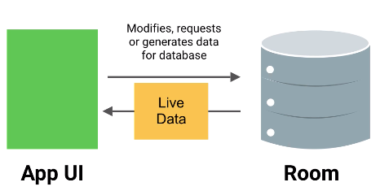
Creating LiveData
To make data observable, return it as LiveData:
@Query("SELECT * from word_table)
fun getAllWords(): LiveData<List<Word>>

Slide 54



Using LiveData with Room
Room generates all the code to update the LiveData when the database is updated

Slide 55
Passing LiveData through layers
When you pass live data through the layers of your app architecture, from a Room database to your UI, that data must be LiveData in all layers:
DAO
ViewModel
Repository

Slide 56
Passing LiveData through layers
DAO:
@Query("SELECT * from word_table")
fun getAllWords(): LiveData<List<Word>>
Repository:
mAllWords: LiveData<List<Word>> = mWordDao.getAllWords()
ViewModel:
mAllWords: LiveData<List<Word>> = mRepository.getAllWords()

Slide 57
Observing LiveData
Create the observer in onCreate() in the Activity
Override onChanged() in the observer to update the UI when the data changes
When the LiveData changes, the observer is notified and its onChanged() is executed

Slide 58
Observing LiveData: example
viewModel.getAllWords()?.observe(this) { words->
words?.let {
adapter?.setWordList(it)
}
}

Slide 59
No memory leaks
Observers are bound to Lifecycle objects which are objects that have an Android Lifecycle
Observers clean up after themselves when their associated lifecycle is destroyed

Slide 60
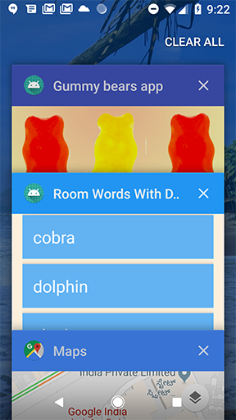
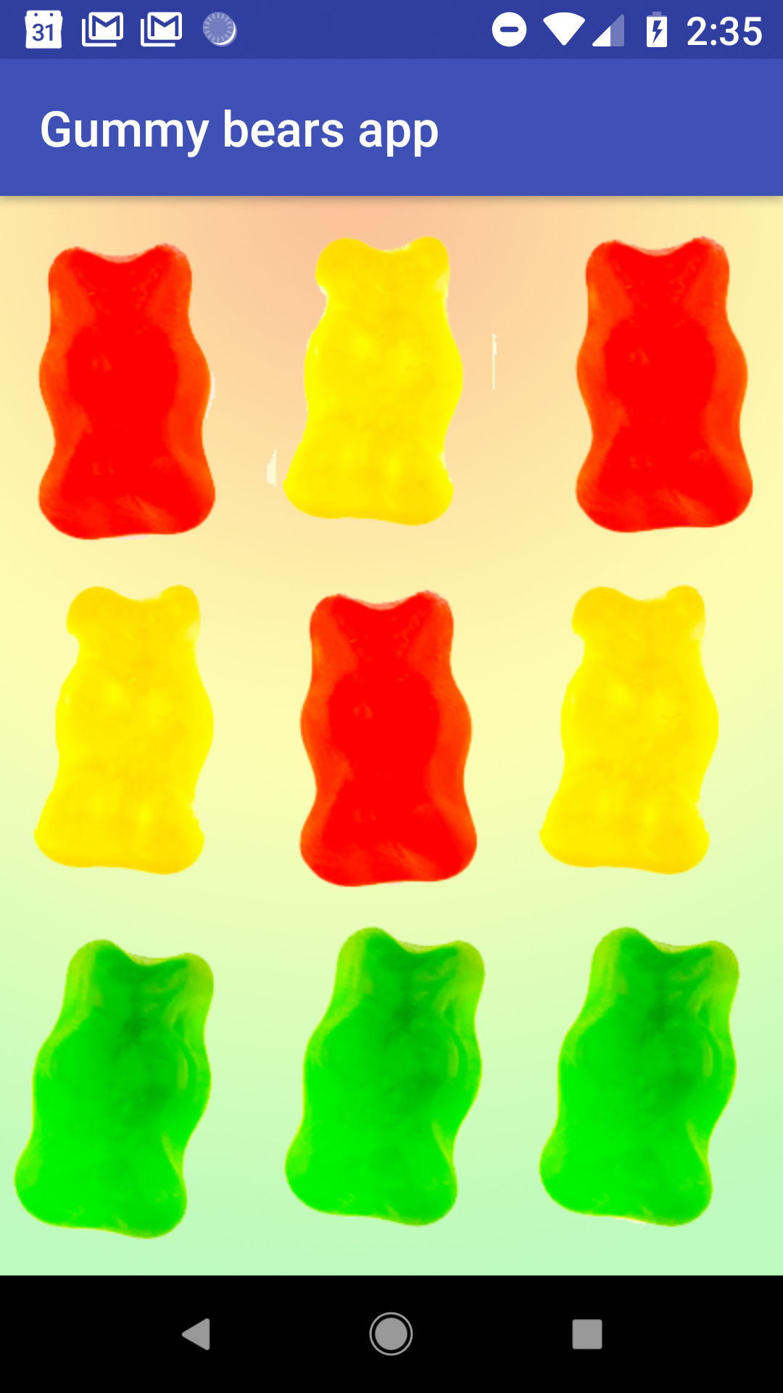
LiveData is always up to date
If a lifecycle object becomes inactive, it gets the latest data when it becomes active again
Example: an activity in the background gets the latest data right after it returns to the foreground

Slide 61
LiveData handles configuration changes
If an activity or fragment is re-created due to a configuration change such as device rotation, the activity or fragment immediately receives the latest available data

Slide 62
Share resources
You can extend a LiveData object using the singleton pattern, for example for services or a database
The LiveData object connects to the system service once, and then any observer that needs the resource can just watch the LiveData object
See Extend LiveData

Slide 63

END

