Slide 1
DSM2294 – Lecture 4a
Linux – Boot process

Slide 2
Linux Startup Flow
power on
BIOS
Checks memory, loads options from non-volatile memory, checks for boot devices, loads MBR of boot device and executes it
MBR
Contains a “boot loader” and the partition table
Traditionally set up by LILO/GRUB
Boot loader
Loads the compressed kernel image into memory
The kernel uncompress itself and starts…
Init process
Configuration file /etc/inittab
run levels
BIOS
boot loader
Linux kernel
init
system ready

Slide 3
System Startup

Slide 4
How does a computer startup?
Booting is a bootstrapping process that starts operating systems when the user turns on a computer system
A boot sequence is the set of operations the computer performs when it is switched on that load an operating system

Slide 5
Booting sequence
Turn on
CPU jump to address of BIOS (0xFFFF0)
BIOS runs POST (Power-On Self Test)
Find bootable devices
Loads and execute boot sector from MBR
Load OS

Slide 6
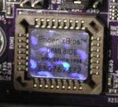
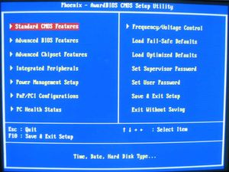
BIOS (Basic Input/Output System)
BIOS refers to the software code run by a computer when first powered on
The primary function of BIOS is code program embedded on a chip that recognises and controls various devices that make up the computer.
BIOS on board
BIOS on screen

Slide 7
Boot loader

Slide 8
MBR (Master Boot Record)
OS is booted from a hard disk, where the Master Boot Record (MBR) contains the primary boot loader
The MBR is a 512-byte sector, located in the first sector on the disk (sector 1 of cylinder 0, head 0)
After the MBR is loaded into RAM, the BIOS yields control to it.
The first 446 bytes are the primary boot loader, which contains both executable code and error message text
The next sixty-four bytes are the partition table, which contains a record for each of four partitions
The MBR ends with two bytes that are defined as the magic number (0xAA55). The magic number serves as a validation check of the MBR

Slide 9
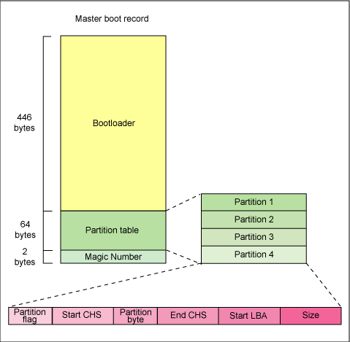
MBR (Master Boot Record)

Slide 10
Boot loader
Boot loader could be more aptly called the kernel loader. The task at this stage is to load the Linux kernel
Optional, initial RAM disk
GRUB and LILO are the most popular Linux boot loader.
Other boot loaders (for various OS):
Bootman, NTLDR, XOSL, BootX, loadlin, Gujin, Boot Camp, Syslinux, GAG

Slide 11
GRUB: GRand Unified Bootloader
GRUB is an operating system independent boot loader
A multiboot software packet from GNU
Flexible command line interface
File system access
Supports multiple executable format
Supports diskless system
Download OS from network

Slide 12
GRUB boot process
The BIOS finds a bootable device (hard disk) and transfers control to the master boot record
The MBR contains GRUB stage 1. Given the small size of the MBR, Stage 1 just load the next stage of GRUB
GRUB Stage 1.5 is located in the first 30 kilobytes of hard disk immediately following the MBR. Stage 1.5 loads Stage 2.
GRUB Stage 2 receives control, and displays to the user the GRUB boot menu (where the user can manually specify the boot parameters).
GRUB loads the user-selected (or default) kernel into memory and passes control on to the kernel.

Slide 13
LILO: LInux LOader
Not depend on a specific file system
Can boot from harddisk and floppy
Up to 16 different images
Must change LILO when kernel image file or config file is changed

Slide 14
Kernel

Slide 15
Kernel image
The kernel is the central part in most computer operating systems because of its task, which is the management of the system's resources and the communication between hardware and software components
The initial program was an exact image of the kernel, stored on disc, of what needed to be loaded into memory and "called" directly to get the kernel going.
The kernel is always stored on memory until computer is turned off
A kernel image is not an executable kernel, but a compressed version of the kernel.
zImage size less than 512 KB
bzImage size greater than 512 KB
Notes:
Kernel is a central component in operating systems which manages the system's resources and the communication between hardware and software components

Slide 16
Tasks of kernel
Process management
Memory management
Device management
System call

Slide 17
Init process
The first thing the kernel does is to execute init program
Init is the root/parent of all processes executing on Linux
The first processes that init starts is a script /etc/rc.d/rc.sysinit
Based on the appropriate run-level, scripts are executed to start various processes to run the system and make it functional

Slide 18
The Linux Init Processes
The init process is identified by process id "1“
Init is responsible for starting system processes as defined in the /etc/inittab file
Init typically will start multiple instances of "getty" which waits for console logins which spawn one's user shell process
Upon shutdown, init controls the sequence and processes for shutdown

Slide 19
Inittab file
The inittab file describes which processes are started at bootup and during normal operation
/etc/init.d/boot
/etc/init.d/rc
The computer will be booted to the runlevel as defined by the initdefault directive in the /etc/inittab file
id:5:initdefault:

Slide 20
Runlevels
A runlevel is a software configuration of the system which allows only a selected group of processes to exist
The processes spawned by init for each of these runlevels are defined in the /etc/inittab file
Init can be in one of eight runlevels: 0-6, S or M

Slide 21
Runlevels
Runlevel | Scripts Directory (Red Hat/Fedora Core) | State
0 | /etc/rc.d/rc0.d/ | shutdown/halt system
1 | /etc/rc.d/rc1.d/ | Single user mode
2 | /etc/rc.d/rc2.d/ | Multiuser with no network services exported
3 | /etc/rc.d/rc3.d/ | Default text/console only start. Full multiuser
4 | /etc/rc.d/rc4.d/ | Reserved for local use. Also X-windows (Slackware/BSD)
5 | /etc/rc.d/rc5.d/ | XDM X-windows GUI mode (Redhat/System V)
6 | /etc/rc.d/rc6.d/ | Reboot
s or S |  | Single user/Maintenance mode (Slackware)
M |  | Multiuser mode (Slackware)

