Slide 1
DTP3033N Technopreneurship
Topic 6: Winning Negotiation

Slide 2
Learning Outcome
Explain conflict management concepts.
Identify factors that contribute towards the organizational conflict.
Explain the techniques to overcome the conflict management.

Slide 3
"The art of communication is the language of leadership" James Humes.

Slide 4
Intro…
When people work as a group, conflict is one of the most predictable outcomes.
Most managers spend a lot of their working time dealing with conflicts or fallouts from people-related problems.

Slide 5
Conti…
Conflict refers to some form of friction, disagreement, or discord arising between individuals or within a group when the beliefs or actions of one or more members of the group are either resisted by or unacceptable to one or more members of another group.

Slide 6
Conti…
Classified into the following four types:
• Interpersonal conflict refers to a conflict between two individuals.
This occurs typically due to how people are different from one another.
• Intrapersonal conflict occurs within an individual.
The experience takes place in the person’s mind. Hence, it is a type of conflict that is psychological involving the individual’s thoughts, values, principles and emotions.

Slide 7
Conti…
Intra-group conflict is a type of conflict that happens among individuals within a team. The incompatibilities and misunderstandings among these individuals lead to an intra-group conflict
Inter-group conflict takes place when a misunderstanding arises among different teams within an organization.

Slide 8
Conflict management methods

Slide 9
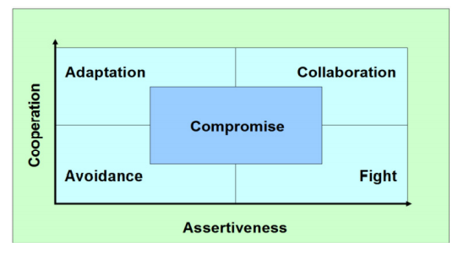

Slide 10
CONCLUSION / SUMMARY

