Slide 1
DTP3033N Technopreneurship
Topic 1: Why Entrepreneurship and starting a business?

Slide 2
Learning outcome
Examine the importance of the business plan and the MDEC requirement.
Define Entrepreneur.
Define Technopreneurship.
Identify the basic requirements to starting up a business.
Identify the types of business and the documents involved to start a business.
Identify the government incentive.
Describe a business idea.

Slide 3

What is Entrepreneurship?
Notes:
Self note: a business principle to create, manage and evolve products and services

Slide 4
Entrepreneur
Defined as:-
An individual who accepts financial risks and undertakes new financial ventures. (risk taker and opportunist)
The term is taken from…
The French words "entre" (to enter) and prendre" (to take)….
In the general sense, it applies to any persons starting a new project or trying a new opportunity
An entrepreneur invests (spend), transforms (change) and makes income (profit or loss)

Slide 5

Characteristics of entrepreneurs???
Generally Risk-taking Personality
Spontaneous Creativity
Ability And Willingness To Make Decisions

Slide 6

Why Technopreneurship???

Slide 7
TECHNOPRENEUR????
Technopreneur is come from 2 words:
Technology and
Entrepreneur.
It means a business that uses technology as their business model

Slide 8
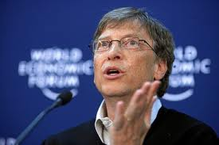
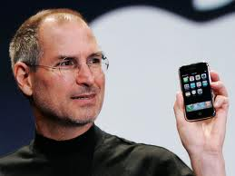
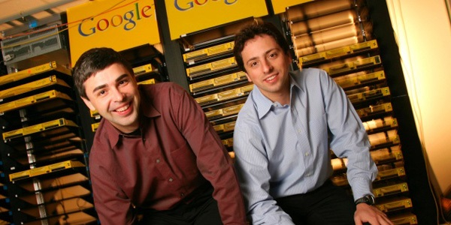

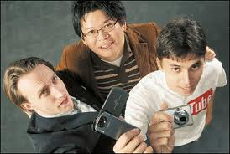

FAMOUS ICONS!!!
Larry Page and Sergey Brin
Steve Jobs
Bill Gates
Evan Spiegel
Mark Zuckerberg
Chad Hurley, Steve Chen, and Jawed Karim
Who are they??? Technopreneurs!

Slide 9
Definition
Technoprenuer ???
Who is technology savvy, creative, innovative, dynamic, dares to be different, take the unexplored path, and very passionate about their work.

Slide 10

Characteristics ????
Strive for great success
Take challenges
Continual improvement
Stride for next challenges
Look things differently
Try to redefine the dynamic digital economy
No fear to fail
Failure as an learning experience

Slide 11
Why be a Technopreneur???
Technology and entrepreneurial skills are driving many economies to prosperity.

Slide 12
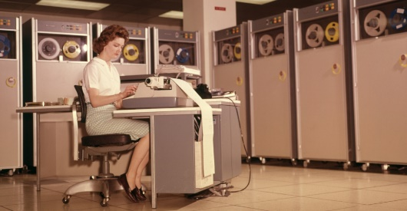
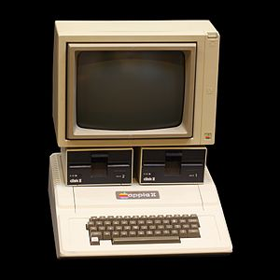
Example:
Steve Jobs:
innovative idea of a personal computer
revolutionized the computer hardware and software industry.
When Jobs was 21, he and a friend, Steve Wozniak, built a personal computer called the Apple.
Changed people's idea of a computer:
Apple Computer Inc made computers user-friendly and accessible.
Jobs re-introduced existing windows interface and mouse technology which became a standard for all applications interface in software.

Slide 13

Steps to Technopreneurship
Getting an idea
Meeting around the kitchen table
Getting the key people’s commitments
Pullout from employer
Creating the business plan
Setting up the management team
Raising capital
Close deal with the funding sources
Finding a base of operation
Starting up
Building the first product
Initial public offering
Review of the entire process
Notes:
Steps Overview:
Getting an idea
Sharing of ideas and obtain insights
Planning business initiatives (plan, team, capital)
Find base of operation
Start business and build product
Market products
Reflection of previous processes

Slide 14
Main Tools For A Technoprenuer (1)
Knowledge:
The knowledge about any particular business is as good as all other resources considered collectively.
This knowledge can be acquired by first hand experience, by consulting an agency that has the first hand experience or by professional training.
It also includes the knowledge about legalities involved with the business that one is looking upon.
Capital:
Money is the fuel and to start a business you need it to ignite the engines.
Though money or capital has taken many forms, but at the end of the day you need to have the ability to buy the resources, hire the people, set up an establishment, etc.
Notes:
Main tools for a technoprenuer business:
-Idea
-Capital
-Infrastructure
-Manpower

Slide 15
Main Tools For A Technoprenuer (2)
Manpower:
You may have a hundred machines, imported ones too that deliver great quality and are cost effective, but you will always need the right manpower to operate them.
In service industry also, manpower is very essential to the business.
In the initial stage or for start-ups, some minimum number of people must be committed to get things done.
Infrastructure:
The need for appropriate infrastructure various.
Many small home business models will require a bare minimum of equipments and workspace, a coffee shop can do with a kiosk, a small restaurant with sitting place for just 10 people, a school for 50 students and so on.

Slide 16
2 Important Questions
What type of business should you start?
How should you start such a business?
Notes:
Idea:
Pet café
Lol
Order specific pet to accompany customers via app

Slide 17
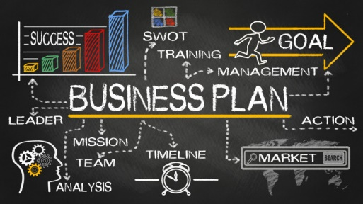
What’s Next???
You need to start with a PLAN!
More precisely… BUSINESS PLAN!

Slide 18
What is business plan?
A business plan
A formal statement of a set of business goals (fact), the reasons (why) why they are believed attainable, and the plan (how) for reaching those goals.
It may also contain background information about the organization or team attempting to reach those goals.
Business plan -> can be internally or externally focused.

Slide 19
Internally Focused Business Plans
Internally focused business plans target intermediate goals required to reach the external goals.
They may cover the development of a new product, a new service, a new IT system, a restructuring of finance, the refurbishing of a factory or a restructuring of the organization.
An internal business plan is often developed in conjunction with a balanced scorecard or a list of critical success factors.
This allows success of the plan to be measured using non-financial measures.
Notes:
scorecard : a record of achievements planned to be reached by a milestone

Slide 20
Externally Focused Business Plans
Externally focused plans target goals that are important to external stakeholders, particularly financial stakeholders.
They typically have detailed information about the organization or team attempting to reach the goals.
With for-profit entities, external stakeholders include investors and customers.
External stake-holders of non-profits include donors and the clients of the non-profit's services.
For government agencies, external stakeholders include tax-payers, higher-level government agencies, and international lending bodies such as the IMF, the World Bank, various economic agencies of the UN, and development banks.
Notes:
Internally vs Externally focused business plans
Internally focused business plans: target goals beneficial for the internal company
Externally focused business plans: target goals beneficial for external parties such as investors and benefactors

Slide 21
Types of Business Plans
Strategic plans: Business plans that identify and target internal goals, but provide only general guidance on how they will be met.
Operational plans describe the goals of an internal organization, working group or department.
Project plans, sometimes known as project frameworks, describe the goals of a particular project.
They may also address the project's place within the organization's larger strategic goals.

Slide 22
Business Plan Template
Table of Contents
Introduction <page number>
Objectives <page number>
Methodology <page number>
Sources of Information <page number>
Time Plan <page number>
Appendices <page number>
References <page number>
Bibliography <page number>

Slide 23
Why is business plan so important?
Business Plan as Reality Check (reference for validating task relevance)
Business Plan as Performance Tool
Business Plan as Message Sender
Business Plan as Motivation Tool
Business Plan as Management Development Tool
Business Plan as Road Map

Slide 24
Your business plan, once it is completed, will give you and your employees goals and direction:
a roadmap to follow in guiding your business through good and bad times.

Slide 25
CONCLUSION / SUMMARY

Slide 26

First Task????
Develop Business Idea!!!

