Slide 1
DTP3033N Technopreneurship
Topic 1: Why Entrepreneurship and starting a business? (Cont.)

Slide 2
Learning outcome
Examine the importance of the business plan and the MDEC requirement.
Define Entrepreneur.
Define Technopreneurship.
Identify the basic requirements to starting up a business.
Identify the types of business and the documents involved to start a business.
Identify the government incentive.
Describe a business idea.

Slide 3
Starting a Business
Starting a business generally requires the following:
1. A business concept or idea involving a product, service, process, or new technology.
2. People to support the work, whether as employees, vendors, or advisors.
3. A process by which the product or service will be delivered, or the technology will be developed.
4. Enough money to support the development of the idea to the point that it generates revenue.
Bonus:
- Motivation

Slide 4
Cont…
Main reasons go out on their own, rather than staying employed, are:
1. Control – to be their own boss
2. Ambition – to start something from scratch themselves
3. Financial – opportunity to earn more money

Slide 5
“ability and willingness to develop, organize and manage a business venture along with any of its risks in order to make a profit.”
Entrepreneurship

Slide 6
“is a practice of consistently converting good ideas into profitable commercial ventures using technology and innovation..”
TECHNOPRENEURSHIP

Slide 7
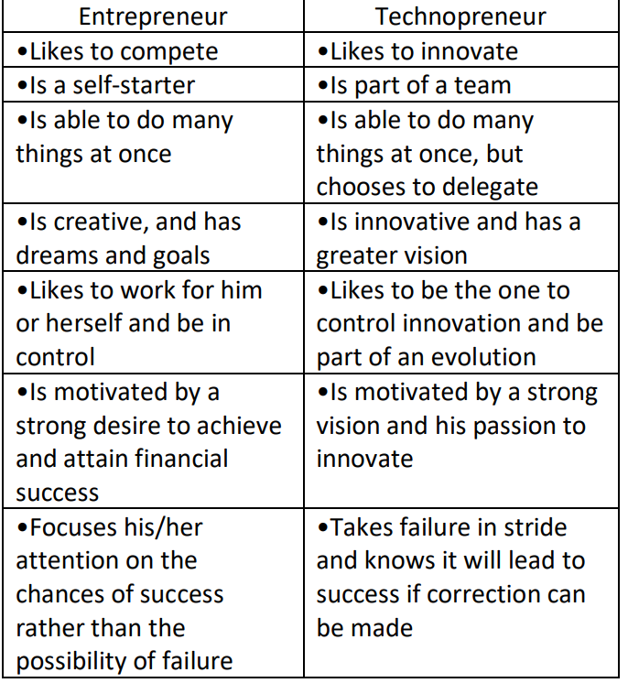
Entrepreneur vs Technopreneur
There are similarities and differences between entrepreneur and technopreneur.
Similarities:-
1. Identify needs,
2. Build products,
3. Mitigate risks,
4. Take the products to market.

Slide 8
Differences
Business model
Entrepreneur: Produces and evolves any products
Technopreneur: Produce technological innovations

Slide 9

Types of business
Main 5 types of business entity in Malaysia.
Partnership
Sole proprietorship
Private Limited Company (Sdn Bhd
Public Limited Company (Berhad)
Limited Liability Partnership (LLP)

Slide 10
Brief explanation:
Sole Proprietorship
simplest and cheapest to establish.
required to pay an annual fee - Companies Commission of Malaysia (SSM)
owned solely by only one individual
Only Malaysian citizens or permanent residents are permitted to register under this business entity.
Partnership
there are more than 1 owner.
joint-entity holder with 2 or more people and a maximum of 20 members.
only Malaysian citizens of permanent residents are permitted to register partnerships.

Slide 11
Brief explanation:
Limited Liability Partnership(LLP)
hybrid between a partnership and private limited company
corporate and a separate legal entity from its partners.
fewer compliance requirements
Private Limited Company / Sendirian Berhad (Sdn Bhd)
separate legal entity from its owners
company is considered as a legal ‘person’ that can buy or sell property.
allows an entrepreneur to keep their finances and assets separately from the business.
Notes:
Difference between LLP vs SdnBhd:
LLP powers scale economy e.g. industrial sectors that has little competitors and requires huge amount of capital - supports & impacts country economy
E.g. Education, Medical, Defences, Waste management
SdnBhd powers economy e.g industrial sectors that has lots of competitors and require adequate capital – lower than LLP
E.g. Trading, finance, marketing, manufacturing, food and beverage

Slide 12
Brief explanation:
Public Limited Company / Berhad(Bhd)
similar to private limited companies except that its shares can be offered to the public.
required to have a minimum of 2 shareholders and has more than 50 members and maximum number of members is unlimited.

Slide 13
Companies Commission of Malaysia
also known as Suruhanjaya Syarikat Malaysia, SSM
statutory body which was initiated under The Act of Parliament to regulate all sort of corporate and business affairs in Malaysia.
established in 2001 under the Companies Commission of Malaysia Act 2001.
deals with all sort of regulation and policies involved with business companies

Slide 14
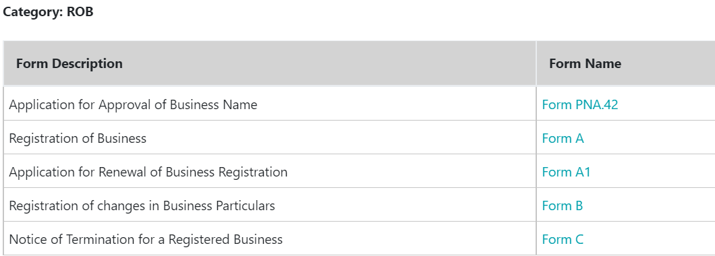
Example-Basic company registration forms

Slide 15
Government Incentive
GOVERNMENT FUNDING SCHEMES
Cradle Fund
Cradle Fund Sdn Bhd (Cradle) is Malaysia’s early stage start-up influencer, and has helped fund over 900 Malaysian tech start-ups and holds the highest commercialisation rate amongst government grants in the country.
MDEC
Malaysia Digital Economy Corporation Sdn. Bhd. (MDEC) is the holistic, government-owned agency launched in 1996 to pioneer the transformation of Malaysia’s digital economy.
MTDC
For 25 years, Malaysian Technology Development Corporation (MTDC) has been the key player in technology commercialization in Malaysia and promoting the adoption of technologies by local companies.
MAVCAP
Malaysia Venture Capital Management Berhad (MAVCAP) raison d’être is to support seed, start-up early stage to late stage companies in the ICT industry as well as other high-growth industries. (including but not limited to content and digital media, IOT, e-commerce, financial tech, etc)

Slide 16
Government Incentive
STARTUP INCUBATORS
MaGIC
The Malaysian Global Innovation and Creativity Centre (MaGIC) has set its mission of building and growing the entrepreneurship ecosystem in Malaysia including support startups going regional and global.
MyCreative Ventures
MyCreative Ventures Sdn. Bhd. is a Government investment arm launched in September 2012 to spur Malaysia’s creative industry via strategic and innovative funding through debt or equity investments in Malaysian creative companies. RM200 million was allocated from the 2012 Malaysian Budget to help boost the creative industry’s significance to the Malaysian economy.
Cyberview Living Lab
The accelerator is another government initiative, with multiple partners running the program (used to be run by Watchtower, 1337, and so on). Thus, the mentorship is provided by different people each year or when the vendors change. The website states that they provide Value Added Services Up to RM50k.

Slide 17
Government Incentive
STARTUP INCUBATORS
1337 Ventures
1337 is a technology accelerator and early stage venture capital focused on pre-seed and seed stage investments in Malaysia as well as South East Asia. Our primary investments are technology solutions (social enterprises, commerce and other out-of-the-box solutions)
Axiata Digital Innovation Fund
Axiata Digital Innovation Fund has been created by Axiata, MAVCAP and Johor Corporation. The three public and private companies established and organized a venture capital fund that starts at RM80 million and offers investments of up to RM10 million per company.
Sunway iLabs Accelerator
The Sunway iLabs from Sunway Group has been established according to a partnership between Sunway University, Sunway Group and its venture capital division, Sunway Ventures. Sunway runs this accelerator in collaboration with Nexea Angels.

Slide 18
BUSINESS IDEA

Slide 19
What is a Business Idea?
A business idea is a concept that can be used for financial gain that is usually centered on a product or service that can be offered for money.
An idea is the first milestone in the process of building a successful business.

Slide 20
Characteristics of a Business Idea
A promising business idea should be:
Innovative
Unique
Problem solving
Profitable
Reliable
Useful to society

Slide 21
Innovation
Can be:
creating new ideas
new product development through research and development
improving existing services
The central focus of a business
Helps a business grow and become a market leader if they execute their ideas properly
Helps a business be more efficient, cost effective and productive
Should be built into the business strategy
to create a culture of innovation and drive forward creative problem solving

Slide 22
Examples of Innovation
Apple:
$2bn company in 1997 to a $700bn valuation in 2015
came from innovating existing products: Macbook, iPod, iPad, iPhone.
Tesla:
Made electric car cost effective, attractive to the mainstream public.
Revenues up by 54%, earning a market capitalization of $33bn.

Slide 23
Unique
Unique selling point (USP)
The factor that makes a company or product stand out from its competitors
Can be either through pricing, quality, customer service or innovation
Each successful company has a USP
E.g. Uber is the first company to offer an app to book a car ride but as competition catches up, Uber has had to innovate: Uber Rush, its delivery service option.

Slide 24
Problem Solving
Focus on providing solutions to problems or customer’s needs
Creative problem solving -> must-have products
E.g. easy-to-use, all-in-one phone -> iPhone
Solve real problems by making things smarter or better
Google -> made search better
Amazon -> made online buying and selling simpler
Netflix -> made on-demand streaming media accessible
Solve problems you identify with, or feel passionate about

Slide 25
Profitable
Profitability – a business’s ability to generate earnings compared to its costs over a certain period of time.
Must be sustainable in the long run -> increases survivability
Successful ideas have strong revenue streams
Current losses does not mean not profitable in the long run
Snapchat – valued at $10bn despite making a loss -> high monetization potential
Uber – valued at $50bn despite a $417m operating loss -> high longer-term potential

Slide 26
Business Idea – An Example
Technology meets nature
Gardening for tech-savvy veggie lovers
Sprout It - a website and mobile app for iPhone that helps novice gardeners plant smarter, healthier vegetable patches.
The app provides useful information:
what plants grow best in your location
guides for how to plant, care for and harvest your veggies and herbs
keep track of all your plants in a "virtual garden"
shows what each of your veggies should look like (seed to harvest)
remind you when to water your plants
Choose from an array of garden layouts

Slide 27
Ideas due to Current Pandemic
Healthcare: Using data, wearables, and VR to make care more accessible -Telehealth technology
Work: Sudden surge in remote work accelerates digital infrastructure adoption -Telecommuting tech
Education: Technology and online content make the classroom optional- Remote learning technology
Manufacturing: 3D and automation technology boost industry’s agility and flexibility - 3D printing, Industrial automation & robotics
Retail: Shopping goes even more online as grocery joins the e-commerce revolution -Enhanced e-commerce
Customer service: Customer experience goes virtual with conversational AI- Conversational AI/chatbots

Slide 28
Ideas due to Current Pandemic
Finance: Demand for contactless options accelerates digital adoption -Contactless payments
Security: Higher internet usage and data generation lead to increased investment – cybersecurity
Entertainment: “Real world” goes online with virtual reality and virtual events - Social online gaming, Virtual events
Food services: Social distancing propels take-outs and deliveries to success - Restaurant & grocery delivery

Slide 29
CONCLUSION / SUMMARY

