Slide 1
DTP3033N Technopreneurship
Intellectual Property

Slide 2
Intro…
Intellectual property concerns the legal rights associated with creative effort or commercial reputation.
Must be aware of the variety of ways that it can affect the management of innovation and the development of new products.

Slide 3
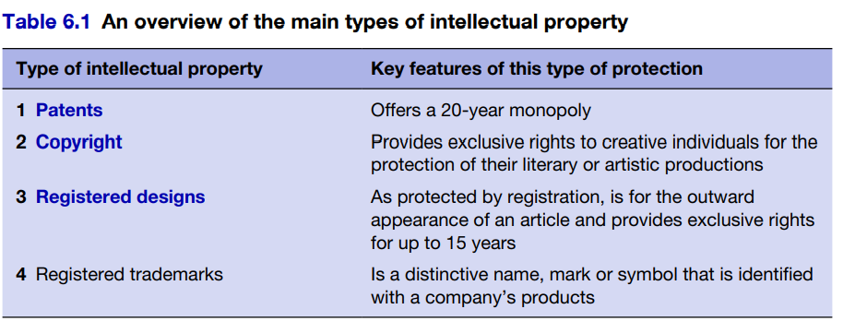

Slide 4
Patents
A patent is a contract between an individual or organisation and the state.
The rationale behind the granting of a temporary monopoly by the state is to encourage creativity and innovation within an economy.
Trademarks
Trademarks are closely associated with business image, goodwill and reputation.
For many companies, especially in the less technology-intensive industries where the use of patents is limited, trademarks offer one of the few methods of differentiating a company’s products.
for example, Apple Computers, the Apple logo

Slide 5
Registered Design
Protect the designs of the product. UK/US
Copyright
Copyright is recognised by the symbol © and gives legal rights to creators of certain kinds of material, so that they can control the various ways in which their work may be exploited.

Slide 6
IP- Malaysia
Laws
Copyright Act 1987.
Geographical Indications Act 2000.
Industrial Designs Act 1996 (Act 552).
Patents Act 1983

Slide 7
CONCLUSION / SUMMARY

