Slide 1
DTP3033N Technopreneurship
Topic 3: Business Plan-Sample

Slide 2
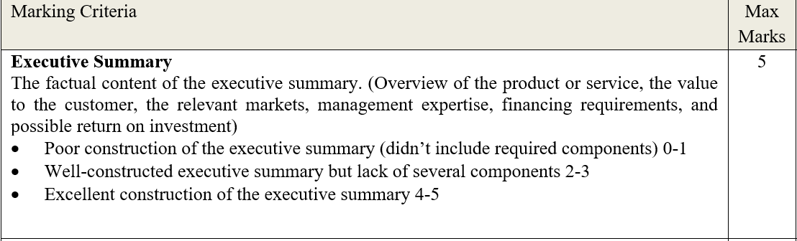

Slide 3
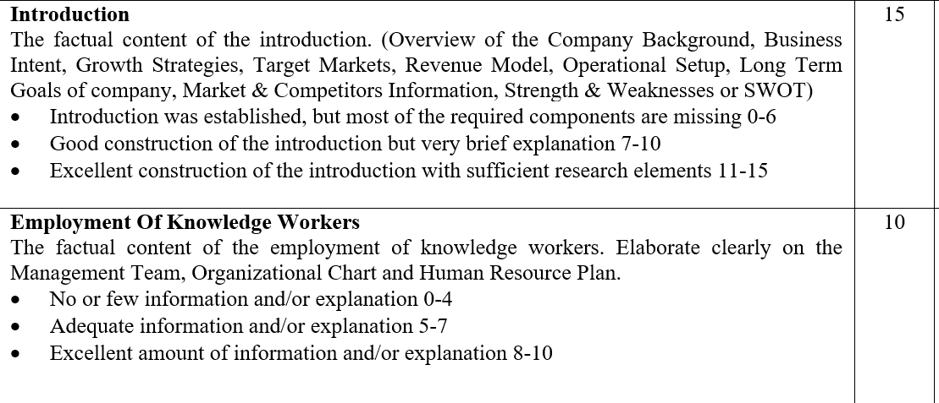

Slide 4
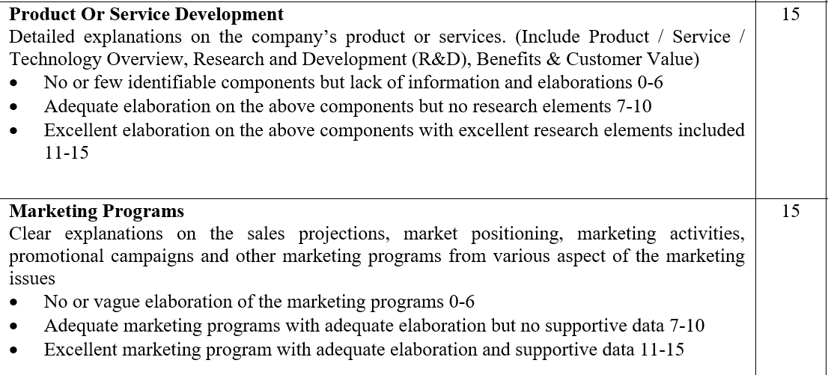

Slide 5
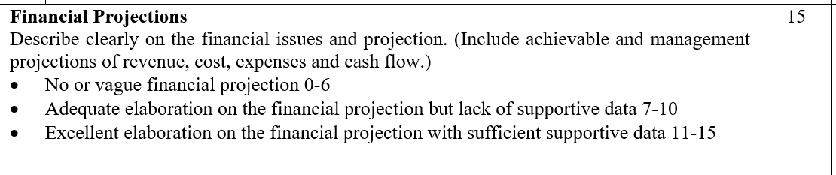

Slide 6
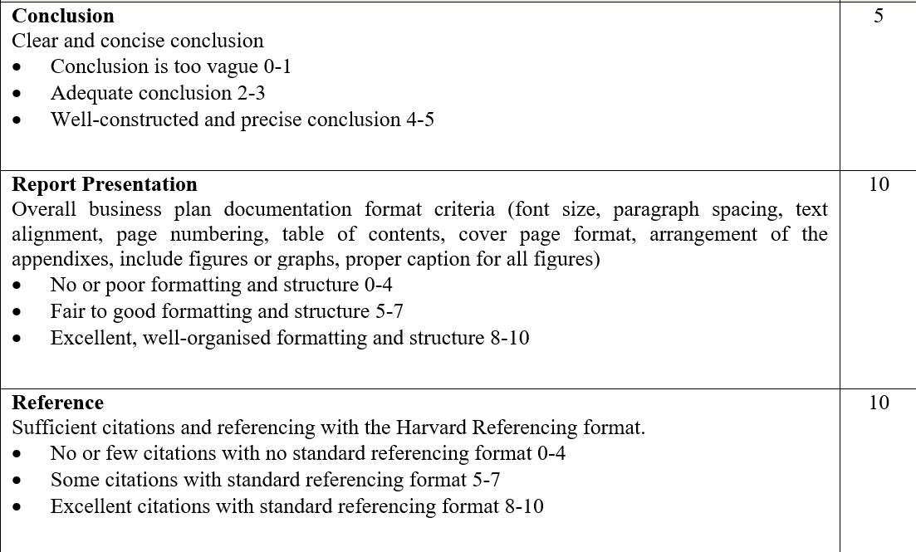

Slide 7

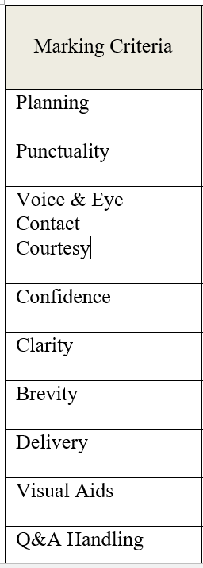

Slide 8
Refer to the sample-no copy and paste

Slide 9
CONCLUSION / SUMMARY

