Slide 1
DTP3033N Technopreneurship
Review Business Idea and SWOT Analysis

Slide 2
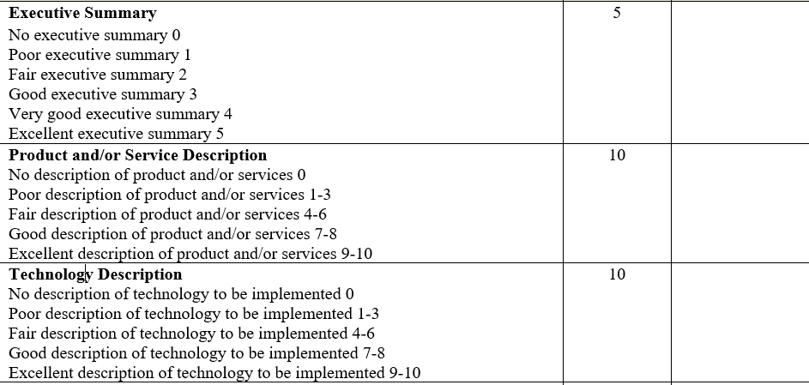

Slide 3
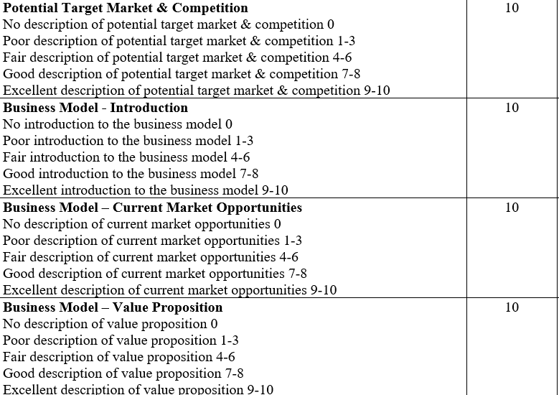

Slide 4
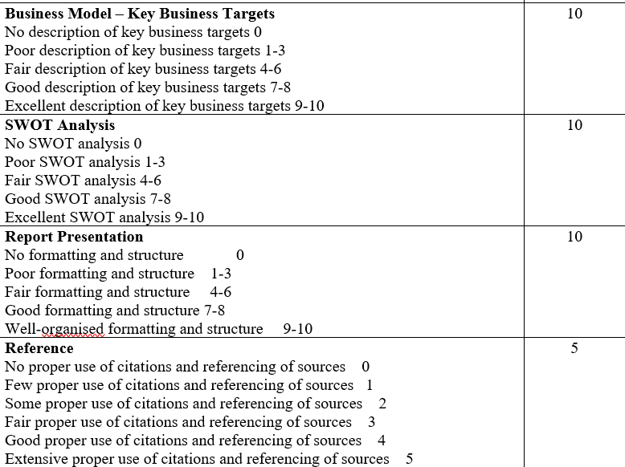

Slide 5
SWOT
Analysis and Strategic Matrix

Slide 6
Layers of Business Environment (With some selected analysis tools)
Industry (or sector) – Five Forces
Macro Environment – PESTLE
Organisation – Value Chain & Value System
Competitors & Markets – SWOT

Slide 7
SWOT
Internal
External
SWOT Analysis
Strengths
Weaknesses
Opportunities
Threats
SWOT Matrix
Using the results of the SWOT Analysis to identify possible strategic options

Slide 8
Identify Company Strengths and Resource Capabilities
A skill or important expertise
e.g. strong e-commerce expertise and technical knowledge
Valuable physical assets
e.g. leading edge computer resources and information systems
Valuable human assets
e.g. collective learning embedded in the organisation built up over time
Valuable organisational assets
e.g. e-commerce systems for exchanging information with suppliers and customers

Slide 9
Conti..
Alliances
e.g. cooperative ventures with suppliers or marketing allies
An achievement that has placed the company in a position of market advantage
e.g. low-cost advantage
Competitive capabilities
e.g. a R & D capability generating innovative ideas
Valuable intangible assets
e.g. brand image, company reputation

Slide 10
Identify Company Weaknesses and Resource Deficiencies
A weakness is:
something a company lacks or does poorly (in comparison to its rivals)
a condition that puts it at a competitive disadvantage
A weakness may relate to:
deficiencies in competitively important skills or expertise
lack of competitively important physical organisational or intangible assets
missing or weak competitive capabilities in key areas
A weakness may:
prevent a company from taking advantage of opportunities
leave a company open to attack by rivals

Slide 11
Determining the Competitive Value of a Company Resource
Differences in company resources account for why some companies are more profitable and competitively successful than others
Four tests of competitive value:
Is the resource hard to copy?
How long does the resource last?
Is the resource really competitively superior?
Can the resource be upstaged by different resources and capabilities of rivals?

Slide 12
Identifying a Company’s Market Opportunities
Market opportunities could be:
New technologies becoming available
e.g those associated with mobile computing
New markets opening up
e.g. when Russia and China opened up their markets
Rival companies suffering from problems
e.g. Ford acquiring Jaguar
A cautionary note:
Not every industry opportunity represents a company opportunity
Not every company has the resources or capability to successfully pursue each industry opportunity

Slide 13
Identifying the Threats faced by a Company
All companies face threats to their position from:
rivals, new products, new entrants, suppliers or buyers, or
changes in their market
changes in their microenvironment
Management has the responsibility to:
Identify the threats
Evaluate their affect:
Decide what strategic actions need to take place to:
Neutralise them, or
Lessen their impact

Slide 14
SWOT Analysis / Matrix
Identifying the Strengths, Weaknesses, Opportunities and Threats is a SWOT Analysis
The real value of a SWOT analysis is not in compiling four lists, it is applying that knowledge to develop a strategy
This is done using a SWOT Matrix, often known as a TOWS Matrix
Weihrich, H. (1982). The TOWS matrix—A tool for situational analysis. Long Range Planning, 15(2), 54–66

Slide 15
SWOT Matrix

Slide 16
SWOT Matrix Strategies
SO Strategy
How can your current strengths help you to capitalize on your opportunities?
Use Strengths to Exploit Opportunities
Maximise both Strengths and Opportunities (Maxi-Maxi)
ST Strategy
How can your current strengths help you identify and avoid current and potential threats?
Use Strengths to Confront Threats
Maximise Strengths while Minimising Weaknesses (Maxi-Mini)

Slide 17
SWOT Matrix Strategies
WO Strategy
How can you overcome your current weaknesses by using your opportunities?
Search for ways to overcome weaknesses by using Opportunities
Minimise Weaknesses while Maximising Opportunities (Mini-Maxi)
WT Strategy
How can you best diminish your weaknesses and Avoid current and potential threats?
Work to Avoid situations where External Threats coincide with Internal Weakneses (Mini-Mini)

Slide 18
SWOT Matrix
 | List Internal Strengths (S) (1) (2) | List Internal Weaknesses (W) (1) (2)
List External Opportunities (O) (1) (2) | SO Strategies: 1) 2) | WO Strategies: 1) 2)
List External Threats (T) (1) (2) | ST Strategies: 1) 2) | WT Strategies: 1) 2)

Slide 19
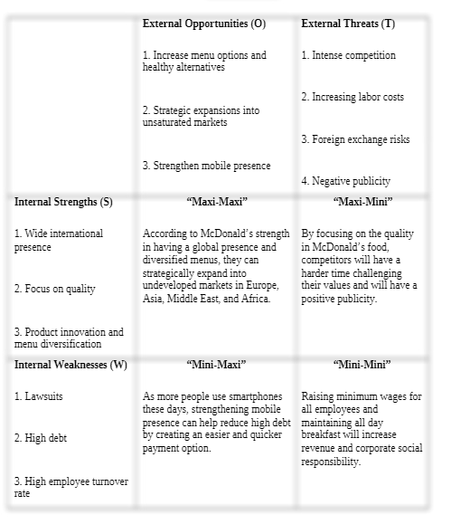
TOWS Analysis for McDonald

Slide 20
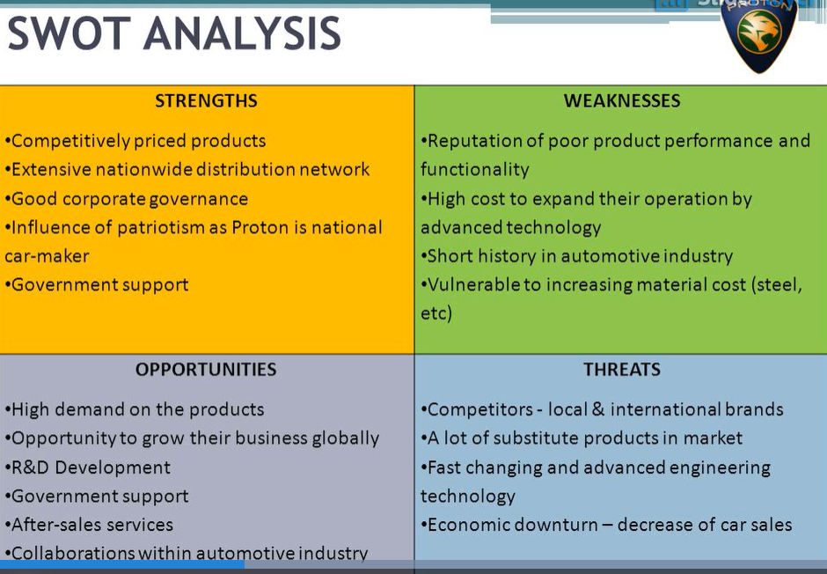

Slide 21
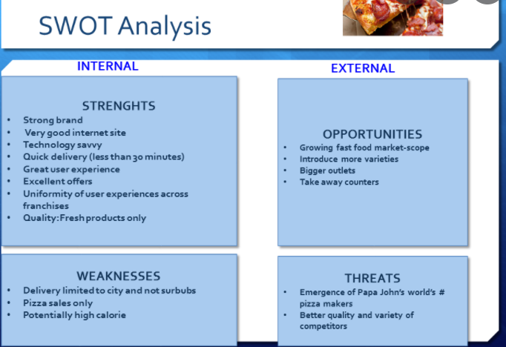
DOMINO

Slide 22
Create for your own company

Slide 23
CONCLUSION / SUMMARY

