Slide 1
DTP3033N Technopreneurship
Topic 4: Marketing (Cont.)

Slide 2
Learning outcome
Define marketing.
Describe how to market the developed product.
Identify the method to understand the target markets.
Identified the avenue to export.
Analyze the ground rules for export the product.
Analyze how to convince and satisfy customer.

Slide 3
The Marketing Mix
The Tools of Marketing Management

Slide 4
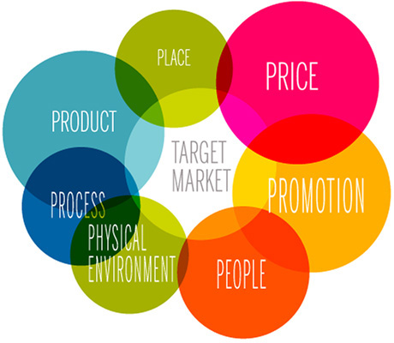
The Marketing Mix
Tools of marketing management employed by marketers.
Areas where marketing managers need to make decisions.
These decisions affect the nature of the offering or package of benefits that the organisation offers to customers.
The tools are commonly known as the 4P’s or 7P’s.

Slide 5

What is A Mix?
The point where a set of tools from the marketing toolbox or the marketing mix is selected in specific proportions to solve specific problems

Slide 6
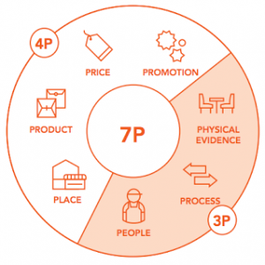
What are the tools?
Product
Price
Promotion
Place (Distribution)
People
Process
Physical evidence

Slide 7
Product
Quality
Features
Options
Style
Brand name
Packaging
Sizes
Services
Warranties
Returns

Slide 8
Price
The value that is put on the exchange process
List price
Discount
Allowances
Payment period
Credit terms

Slide 9
Promotion (Communication)
Advertising
Personal selling
Sales promotion
Public relations
Direct Marketing

Slide 10
Place (Distribution)
Channels
Coverage
Locations
Inventory
Transport

Slide 11
The Seven P’s
Booms and Bitner extended the traditional 4P (McCarthy) framework to seven to reflect a predominantly service economy (UK= 74% of GDP).
Extended mix:
People
Process
Physical evidence

Slide 12
People
The attitudes of staff
Training of staff
Internal relations
The observable behaviour of staff
The level of service-mindedness in the organisation
The consistency of appearance of staff
The accessibility of people
Customer-customer contacts

Slide 13
Process
The manner in which the service is delivered
Degree of customer contact
Quality control standards
Quality assurance
Payment methods (degree of convenience)
Queuing systems for customers
Waiting times

Slide 14
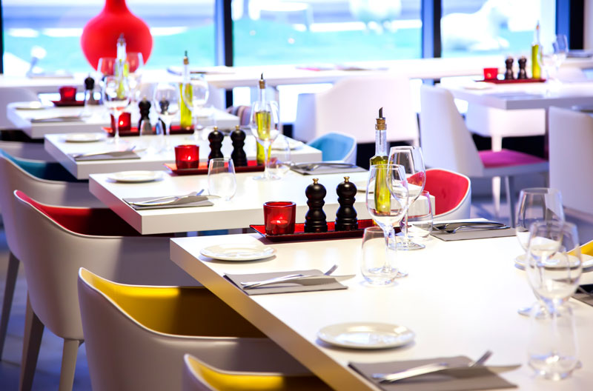
Physical Evidence - ambience
The “environment” or atmosphere in which the service is delivered
Buildings
Furnishings/décor
Layout
Goods associated with the service e.g. carrier bags, tickets, brochures
All the above can help shape customers’ perceptions of the service

Slide 15
Combining the Mix
The marketing manager has to identify the needs of his or her target market through marketing research and other investigative techniques.
The manager must understand customers’ characteristics and buying habits, for example.
He/she then has to blend the components of the mix to formulate strategies and tactics by which those needs can be met.

Slide 16
Combining the Mix
This is the essence of marketing: identifying, anticipating, and satisfying customer needs in the most profitable way possible: delivering profits to the organisation and value to customers at the same time!

Slide 17
Task

Slide 18
Relate to Your Company
How do you plan to apply any 4Ps for your company?

Slide 19
CONCLUSION / SUMMARY

