Slide 1
Chapter 8 Public Opinion, Participation, and Voting

Slide 2
Public Opinion Defined: Individual preferences about a given issue, candidate, or institution within a specific population.

Slide 3
How Do We Gauge or Measure Public Opinion? By Taking Public Opinion Polls or Surveys.

Slide 4
When researchers take a public opinion poll they use some form of random sampling (where every individual has an ascertainable and equal chance of being selected).

Slide 5
Errors in Opinion Polls or Surveys: In order to be accurate, a survey’s population must be safeguarded against the calculation of erroneous factors.

Slide 6
An opinion poll or survey must be representative of a population. Otherwise erroneously data will result. A survey of only college students, of only suburban residents, of only retirees, etc., will lead to incorrect conclusions.

Slide 7
Exit Polls are Traditionally Accurate: Asking people questions when they leave the polling stations.

Slide 8
Margin of Error Every poll or survey has a margin of error (a probable percentage that the date is inaccurate). Usually +/- 3% per 1,000 people polled.

Slide 9
Example of 3% Margin of Error: Candidate A: 24% (21% - 27%) Candidate B: 18% (15% - 21%) Candidate C: 22% (19% - 25%)

Slide 10
Some Polling Terminology: Panel Survey: Asking the same people questions over a period of time in order to track changes in opinion. Consensus: When a majority of the people polled agree on an issue. Polarization: When a majority of the people polled strongly disagree on an issue.

Slide 11
Some Polling Terminology: Intensity: The degree to which people feel strongly about any given topic. Latency: An opinion about something that isn’t yet expressed, typically until the issue manifests itself. Salience: The degree to which a particular issue is relevant to someone (the price of gas, food and energy were “salient” issues in the 2008 elections).

Slide 12
From Where Do We Get Our Political Views? Political Socialization is the term used by most political scientists to describe the process in which we develop our political beliefs and values.

Slide 13
Political Socialization Includes: Family, Schools, Church, Mass Media, Friends, Co-Workers, our Ethnic Makeup and Backgrounds, etc.

Slide 14
Selective Exposure: Our innate tendency to choose the news sources that typically comports with our already established beliefs.

Slide 15
Political Stability and Political Change Traditionally we as humans are slow to change what we believe politically. Our political beliefs tends to be strongly rooted in our family (and other) backgrounds, and are thus typically stable over time.

Slide 16
Political Stability and Political Change Harsh, life-changing events can shift those traditionally strong beliefs. Occurrences such as losing a job, going to war, worsening economic conditions, etc., can and often do alter a person’s political beliefs.

Slide 17
How Public Opinion Affects Public Policy Typically politicians observe and adhere to the general consensus of the people. Politicians tend to pay attention to and shape policy around public opinion. Why? Politicians care about being reelected.

Slide 18
Polling Data Shapes the Campaign Trail: McCain and Obama battled heavily in Pennsylvania, Ohio, Florida, Virginia, North Carolina (these became “battleground states”). But they did not campaign so strongly in Illinois, Texas, New York, California, etc. Because those state were already largely decided.

Slide 19
Political Awareness and Interest About 25% of our public is interested in politics most of the time (“attentive public”). They vote in most elections, watch the news regularly and discuss politics with others.

Slide 20
Political Awareness and Interest About 1/3 (roughly 33%) of Americans are hardly interested in politics or not at all interested. 40% of us are “part time citizens” (those that participate selectively in politics, such as in presidential elections only).

Slide 21
Voting Trends and Changes

Slide 22
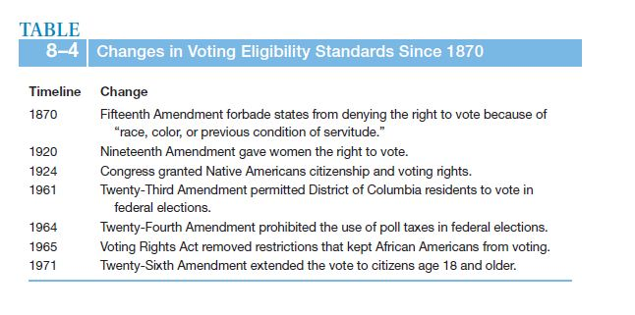

Slide 23
Voting Voting trends have dropped notably since the 1800s. Some political scientists attribute this to laws that establish voting requirements (voter registration, weekday voting, specific polling locations, photo ID at polling stations). These laws are designed to curtail voting fraud, but some suspect that they negatively impact voting numbers.

Slide 24
Voting Absentee voting (voting by mail), early poll station voting, and e-voting in some states have had a marginal increase on the number of people who vote.

Slide 25
Election Terminology Primary Elections – Where parties determine their candidates for office. General Elections – Where people chose the among the final candidates.

Slide 26
Election Terminology Presidential Elections – Election held when presidential candidates are on the ballot. Midterm Elections – Elections held between presidential elections (example: 2002, 2006, 2010). Off Year Elections – Elections held in odd numbered years (example: 2009).

Slide 27
Every Two Years: 1/3 of Senate seats are elected. Every Representative seat is elected.

Slide 28
Trends in Voter Turnout Turnout is typically higher in general elections than in primary elections. Turnout is higher in presidential elections versus midterm elections. Turnout is higher in midterm elections than in off year elections.

Slide 29
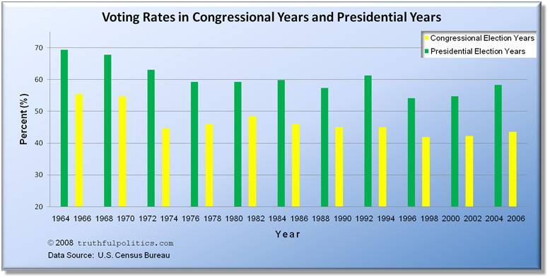

Slide 30
Trends in Voter Turnout 1960 Presidential Election: 65% of eligible voters turned out. 2004 Presidential Election: 60% of eligible voters. 2008 Presidential Election: ~61% turned out. 1998 Midterm Election: 38% turned out. 2002 Midterm Election: 39% turned out. 2006 Midterm Election: 40% turned out.

Slide 31
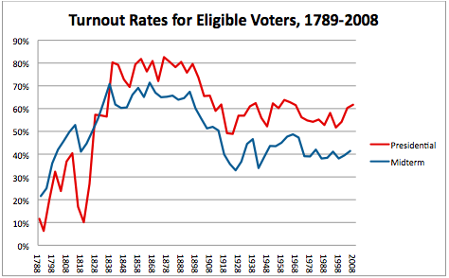

Slide 32
Who Votes? Higher education = higher voting rates Older people vote more than younger people Women tend to vote more than men Wealthier tend to vote more than the poor

Slide 33
Nonvoting: About 40% of eligible voters do not vote. Why? More people than ever are eligible to vote (compared to our Country’s past history of excluding minorities from voting). Poll taxes and literacy tests have been ruled unconstitutional.

Slide 34
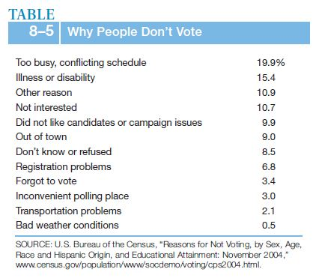

Slide 35
How We Vote When We Do Vote Voting based on party identification Voting based on candidate appeal Voting based on the Issues

Slide 36
How We Vote When We Do Vote Voting based on party identification We tend to vote for a particular candidate because of their party affiliation (i.e., they belong to the party that we prefer).

Slide 37
How We Vote When We Do Vote Voting based on candidate appeal Our tendency to vote for a candidate because we find them or their beliefs appealing (their personality, their values, their religious affiliation, their competency, their integrity, etc.).

Slide 38
How We Vote When We Do Vote Voting based on the Issues When we vote for a candidate because of their stance on certain issues (abortion, gun control, taxes, gay marriage, etc.).

Slide 39
Prospective Issue Voting: When we vote for a candidate based on what that person promises to do about a particular issue if elected.

Slide 40
Retrospective Issue Voting: When we vote on a candidate (or even their party) based on their records on certain issues. That is, punishing candidates for performing poorly. Also, rewarding them for having performed well.

Slide 41
Retrospective Issue Voting: Poor Economy = Outside party gains Congressional seats. Good Economy = Inside party retains or gains Congressional seats.

Slide 42
Retrospective Issue Voting: Voters tend to vote against the party in power when they (the voters) feel that they are not doing well financially.

Slide 43
Counting the Votes Each state (by way of the Secretary of State) is in charge of how elections are conducted (electronic polling versus punch cards; absentee voting, e-voting, etc.). States have a lot of freedom in regulating how and where their citizens vote (so long as the state’s rules or laws do not offend the Constitution or federal laws on voting).

Slide 44
Counting the Votes Additionally, voting methods can vary from county-to-county, and district-to- district within states, depending on how the voting system is structured by that state’s constitution.

Slide 45
The End.

