Slide 1
Chapter 7 Political Parties

Slide 2
Political Parties Organizations that seek to gain political power by having members of their group elected to public office.

Slide 3
Political parties exist to win elections and gain control over government.

Slide 4
Some elections are “nonpartisan” which means that the candidates are not identified with any specific party. An overwhelming majority of elections are “partisan” elections (i.e., the candidates are associated with a political party).

Slide 5
Current Political Makeup of Congress Democrats currently hold the majority in the Senate and the Republicans currently hold the majority in the House of Representatives. The party in charge chooses chairs and committees.

Slide 6
The party in power (especially the executive like the president or governor) often bestows patronage (political appointments) to loyal party supporters. Examples include appointments to cabinet positions, ambassadorships, judgeships, etc.

Slide 7
The United States is typically thought of as a “two party system” We have two major parties and third parties (aka minor parties) come and go, but often times there is a third party candidate on the ticket.

Slide 8
Each state determines how candidates for office get their names on the ballot. This is typically done by obtaining a minimum number of signatures on a nomination petition. Usually volunteers in each state are recruited to head up petition drives.

Slide 9
No third party has ever won the White House, but they have done better in winning seats in Congress, some gubernatorial races, and state/local races.

Slide 10
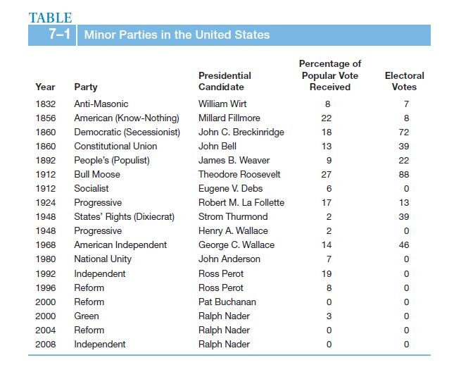

Slide 11
Divided Government: When one party controls Congress and the other party controls the White House. The opposite is often termed “united government” which is what we have now. 1992 – 1994 United government (Democrats) 1994 – Republicans won control of Congress 2000 – Republicans gained White House and kept control of Congress 2006 – Democrats retook Congress 2008 – Democrats gained White House and kept control of Congress. 2010 - Republicans gained control of House, Democrats retained Senate.

Slide 12
Organization of Political Parties Each party (Democrats and Republicans) holds a “National Party Convention” every 4 years in order to nominate candidates for president and vice president (after the primaries have been held), and to adopt an official party platform.

Slide 13
Each major party also has a “National Committee” which is in charge of party rules, meetings, etc. Each national committee has a “chair” as its top leader: Democratic National Committee (DNC): Chair = Tim Kaine (Former Gov. of Virginia) Republican National Committee (RNC): Chair = Reince Priebus (Wisconsin) who just replaced Michael Steele (Lt. Gov. of Maryland)

Slide 14
Official Party Platforms: At each national party convention (held every 4 years) each party votes on and adopts an official party platform. These are generalized, written statements on the parties’ goals and positions on certain issues.

Slide 15
Official Party Platforms: Platform positions are typically vague and general in nature. Party nominees can and do sometimes disagree with the official party platform.

Slide 16
Parties in the Federal Government Congress is very partisan. Powerful committees are chaired by the “in” party and the “out” party constantly seeks to gain control again.

Slide 17
Parties in the Federal Government Party loyalty is rewarded in the Executive Office with cabinet appointments and nominations to high ranking positions (patronage).

Slide 18
Parties in the Federal Government Federal judgeships are designed to be free from the pressures of politics. Federal judges are appointed for life terms and cannot be removed except by impeachment. In theory, this insulates them from changes in power in Washington.

Slide 19
How Parties Raise Money Political parties rely on donations from individuals, interest groups and fund raising events.

Slide 20
As discussed in earlier chapters, the courts have traditionally allowed some limitations on the amount of money that can be donated to a party or candidate for office.

Slide 21
Political money in the United States is often divided into two categories: "hard" money and "soft" money.

Slide 22
Hard Money: "Hard" money is contributed directly to a candidate of a political party. It is heavily regulated by law and the Federal Election Commission in both the source and the amount. Due to limitations placed on direct contributions the term “hard money” evolved, because of how difficult it is for candidates to get that kind of money.

Slide 23
Soft Money: "Soft" money is contributed to the political party as a whole. Historically, "soft money" referred to contributions made to political parties for purposes of party building and other activities not directly related to the election of specific candidates. Because these contributions were not used for specific candidate advocacy, they were not regulated by the Federal Election Campaign Act.

Slide 24
Soft Money: The Bipartisan Campaign Reform Act of 2002 (aka the McCain-Feingold Act) amended the Federal Election Campaign Act of 1971 to ban political parties from accepting unlimited soft money contributions.

Slide 25
The End.

