Slide 1
Chapter 10 The Media and U.S. Politics

Slide 2
Media Influences Politics Politics Influences Media

Slide 3
Media also Influences Public Opinion Differences Between Reporting and Opinion: The Nightly News Versus Rush Limbaugh, Keith Oberman, Glenn Beck, Sean Hannity, etc., etc., etc.

Slide 4
Media also Influences Public Opinion Spin doctors take a political event, political statement, political speech, etc., and “spin” it in a way that makes it appear more or less appealing.

Slide 5
Media also Influences Public Opinion Brings unforgettable events to our attention which can shape our opinions about certain matters: September 11th – Hurricane Katrina

Slide 6
Media and Politics The Penny Press (Birth of the Newspaper) The Federalist Papers Newspapers (Declining) Radio (FDR’s “Fireside Chats,” Sunday Radio Address) Television (1960 Nixon/Kennedy Debate) Internet (Increasing)

Slide 7
Investigative Journalism Press as a watchdog of the government. Referred to informally as the 4th estate or the 4th branch of government. In the 1960s and 1970s we grew ever-distrustful of our government officials. Investigative journalism was born.

Slide 8
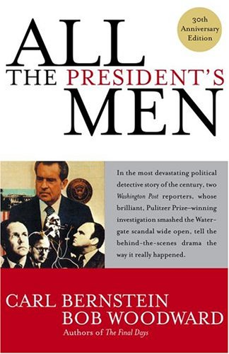
On the topic of media and politics: Recommended Book: “All the President’s Men”

Slide 9
The Media Covers Political Events Shapes our opinions about politicians, candidates for office, political events, etc. By keeping us informed we are able to formulate opinions about our political culture.

Slide 10
When the Press Doesn’t Pay Attention to Politics (or Ignores Some News Items) 2000 presidential election overshadowed massive deregulation package that was pushed through Congress.

Slide 11
70% of the public views the press as a watchdog that keeps government officials from misbehaving. From the Times Mirror, January 16, 1992.

Slide 12
The End.

