Slide 1
Chapter 9 Campaigns and Elections

Slide 2
Plurality versus Majority Sometimes those terms are used interchangeably, but they do mean different things.

Slide 3
In Election Parlance: Majority = More than 50% of the votes Plurality = More votes than all other candidates

Slide 4
Simple Majority: Most any election or contest involving only two people: Candidate 1: 51% Candidate 2: 49%

Slide 5
Extraordinary Majority: When something more than a simple majority is needed. Usually this is not associated with elections, but does appear in other aspects of our system of government. Examples . . .

Slide 6
Examples of Extraordinary Majority: Congress can override a Presidential veto with 2/3 vote (~66%) of both houses.

Slide 7
Examples of Extraordinary Majority: A constitutional amendment is proposed in Congress and both houses must pass it by 2/3 vote; or Congress can call a convention at the request of the legislatures in 2/3 of the states

Slide 8
Examples of Extraordinary Majority: Two ways that the states can ratify a proposed amendment: Approval by ¾ of the state legislatures or Approval by special ratifying convention in ¾ of the states ¾ = 75%

Slide 9
Examples of Extraordinary Majority: Impeachment . . . Simple Majority in the House but 2/3 Majority in the Senate

Slide 10
Plurality: Where no candidate gets a majority (50% or more), so the winner is the one that gets more votes than anyone else). Candidate 1: 35% Candidate 2: 25% Candidate 3: 40%

Slide 11
The U.S. Electoral System

Slide 12
Fixed Terms: Our elected officials serve for a limited period of time and when that time is up they must either run for reelection or leave office (if there are term limits for that particular office). Members of the US House: Serve 2 year terms Members of the US Senate: Serve 6 year terms

Slide 13
Not all offices are up for reelection at the same time. Our federal electoral system is staggered: All House seats are up for election every 2 years, but only 1/3 of the Senate seats are up for election at a time, and the Presidential election is held every 4 years.

Slide 14
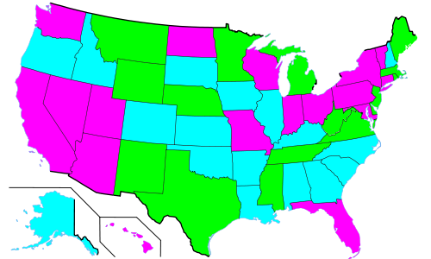
Election of U.S. Senate Seats is Based on 3 Different Classes Article I, § 3 of the Constitution

Slide 15
Term Limits Term limits are common more on the state level than the national level. Several states have term limits on how long their legislators and governors can remain in office. The federal government does not have term limits on members of congress but the President can only serve two four-year terms (See the 22nd Amendment)

Slide 16
It would take a constitutional amendment to place term limits on members of Congress. States can not place term limits on U.S. Senators or U.S. House members. This is the holding in the Supreme Court case U.S. Term Limits Inc. v. Thornton (1995)

Slide 17
Winner-Take-All (sometimes called First-Past-The-Post) elections are very common to the U.S. electoral system. The person that wins the majority or plurality wins the race (in other words, the person who comes in second gets nothing). In some (mainly parliamentary) countries elections result in an apportionment of power to the candidates (this is called proportional representation).

Slide 18
Running for Congress

Slide 19
Running for Congress is extremely expensive. Elections for the House of Representatives typically costs upwards of a million dollars. Senate elections cost many millions of dollars.

Slide 20
Why the Difference in Costs? Candidates for a House seat need only campaign in a specific district (a handful of counties in a particular state). Candidates for a Senate seat however must campaign for votes across the entire state.

Slide 21
Incumbents (already elected officials) tend to enjoy a high rate of reelection, especially in the House of Representatives (over 90%). Turnover is higher in the Senate than in the House.

Slide 22
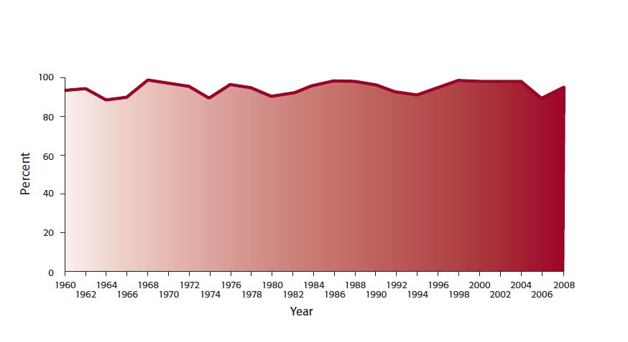
U.S. House Incumbents Reelected (1960 – 2008)

Slide 23
Incumbents have the advantage of established name recognition, popularity, and it’s easier for them to raise money from donors than it is for their lesser known challengers.

Slide 24
Running for the House or Senate Every two years each seat in the House is up for election (435 seats). Every two years 1/3 of the Senate seats are up for election (~33 seats). Most are incumbents running for reelection.

Slide 25
Running for the House or Senate - Candidates announce their intentions to run for their party’s nomination; - Candidates begin fund raising efforts; - Candidates begin campaigning for the primary (speeches, campaign ads, etc.); In the nomination phase the candidates are running for their respective party nomination (which will be decided by a primary).

Slide 26
Running for the House or Senate After the campaigning for nomination the state will hold a primary (anywhere from January through September).

Slide 27
Running for the House or Senate Voters will turnout for the primary and vote for the candidate that they want to run in the November general election. Closed Primary: Voters can only vote for a candidate of the party that they belong to. This is the most common. Open Primary: Voters can vote across party lines (cross-party voting). Mixed Primary : Independents can vote for Democrats or Republicans.

Slide 28
Running for the House or Senate Whichever candidate wins the majority or plurality of votes wins the party nomination and will go on to the general election in November.

Slide 29
Running for the House or Senate Primary Election Democrats Candidate 1 Candidate 2 Candidate 3 Candidate 4 Republican Candidate 1 Candidate 2 Candidate 3 Candidate 4 Third Party 1 Third Party 2

Slide 30
Running for the House or Senate Primary Election Democrats Candidate 1 Candidate 2 -------------------- Winner Candidate 3 Candidate 4 Republican Candidate 1 Candidate 2 Candidate 3 -------------------- Winner Candidate 4 Third Party 1 -------------------- Winner Third Party 2 -------------------- Winner

Slide 31
Running for the House or Senate The candidates that won in the primary election begin campaigning for the general election in November. The purpose of the general election is to pick an ultimate winner from the candidates who prevailed in the primary election.

Slide 32
Running for the House or Senate The winner of the general election will be the person who obtains the most votes (either a majority or a plurality).

Slide 33
Running for the House or Senate General Election Democrats Candidate 1 Candidate 2 -------------------- Winner ---------- 41 % Candidate 3 Candidate 4 Republican Candidate 1 Candidate 2 Candidate 3 -------------------- Winner ---------- 49 % ------------ Winner Candidate 4 Third Party 1 -------------------- Winner ---------- 8 % Third Party 2 -------------------- Winner ---------- 2 %

Slide 34
Running for the House or Senate General Election Democrats Candidate 1 Candidate 2 -------------------- Winner ---------- 38 % Candidate 3 Candidate 4 Republican Candidate 1 Candidate 2 Candidate 3 -------------------- Winner ---------- 52 % ------------ Winner Candidate 4 Third Party 1 -------------------- Winner ---------- 8 % Third Party 2 -------------------- Winner ---------- 2 %

Slide 35
The 17th Amendment U.S. Senators are now elected directly by the people.

Slide 36
Running for President

Slide 37
Running for President Campaigning for and winning the presidency differs greatly from how Congressional elections are won.

Slide 38
Steps of a Presidential Election - Announcing candidacy - Running for party nomination (primary or caucus elections) - Campaigning at the party convention - Campaigning to win the general election

Slide 39
Typically, a year or so before the presidential elections people begin to officially announce their candidacy. They will develop a strategy, start the fund raising process and prepare to campaign for their party’s nomination.

Slide 40
Several candidates will initially throw their hats into the ring for their party nomination. In the beginning there could be upwards of a dozen candidates per party (Democrats and Republicans) all competing for their respective party nomination. Third party candidates are different, they don’t go through the nomination process (they get on state ballots by obtaining a certain number of signatures. This is much more difficult than the nomination process that the major parties must go through).

Slide 41
From January through June of the election year states will hold presidential primaries or caucuses. Most states hold primaries but some hold caucuses. The results of these ballots will determine how many delegates will represent each candidate at the national party nominating convention (which is usually held in July or August of the election year).

Slide 42
Caucasus: Open forums where people show up in churches, town halls, schools, fire departments, etc. They openly vote for a candidate (usually a showing of the hands). Primaries: Closed forum elections. Ballots are cast in secret.

Slide 43
In a presidential election the caucuses and primaries serve the same purpose: to select delegates to go to the national convention. They are simply conducted in different formats.

Slide 44
Caucus States: Iowa Nevada Hawaii Maine Alaska Colorado Idaho Kansas Minnesota Montana North Dakota Nebraska Washington Wyoming (All other states hold primaries or conventions)

Slide 45
The caucuses and primaries do not decide directly which candidate will get the party nomination. Instead, they decide which candidate’s delegates will attend and vote at the nominating convention.

Slide 46
The delegate selection process varies greatly from state-to-state and is very complex. The Republicans have about 2,300 delegates and the Democrats have around 4,119

Slide 47
Each state has a set number of delegates. In State X the Republicans have 100 delegates and the Democrats have 200 delegates. Apportionment of delegates depends on party rules in each state. The party rules in State X might require a proportional system or winner-take-all system. So, the Democratic candidate that wins the most votes in State X might get all 200 delegates (winner-take-all) or the delegates might be divide proportionally among all the Democratic candidates.

Slide 48
Depending on the state law and particular party rules, when voters cast their ballots for a candidate in a presidential caucus or primary, the resulting delegates may be “bound” or “pledged” (obligated to vote for the candidate that the people picked) or “unpledged” (free to vote for someone other than whom the people picked).

Slide 49
Each major party (Democrats and Republicans) have both “pledged” and “unpledged” delegates. The most common are “pledged” delegates.

Slide 50
The Democratic Party has “super delegates” who are party leaders. Their votes at the nominating convention is worth more than the average delegate’s vote. Super delegates are unpledged and can vote as they wish. The Republican Party does not have super delegates.

Slide 51
Iowa Caucus and New Hampshire Primary The state law of Iowa requires that it be the first state to hold a presidential caucus. The state law of New Hampshire requires that it be the first to hold a presidential primary.

Slide 52
The Iowa Caucus is held early in the presidential election year. The 2012 Iowa Caucus is set for February 6, 2012. Candidates will typically campaign heavily at the Iowa Caucus because historically the outcome will determine the fate of many candidates. The media and the nation watch the Iowa Caucus closely. A candidate that does well in the Iowa Caucuses is likely to go on to campaign in other states. If a candidate gets trounced in Iowa, that usually spells defeat for that particular person’s campaign. Thus the Iowa Caucus is a great barometer of what will happen later in the election.

Slide 53
The New Hampshire primary is also held early in the presidential election year. The 2012 New Hampshire primary is set for January 24, 2012. The media and the nation watches the New Hampshire primary nearly as closely as they do the Iowa Caucus, and for the same reasons: those candidates that do well tend to have better luck campaigning in other states afterwards. Those who don’t tend to get defeated early on.

Slide 54
Other State Primaries and Caucuses then Follow Iowa and New Hampshire The 2008 Calendar: January 3 - Iowa Caucus January 5 - Wyoming Caucus January 8 - New Hampshire Primary January 15 - Michigan Primary January 19 - Nevada Caucus January 26 - South Carolina Primary January 29 - Florida Primary February 1 - Maine Caucus February 5 - Super Tuesday (~23 state caucuses/primaries)

Slide 55
Once the primaries and caucuses are over, both parties (Democrats and Republicans) will hold their national party convention. The purpose of the national party convention is to pick the presidential nominee, vice presidential nominee and decide on a party platform.

Slide 56
At the party’s national convention a candidate needs a majority of that party’s delegates to be nominated.

Slide 57
The delegates that we send to the party conventions will cast their ballots for which candidate will get the official party nomination. Most are pledged votes, some are left to the discretion of the delegate. In actuality, the person that ends up getting the party nomination is well-known way ahead of time, based on which candidate does best overall in the caucuses and primaries, and the fact that most of the delegates are pledged and bound to cast their ballot for whichever candidate got the most votes in the state.

Slide 58
The national party conventions are thus more of a traditional formality anymore, but candidates still participate because it’s a great opportunity to capitalize on all of the media attention.

Slide 59
After the party has nominated (chosen) their candidate for the White House, the party nominee will give their acceptance speech. In many cases the nominee will go ahead and announce his Vice Presidential running mate. The winner of the party’s nomination (the presidential candidate) actually casts a vote for his Vice Presidential running mate (the nominee has one vote).

Slide 60
The 12th Amendment The President and Vice President must run for office together.

Slide 61
After the party conventions conclude, the second phase of the presidential campaign begins: the election campaign.

Slide 62
From July/August – November the presidential candidates will campaign for the November general election. The candidates will give speeches, run ads, attend fund raisers and, very importantly, engage in public debates. They will spend more time in certain states than in others (based on how many electoral votes the state is worth, political trends, and poll results).

Slide 63
The Nonpartisan Commission on Presidential Debates determines the dates, locations and format of the presidential debates and the vice presidential debates.

Slide 64
Under the Commission’s rules third parties are not able to participate in the debates unless they average 15% or more on the polls used by the commission for calculating participation, and they must be on the ballots in enough states to feasibly be able to win enough electoral votes to win the presidency.

Slide 65
The presidential election is held on the first Tuesday following the first Monday in November. The election is considered “national” (i.e., all states participate at once, unlike the staggered elections that took place in the campaign for nomination), but really it’s a state election for the President.

Slide 66
Elections are held in every state and the candidates compete for the number of electoral votes each state is worth. The winner of the state’s electoral votes is the candidate that gets the most votes in the state (plurality or majority).

Slide 67
The number of electoral votes is based on the number of U.S. House and Senate members from that state: WV = 5 electoral votes (2 Senators and 3 members in the House of Representatives)

Slide 68
Most states award their electoral votes on a winner-take-all basis. So whomever wins Ohio gets all 20 electoral votes. Nebraska splits their electoral votes proportionally (4 and 1 in the 2008 election)

Slide 69
The candidate who obtains 270 electoral votes wins the presidency. Why the number 270? Because it’s a majority of all 538 electoral votes available: 435 House + 100 Senate + 3 D.C. = 538 / 2 = 269

Slide 70
A Note on the 10 Year Census How do we know the number of total electoral votes? The number of Senators always remains the same, but the House of Representatives is based on population. The census tells us about population changes, which can increase or decrease the number of representatives a state has in the House. Thus, as population changes, over time the number of electoral college votes will change. However, the number of Representatives has not changed since 1911.

Slide 71
After the General Election: On the first Monday after the second Wednesday in December the electors of each state meets at the state capitol and casts their ballots for the president. They send their ballots to Washington to be counted. In early January Congress counts the electoral ballots and declares who won the presidency (even though by then it is a well-known fact who won).

Slide 72
Most electors from the electoral college will cast their ballot for the candidate that won their respective state. Although they are free to vote for the other candidate, as your textbook points out, no “faithless voter” has ever altered the outcome of a presidential election.

Slide 73
Most electors will cast their ballot for the candidate that their state voted for because they don’t want to offend their constituency and get thrown out of office (i.e., not re-elected). Thus, a “faithless voter” is very.

Slide 74
Side Note: If no candidate gets a majority of the electoral votes then the House of Representatives chooses who wins by voting on the top 3 candidates. The chances are extremely remote, but it has happened twice in our nation’s history.

Slide 75
There has been only one person in U.S. history to serve as Vice President and President, but was never elected to either position. Who?

Slide 76
Why is Washington D.C. worth 3 electoral votes (when it has no Senators or Representatives)? The 23rd Amendment was passed so that the citizens of Washington D.C. would be represented in Congress. Otherwise, it would constitute taxation without representation.

Slide 77
Last Part of Chapter 9 (Money in U.S. Elections) In Previous Lectures We Have Already Discussed: Federal Elections Campaign Act Federal Elections Commission BCRA (McCain-Feingold Act) Soft Money Hard Money Political Action Committees (PACs) 527 Organizations 501(c)(3) and 501(c)(4) Originations

Slide 78
Expenditure Differences Political Spending Can Be Divided into Two Different Types Money Given to a Candidate or Party: -Direct contributions to candidate (hard money) -Indirect contributions to party (soft money) -Both hard and soft money heavily regulated Money not Given to a Candidate or Party: -AKA Independent expenditures (ads, commercials) -No candidate or party gets the money -No limitations on dollar amount -No limitations (now) on time frame before election -Regulations on disclosure of content source

Slide 79
The End.

